Slide 1
PHD RESEARCH · WEEKLY UPDATE
FTIR-EC Calibration
Rethinking sample filtering for biomass-burning aerosols
For advisors · Following the June 25 review · July 2, 2026
Notes:
One-line framing: last week we cleaned the calibration and it looked great — the feedback was that it was too clean. This week: keep the samples we threw away, evaluate against Tor instead of FTIR-vs-FTIR, add Ethiopia, and test OPT and a second-derivative fit.

Slide 2
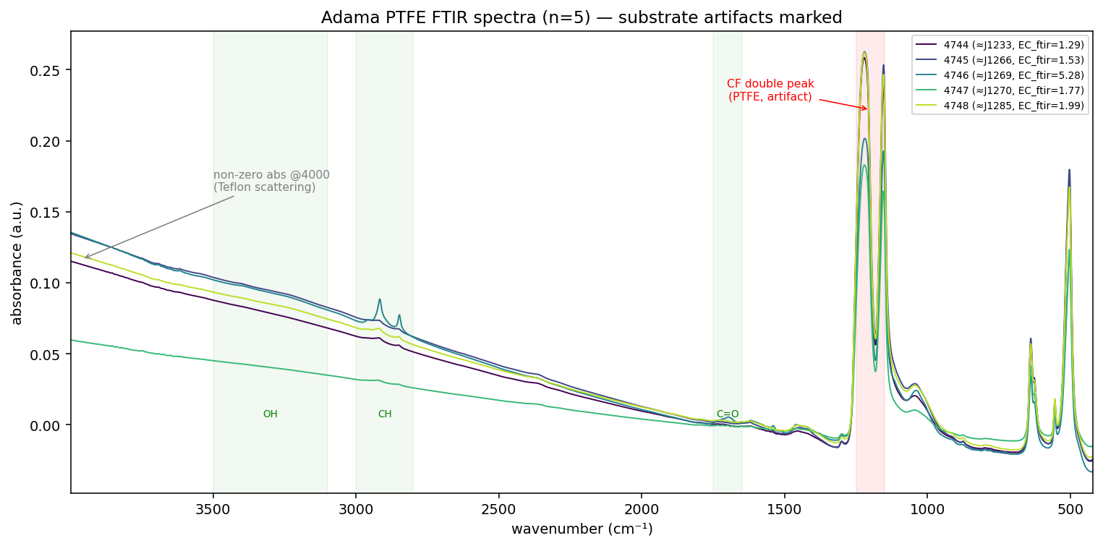
ADAMA · TASK 1
The five Adama FTIR spectra
FINDING
The 5 Adama spectra with Teflon artifacts marked — the CF double peak and the sloping baseline at 4000 (substrate scattering, not aerosol). The highest-EC sample (J1269) is NOT the biggest-peak spectrum.
Notes:
These 5 are the only Adama samples with Tor EC ground truth. Emphasize J1269 not showing the biggest peaks — reinforces the underestimate hypothesis.

Slide 3
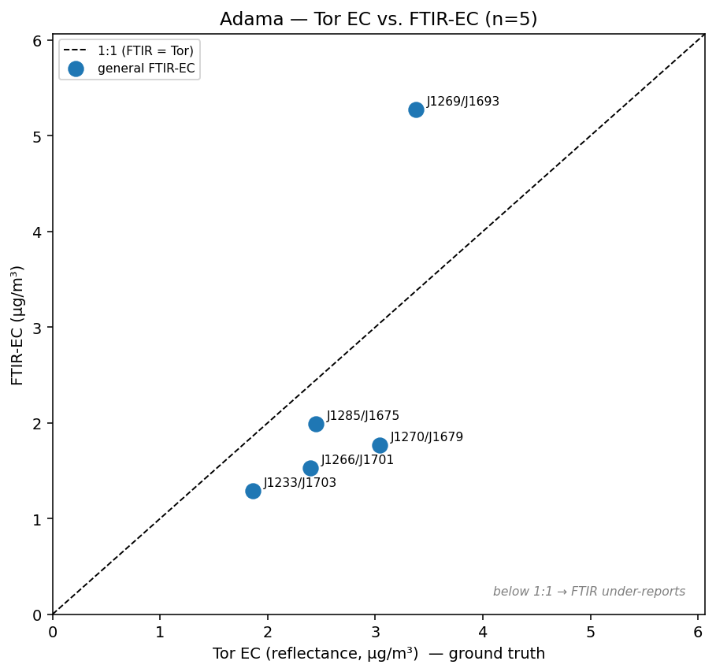
ADAMA · TASK 2
Tor vs FTIR-EC, against the 1:1 line
Notes:
This is the meeting's corrected framing — Tor on x with a 1:1 line, not side-by-side bars. The below-1:1 cluster is exactly the population we now want to keep.

Slide 4
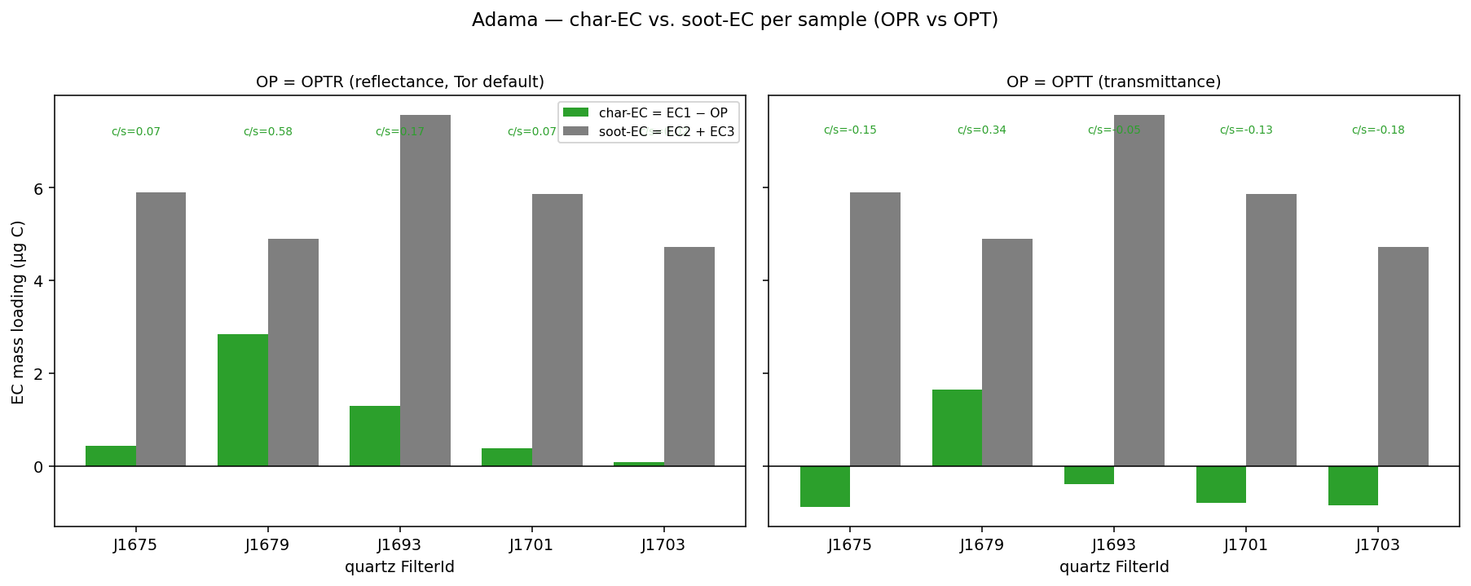
ADAMA · TASK 3
Char vs soot — OPR and OPT
Notes:
Most Adama samples are soot/diesel — except the one anomalous sample that moves the opposite
Per-sample char (EC1−OP) vs soot (EC2+EC3). OPR (reflectance) reproduces last week: soot-leaning, mostly diesel. Switching to OPT (transmittance) flips char-EC negative for 4 of 5 samples.
way under the biomass calibration. This contrasts with Navid's expectation that summer is biomass-heavy.

Slide 5
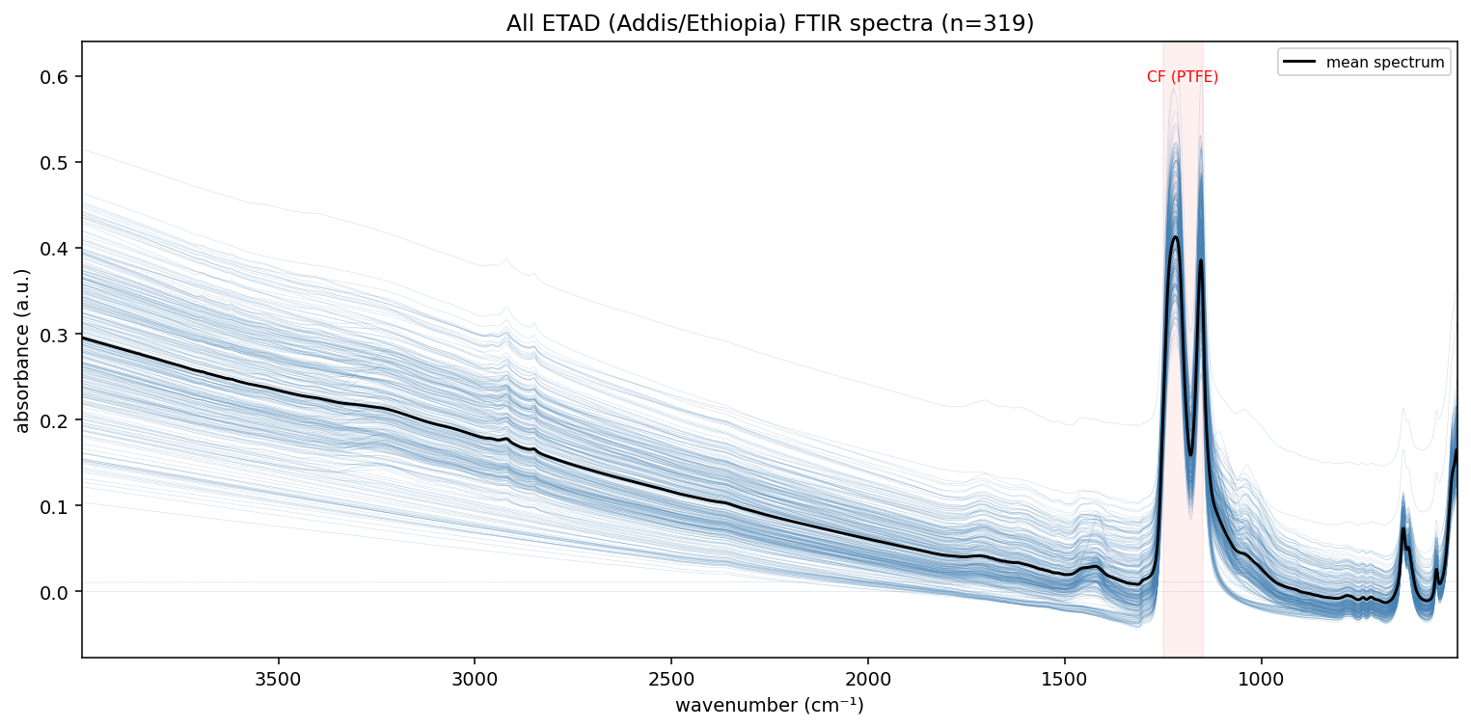
ETHIOPIA · TASK 4
Ethiopia (ETAD) — all spectra
Notes:
Orient everyone to the dataset. This feeds the EC-vs-FABS comparison downstream.
All ~319 Addis/Ethiopia spectra plus the mean. No Ethiopia data appeared in last week's deck — this is the dataset the whole underestimate hypothesis is really about.

Slide 6
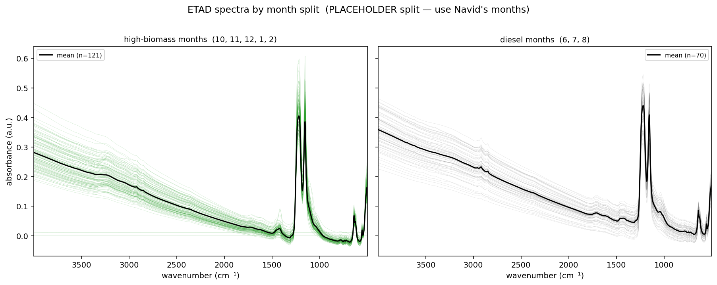
ETHIOPIA · TASK 4
Ethiopia — biomass vs diesel months
Notes:
MAC 6 vs 10 is still unresolved — use 10 for now. Navid's segregation is the source for the month spli
Spectra split by month as a first pass (placeholder split for now). Once the real month labels are in, the two clouds should separate the biomass-heavy season from diesel-dominated months.

Slide 7
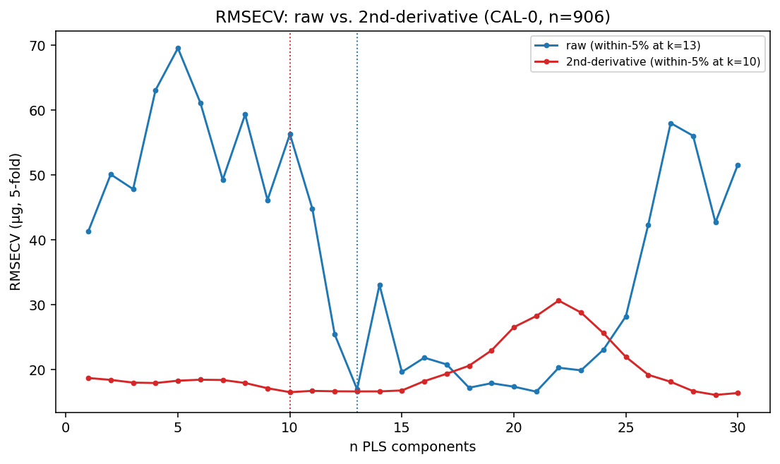
CALIBRATION · COMPONENTS
How many PLS components?
Notes:
Don't re-pitch the ensemble from last week. The new angle is one written rule plus the Weakley second-derivative direction.

Slide 8
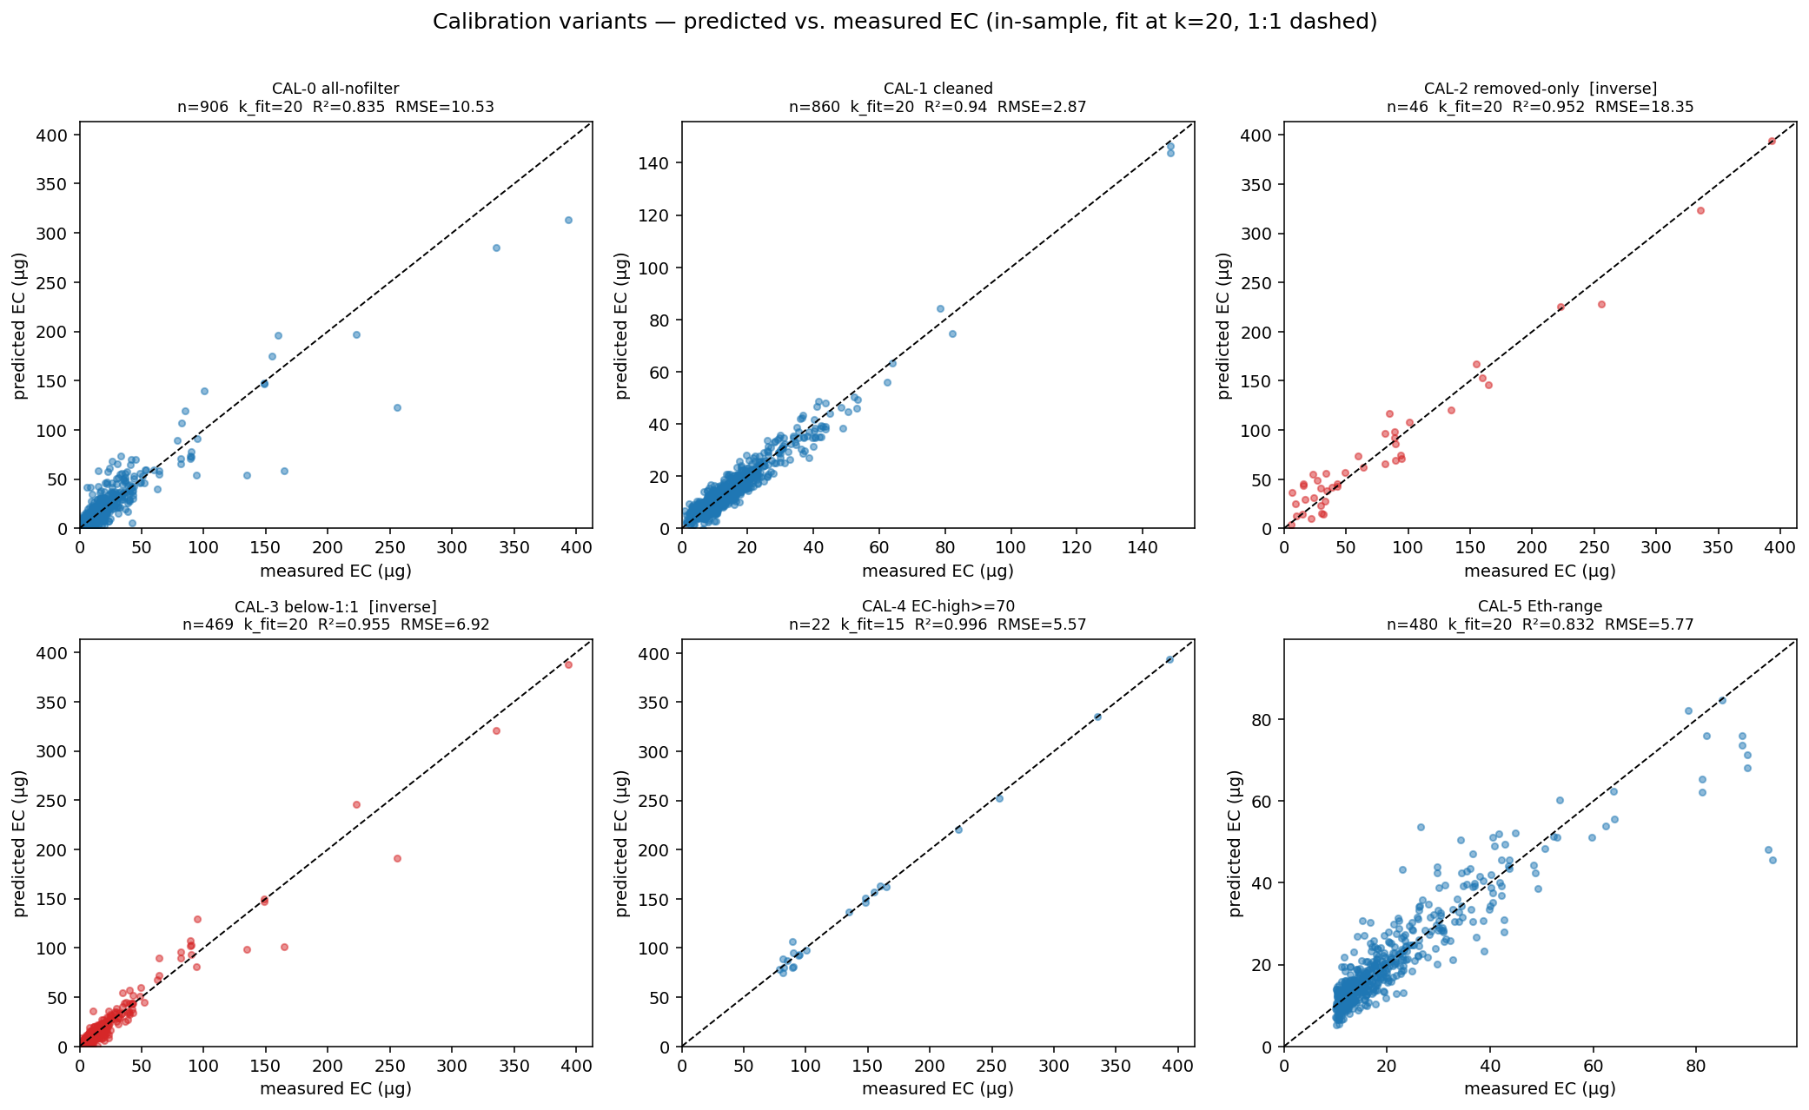
CALIBRATION · VARIANTS
Calibration variants CAL-0 … CAL-5
Notes:
This is the money slide: cleaning improves the in-sample R-squared while hurting the cross-validated error. That is exactly the generalization concern the advisors raised.

Slide 9
Name | What it means
CAL-0 All-smoke no-filter | All biomass/smoke samples, no manual removal
CAL-1 Current cleaned | original cleaned calibration with high/removed samples excluded
CAL-2 Removed-only | Only samples removed from CAL-1
CAL-3 Below-1:1 | Only samples below the FTIR-vs-TOR 1:1 line
CAL-4 EC-high | Only samples above an EC cutoff, e.g. ≥70 µg
CAL-5 Ethiopia-range | Only samples matching or exceeding the Ethiopia/Addis loading range

Slide 10
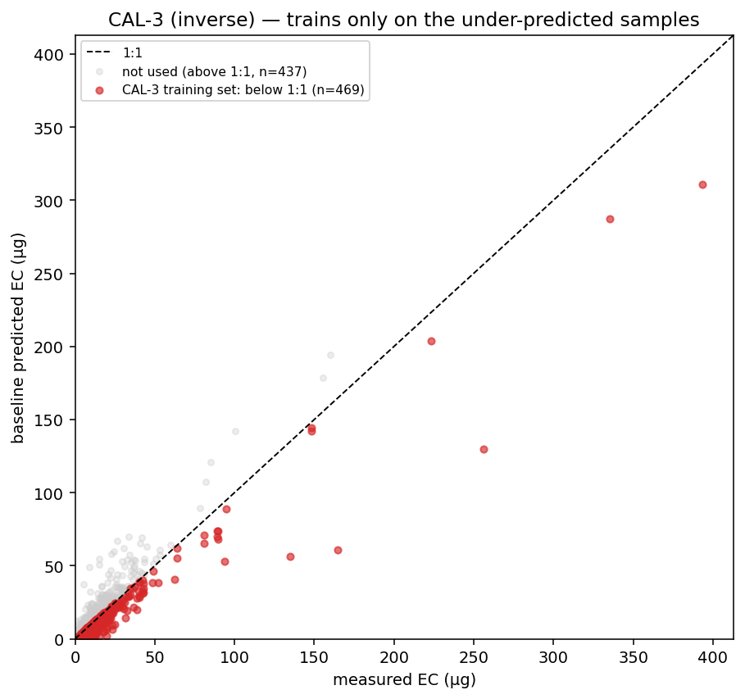
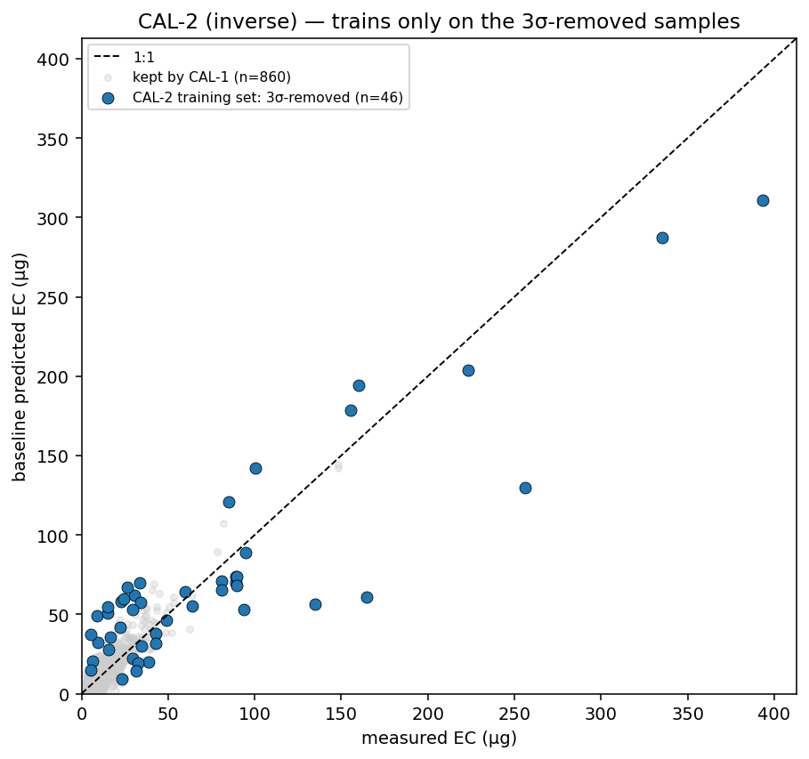
CALIBRATION · THE WEIRD SAMPLES
The inverse calibrations
CAL-3 — trained on everything below 1:1
CAL-2 — trained on the 3σ-removed samples
Notes:
These two experiments are the direct test of the reframe. If the below-1:1 samples carry the missing signal, a calibration built only on them should behave distinctively.

Slide 11
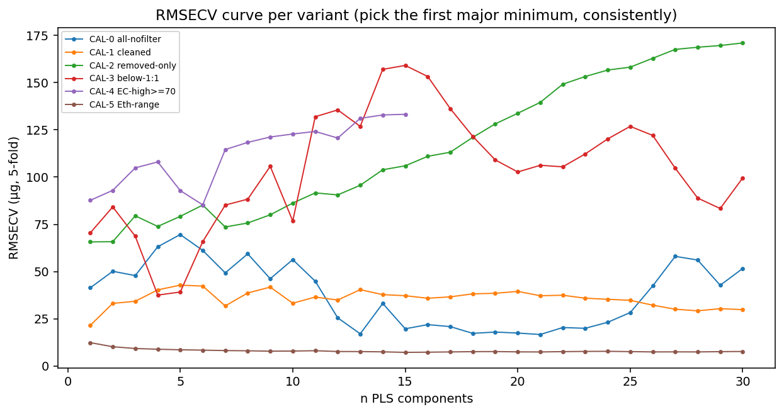
CALIBRATION · CONSISTENCY
One component rule + second derivative
Notes:
Consistency is what makes the variants comparable. Second derivative flattens the PTFE baseline, which is why it needs fewer components.

Slide 12
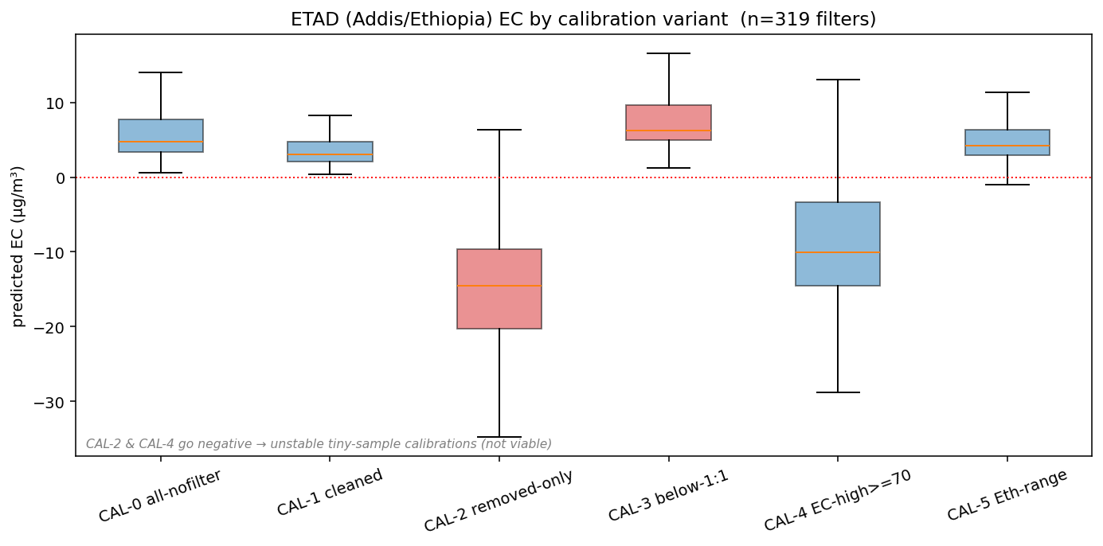
ETHIOPIA · APPLICATION
Ethiopia EC by calibration variant
Notes:
This ties the variant work back to the Ethiopia data and the FABS comparison that the whole hypothesis rests on.

Slide 13
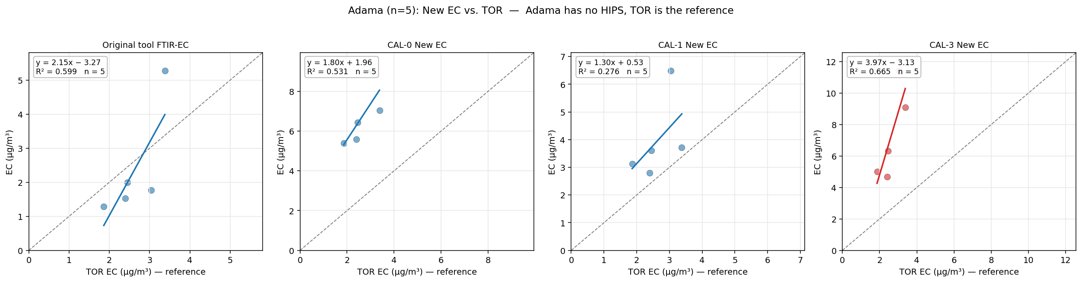

Slide 14
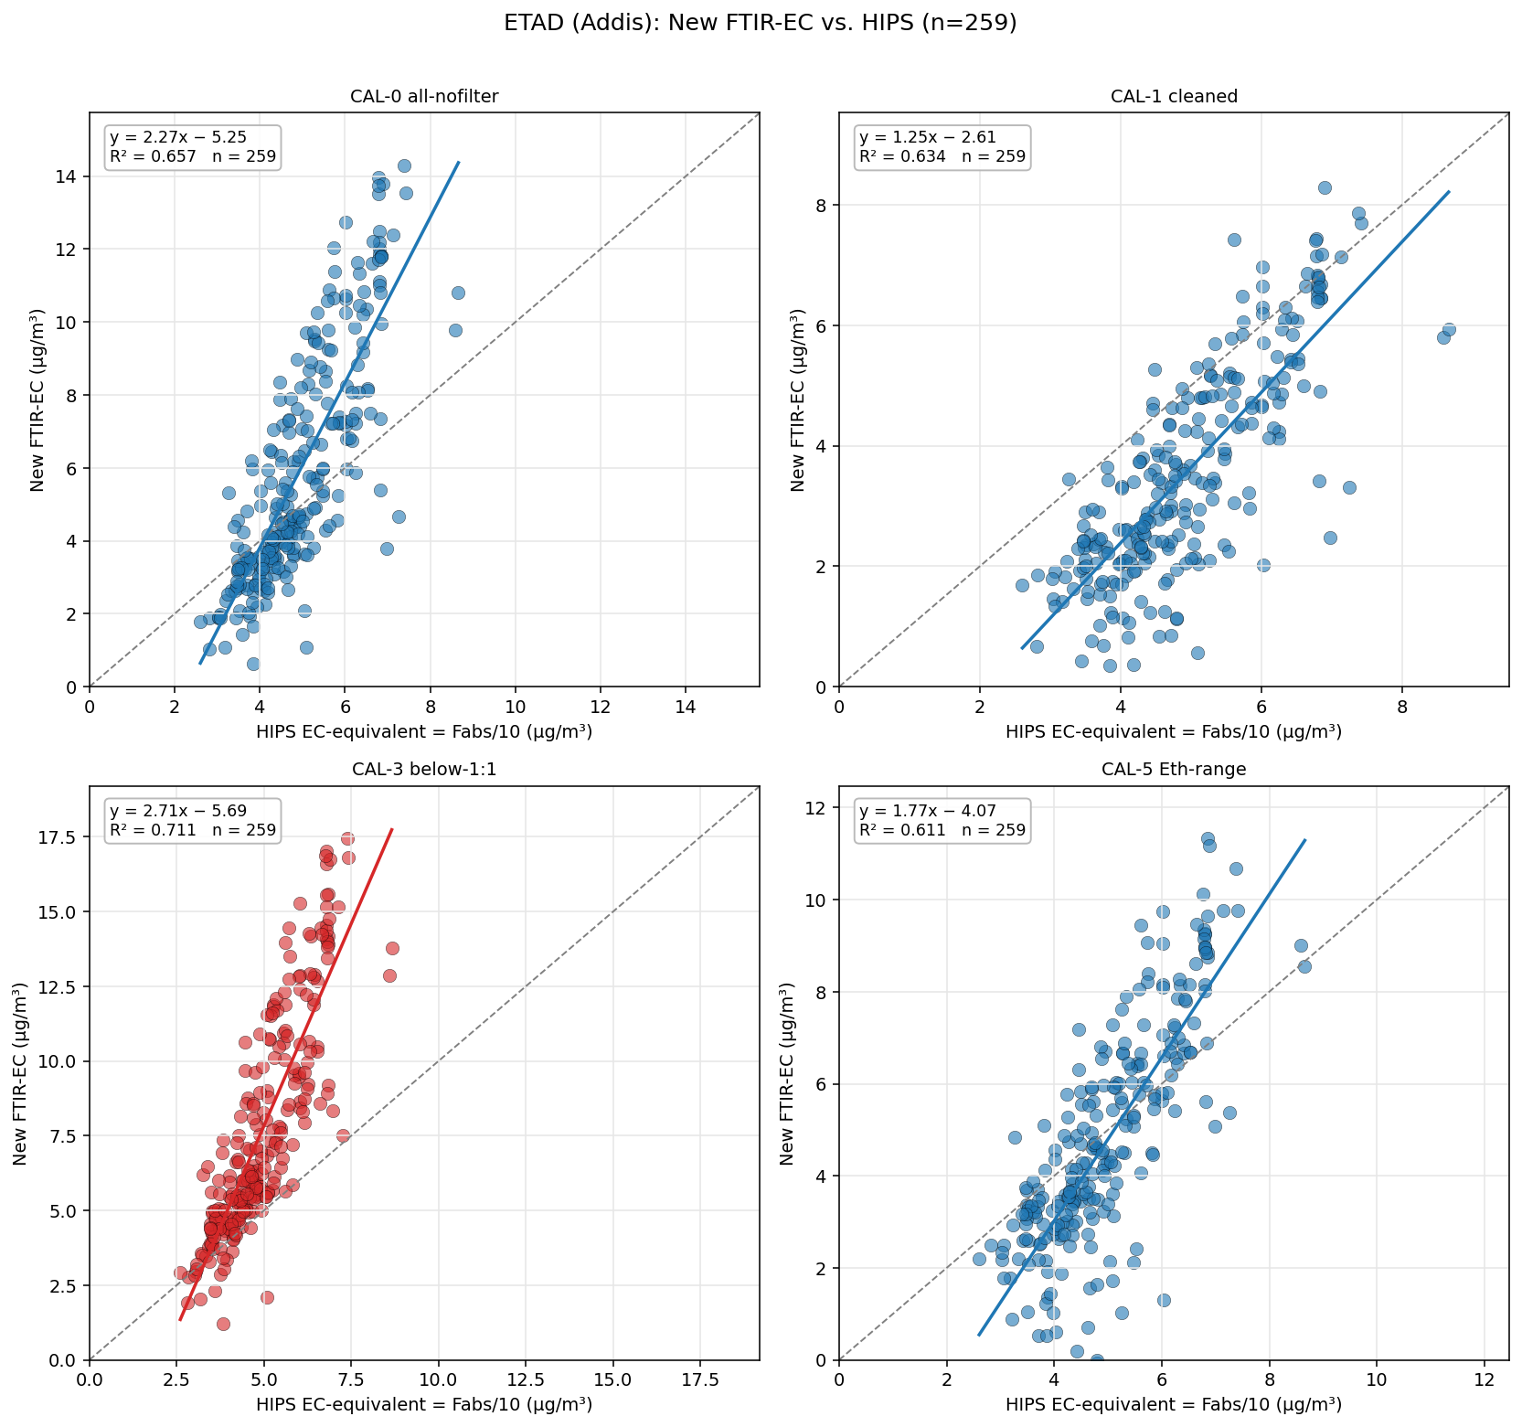

Slide 15
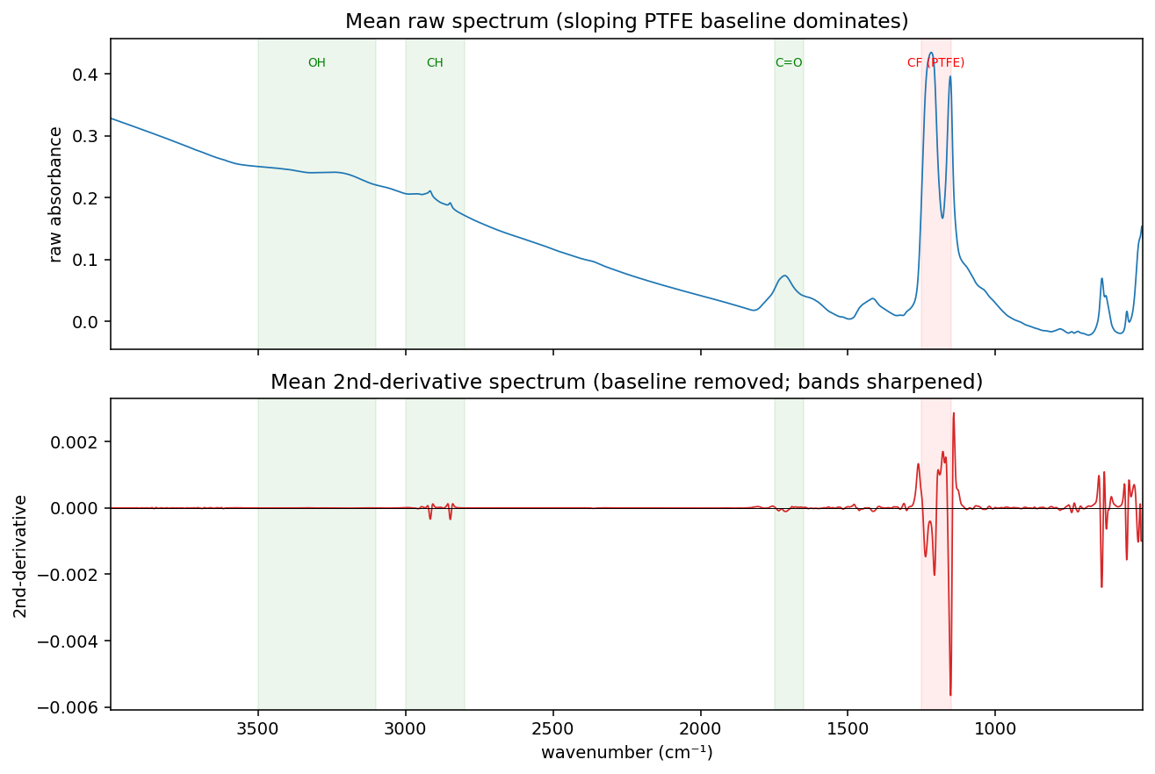

Slide 16
