Slide 1

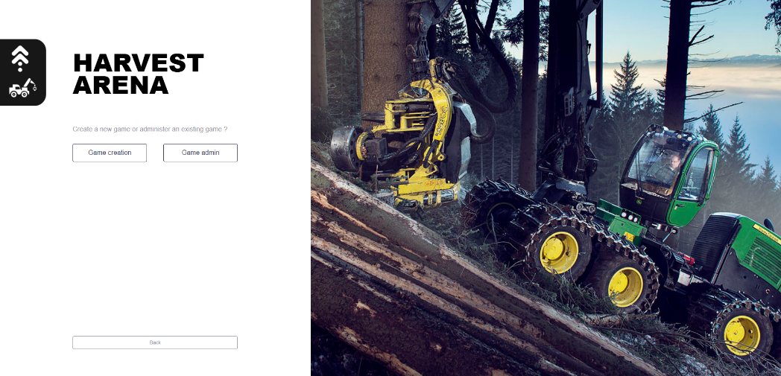



1. Introduction to production planing
in FORAC Harvest Arena
Dag Fjeld, Skogkurs, NMBU
Philippe Marier, FORAC, U.Laval
Luc LeBel, FORAC, U.Laval

Slide 2

CTL production planning
Goals
high fulfillment of production goals and harvesting capacity utilization.
short relocation distances and minimal risk for ground damage.
Assumptions
information on harvesting sites: volumes, expected production rates and bearing capacity.
Training aims towards
meeting multiple targets
being prepared for change

Slide 3
A typical planning cycle in practice
Planning
check available harvesting capacity and production priorities
search for suitable harvesting sites (contracts)
allocate sites to teams, propose schedule.
Confirming schedule and re-planning
confirm schedule with teams
carry on harvesting, re-plan as required.

Slide 4
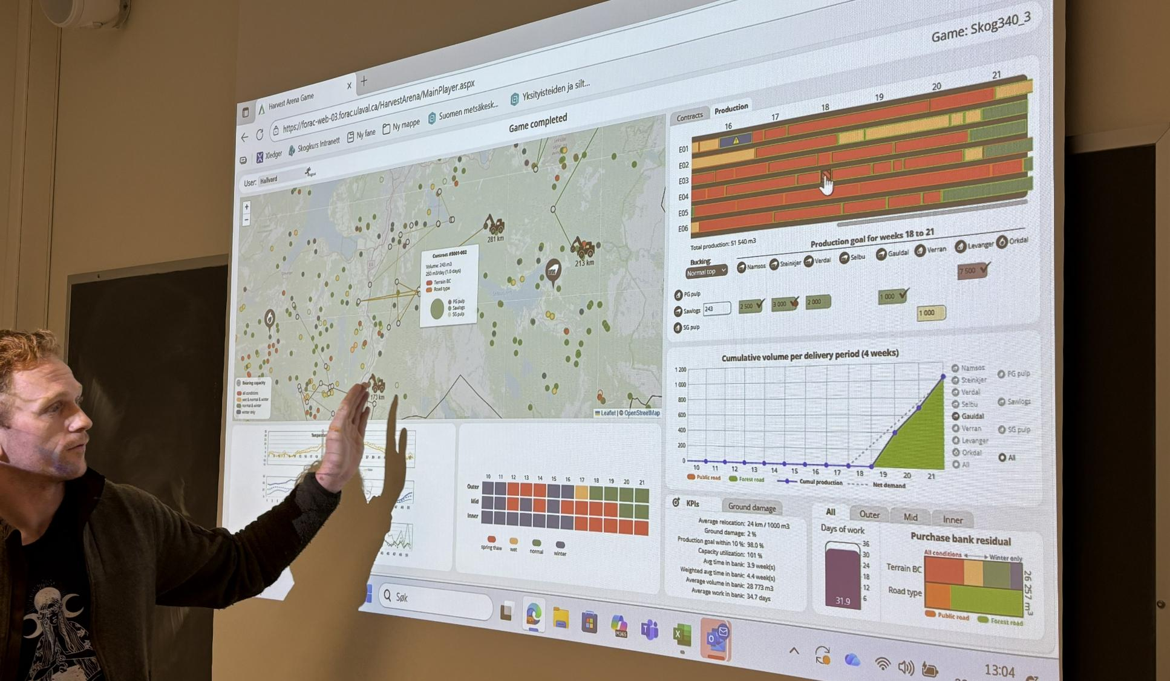
Simulator training for production management
- weekly planning for 6 CTL harvester teams
- through 12 weeks of varying weather and trafficability
- 3 to 4 hours per training run

Slide 5
Basic features
Uncertainty in planning
12 weekly planning periods (3 months; 4 weeks/month)
weekly weather variation (prognosis vs. actual for current week)
weekly weather must be matched with site bearing capacity
The interface
map hover information: mills and harvesting sites
production goals: monthly mill demand
Monthly KPIs
production goal fulfillment; +/- 10 % of monthly demand per mill customer
harvesting capacity utilization, relocation distances and risk for ground damage

Slide 6
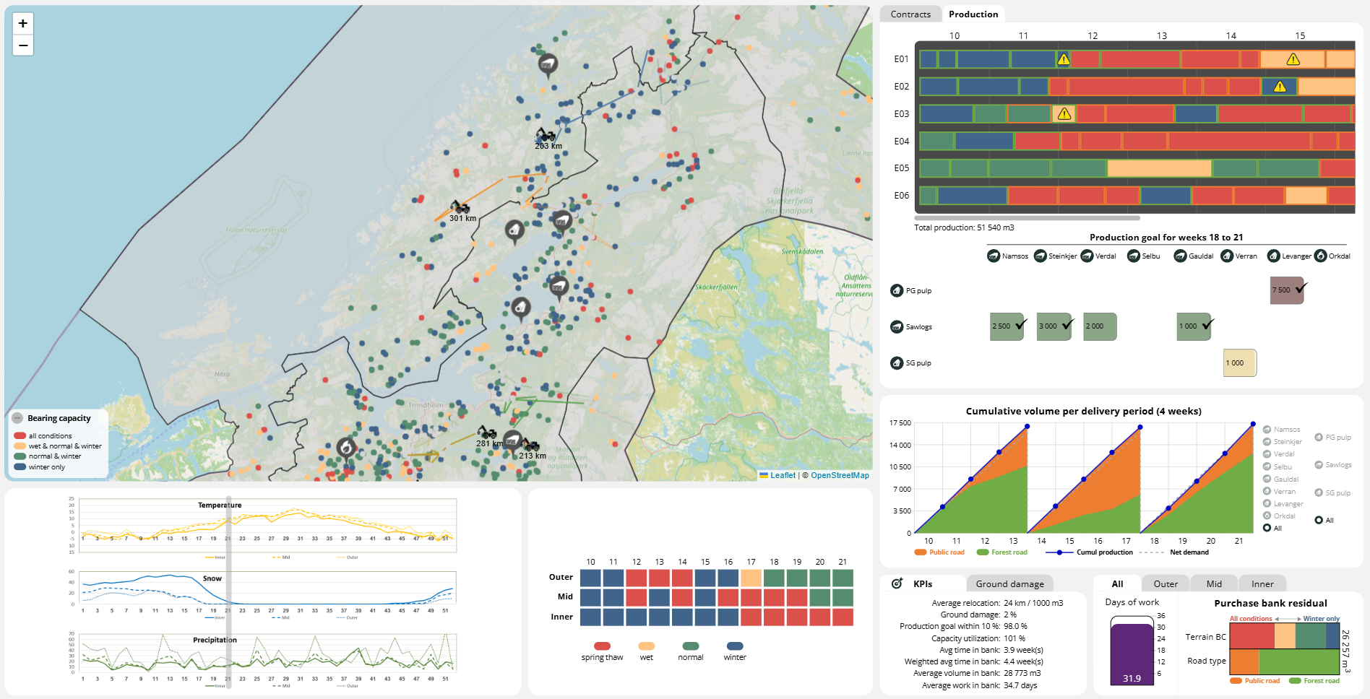
Outer coast
Mid coast
Inner
coast
Site bearing capacity
12 week planning period

Slide 7
Demo 1
- Overview

Slide 8

Next video:
2. Working in the production interface

Slide 9
2. Working in the production interface
Dag Fjeld, Skogkurs, NMBU
Philippe Marier, FORAC, U.Laval
Luc LeBel, FORAC, U.Laval

Slide 10
«Drag and drop» team routing on map
corresponding site schedule is presented on the production chart
production follow-up per assortment and mill customer
(after the mill destination is selected)
The challenge is to select the right operations
with respect to changing weather and mill customer demand
Filter function
selects which type of sites are displayed on the map
considering needs for the coming planning period.
Working in the production manager interface

Slide 11
Team production schedules (1-6)
week number
Team 1: production route
Team 2: production route
Select mill destination
Production follow-up
KPIs
mill assortment

Slide 12
Monthly production goals
- per assortment
- per mill customer
Spruce | Mill | assortment | m³/month
Sawlogs (7500 m³) | Namsos | Sawlogs | 2500
 | Steinkjer | Sawlogs | 3000
 | Verdal | Sawlogs | 2000
 | Selbu | Sawlogs
 | Gauldal | Sawlogs
Pulpwood (8500 m³) | Levanger | PG pulp (prime grade) | 7500
 | Verran | SG pulp (second grade) | 1000

Slide 13
Contracts
Filter function to help find suitable harvesting sites
assortment distribution
Suitable
range of sites
production rate
site volume
bearing capacity
(terrain and road)

Slide 14
Monthly
- mill demand (m³/month)
- required team production (m³/day)
 | Namsos | Namsos | Steinkjer | Steinkjer | Verdal | Verdal | Verran | Verran | Levanger | Levanger | Sum m³ | Sum %
Prime grade pulpwood |  |  |  |  |  |  |  |  | 7 500 | 7 500 | 7 500 | 47 %
Sawlogs | 2 500 | 2 500 | 3 000 | 3 000 | 2 000 | 3 000 |  |  |  |  | 7 500 | 47 %
Second grade pulpwood |  |  |  |  |  |  | 1 000 | 1 000 |  |  | 1 000 | 6 %
Sum |  |  |  |  |  |  |  |  |  |  | 16 000 | m³/month
Per team |  |  |  |  |  |  |  |  |  |  | 2 667 | m³/month
Per team/day (required production rate) |  |  |  |  |  |  |  |  |  |  | 133 | m³/day

Slide 15
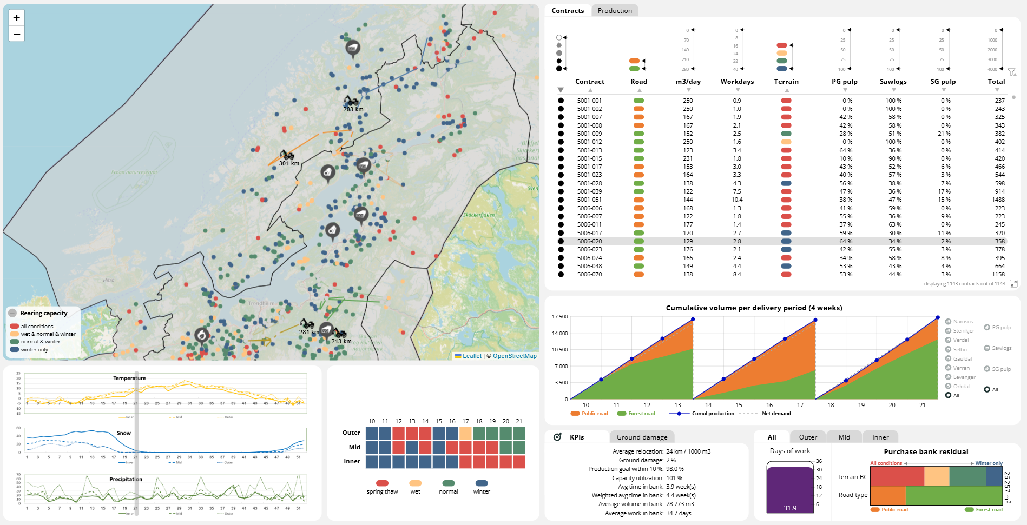
Filter: daily production (m³/day), % sawlogs
Suitable sites
shown on map

Slide 16
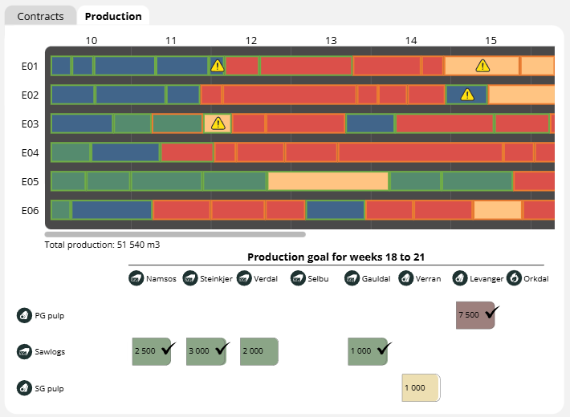
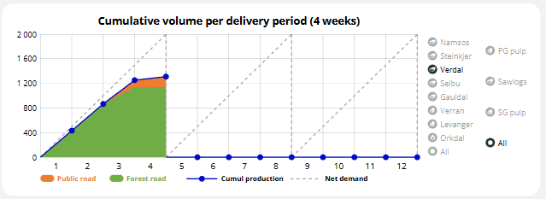
Selecting mill destinations
For each harvesting site you must select the mill for each assortment
Under Production: a) click on the site b) check production goal fulfilment c) click on your selected destination
demand fulfilled
demand not being fulfilled
mill assortment
Keep you eye on the production fulfillment
per assortment
per mill customer

Slide 17
Demo 2
- planning

Slide 18

Quick review
3 steps
1) make initial plan
2) select mill customers
3) adjust plan after follow-up
When satisfied, click
Step 1 – initial plan
A) Check production pace
B) Adjust filter to show suitable contracts
C) Plan route between suitable harvesting sites.
Step 2 – selecting mill customers
A) Production schedule (per team): click on site
B) Production goals (per assortment): select mill customer
C) Cumulative volume: check cumulative production in relation to demand, per assortment, and per mill.
Step 3 – adjusting plan after follow-up
Satisfied...? Options:
- change mill destination (click on «bucking»)
- or delete site from schedule, and add a new one (refresh afterwards).

Slide 19
Next video:
3. Some pointers and examples

Slide 20
3. Some pointers and examples
Dag Fjeld, Skogkurs, NMBU
Philippe Marier, FORAC, U.Laval
Luc LeBel, FORAC, U.Laval

Slide 21
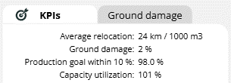
5-point focus
1) fulfilling production goals (+/- 10 of monthly demand; per mill customer)
2) avoiding ground damage (weather ; think ahead)
3) effective relocation (when can you make a long move?)
Re-think; where should this wood be going?
4) production is half the battle; consider the transport perspective
5) before starting, allocate your harvesting capacity to the right areas.
KPIs – eye on the ball

Slide 22
Start with the big orders
1. Fulfilling production goals
 | Namsos | Steinkjer | Verdal | Verran | Levanger | Sum m³ | Sum %
Prime grade pulpwood |  |  |  |  | 7 500 | 7 500 | 47 %
Sawlogs | 2 500 | 3 000 | 2 000 |  |  | 7 500 | 47 %
Second grade pulpwood |  |  |  | 1 000 |  | 1 000 | 6 %
Sum |  |  |  |  |  | 16 000 | m³/month

Slide 23
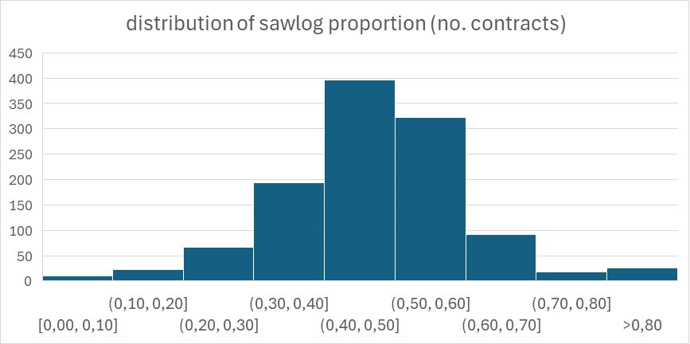
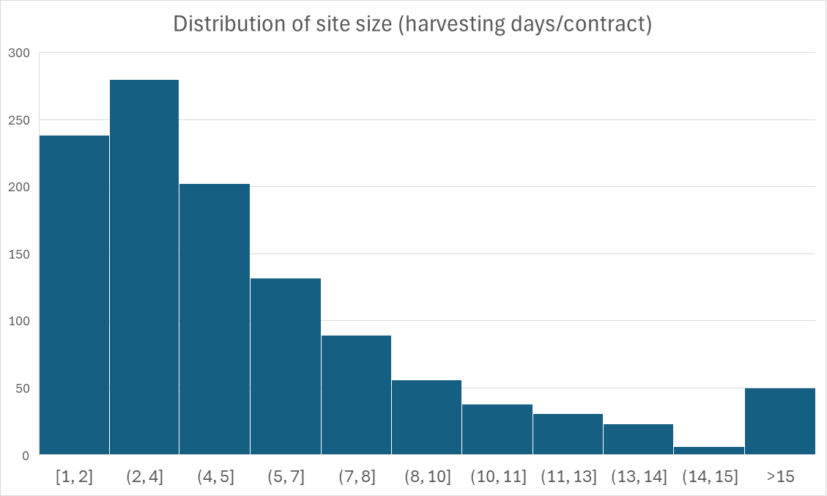
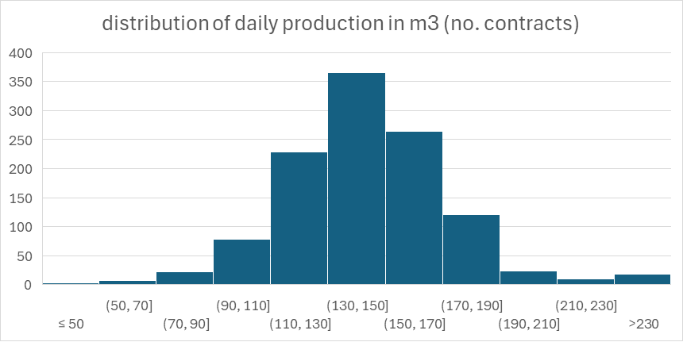
1100 sites
- know your wood
1. Fulfilling production goals
40-60% sawlogs
750-800 m³/site
Many small, few large
Production rates (110-170 m³/day)

Slide 24
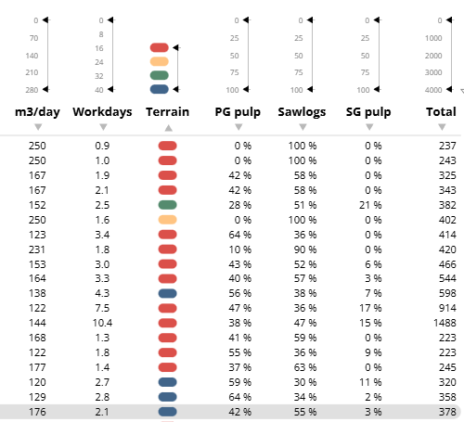
Vary your filter and
Watch the map
- how far to the next right site?
- can you find clusters?
133
5-6
47%
filter

Slide 25
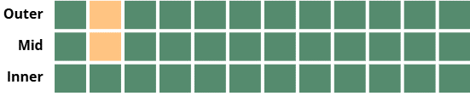
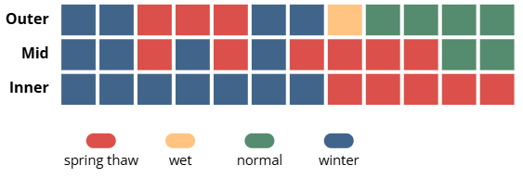
How far ahead can you plan?
- it depends on the season:
Stable periods (mid-winter, mid-summer)
- up to 4 weeks
Less predictable periods (spring thaw, fall rain)
- up to 2 weeks
Safe or gamble?
- save your best sites til you need them
2) Avoiding risk for ground damage
(watch the weather and think ahead)

Slide 26
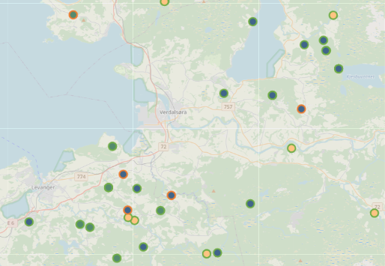
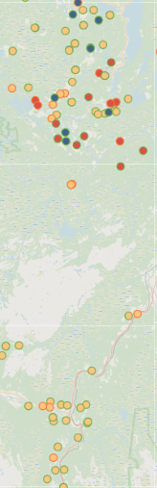

Clustering of sites
- reduces relocation km per 1000 m³
^{otherwise:}
- clusters for stable weather; same BC
- clusters for instable weather; mixed BC
3) Effective relocation
- when can you make a long move?
Spring thaw
Winter
Summer
Fall rain
10 km

Slide 27
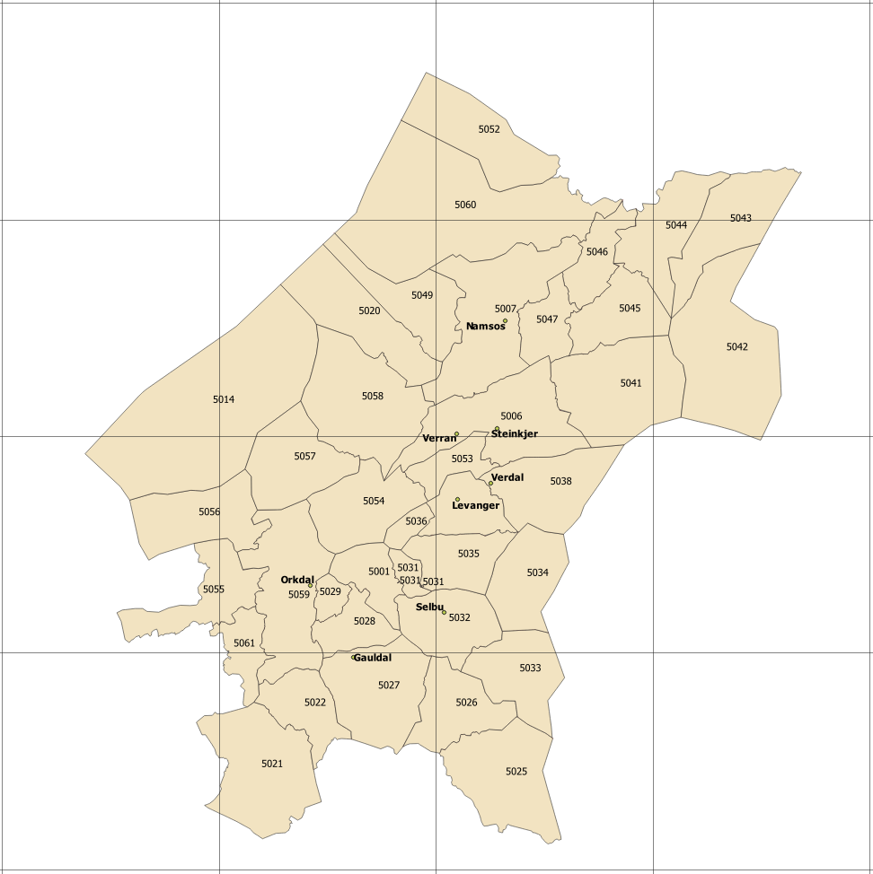
Example plan sawmill destination
(minimal transport costs for all mills)
4) Production is half the battle; re-think from a transport perspective
Sawmill | market share
Namsos | 25 %
Steinkjer | 30 %
Verdal | 20 %

Slide 28
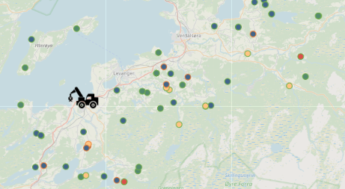
4) Planning for bearing capacity; harvesting and hauling
Seasonal hauling solutions
Stable conditions (harvesting and hauling)
- winter (frost)
- summer (frost-free)
Autumn (falling temperatures, sustained rain)
- harvesting and hauling or
- when hauling waits for frost
Late winter (rising temperatures, melting snow)
- harvesting and hauling
- when hauling during warm periods
- when hauling waits til after thaw
Spring thaw
- harvesting and hauling
- when hauling waits til after thaw
Harvesting (terrain) BC classes Hauling (road) BC classes
1 – spring thaw
2 – rainy periods
3 – frost-free weather
4 – frost or dry weather only
Public roads (higher BC)
Forest roads (varying BC)

Slide 29
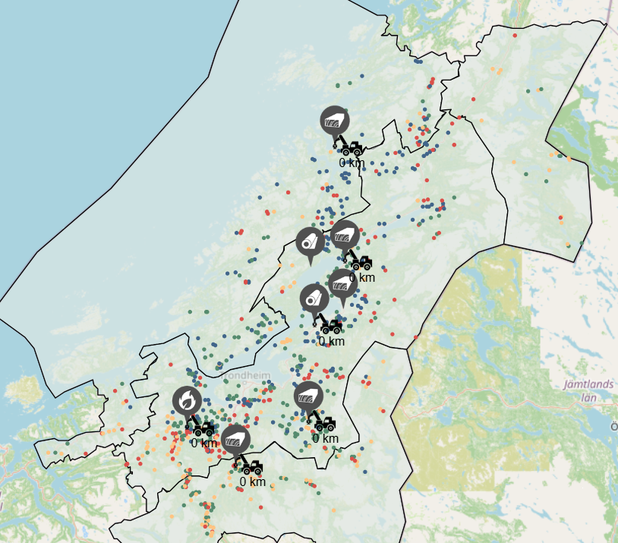
Relocation distance is tracked from the first harvested site.
So locate your teams before starting.
Consider:
- where are your main customers?
- where is your wood concentrated?
- which weather do you expect?
5) Allocate your harvesting capacity to preferred areas

Slide 30

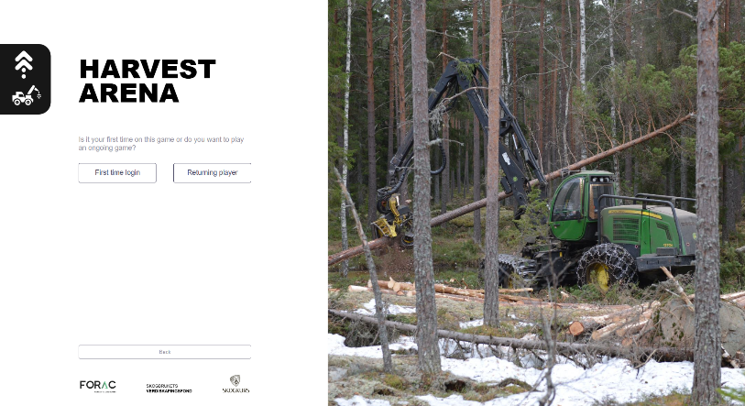
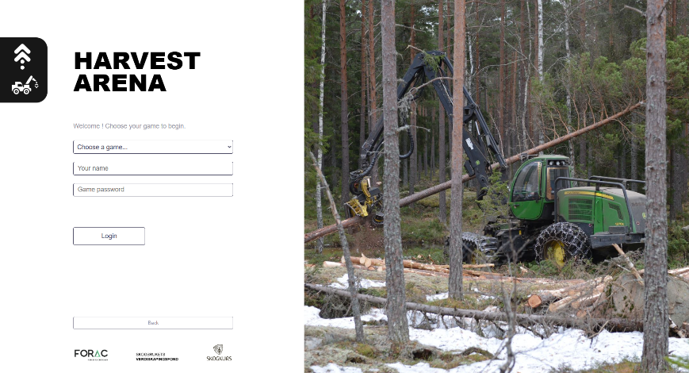
Log-on and test! a) Player b) New player c) Game, your name, password

Slide 31
Think ahead, stay sharp!

