Slide 1
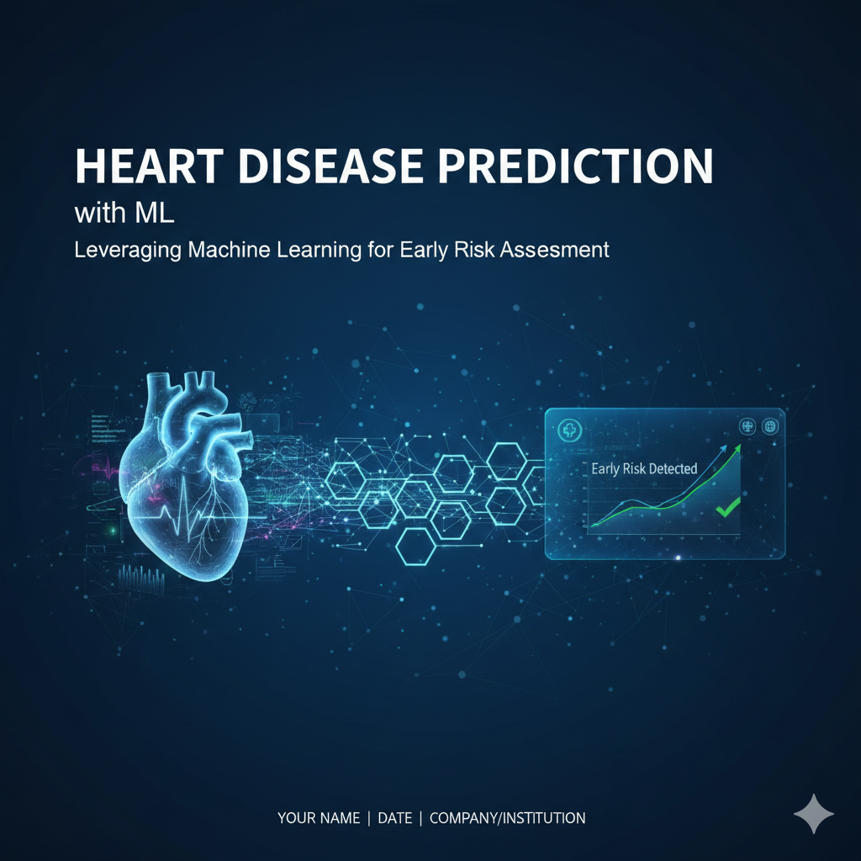

Slide 2
About the project
This project aims to build a machine learning-based prediction model that helps estimate the risk of heart disease in individuals. The purpose is to support preventive healthcare by identifying whether a patient is at high risk ⚠️ or low risk ✅.
The system will:
👤 Take in patient demographics (e.g., age, gender) and clinical/lifestyle features (e.g., blood pressure, cholesterol, smoking habits).
🤖 Use an ML model to predict heart disease risk.
💻 Provide results through a lightweight frontend, enabling healthcare professionals and analysts to obtain quick risk estimates for better decision-making and early interventions.

Slide 3

The dataset
A dataset of medical records have been used in ML researches
Data Source https://archive.ics.uci.edu/dataset/45/heart+disease

Slide 4
Dataset description
ge : age in year
sex : gender
cp : Ceruloplasmin protein
trestbps : resting blood pressure in mm Hg
chol : serum cholestoral
fbs : fasting blood sugar > 120 mg/dl
restecg : resting electrocardiographic results
thalach : maximum heart rate achieved
exang : exercise induced angina
oldpeak : ST depression induced by exercise relative to rest
slope : The slope of the ST segment in relation to heart rate
ca : number of major vessels (0-3) colored by flourosopy
thal : Thalassemia
target : result

Slide 5
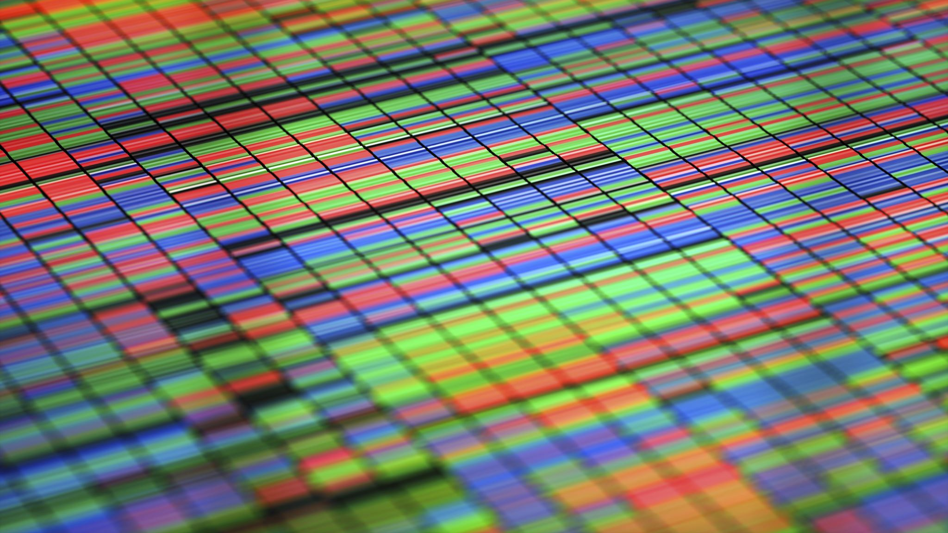
Project phases

Slide 6
Phase(1)
DATA PREPARATION
By: Ahmed Anwar

Slide 7
What I did
Exploring data shape
Studying columns types and basic information
Checking missing or duplicated values
Converting data types to prepare for molding

Slide 8
Phase(2)
Exploratory Data Analysis (EDA)
By: Ali Mohamed

Slide 9
What I did
Basic Data Overview For the Dataset
Visualizations
Key Patterns and Observations
Feature Engineering

Slide 10
Impact
Provided a clear and detailed visualized plots
Made it easier to understand the data and it’s characteristics
Made some simple feature engineering to help building the machine learning model

Slide 11
Phase(3)
Model training & Validation
By: Marwan Ammar
By: Omar El Amir

Slide 12
Model training : What I did
Importing modeling libraries
Implemented different machine learning models like Logistic Regression, Decision Tree, Random Forest, SVC
Compared performance using metrics such as accuracy, precision, recall,F1-score
Optimized features to enhance predictive power of the model

Slide 13
Built and compared multiple machine learning models to identify the best candidate Made it easier to understand the data and it’s characteristics
Provided clear metrics (accuracy, precision, recall, F1score) for decision-making
Model Training
Impact

Slide 14
Hyperparameter & model fitting: What I did
Cross-Validation Analysis , To evaluate model performance on unseen data and prevent overfitting
created ROC-AUC curves to visually analyze each model's ability
Model Comparison table to summarize the key performance metric
Hyperparameter Tuning , To improve the model's performance and generalization

Slide 15
Trained and evaluated five different machine learning models using 10-fold cross-validation.
ROC-AUC curves to discriminate between healthy and heart disease patients.
Used a comparison table to summarize the key performance metrics, which clearly showed that the Random Forest model provided the best overall results.
Final model was not only accurate but also robust and generalizable to new, unseen patient data.
The final solution is both well-justified and highly reliable for predicting heart disease
Impact

Slide 16
Phase_(4)
Deployment using Streamlit
By: Abanoub Michel 👨‍💻

Slide 17
My Role
Focused on deployment of the ML model
Built a Streamlit web application for easy user interaction
Designed UI for patient data input and real-time prediction

Slide 18
Deployment Steps
Integrated trained ML pipeline into Streamlit
Created user input forms (age, cholesterol, blood pressure, etc.)
Applied feature engineering to user inputs
Displayed prediction results in an intuitive format (✅ Low Risk / ⚠️ High Risk)

Slide 19
Impact
Provided a user-friendly interface for non-technical users
Enabled real-time disease risk prediction in a browser
Demonstrated how to bridge ML models with practical healthcare applications

Slide 20
Project Preparation
By: Mahmoud Amr Amin

Slide 21
Organizing Files for Deployment
Points:
Structured project into clear folders (data, models, src, etc.)
Removed unused files & scripts
Ensured consistent naming conventions

Slide 22
Requirements.txt Setup
Points:
Collected all Python dependencies
Specified exact versions for reproducibility
Ensured compatibility for cloud deployment

Slide 23

Thanks

