Slide 1

AV CADO
Altice USA 2020 Innovation Roadshow Hackathon Project
Akim Adams
Lead DevOps Engineer

Slide 2
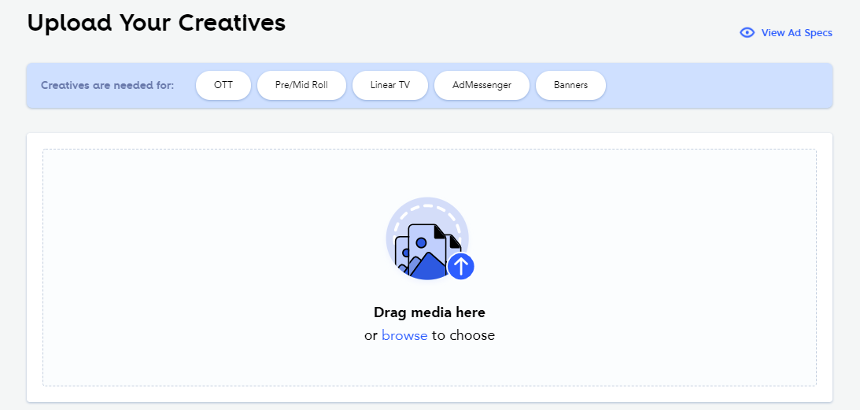
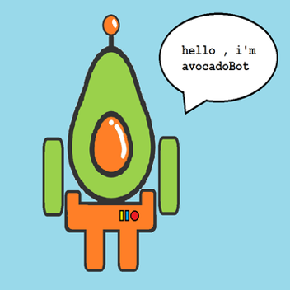

elevator.pitch
what is AVOCADO?
a4 advertising photo caption & face detection bot
upload any standard image (i.e. PNG, JPG, etc.),
automatically generate a single-sentence caption describing the image in plain English
automatically detect and count number of faces in a photograph
Why?
to discover and capture useful metadata about multimedia files (i.e. creatives, banners, ads, etc.) uploaded to Athena

Slide 3
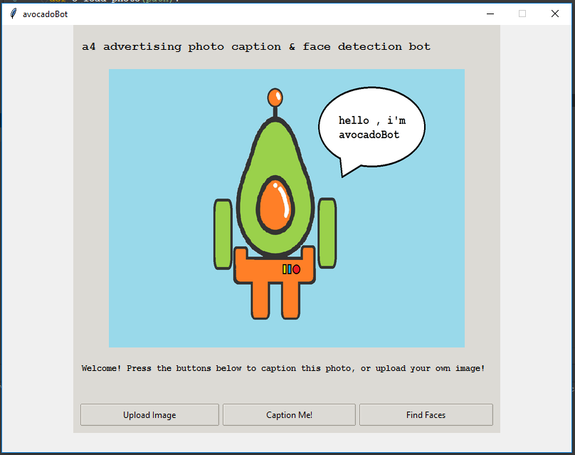
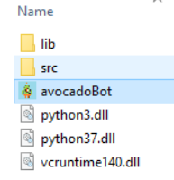
startup
OR*
~.\avocadoBot> pip install -r requirements.txt
~.\avocadoBot> python avocadoBot.py

Slide 4
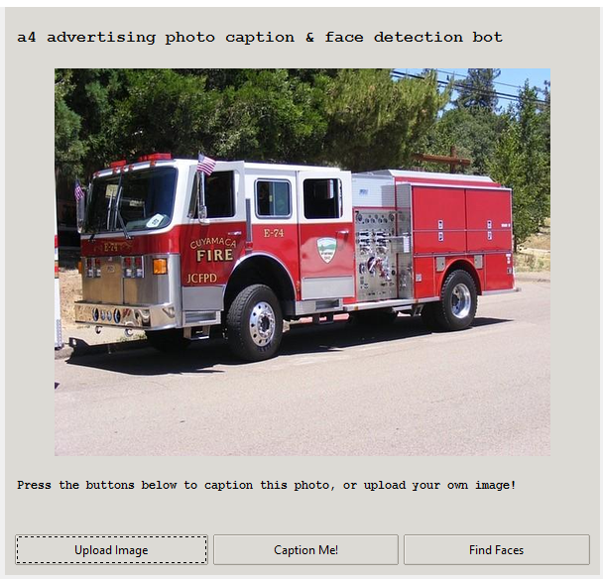
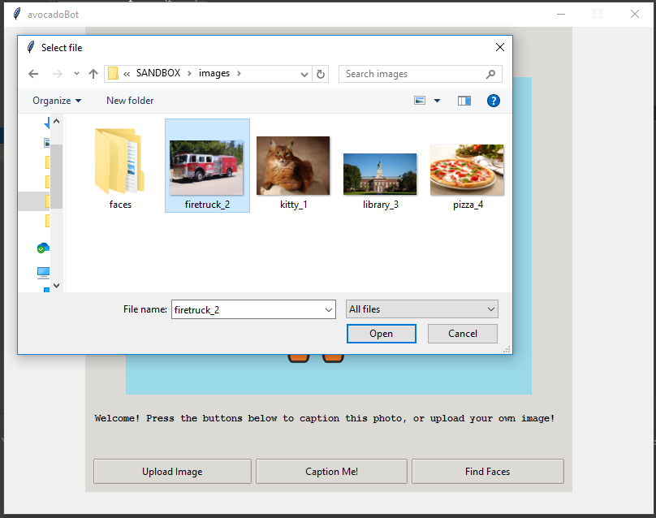
upload a new image

Slide 5
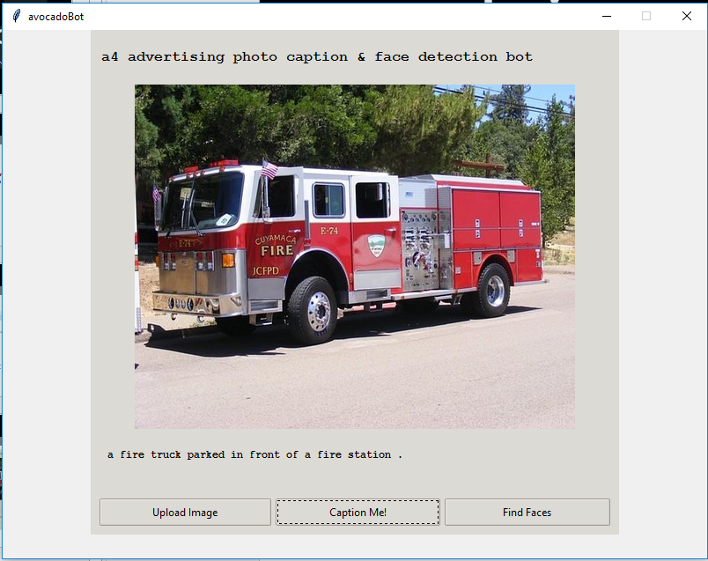
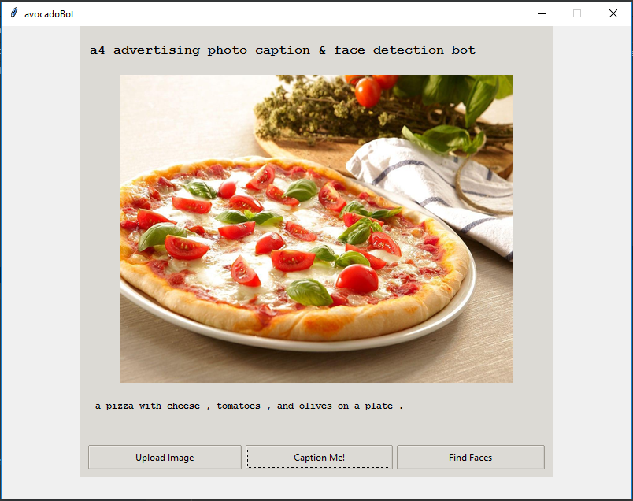
generate image captions

Slide 6
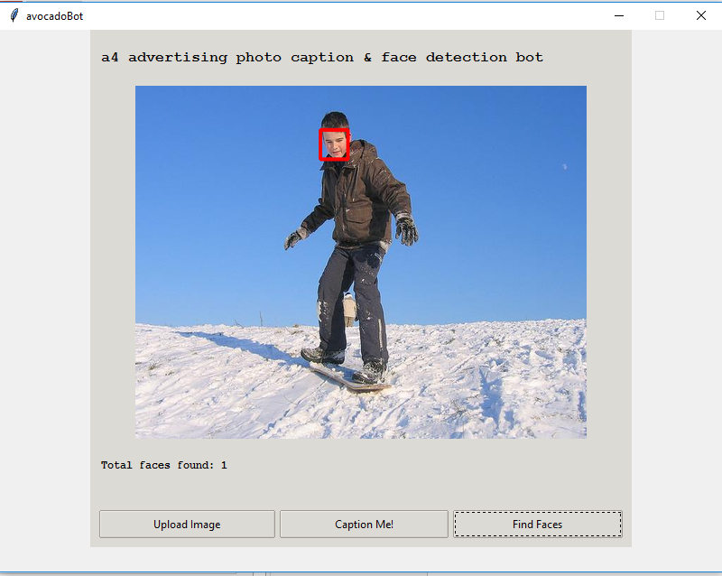
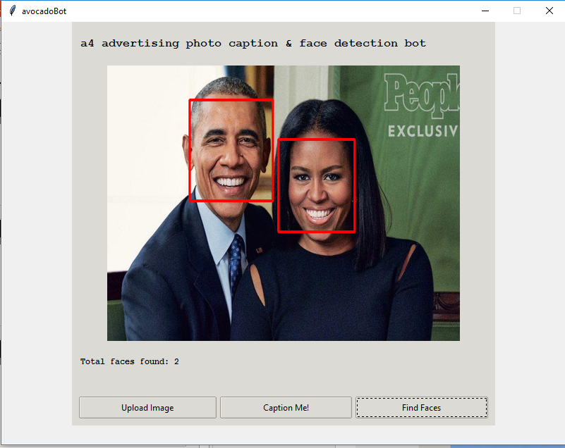
detect faces

