Slide 1

IPGuard: Protecting Intellectual Property of Deep Neural Networks via Fingerprinting the Classification Boundary
Xiaoyu Cao, Jinyuan Jia, Neil Zhenqiang Gong
Duke University
ASIA CCS 2021

Slide 2

Intellectual Property
Effort in Training DNN Model
Large-scale datasets
$1.6 million to train a BERT model on Wikipedia and Book corpora (15 GB)
Significant computational resources
API
cloud platform
open-source toolkits
Notes:
Deep learning models, e.g., deep neural networks (DNNs), have become the standard models for solving many complex real-world problems
However, training large-scale DNN models is by no means trivial, which requires not only largescale datasets but also significant computational resources.
For instance, it can cost $1.6 million to train a BERT model on Wikipedia and Book corpora (15 GB) [37].
It is thus of utmost importance to protect DNNs from unauthorized duplication or reproduction.
One concerning fact is that well-trained DNNs are often exposed to the public via APIs, cloud platforms or open-source toolkits.
It gives rise to adversaries (e.g., a model “thief”) who attempt to steal the model in stealthy ways, causing copyright infringement and economic losses to the model owners.

Slide 3
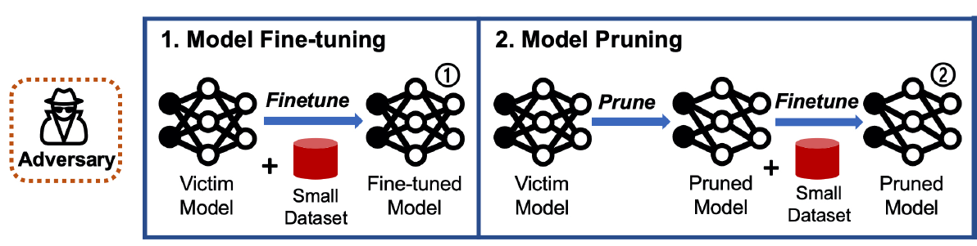
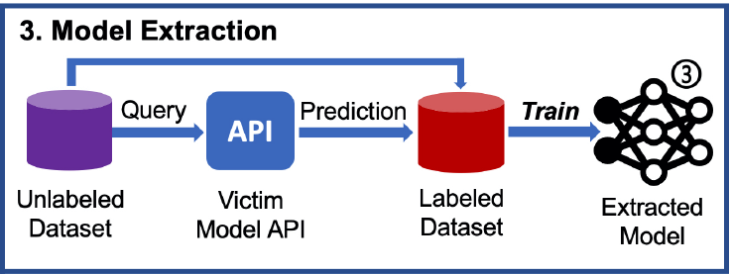
Model Stealing
Model “Thief”
Notes:
The adversary attempts to steal a copy of the victim model, which 1) mimics its functionality while 2) cannot be easily recognized as a copy.
Model Finetuning. In this case, we assume the adversary has full knowledge of the victim model, including model architecture and parameters, and has a small dataset to finetune the model.
This occurs, for example, when the victim open-sourced the model for academic purposes only, but the adversary attempts to finetune the model to build commercial products.
Model Pruning. In this case, we also assume the adversary has full knowledge of the victim model’s architecture and parameters.
Model pruning adversaries first prune the victim model using some pruning methods, then finetune the model using a small set of data
Model Extraction. In this case, we assume the adversary can only query the victim model for predictions.
The adversary may be aware of the architecture of the victim model but has no knowledge of the training data or model parameters.
The goal of model extraction adversaries is to accurately steal the functionality of the victim model through the prediction API.
To achieve this, the adversary first obtains an annotated dataset by querying the victim model for a set of auxiliary samples, then trains a copy of the victim model on the annotated dataset.

Slide 4


Threat Model
Model owner and attacker
Target Model
Pirates
model owner
Verify whether it has the same fingerprint
Suspect Model
Notes:
We consider two parties, i.e., model owner and attacker. A model owner trains a DNN classifier (called target classifier) using a (proprietary) training dataset and algorithm.
The model owner could deploy the target classifier as a cloud service (also known as machine learning as a service) or as a client-side software (e.g., Amazon Echo).
An attacker pirates the target classifier and deploys it as its own software or service. Moreover, the attacker may post-process the target classifier before deploying it.
The model owner derives a fingerprint for its target classifier.
For a suspect classifier, the model owner verifies whether it has the same fingerprint via leveraging its prediction API. If the suspect classifier has the same fingerprint, then the suspect classifier is likely pirated from the model owner’s target classifier and the model owner can take further follow-up actions, e.g., collecting other evidence and filing a lawsuit.

Slide 5
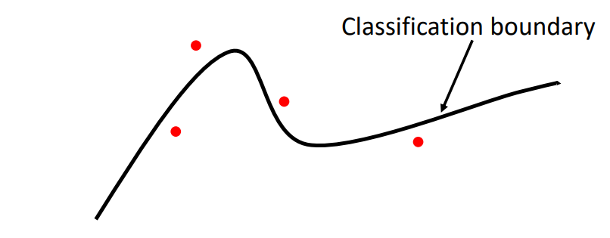
Fingerprinting
The Classification Boundary
Fingerprinting data points
Predicted label
Fingerprint
Notes:
Our key observation is that a DNN classifier can be uniquely represented by its classification boundary, which essentially divides the data domain into regions。
Based on the observation, IPGuard finds some data points near the target classifier’s classification boundary (see Figure 1).
Moreover, IPGuard treats these data points and their labels predicted by the target classifier as a fingerprint for the target classifier.
For a suspect classifier, the model owner queries its prediction API to get the labels of the fingerprinting data points.
If the suspect classifier and the target classifier predict the same labels for most fingerprinting data points, then the model owner verifies that the suspect classifier is potentially pirated from the target classifier.
Unlike watermarking, IPGuard provably incurs no accuracy loss for the target classifier, because IPGuard does not tamper its training or fine-tuning process at all.

Slide 6
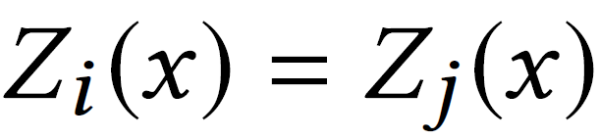

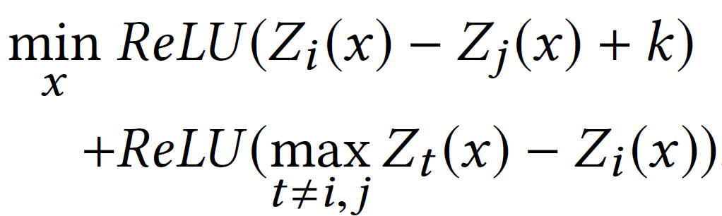
Extract Fingerprinting
Classification Boundary:
Class i
Distance K
Class j
Finding data points near the classification boundary

Slide 7


Verify Fingerprinting
Fingerprinting
Fingerprint
Fingerprinting
data points
Target Model
Suspect Model
matching rate

Slide 8
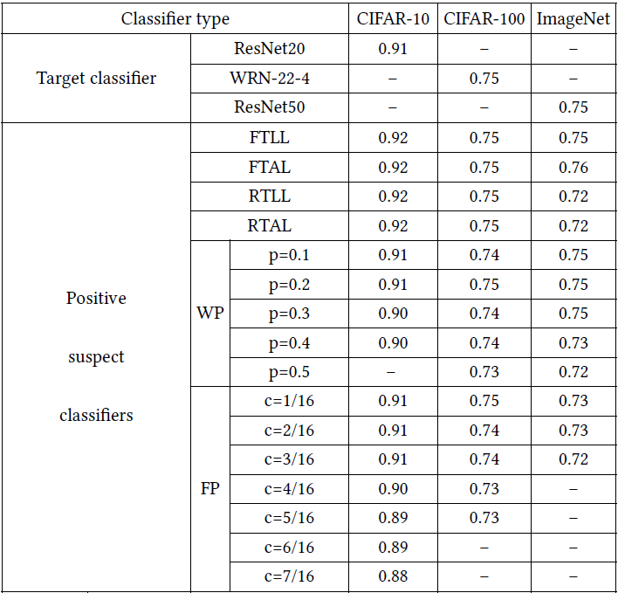
EXPERIMENTS
Target Model and Positive Suspect Model
Fine-tune last layer (FTLL)
Fine-tune all layer (FTAL)
Retrain last layer (RTLL)
Retrain all layers (RTAL)
Weight pruning (WP)
Filter pruning (FP).

Slide 9
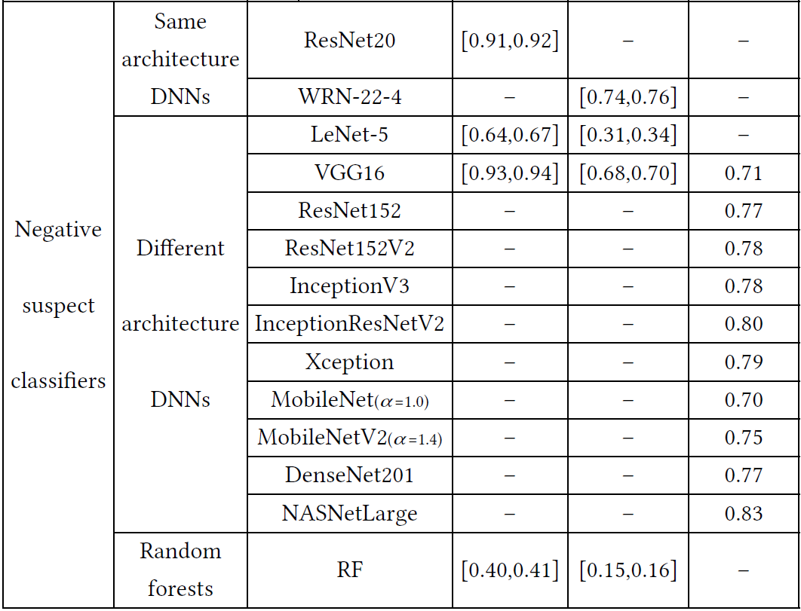
EXPERIMENTS
Negative Suspect Model
Same-architecture neural network classifiers
Different-architecture neural network classifiers
Random forest (RF)

Slide 10
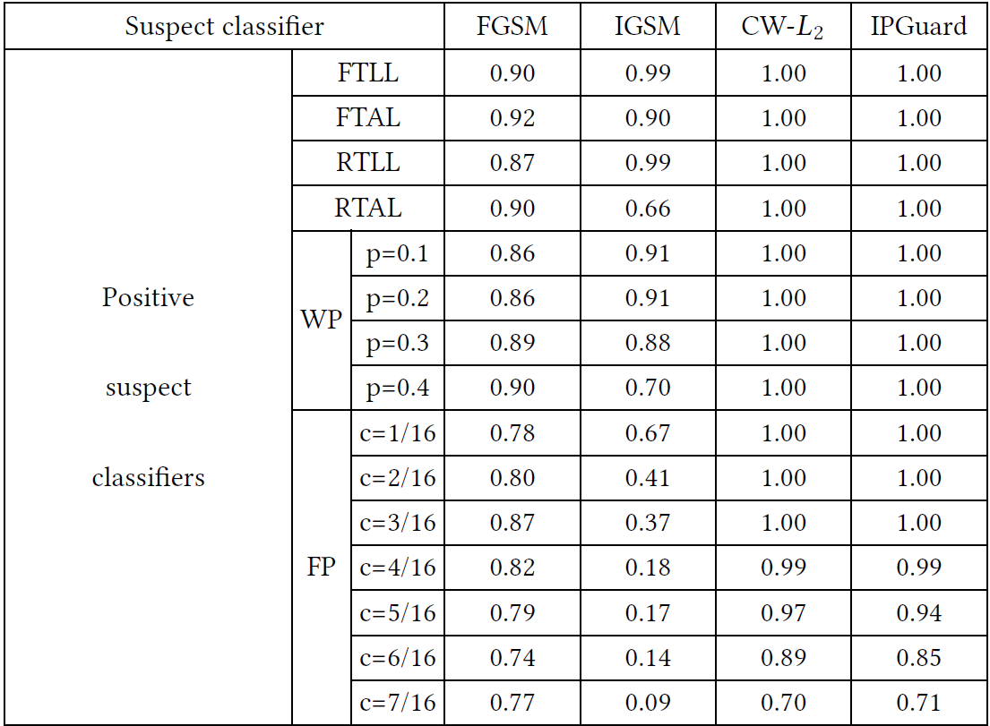
EXPERIMENTS
Matching Rate

Slide 11
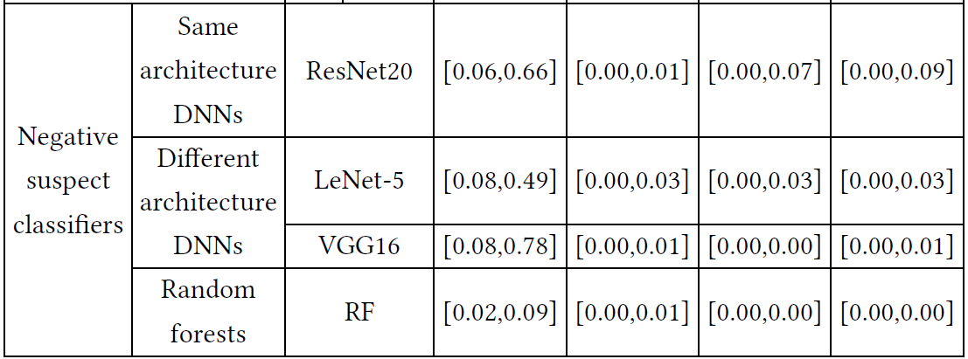
EXPERIMENTS
Matching Rate

Slide 12
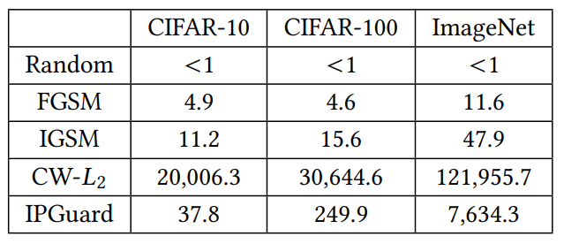
EXPERIMENTS
Effectiveness

Slide 13
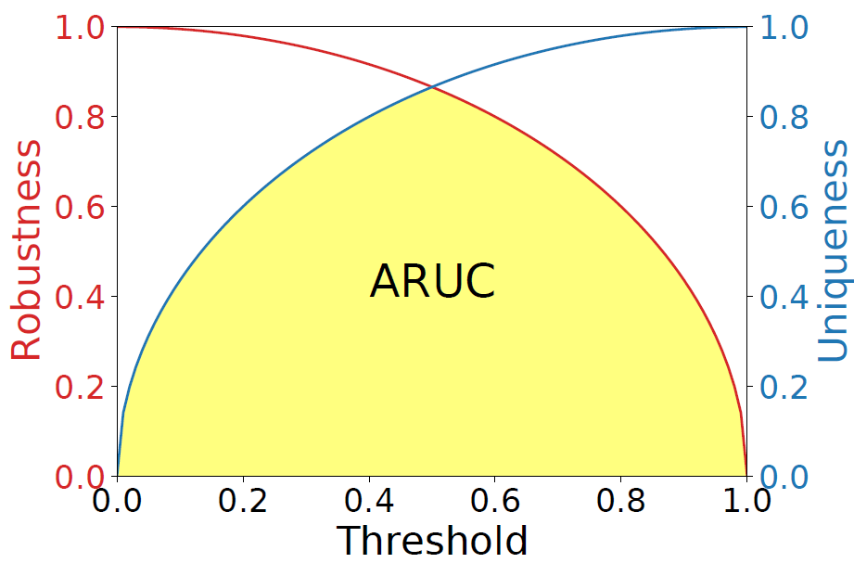
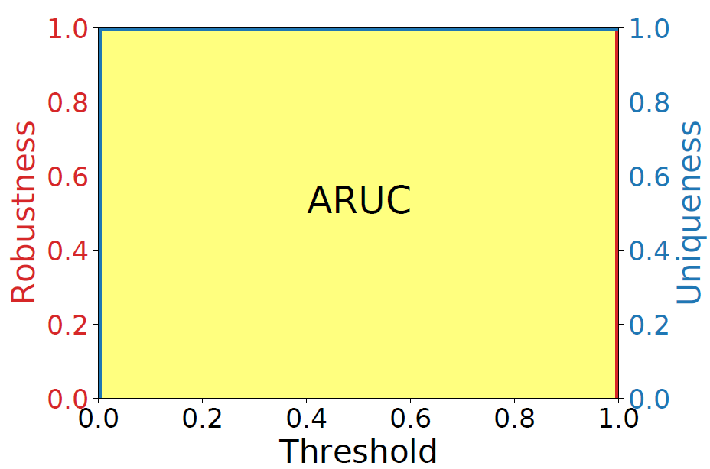
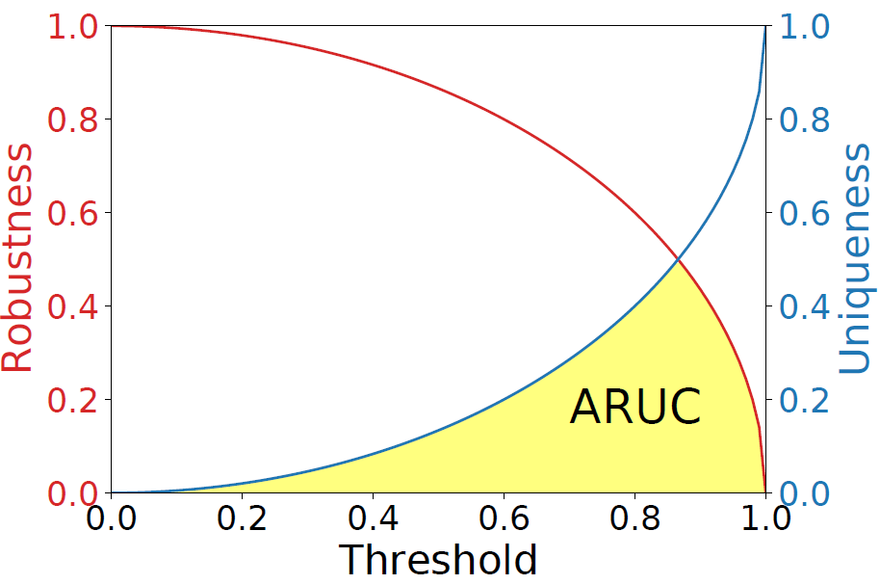
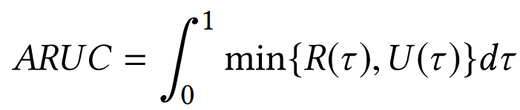
EXPERIMENTS
Metrics——ARUC
Area under the Robustness-Uniqueness Curves (ARUC)

Slide 14
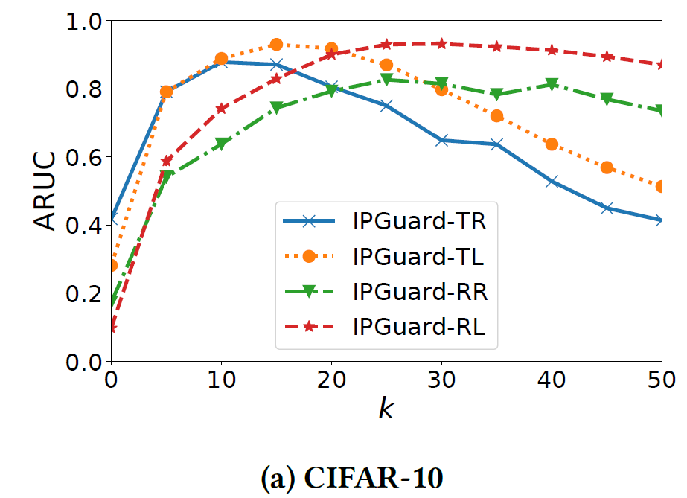
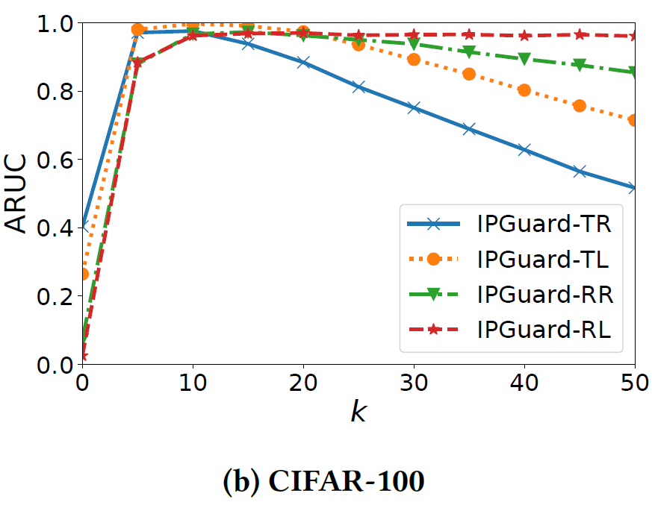
EXPERIMENTS
Impact of k on ARUC for IPGuard

