Slide 1
Understanding Contrastive Representation Learning through Geometry on the Hypersphere
Xiaobing Chen
May 11, 2021

Slide 2
New Metrics for Contrastive Learning

Slide 3
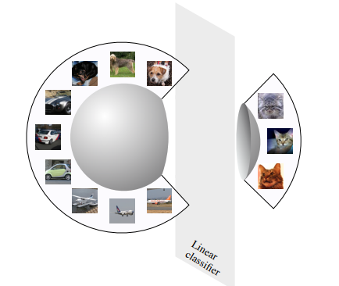
Representation on the Unit Hypersphere
Many work learn representations using l2 normalization, which restricts the latent space to the unit hypersphere
Intuitively, high quality of representations can be linearly separable in the latent space.
Besides the clustering property, good representations should be invariant to unnecessary information. (InfoMax principle.)

Slide 4
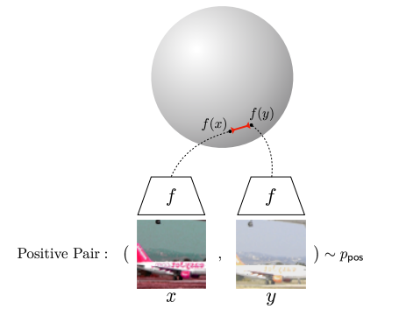
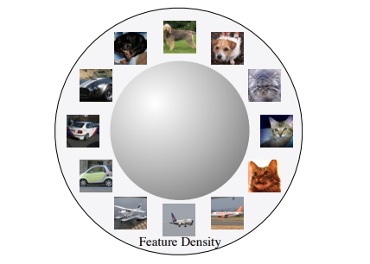
Properties of Good Representations
To explore what desirable properties of good representations, authors propose two metrics: alignment and uniformity, and use them to interpret the success of existing contrastive loss, InfoNCE.
Alignment: to measure the distance between positive representations.
representations of positive pairs are close in the latent space.
Uniformity: to measure how well representations are uniformly distributed.
uniform distribution would preserve maximal information.

Slide 5

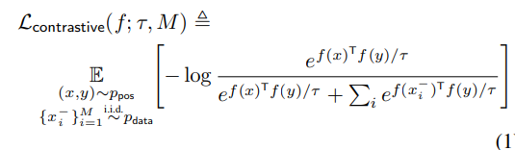
Background-Contrastive Learning
Data:
Encoder:
InfoNCE loss:

Slide 6
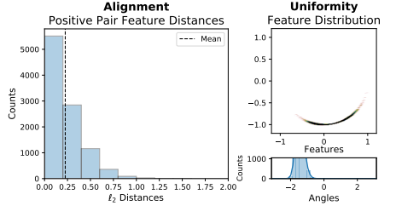
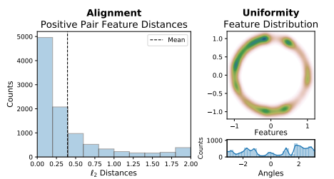
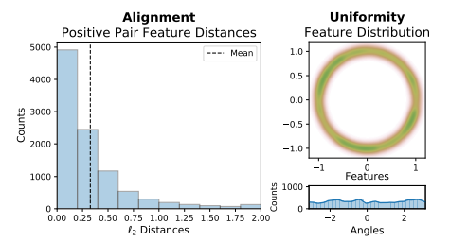
Properties of Good Representations
Toy example:
Train CIFAR-10 encoders
2-dim representations, 1-sphere feature space (circle)
Computing alignment: l2 distance of positive pairs; uniformity: Gaussian kernel density estimation
Visualize feature distributions on the validation set.
Random Initialization: Linear classification accuracy: 12.71%
Supervised Learning: Linear classification accuracy: 57.19%
Contrastive Learning: Linear classification accuracy: 28.60%
Features from contrastive learning is most uniformly distributed !

Slide 7

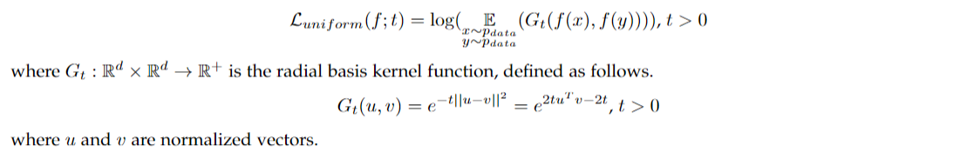
Quantifying Alignment and Uniformity
Alignment: expected distance between positive pairs
Uniformity: logarithm of the expected pairwise Gaussian potential
Why choose RBF kernel?

Slide 8
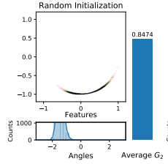
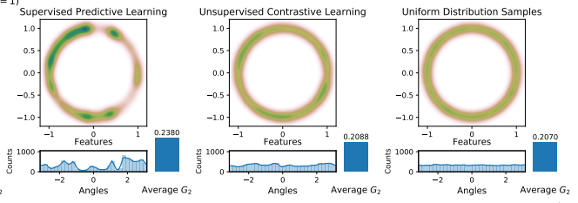
Evaluating Uniformity
Empirical evaluation of toy example: evaluate the average pairwise potential of various finite point collections.
The average G2 decreases as the distribution becomes more uniform. It’s a good metric for uniformity.

Slide 9
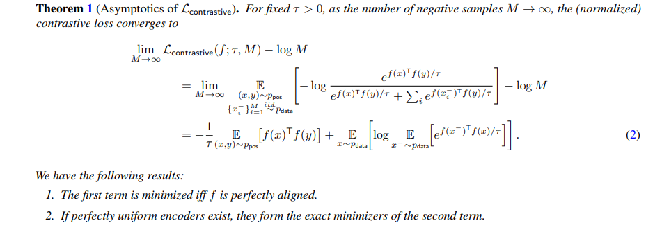
Asymptotics of InfoNCE
Theorem 1 is proposed to connect alignment and uniformity with InfoNCE.
Minimizing InfoNCE loss indeed requires both alignment and uniformity.

Slide 10
Experiments

Slide 11

Experimental Settings
Encoder: multiple encoders based on CNN and RNN
Downstream task & datasets:
STL-10: classification on AlexNet based encoder outputs or intermediate activations with a linear or k-nearest neighbor (k-NN) classifier.
NYU-DEPTH-V2: depth prediction on CNN encoder intermediate activations after convolution layers.
IMAGENET and IMAGENET-100 (random 100-class subset of IMAGENET): classification on CNN encoder penultimate layer activations with a linear classifier.
BOOKCORPUS: RNN sentence encoder outputs used for Moview Review Sentence Polarity (MR) (Pang & Lee, 2005) and Customer Product Review Sentiment (CR) (Wang & Manning, 2012) binary classification tasks with logisitic classifiers.
Positive pair construction:
two augmented images from the same image for image-relevant tasks
neighboring sentences for NLP
Experiments with varying:
Objectives: weighted combinations of
Hyperparameters: temperatures, batch size, representation dim, …

Slide 12
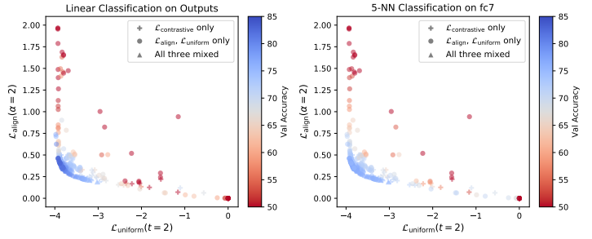
Results-STL-10 Classification
High performance region
Best downstream performance give lowest alignment and uniformity.

Slide 13
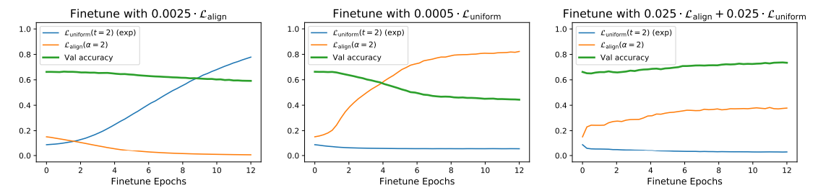
Results-STL-10 Classification
Both alignment and uniformity are necessary for a good
representation.

Slide 14
Conclusions & Discussions

Slide 15
Conclusions & Discussions
Alignment and uniformity are two important goals of contrastive learning and good metrics to evaluate the quality of representation.
It provides theoretical proof that uniform distribution on sphere is the optimal solution for the Radial Basis Function (RBF) kernel.
Why unit hypersphere benefits the representation learning remains explored.

Slide 16
Thanks ! Q & A

