Slide 1
PITCH DECK · CLIENT PRESENTATION
Vehicle Selector Pro
A Production-Grade Shopify App for Vehicle Fitment
CLIENT DELIVERABLE · AUGUST 2026
Live demo: https://vehicle-selector-pro.fly.dev/demo
Merchant admin: https://vehicle-selector-pro.fly.dev/demo/admin
Repository: https://github.com/ai-dev-2024/vehicle-selector-pro

Slide 2
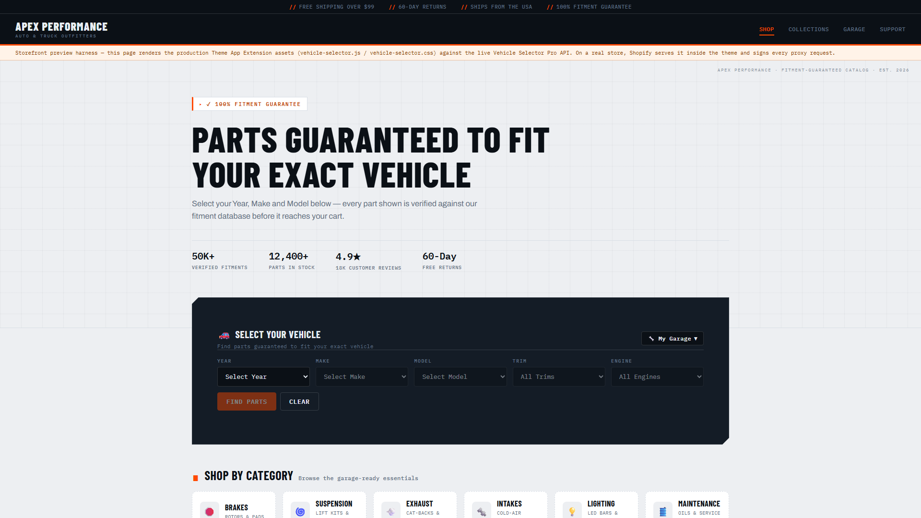
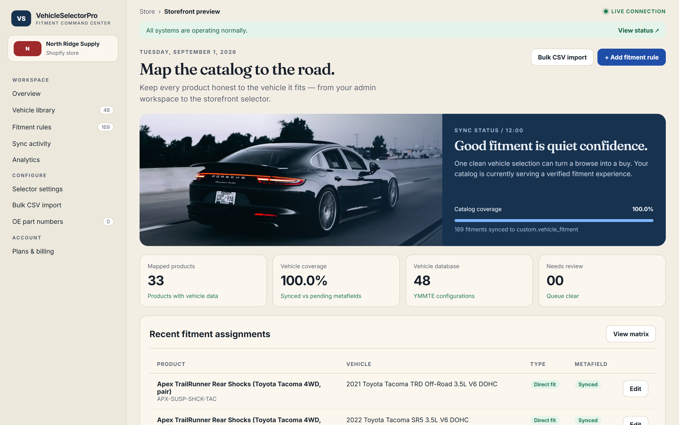
THE PROBLEM
Aftermarket parts sell badly online — compatibility is the whole sale
A brake pad or wiper blade only fits an exact Year / Make / Model / Trim / Engine. Wrong-fit means wrong parts, angry customers, and costly returns — so fitment data becomes the product.
▪ Dense compatibility tables bury the answer
▪ Per-product manual rules rot and cost hours
▪ Paid fitment feeds lock merchants into contracts
▪ Built end-to-end with free AI tooling on a 2018 ASUS ZenBook — proof of the headroom ahead

Slide 3
THE SOLUTION · ONE DATASET, SYNCED EVERYWHERE
A real, browsable demo catalog already in production
48
402
74
25
YMMTE configurations
verified fitments
mapped products
brands represented
Fitments entered once into a normalized cache, pushed to Shopify metafields, and served to shoppers behind an HMAC-signed App Proxy — Guaranteed Exact / Does-NOT-Fit / Universal badges on every product page.

Slide 4
HOW IT WORKS
A cascading fitment engine, engineered for production
Storefront
App Proxy
Controllers
Sidekiq/Redis
PostgreSQL
GraphQL
Zero ScriptTag API — pure Theme App Extension, signed App Proxy, safe webhooks.

Slide 5
READY WHEN YOU ARE
See it live — watch it run
›
Try the live storefront demo
›
Explore the merchant admin
›
Open the repository
›
Watch the two narrated walkthroughs
Both the live storefront and merchant admin are running right now.

