Slide 1
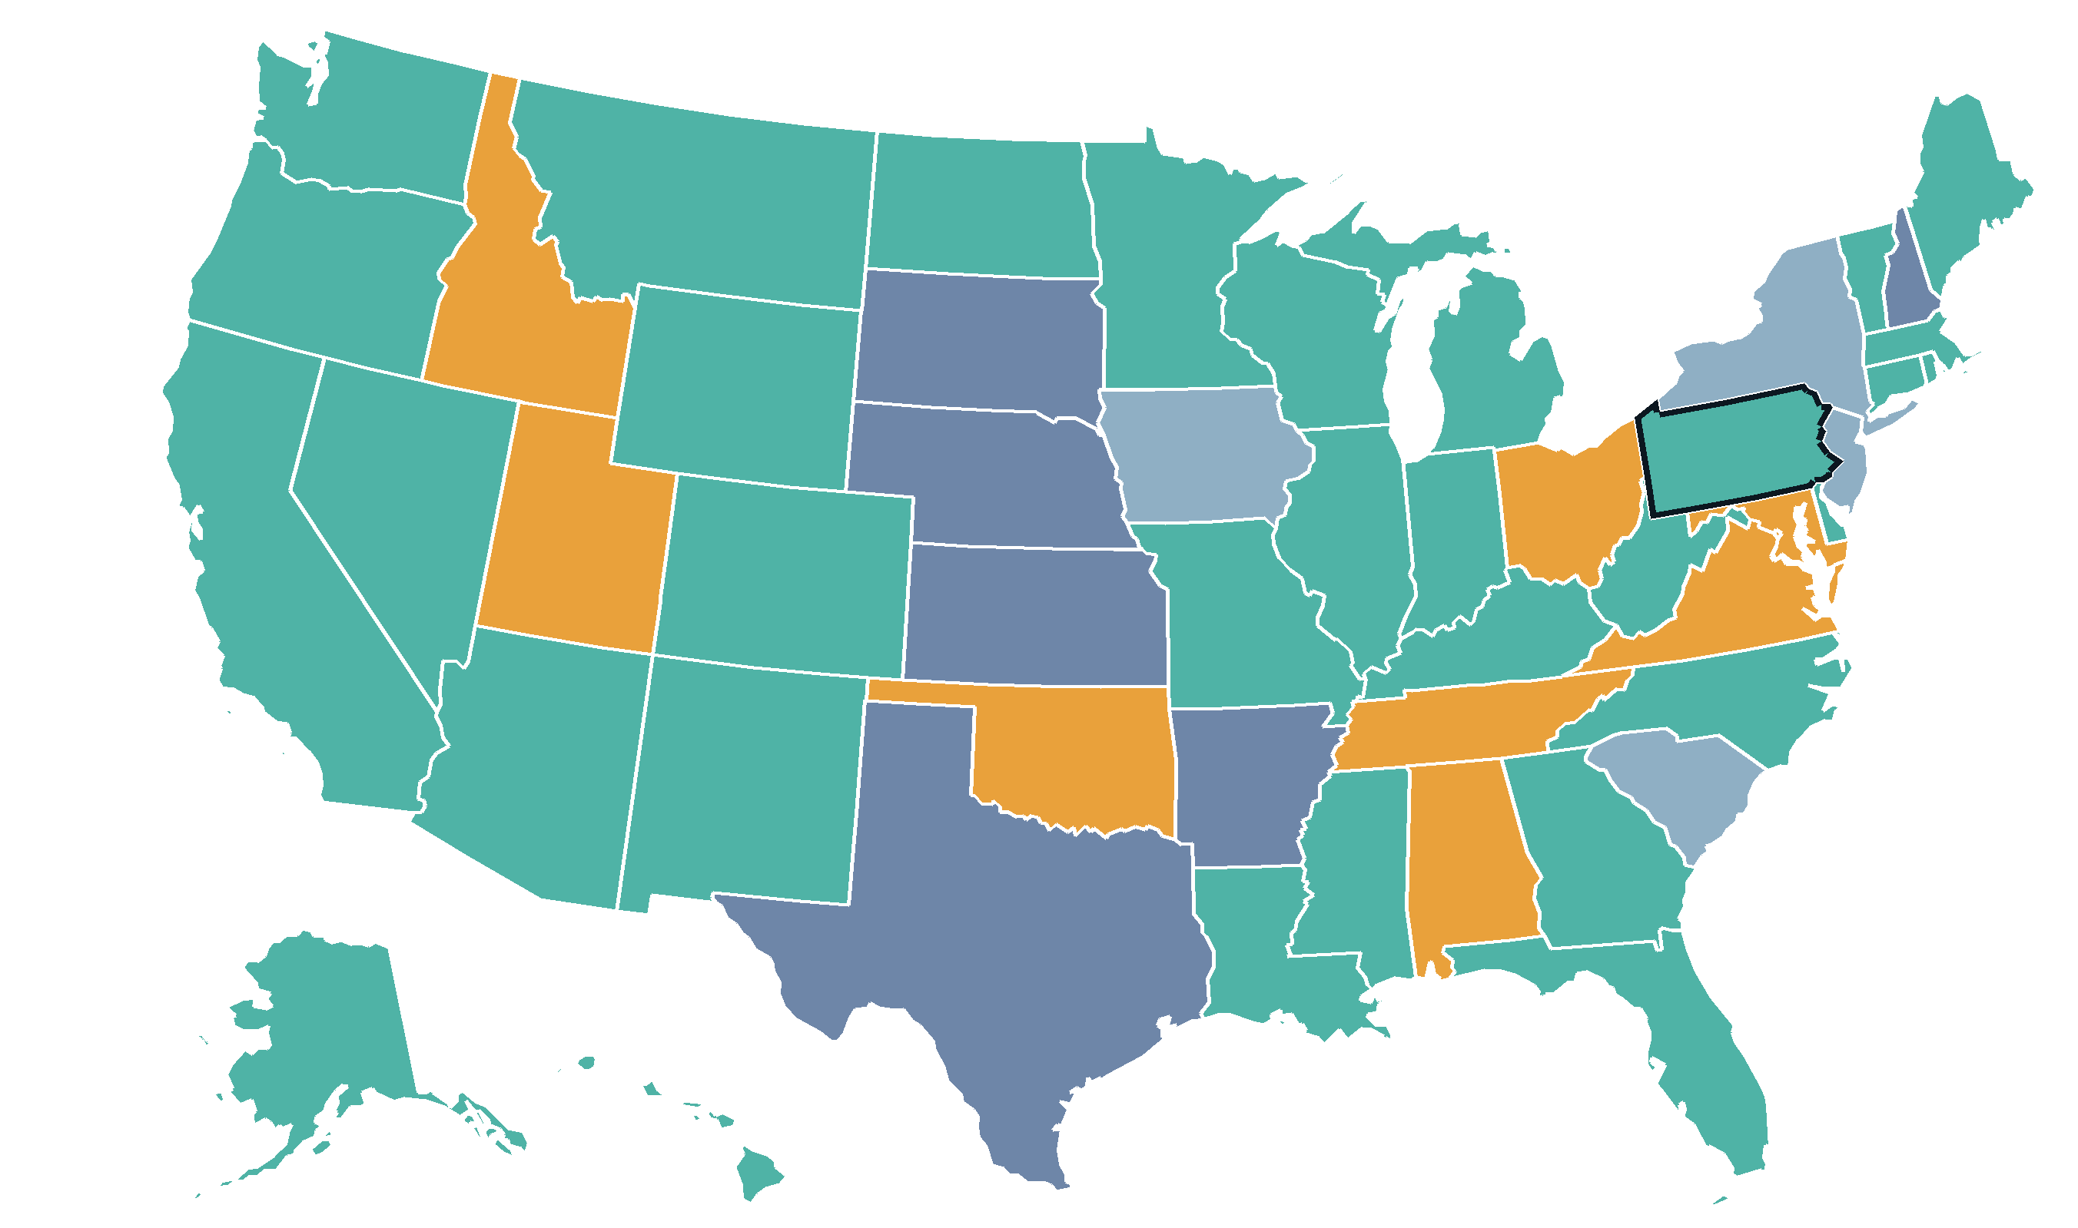

What Do Our Incoming Students Know about AI?
K-12 AI policy in all 52 US school systems · every claim checked against the states’ own documents
PENNSYLVANIA · HOST STATE
No statewide classroom framework. Each district wrote its own AI rules.
The state’s one AI program is for teachers: a 12-credit AI endorsement on the teaching certificate, offered through colleges.
Penn State is gathering input from schools statewide to shape Pennsylvania’s first AI guidance.
Your classrooms also hold MD and NJ students. Maryland requires district AI policies. New Jersey may soon require public colleges to offer AI degrees for students.
Scan. Find your students’ state.
One surprise. Ninety seconds.
bit.ly/K-12AIFieldGuide
10 mandates
32 guidance
4 pending
6 no guidance
52 systems documented · 7 teach leveled AI permission scales
Notes:
ACTIVITY (2 min): Ask everyone to scan the QR and look up the state THEY went to high school in, or where their students come from. Find one thing that surprises you. Then take 3-4 shares. PENNSYLVANIA TALKING POINTS: PA has no K-12 classroom AI framework, so every PA student's rules came from their district — incoming classes are a patchwork by design. What PA does have is aimed at higher ed: PDE published a 12-credit AI endorsement teachers add to their certificates, and colleges are who deliver it (framework written with Millersville, St. Vincent, Moravian). Penn State has been gathering input from K-12 leaders statewide, which will shape PA's first statewide AI guidance. In PA, higher ed is the author of AI policy, not the recipient. NEIGHBORS: Etown draws from PA, MD, NJ, NY. Maryland: SB 720 mandates district AI policies + AI coordinators, and state guidance calls AI detectors 'unreliable and inequitable.' New Jersey: pending bill A4352 would require every public college to OFFER AI certificate and degree programs that students enroll in (academic programs, not teacher training). New York: nothing statewide; NYC's own guidance dominates. One first-year seminar here can hold students from a no-framework state, a mandate state, and a state about to legislate universities. STORIES if asked: Iowa spent $3M putting a voice-based AI reading tutor (Amira) in every elementary school. Rhode Island surveyed its own students: 20% use AI for schoolwork vs 6% of educators. Oklahoma students submit links to their AI chats with assignments.

