Slide 1



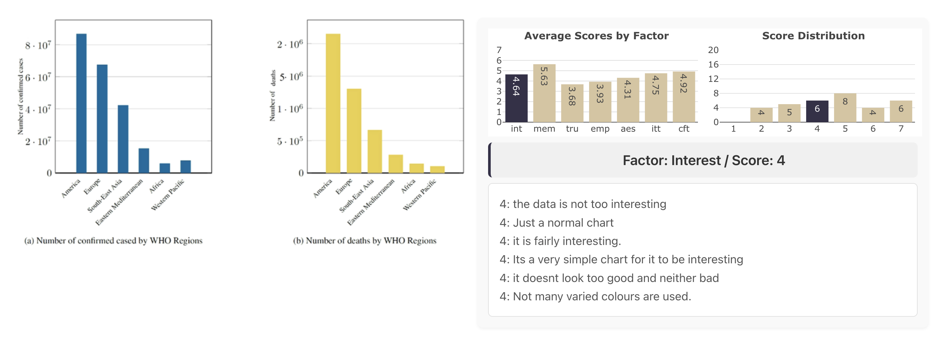
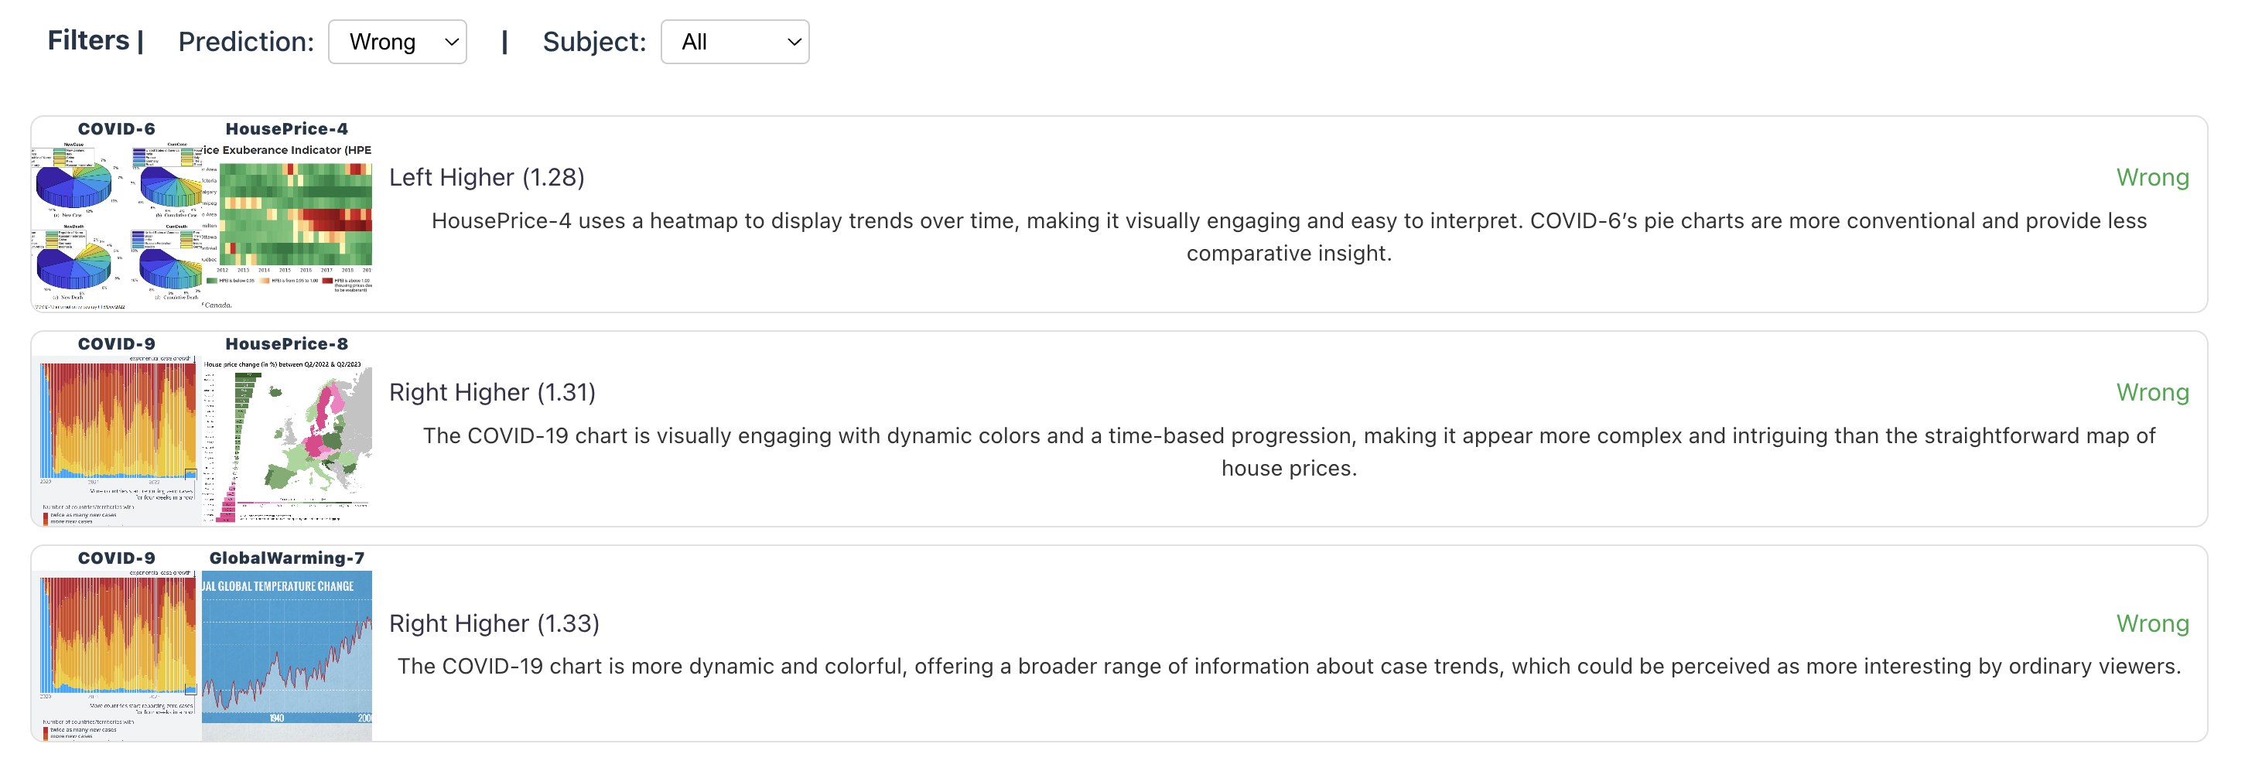
Absolute Scores by Human / MLLM
Pairwise Comparison Accuracy

