Slide 1
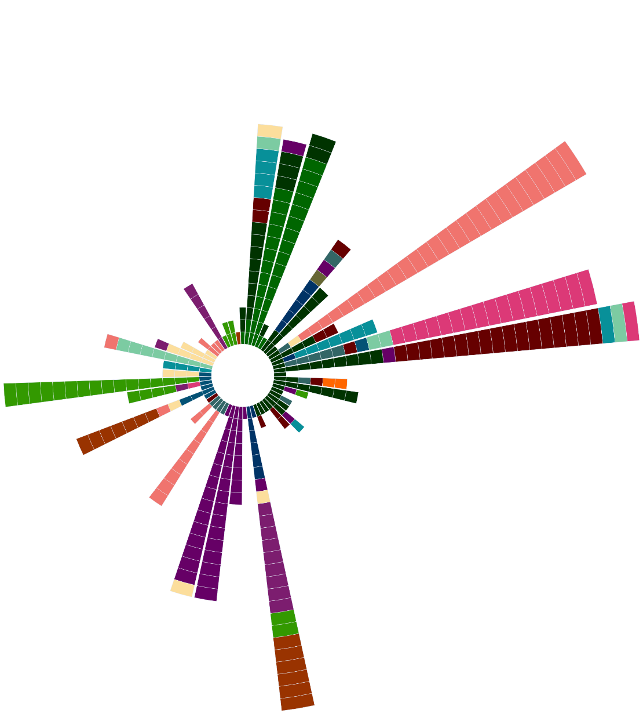
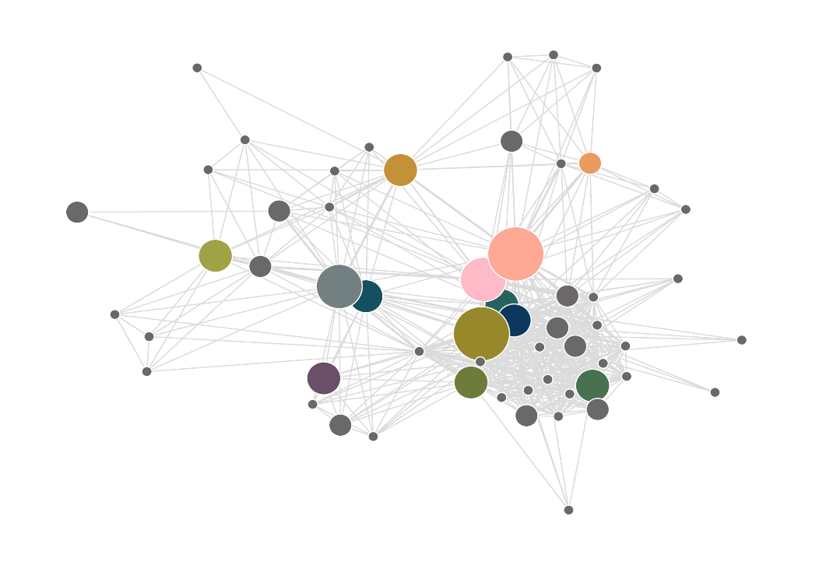
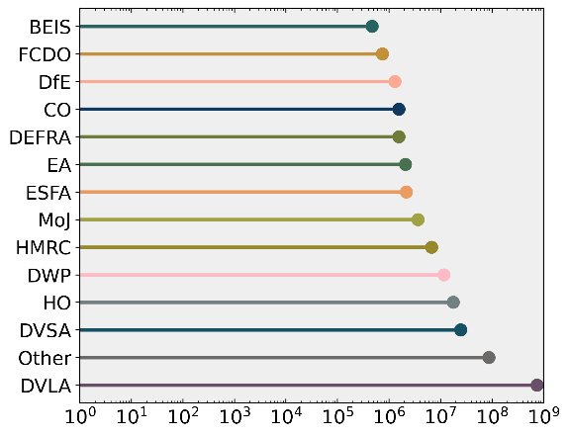
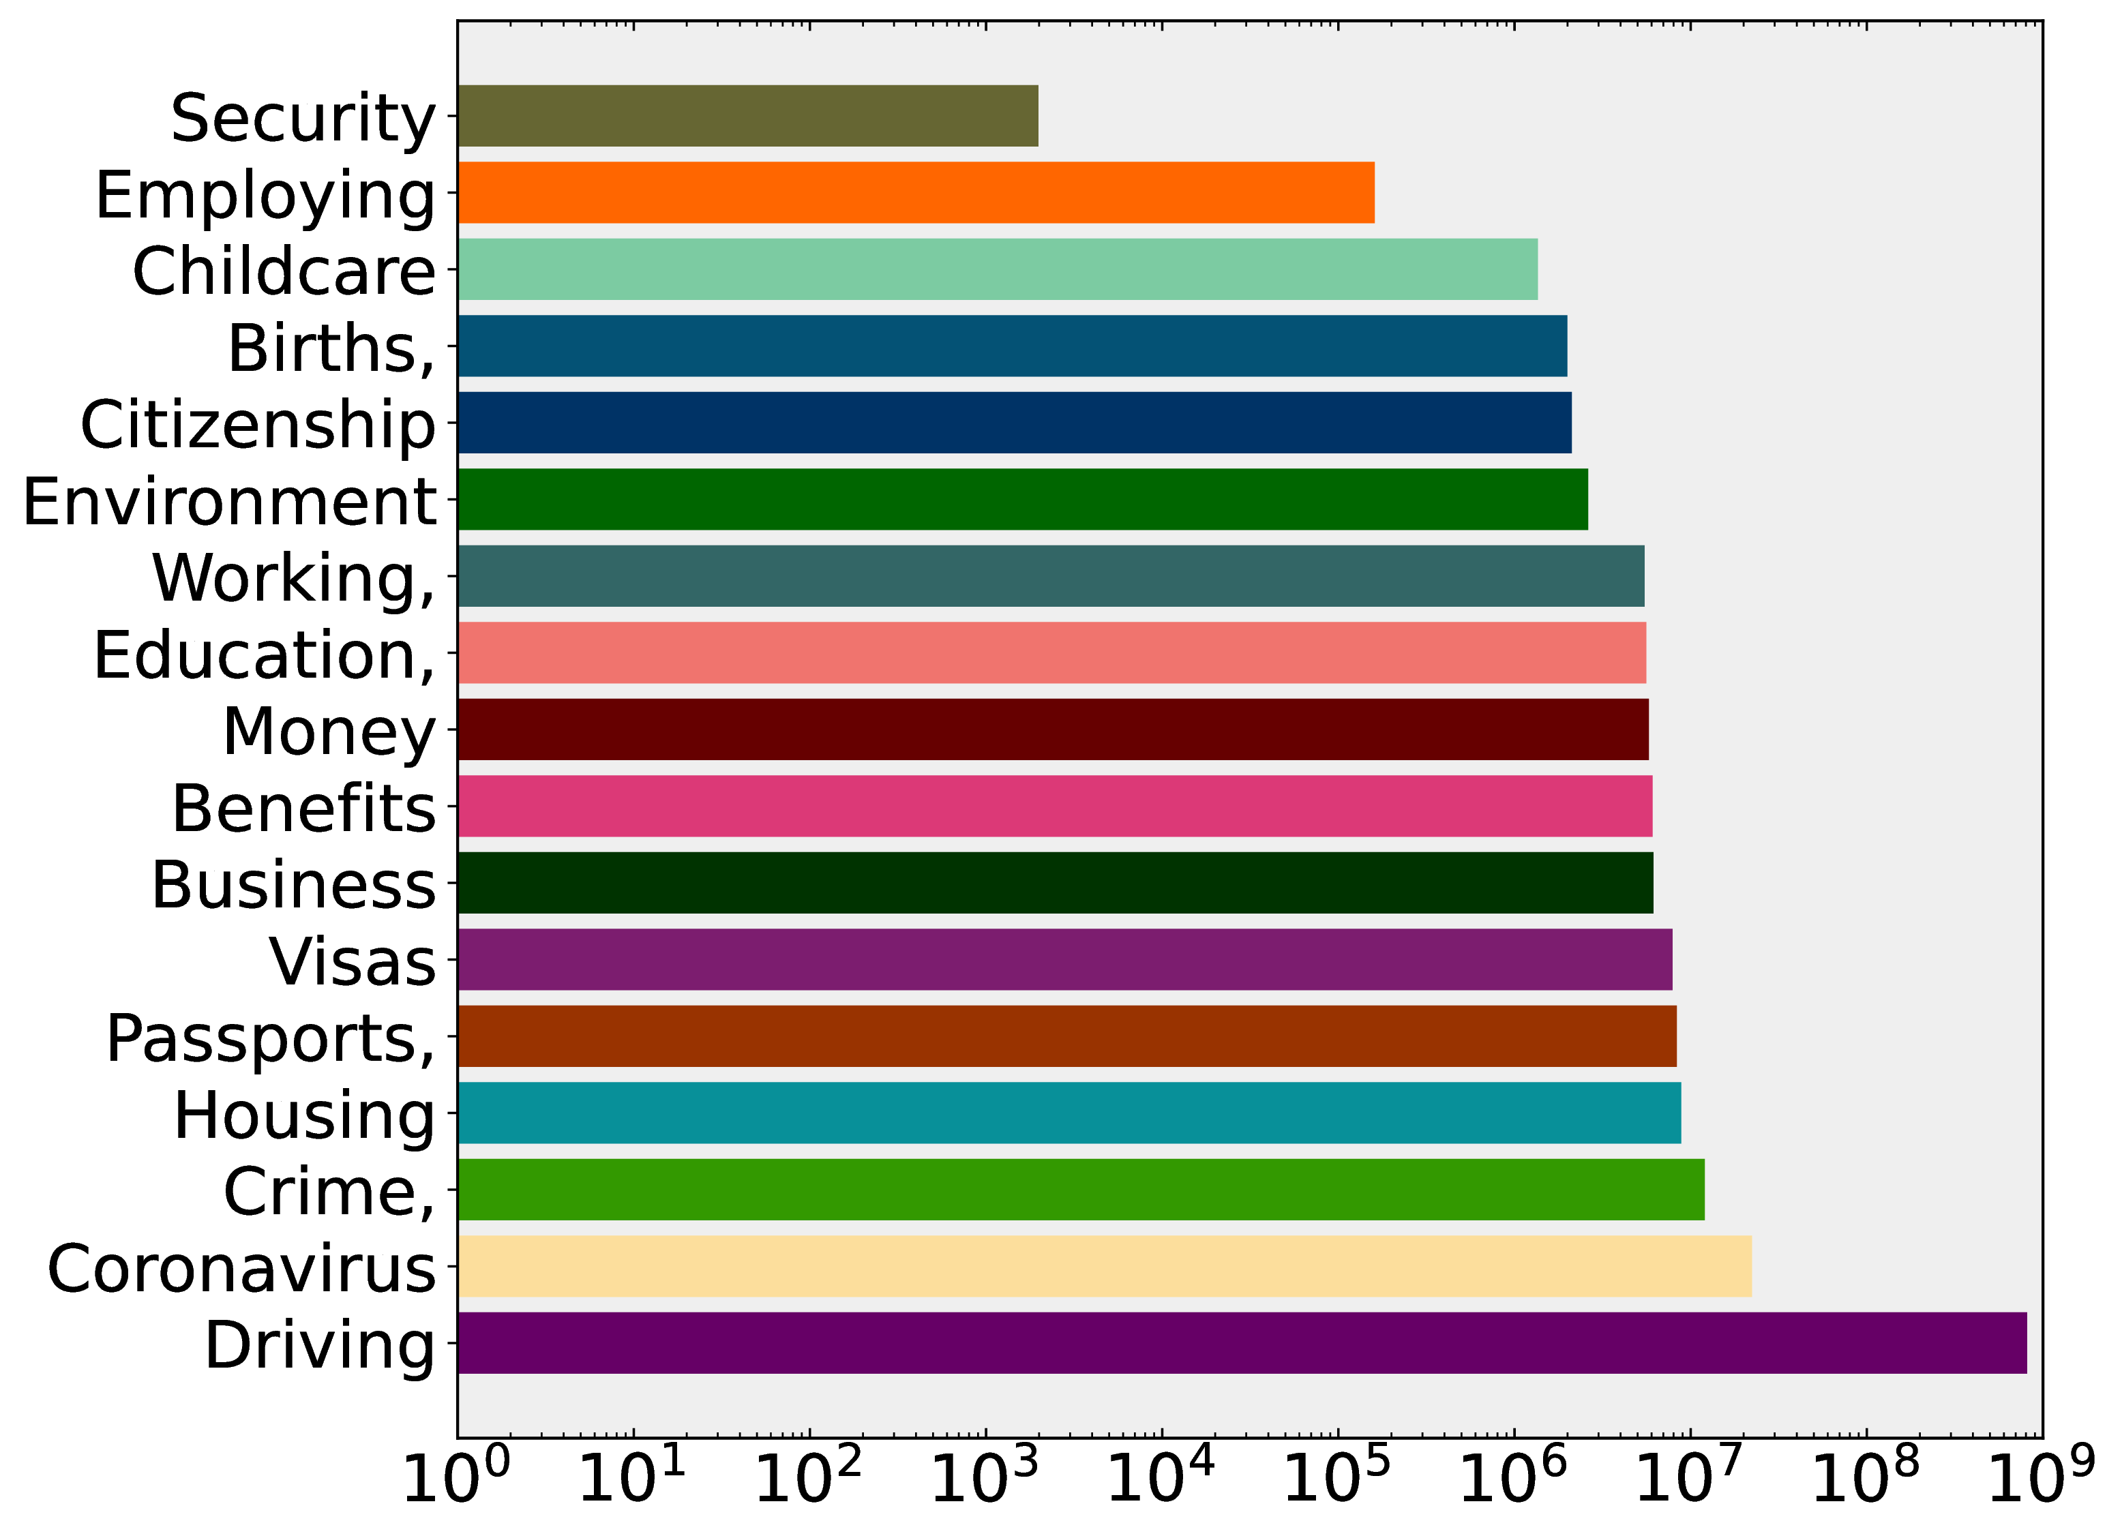
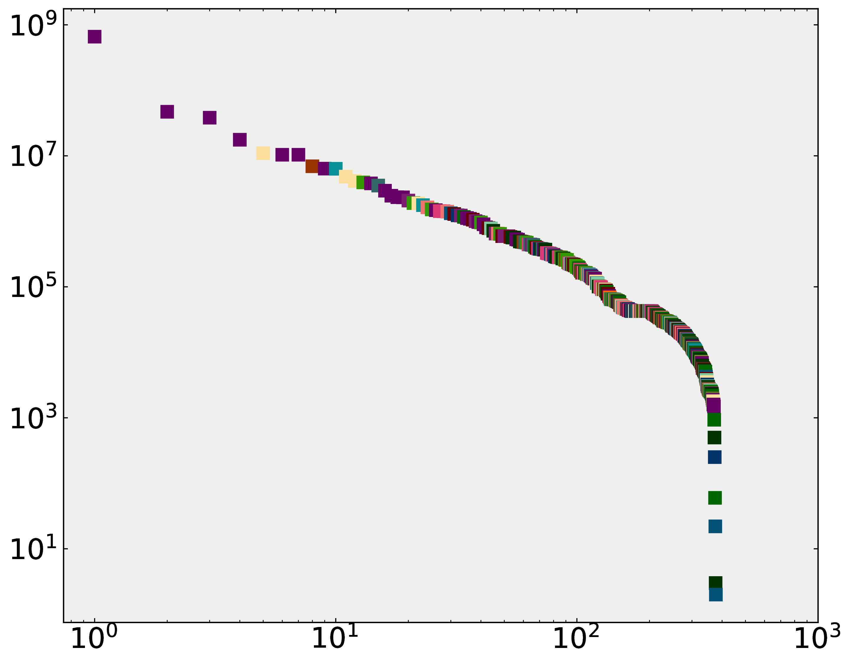
DVSA
HMRC
MoJ
Citizenship & living in the
UK
Passport, travel &
living abroad
Money and tax
Employing people
CO
FCDO
DVLA
Births, deaths, marriages
& care
National security
Driving and transport
Coronavirus
(COVID-19)
BEIS
ESFA
HO
Working, jobs & pensions
Business & self-employed
Visas & immigration
EA
DfE
Other
Housing and local
services
Environment and
countryside
Benefits
DEFRA
DWP
Childcare & parenting
Crime, justice & the law
Education, training & skills
A
HO (n=25)
B
DVLA (n=16)
DVSA (n=16)
Organisation
DfT (n=8)
ESFA (n=10)
HE (n=1)
FCDO (n=12)
DCMS (n=1)
CSFS (n=1)
NHS BSA (n=1)
CAA (n=1)
GEO (n=1)
UKEF (n=1)
SLC (n=3)
OZEV (n=4)
CQC (n=1)
CC (n=3)
OPSS (n=2)
MoD (n=2)
GRO (n=1)
MHRA (n=1)
UKTI (n=1)
HMCTS (n=7)
MoJ (n=17)
MCA (n=3)
VOA (n=2)
IPO (n=7)
IS (n=6)
NHS D (n=4)
IUK (n=1)
LR (n=4)
MMO (n=2)
Ofsted (n=9)
DLHC (n=9)
CCS (n=1)
DHSC (n=5)
DFIT (n=6)
GDS (n=3)
HMRC (n=30)
CH (n=7)
Ofqual (n=2)
ONS (n=1)
PHE (n=1)
DWP (n=27)
HMPA (n=1)
STA (n=1)
LAA (n=2)
DBS (n=1)
CO (n=11)
APHA (n=3)
TRA (n=1)
UKVI (n=6)
OPG (n=2)
DfE (n=30)
EA (n=18)
DEFRA (n=17)
Service count ≥ 30
BEIS (n=18)
20 ≤ Service count ≤ 29
11 ≤ Service count ≤ 19
5 ≤ Service count ≤ 10
Service count ≤ 4
Service
C
D
E
Check if a vehicle is taxed
Tax your vehicle
Apply online for a UK passport
Dart charge
Organisation
Topic
Log(Transaction volume)
Report a COVID-19 test result
Search for property information
Service
Log(Transaction volume)
Log(Transaction volume)
Log(Rank)

