Slide 1
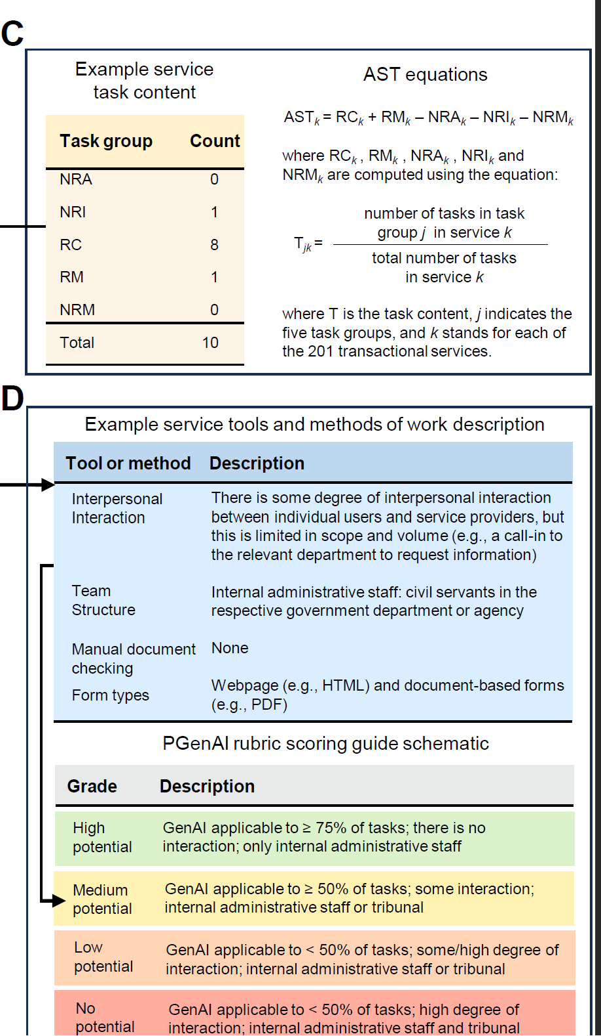
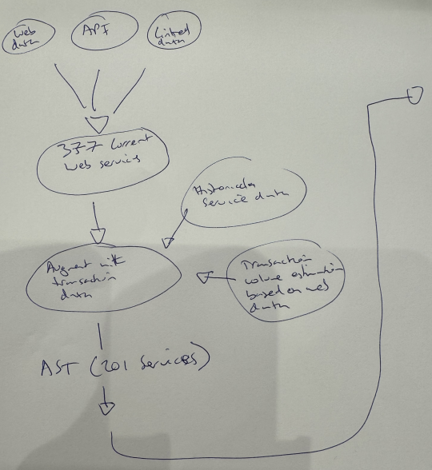

Slide 2
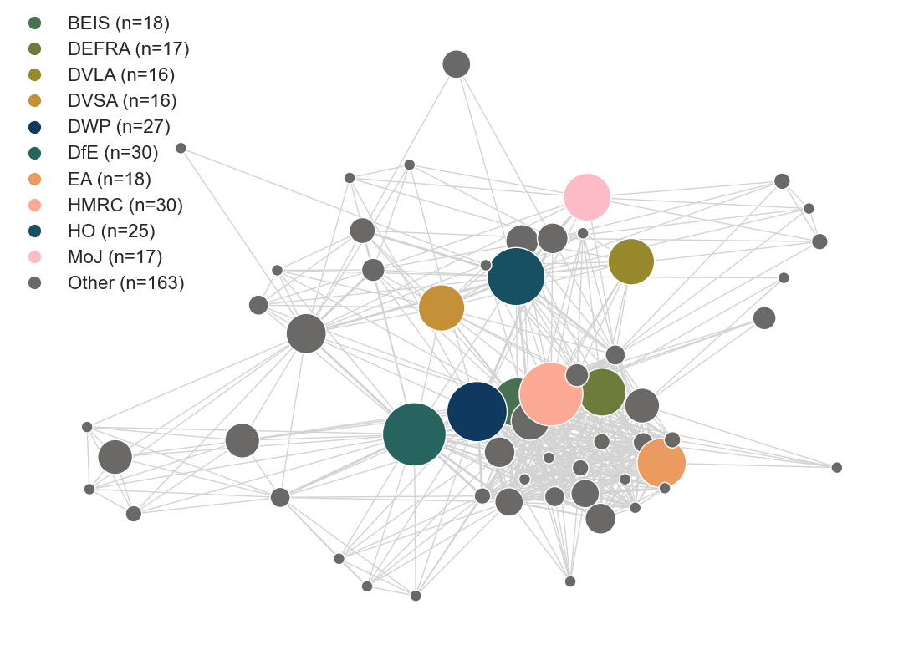
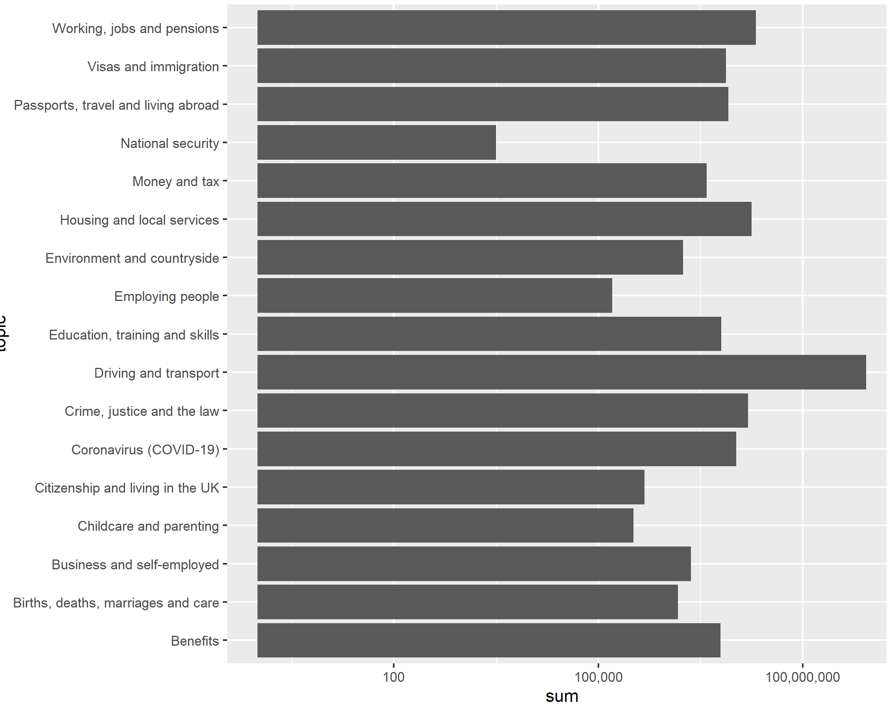
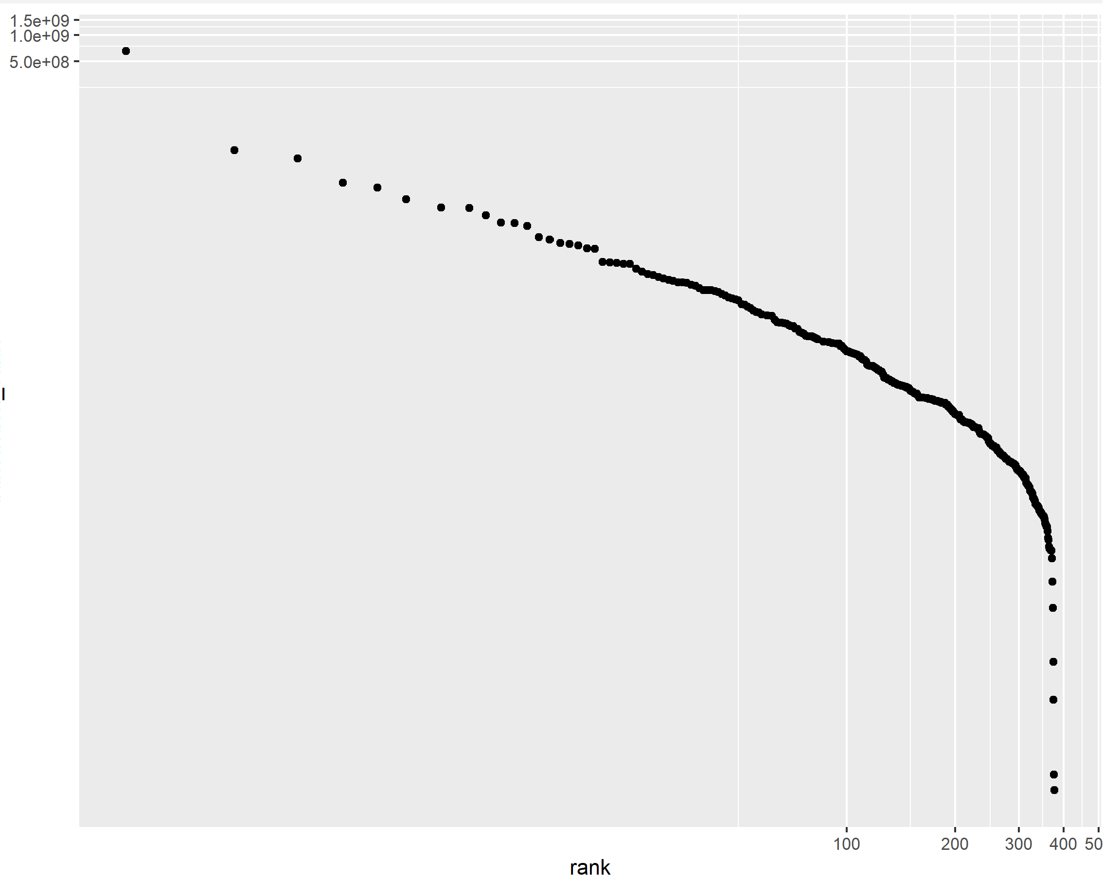
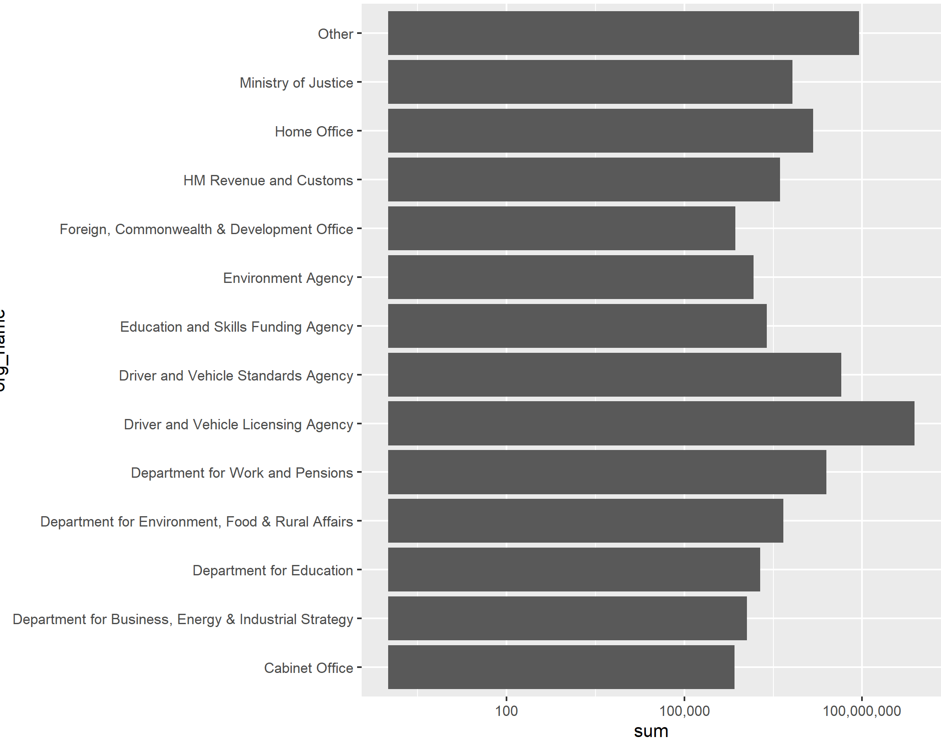
Services by topic and department
Service volumes by topic and department
Overlap between depts and topic
Zipf plot of service volume

Slide 3
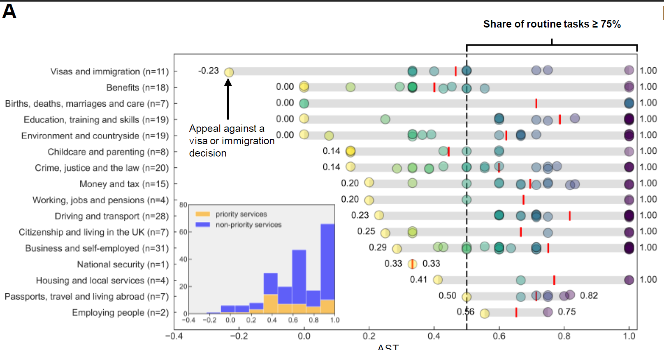
AST by topic and department

Slide 4
RTI
score
# of
services
% of
services
# of
orgs
# service delivery
professionals
0%
< 50%
≥ 50%
≥ 75%
100%
−1
< 0
≥ 0
≥ 0.5
1
0
(0)
1
(0)
200
(48)
149
(28)
66
(10)
0
(0)
0.50
(0)
99.50
(100)
74.13
(58.33)
32.84
(20.83)
0
(0)
1 (0)
46
(18)
41
(14)
30
(7)
0
(0)
10,403
(0)
76,233
(54,260)
75,523
(53,540)
70,133
(4,230)

Slide 5
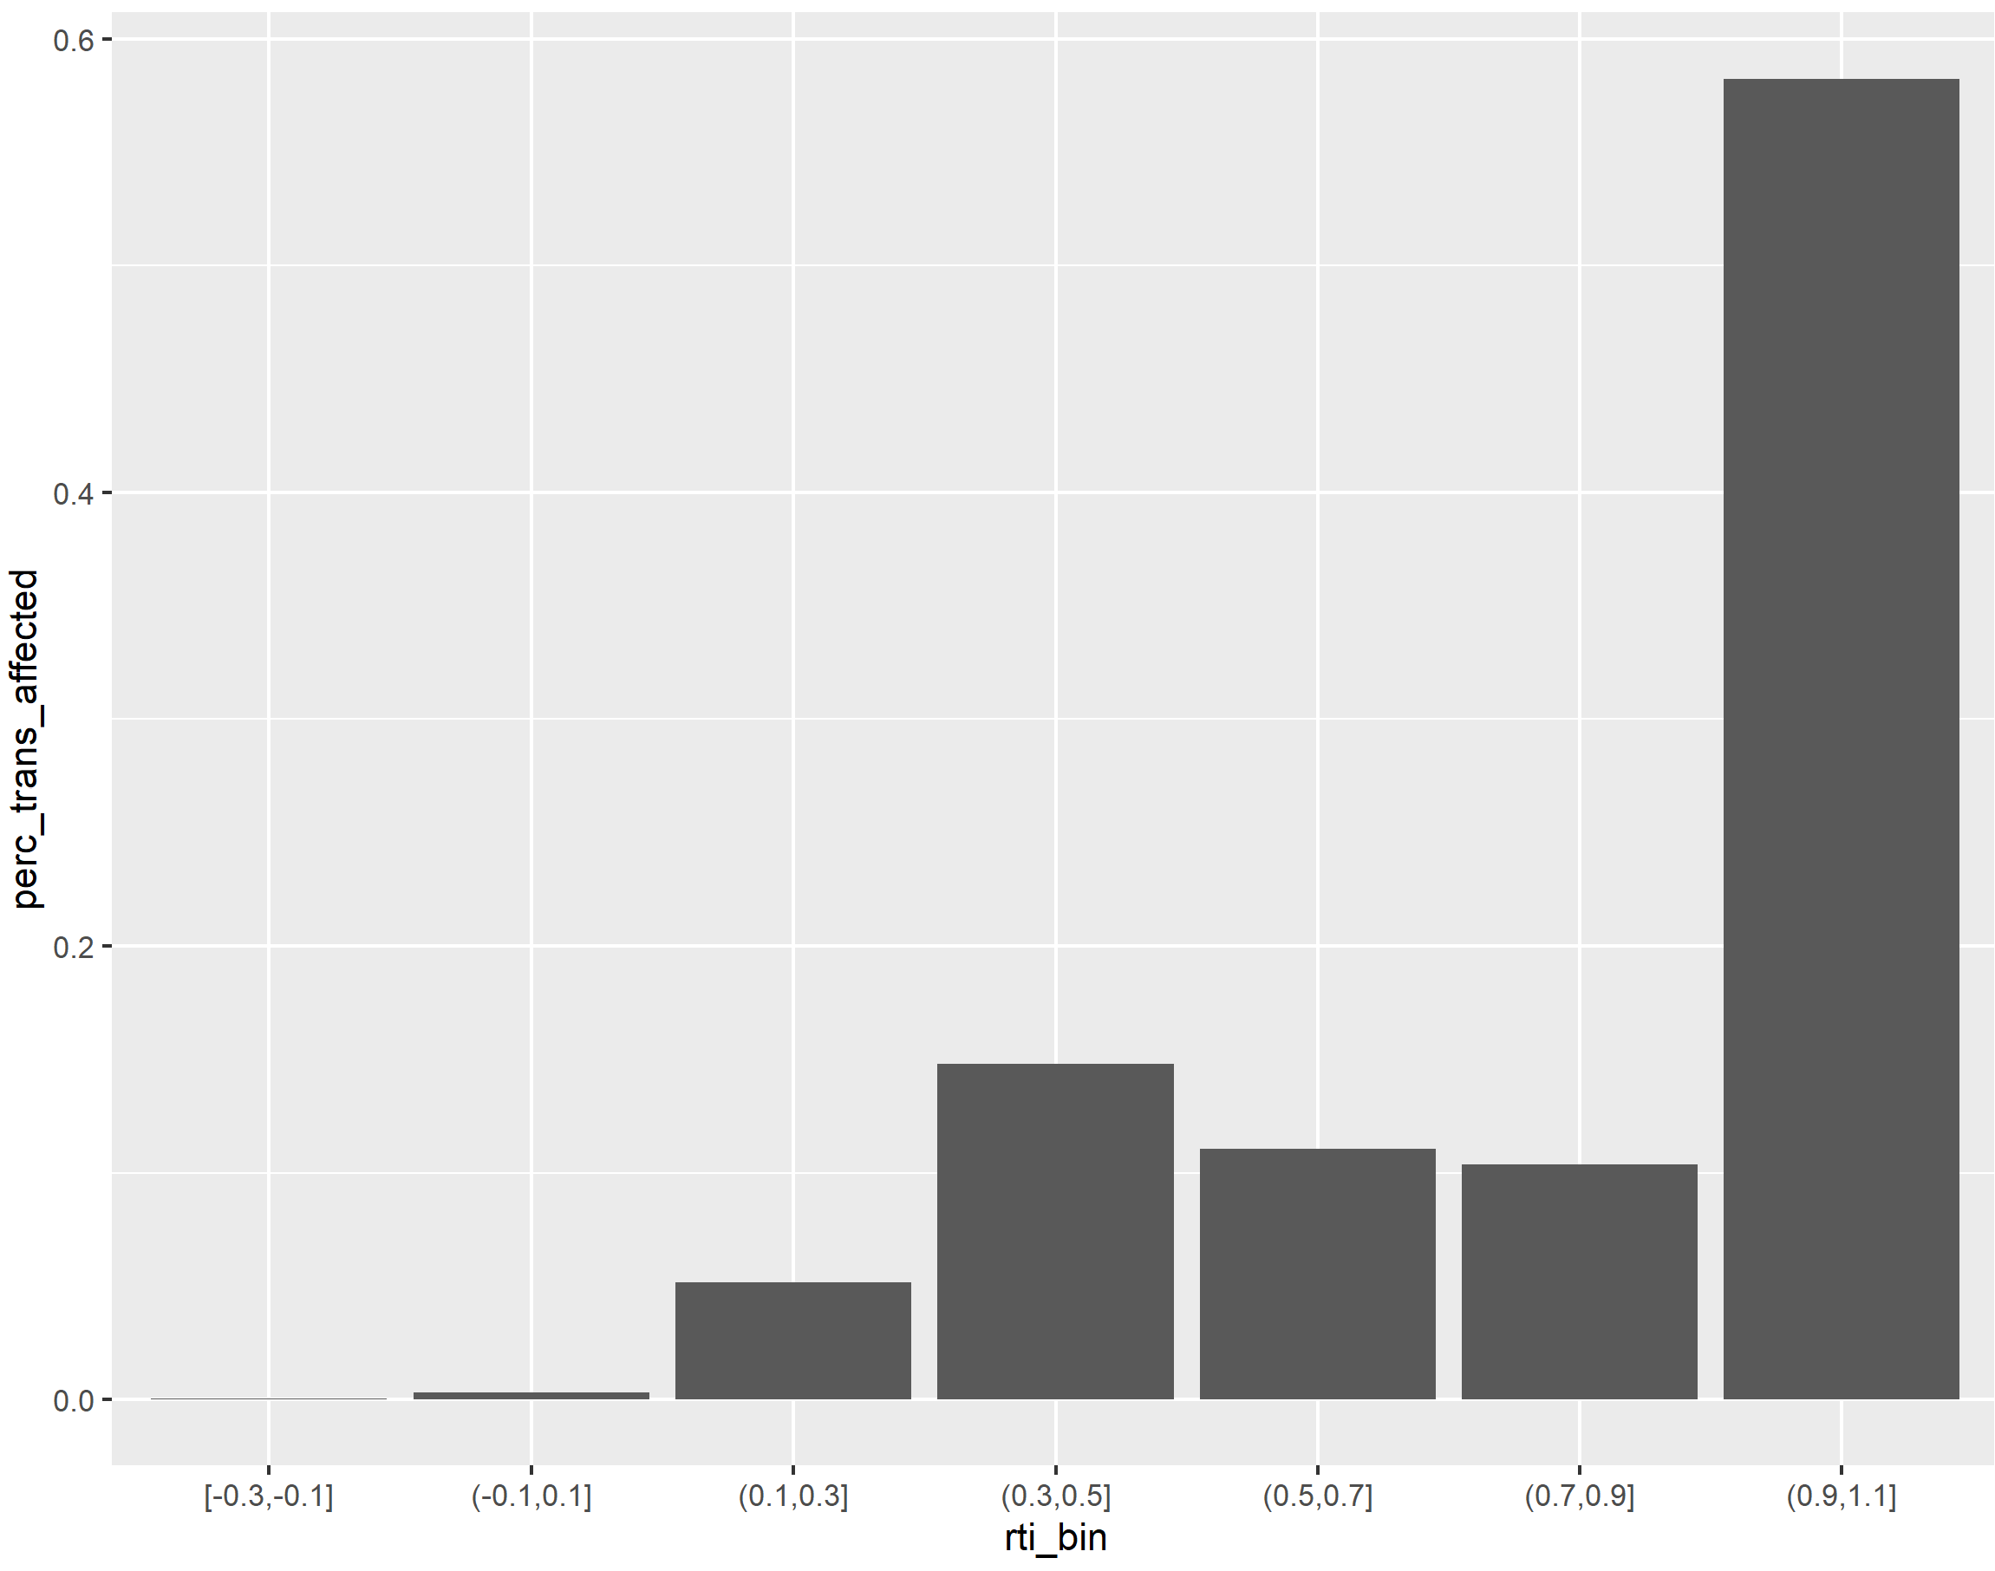
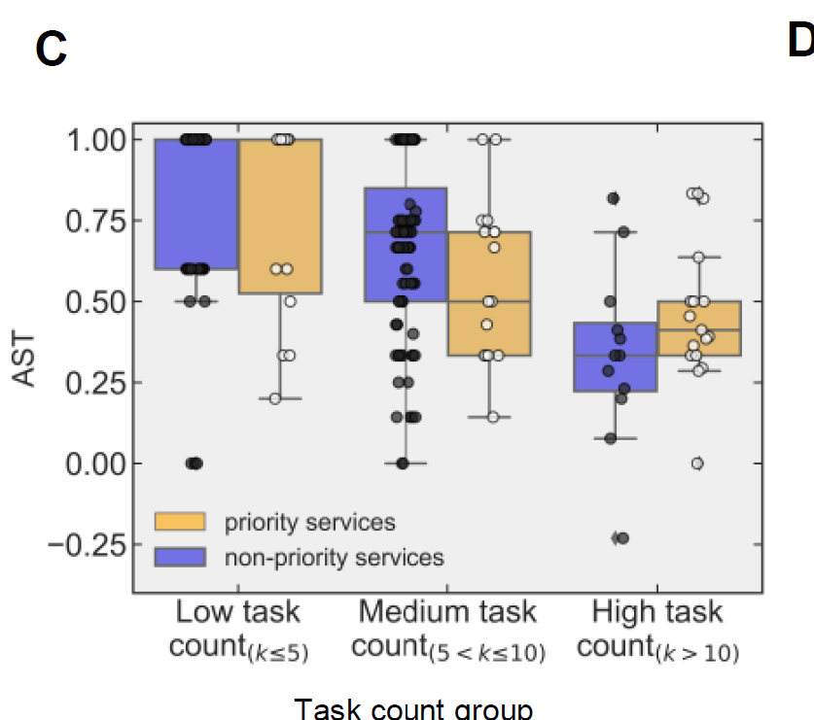
RTI volumes breakdown
Task count graphic
PGENAI HERE

