Slide 1


A
UK Government
B
C
Distribution of AST index scores across transactional services
Example service
task content
AST equations
1 domain (GOV.UK)
468 Organisations
(i.e., 44 departments, 424 executive agencies and public bodies)
AST_{k} = 1
AST = 0.8
Get a passport urgently: Renew or replace a passport urgently with the 1 day Premium service or the 1 week Fast Track service.
Task group Count
NRA 0
NRI 1
RC 8
RM 1
NRM 0
Total 10
AST_{k} = RC_{k} + RM_{k} – NRA_{k} – NRI_{k} – NRM_{k}
where RC_{k} , RM_{k} , NRA_{k} , NRI_{k} and
NRM_{k} are computed using the equation:
where T is the task content, j indicates the five task groups, and k stands for each of the 201 transactional services.
number of tasks in task
group j in service k
total number of tasks
in service k
Quantifying
dynamics and scale
of service delivery
Estimating
the potential of
automation and AI
T_{jk} =
AST = 0.14
Apply for a basic criminal record check: How to apply for a basic DBS check to get a copy of your criminal record, and what you must provide.
Administrative record
Primary
data collection
D
Example service tools and methods of work description
Data sharing
GOV.UK API
Direct download
Data sharing
Manual assignment
GPT labelling
Tool or method Description
Interpersonal
Interaction
Team
Structure
Manual document
checking
Form types
There is some degree of interpersonal interaction between individual users and service providers, but this is limited in scope and volume (e.g., a call-in to the relevant department to request information)
Internal administrative staff: civil servants in the respective government department or agency
None
Webpage (e.g., HTML) and document-based forms (e.g., PDF)
AST_{k} = 0
457 historical services
24,301 webpages
5,731 online forms
…
377 active services
58 priority services
201 transactional services
AST = –0.25
Appeal against a visa or immigration decision: You may need a visa to come to the UK to visit, study or work. You can appeal to the First-tier Tribunal (Immigration and Asylum Chamber).
PGenAI rubric scoring guide schematic
Grade Description
High
potential
GenAI applicable to ≥ 75% of tasks; there is no interaction; only internal administrative staff
Δ Yearly Count
Medium
potential
GenAI applicable to ≥ 50% of tasks; some interaction;
internal administrative staff or tribunal
AST_{k} = –1
Low
potential
GenAI applicable to < 50% of tasks; some/high degree of interaction; internal administrative staff or tribunal
Non-priority
services
Priority
services
No
potential
GenAI applicable to < 50% of tasks; high degree of interaction; internal administrative staff and tribunal
Year

Slide 2
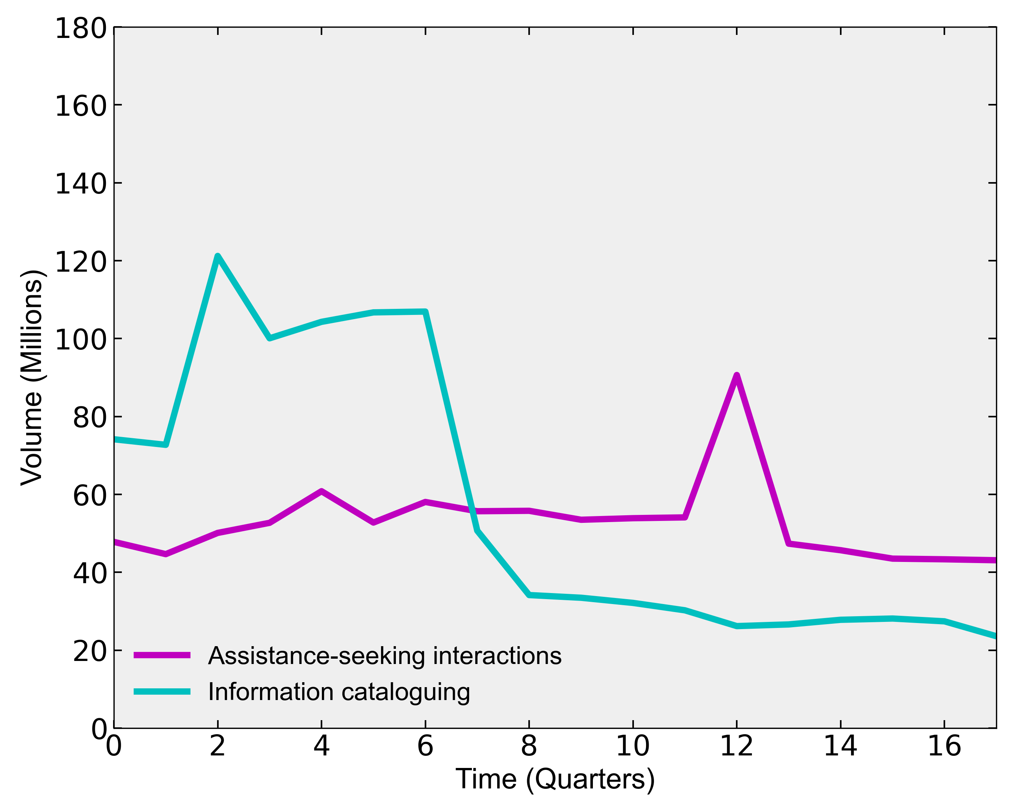
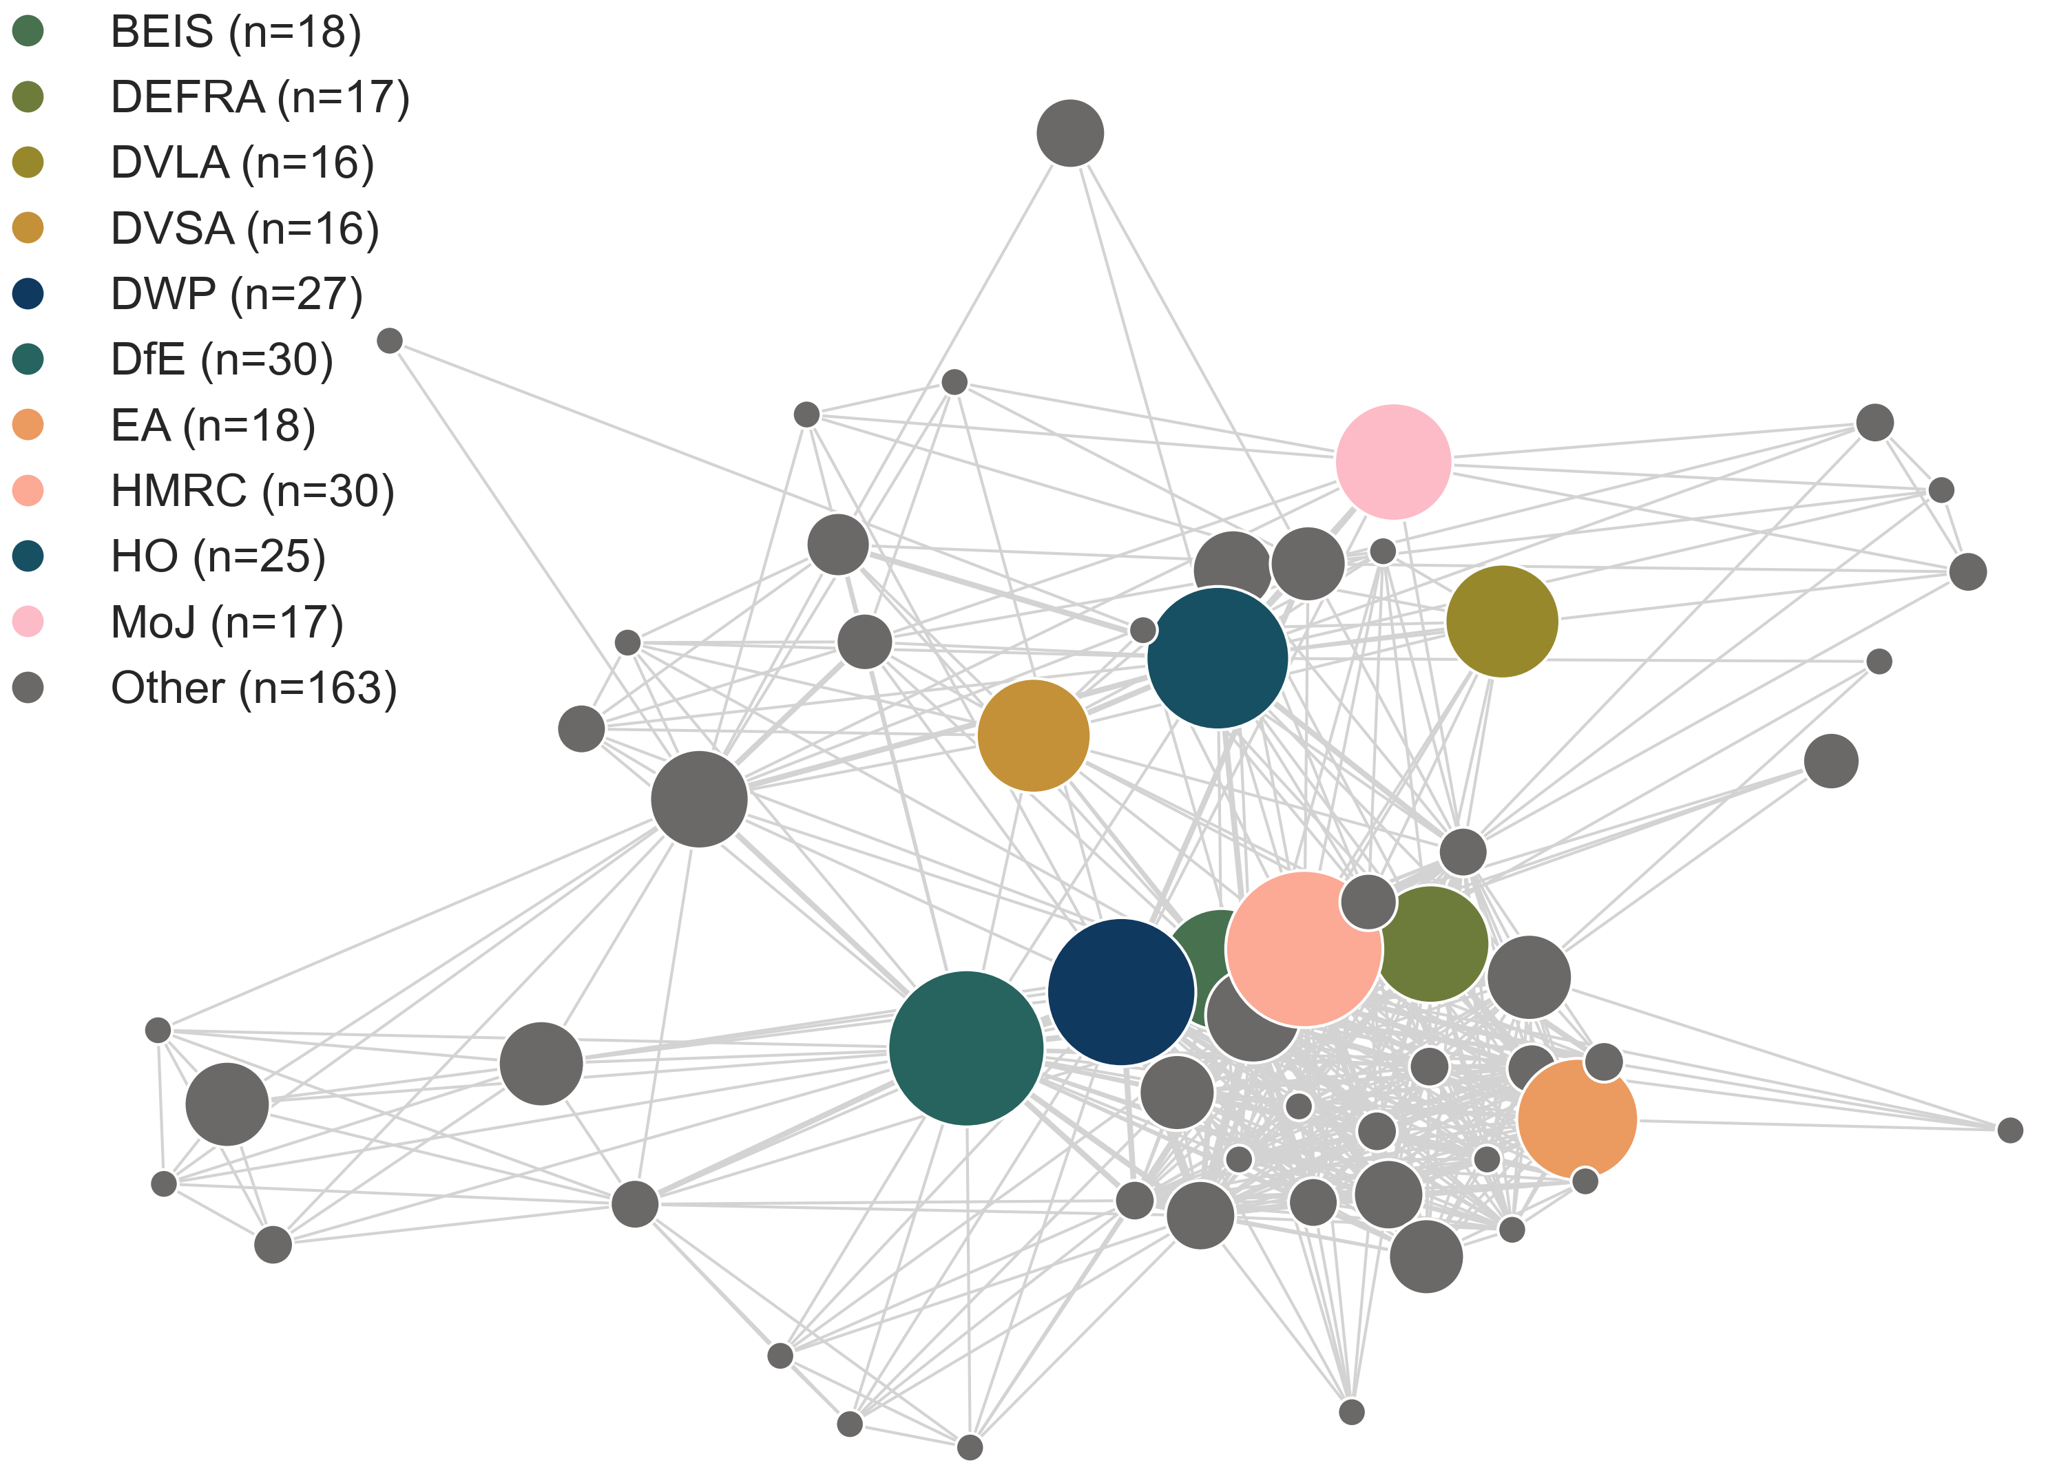
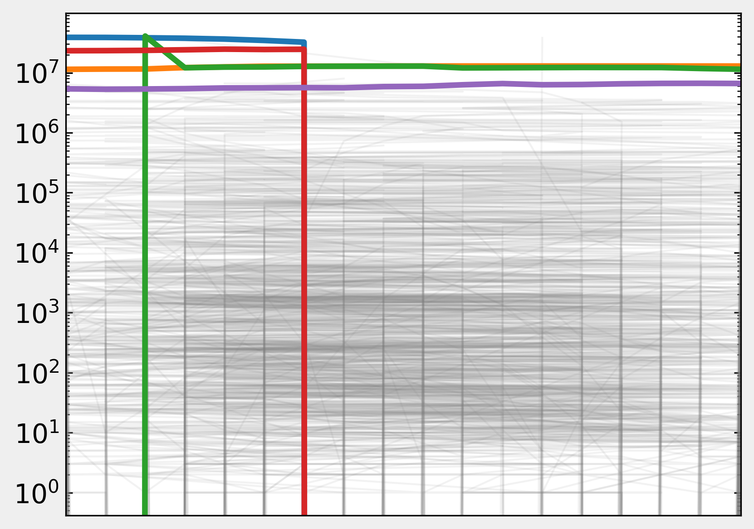
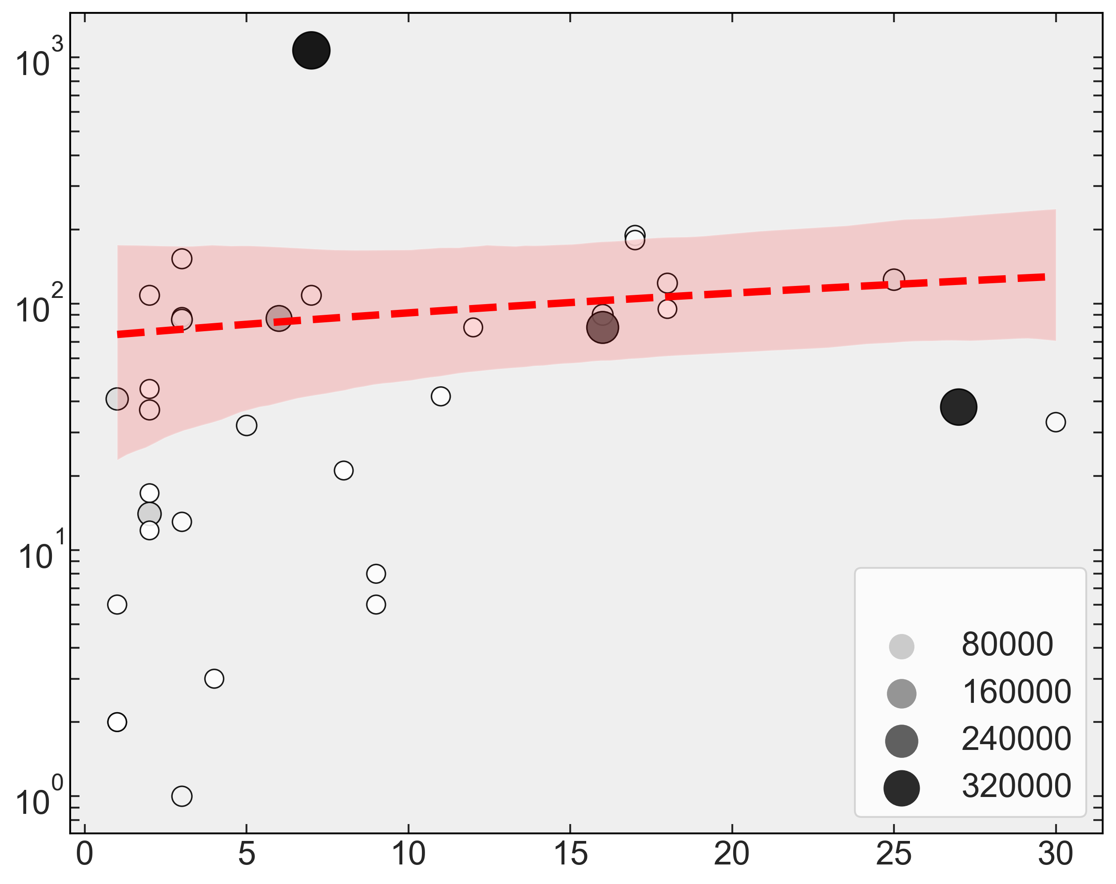
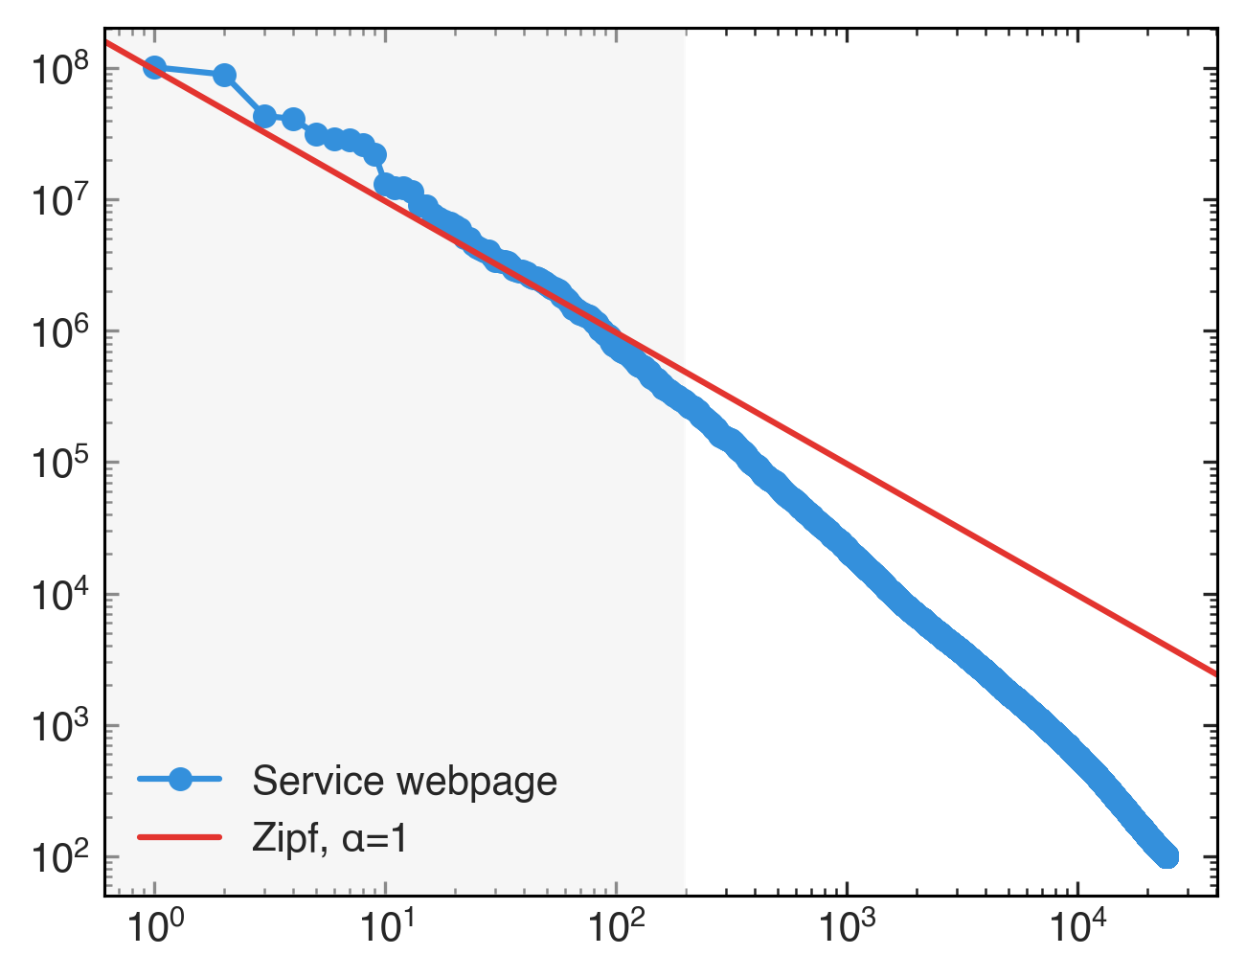
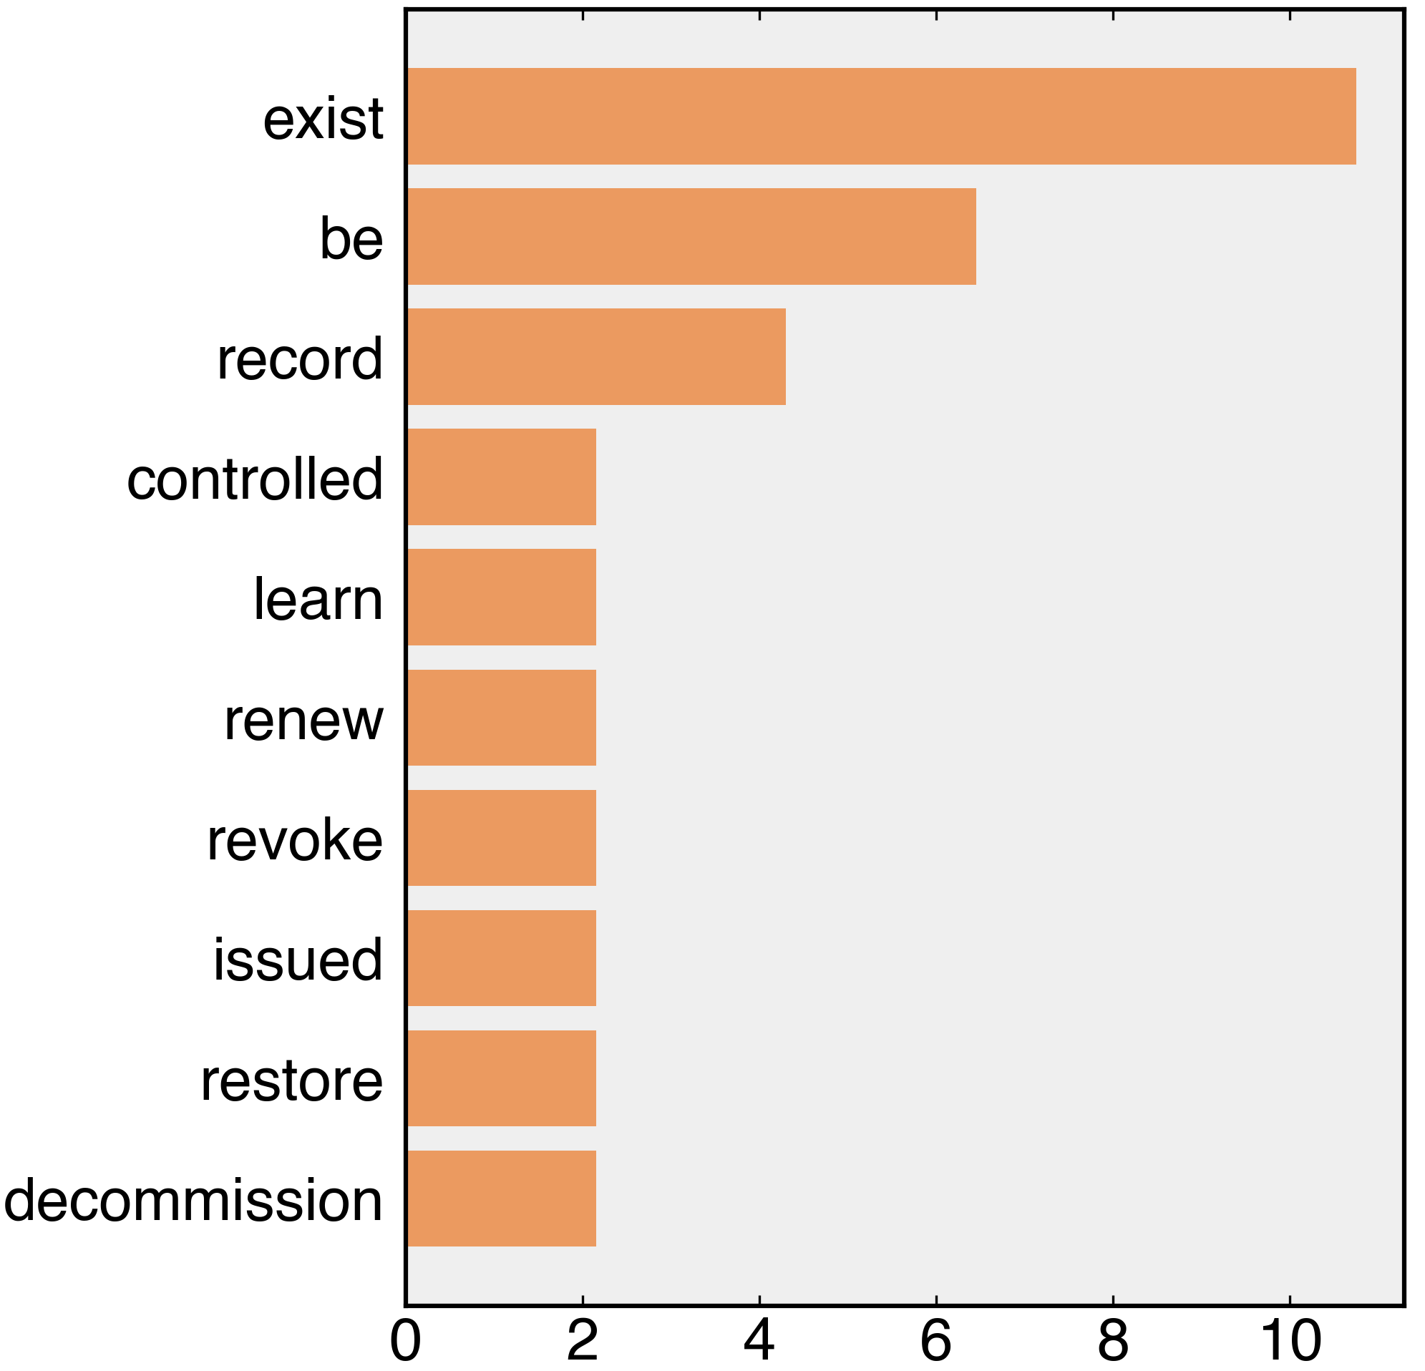
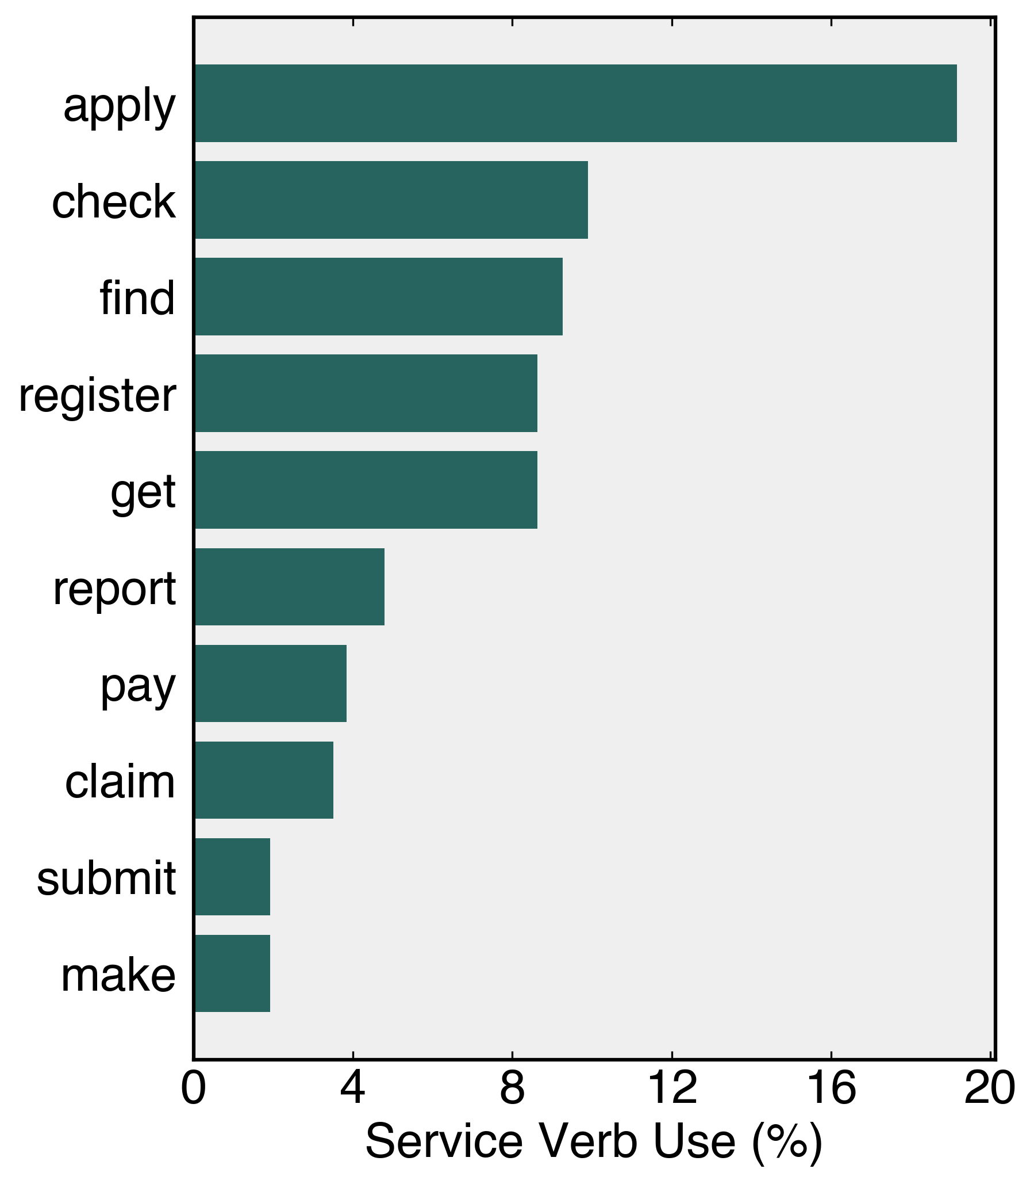
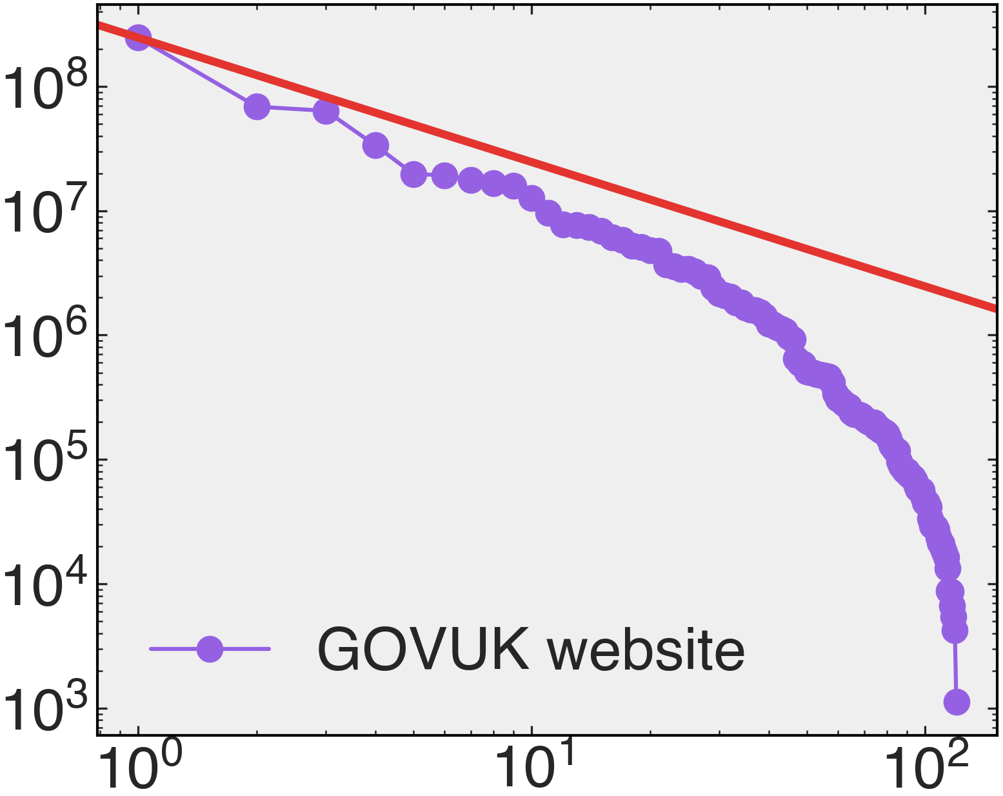
A
B
— State pension claims
— Vehicle registration
— Passport applications
— Jobseeker’s Allowance
— Jobcentre Plus
C
Pearson ρ = 0.38
D
E
2012
2022
HMCTS
/sign-in-universal-credit
/check-mot-history
# Forms
DVLA
DWP
# Visits
/report-covid19-result
Form views
# Services
Rank
Service verb use (%)
Service verb use (%)

Slide 3
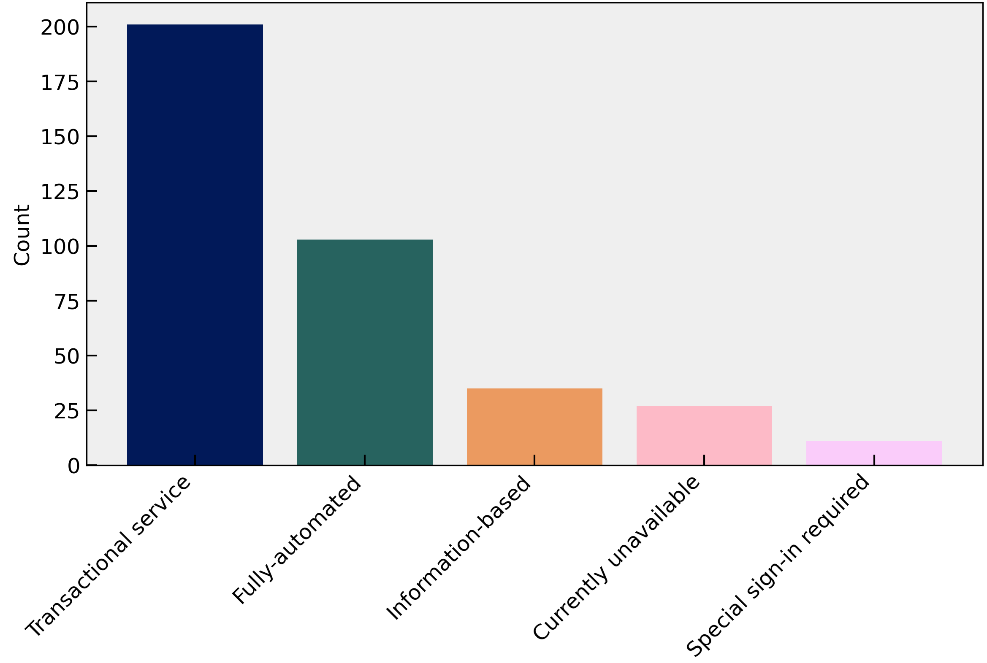
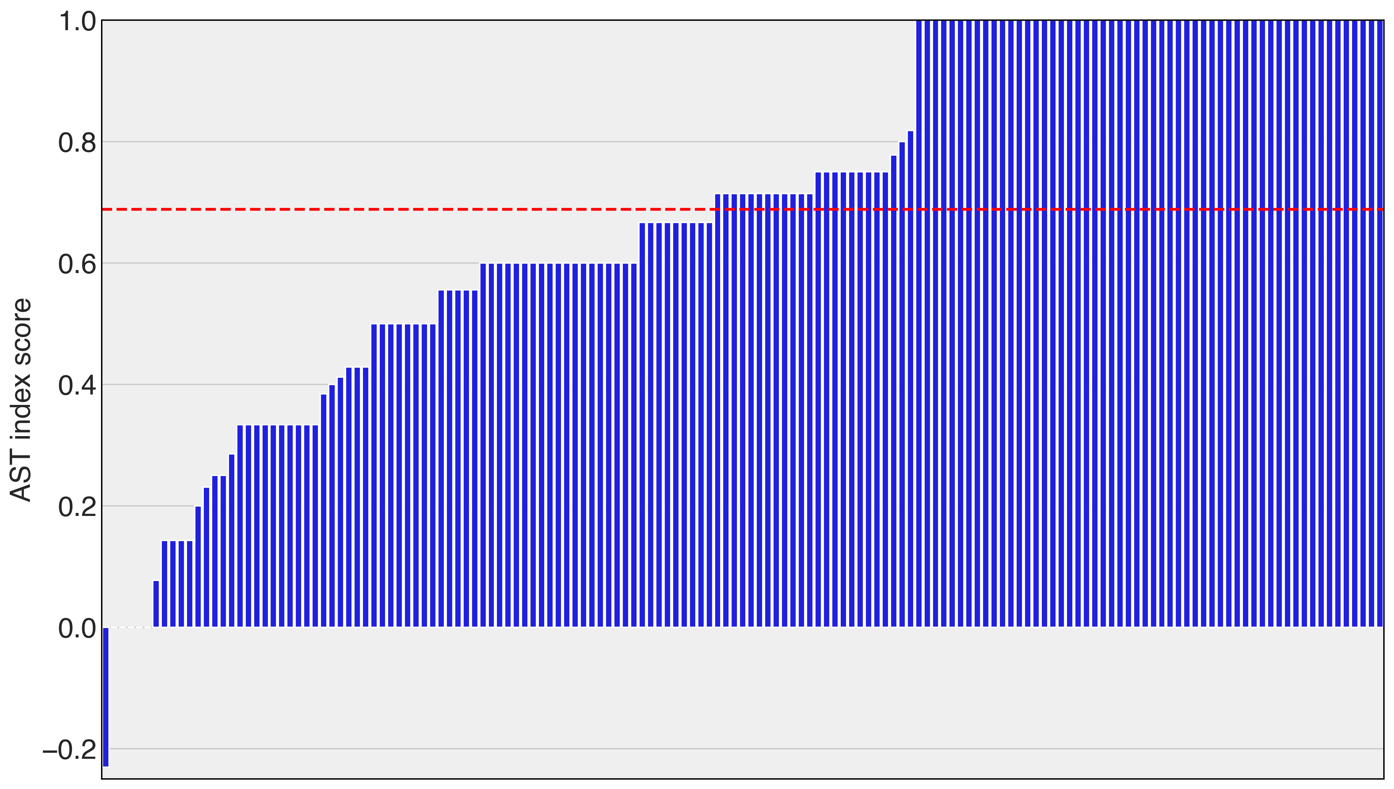
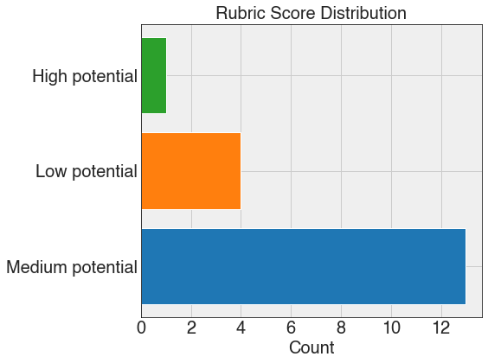
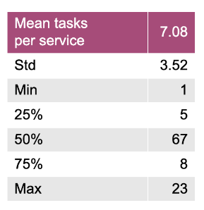
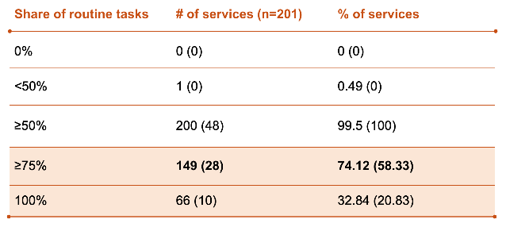
A
B
C
D
E

