Slide 1
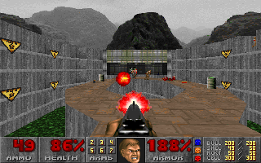
Building an AI-Bot playing the game Doom Applied Deep Reinforcement Learning
Rodolphe Masson
rodolphe.masson8@gmail.com
Hacking Machine Learning Meet-Up
Munich, 2018 May 24
https://github.com/Rodolphe21/AI-Bot_playingDoom

Slide 2
Executive Summary
In this presentation, I will show the results (videos) of my investigations of various deep reinforcement learning techniques, standard deep Q-network (DQN), Replay Memory (RM), Double DQN and Dueling DQN, applied to a software agent whose goal is to play autonomously the game Doom through three different scenarios of increasing complexity, “basic”, “health gathering supreme” and “deadly corridor”, from the ViZDoom Environment.
After having explained what deep reinforcement learning is, described the ViZDoom environment and the three scenarios, I will show the results (videos) of a standard DQN fitted with a Replay Memory. I will show that DQNs perform very well for fully-observable Markov Decision Process (MDP) situations in the ViZDoom environment, not so well for partially-observable MDPs, specifically where the agent needs to learn different skills like navigation & actions.
I will then describe the limitations of standard DQNs for partially-observable MDPs, “temporal difference”, “sparse and delayed rewards” and “overestimation” before showing the results (videos) of a dueling double DQN (Dueling DDQN) fitted with a Replay Memory whose aim is to solve “temporal difference” and “overestimation”. We will see that the “sparse and delayed rewards” issue is very dominant among all the issues and that it overshadows the benefits of dueling DDQN. I will then present further techniques like prioritized experience replay (PER) as another potential improvement of dueling double DQN to contain the “sparse & delayed rewards” issue
I will then conclude on the most promising techniques to pursue this project in the future like Asynchronous Advantage Actor-Critic (A3C) and Direct Future Predictions (DFP)
All references to publications and step-by-step applications are provided

Slide 3
Agenda
Motivation & Context
Reinforcement Learning, MDPs, Q-Learning, Bellman & Next-Best-Action
Deep Q-networks
Exploration vs. Exploitation
Memory Replay
The VizDoom AI environment
3 Scenarios: random & DQN videos
Challenges
2 Improvements: Double DQN, Dueling Architecture DQN
3 scenarios: Double Dueling DQN videos
More techniques: PER, A3C, DFP, DRQN, DARQN, h-DQN, transfer learning, imitation Learning
Conclusions
References, Resources, Acknowledgments, set-up

Slide 4
Motivation & Context
1997
No possible implementation of neural networks
Fascinated by Doom multiplayer mode
20 years later
Curious about self-learning systems
Processing power available for Deep Neural Networks
Decided to deepen this topic: Machine Learning Nano Degree @ Udacity
Capstone project
deep learning
reinforcement learning
the Doom environment

Slide 5
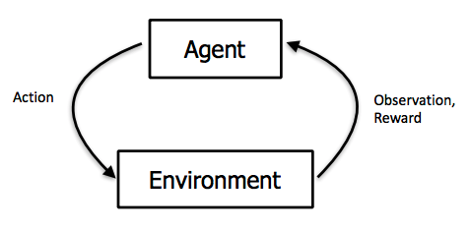
Reinforcement Learning
Supervised Learning
Unsupervised Learning
Reinforcement Learning
= reward learning
No dataset
An environment

Slide 6
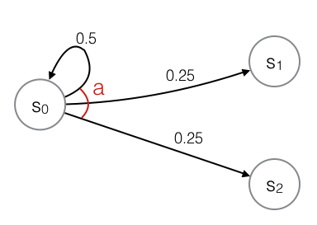
Markov Decision Process (MDP)
The game = the environment
State of the game at time t is s_{t} = the image at time t
action a_{t} => reward r_{t}
This action a_{t} changes the environment and leads to s_{t+1} where the agent can perform another action a_{t+1}
MDP = the list of all transitions {s_{t,} a_{t,} r_{t,} s_{t+1}}
One game episode = finite sequence of transitions
The probability of s_{t+1} = function (s_{t} ; a_{t})

Slide 7
Q-Learning & the Bellman Equation
Model-free learning = the agent learns the policy through training
Q-Learning is used to find the next-best-action for any given state in a finite MDP, i.e. the highest Q-value
This defines the learnt policy π (s) as π(s) = arg_{a}max Q(s,a)
We approximate the Q-function with the Bellman equation:
Q(s_{t}, a_{t}) = r + γ * max_{at+1} Q(s_{t+1}, a_{t+1})
γ = discount factor, typically 0.99
We perform stochastic gradient descent on the Bellman equation, backpropagating the reward through the state space (episode) and averaging over many trials (epochs)

Slide 8
Q-Learning & Next-Best-Action
(intuitively) Q-function = look-up table where the states “s” are rows and actions “a” are columns and the table elements are the Q(s,a), the rewards the agents gets when in state “s” and performing action “a”. The next-best-action to be performed by the agent at any state is the action with the highest reward
Pseudo-code
Observe initial state s
Repeat
Select and carry out action a
Observe reward r and move to new state s’
Q(s,a) <= Q(s,a) + α*(r + γ*max_{a’}Q(s’,a’) – Q(s,a))
s = s’
Until game over
α is the learning rate

Slide 9
Deep Q-Network (DQN) as Q-Function
In our implementation, a state s = a frame provided by the Doom Game, a frame of size 30 x 45 with 256 grey levels and 3 possible actions for the “basic” scenario” (strafe_right, strafe_left, fire) => state space of dimension 30 x 45 x 256 x 3 = ~1 million
CNNs are perfect candidates for the Q-Function
local connectivity => avoid improbable pixel combinations
generally very good at finding good features out of structured data like images
CNN Implementation
fully connected layers
no pooling layers because the locations of the features in the image are important
How do we know the network has learnt?
Minimizing the difference of the squared error between
the current value of Q(s,a) (known at the beginning of the iteration)
the computed value in terms of the sum of the reward and discounted Q-value(s’,a’) one step into the future (calculated with the Bellman equation)
Loss function to be minimized: L = ½ * [r + γ*max Q(s’, a’) - Q(s,a)]²

Slide 10
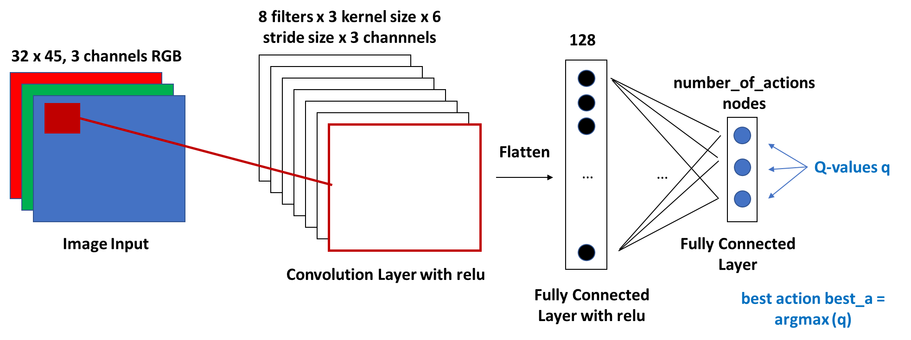
DQN Architecture

Slide 11
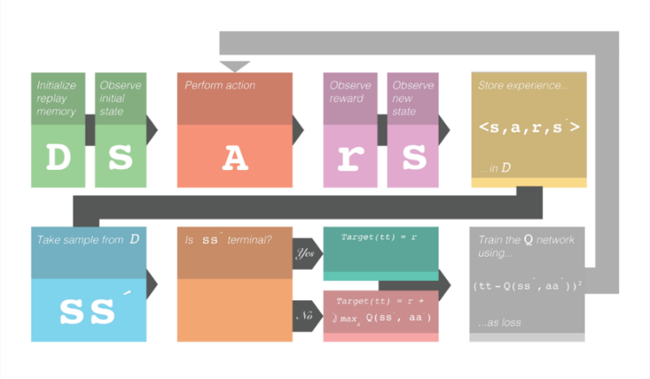
Replay Memory
https://www.kdnuggets.com/2017/09/5-ways-get-started-reinforcement-learning.html

Slide 12
Exploration / Exploitation
s1 = preprocess(game.get_state().screen_buffer)
# With probability eps, makes a random action
eps = exploration_rate(epoch)
if random() <= eps:
a = randint(0, len(actions) - 1) # random action
else:
a = get_best_action(s1) # the next best action according to the network
reward = game.make_action(actions[a], frame_repeat) # collects reward from game

Slide 13
The VizDoom Environment
Doom-based AI research platform for reinforcement learning from raw visual information
Allows developing AI bots that play Doom using only the screen buffer
ViZDoom is primarily intended for research in machine visual learning and deep reinforcement learning.
The developers of this environment are: Michal Kempka, Grzegorz Runc, Jakub Toczek, Marek Wydmuch and Wojciech Jaskowski from the Institute of Computing Science, Poznan University of Technology, Poland
The home of ViZDoom http://vizdoom.cs.put.edu.pl/
Tutorial http://vizdoom.cs.put.edu.pl/tutorial
GitHub repo https://github.com/mwydmuch/ViZDoom

Slide 14
The VizDoom API
The object "game" gets instantiated with game = DoomGame()
game.init() : starts the environment
game.load_config() : loads configuration files
game.set_window_visible() : "true" for watching, "false" for (offline) training/testing
game.set_mode() : player, spectator etc.
game.set_screen_format() : selects screen format
game.set_screen_resolution() : selects screen resolutions
game.new_episode() : starts a new episode
game.is_episode_finished() : "true" means the episode is finished (to test ends of game condition)
game.close() : closes the window
game.get_available_buttons_size() : collects available actions the agent can do (defined in configuration file)
These are the routines used for the agent-environment interactions:
game.get_state().screen_buffer : gets a frame (=a state), raw visual inputs
game.make_action() : get the agent execute the action in the current frame
game.set_action(), game.advance_action() : same as game.make_action(), smooth rendering for watching the agent play
game.get_total_reward() : collects reward from the environment

Slide 15
Set-up
AMD A9, 5 compute cores 2C +3G, 3GHz
12GB RAM
ubuntu 16.04 / VMware / 64 bit Win10
VizDoom 1.1.4
Python 2.7.12
TensorFlow 1.5.0

Slide 16
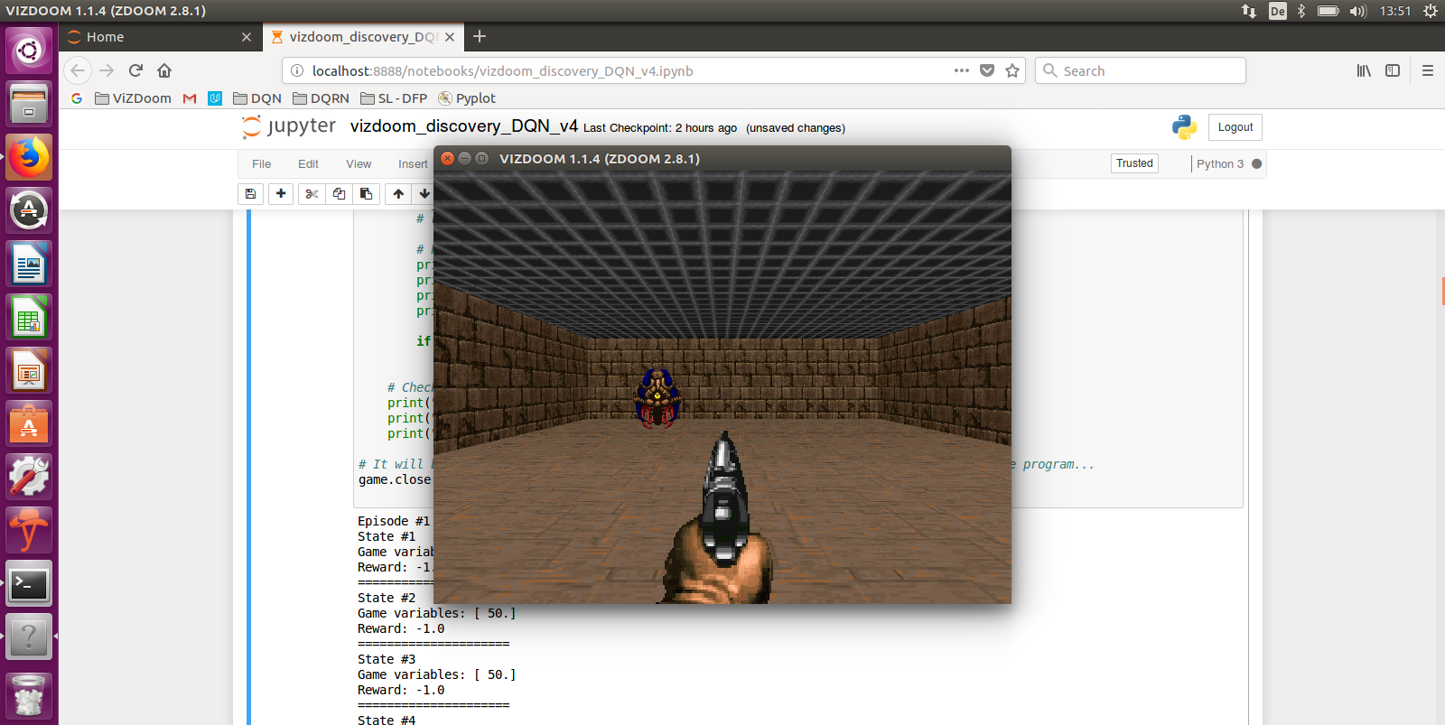
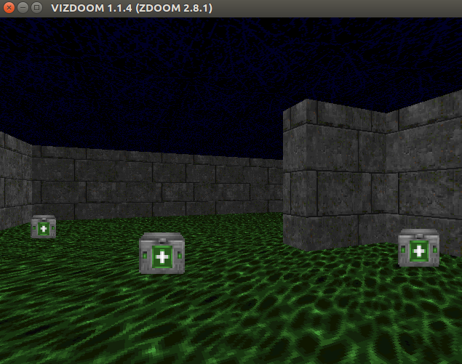
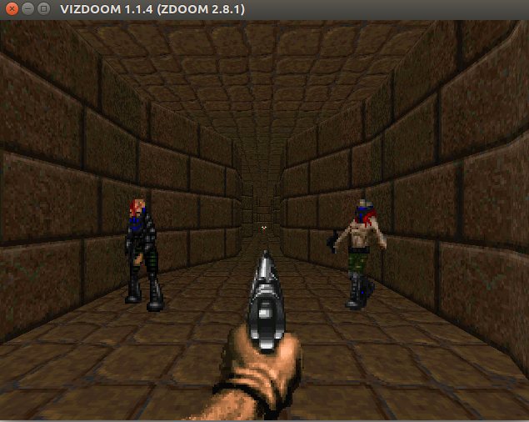
Random walks
“Basic” “Health Gathering” “Deadly Corridor”
https://youtu.be/WsG09c5YHng https://youtu.be/jxYesqMhx1Q https://youtu.be/fGpUp8b1m-E
Fully-observable Navigation & Targeting Navigation & Targeting

Slide 17
Standard DQN
“Basic” “Health Gathering” “Deadly Corridor”
Fully-observable Navigation & Targeting Navigation & Targeting
https://youtu.be/KiaKKpqLlBU https://youtu.be/G7LBuRdrXl0 https://youtu.be/UbtQP0CIdJY
1 Conv Layer, 40 epochs 1 Conv Layer, 40 epochs 1 Conv Layer, 40 epochs
=> Excellent => Navigation ~OK => Targeting ~OK

Slide 18
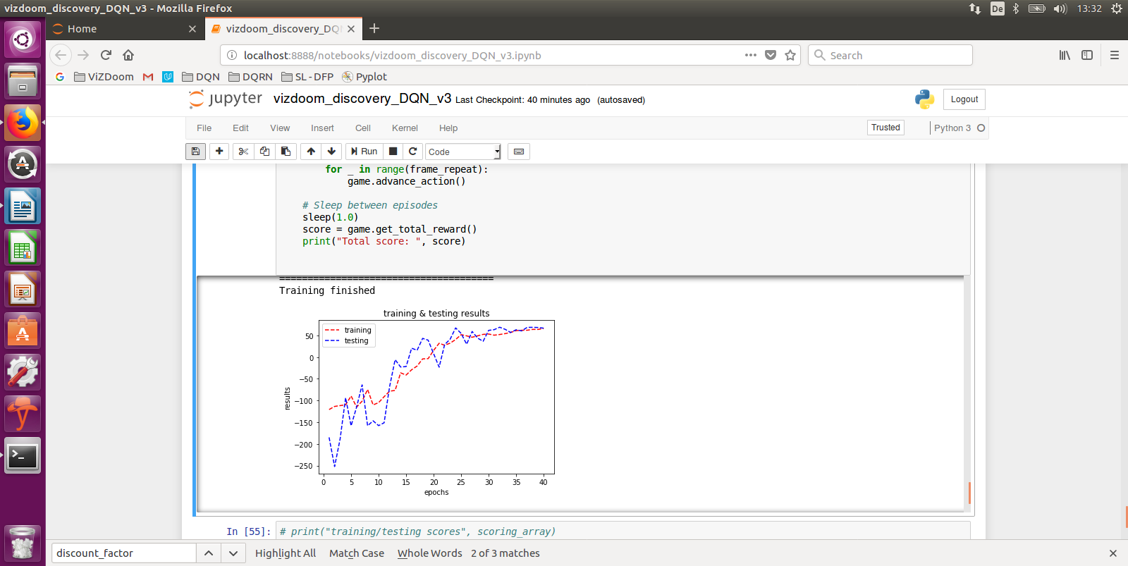
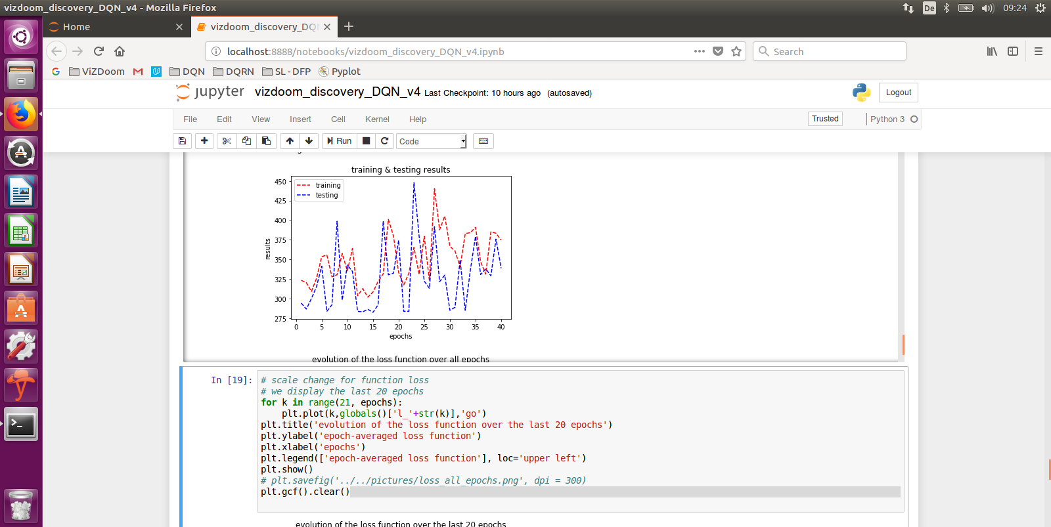
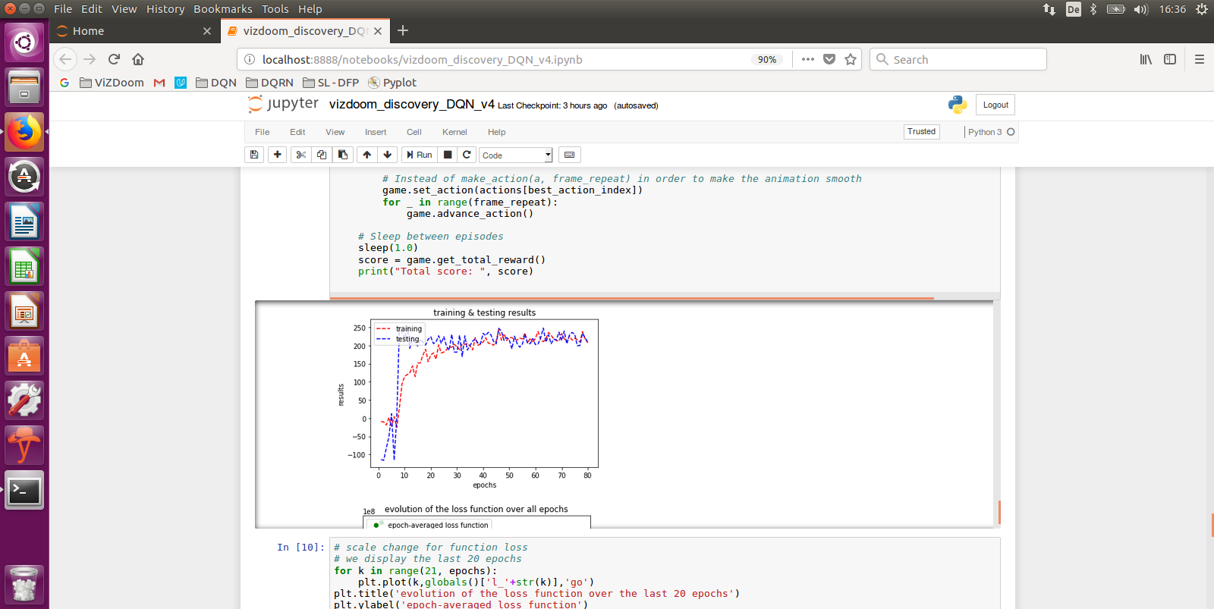
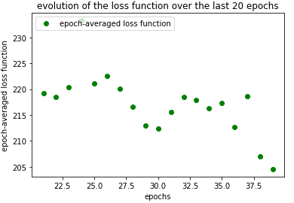
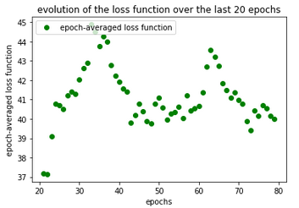
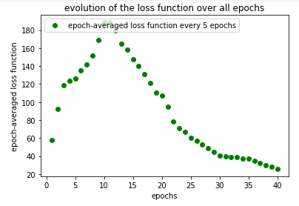
“Basic” “Health Gathering” “Deadly Corridor”
1 Conv Layer, 40 epochs 1 Conv Layer, 40 epochs 1 Conv Layer, 40 epochs
=> Excellent => Navigation ~OK => Targeting ~OK

Slide 19
Challenges
Temporal correlations
Agent observations are strongly correlated in time and the latest observation is more important than earlier ones, creating data imbalance => Replay Memory: randomly selected transitions (experiences) from the past train the network
Fully vs. Partially Observable Environments
The Q-Learning model makes the strong assumption that the agent has the full knowledge of the current state of the environment
Overestimation of action values
The single estimator used in Q-Learning approximates the “maximum expected action” with the “maximum action value”
Sparse & delayed rewards
The consequence of an agent action can materialize after many transitions in the environment: this is the “credit assignment” problem or “n-step Q-Learning” case
Learning different skills like navigation and action

Slide 20
Technique / Improvement 1: Double DQN
Van Hasselt et al. (2015)
Issue with standard DQN: the max operator uses the same values to both select and evaluate an action (overestimation)
Double DQN decouples selection from evaluation, i.e. evaluates the policy according to the online network but using the target network to estimate its value
The parameters are updated as follows:
Θ_{t+1} = Θ_{t} + α ( y_{t}^{Q} - Q(s_{t}, a_{t} ; Θ_{t}) ) Ƞabla Θt ( Q (S_{t}, a_{t}; Θ_{t}) )
…where y_{t}^{Q} = R_{t+1} + γ max_{a} Q(s_{t+1}, a; Θ_{t})
This can be achieved with a minor change to the DQN algorithm, replacing y_{t}^{Q} with:
Y_{t}^{D-DQN} = R_{t+1} + γ Q ( s_{t+1}, arg_{a}max Q(s_{t+1}, a_{t}; Θ_{t}); Θ_{t}⁻)
…where Θ_{t} are the parameters of the online network and Θ_{t}⁻ are the parameters for the target network
These two networks Θ_{t} and Θ_{t}⁻ are the two value functions. For each update, one set of weights is used to determine the policy and the other to determine its value
The target network Θ_{t}⁻ is a periodic copy of the online network Θ_{t}

Slide 21
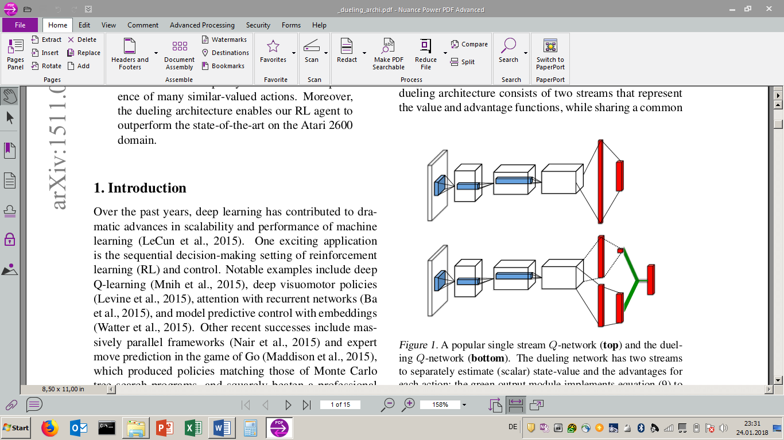
Technique / Improvement 2: Dueling Architecture
Wang et al. (2016)
Separately estimate the state value function V(s) and its associated advantage function A(s,a), then combines them to estimate action value function Q(s,a)
While for some states it is of utmost importance to know which action to take, for many states it is unnecessary to estimate the value of each action choice for many states. This architecture learns which states are or aren’t valuable without having to learn the effects
Q(s, a; θ, α, β) = V(s; θ, β) + [ A(s,a; θ, α) – (1/A) * Σ_{a’} A(s, a’; θ, α) ]
θ are the parameters of the convolution layers and α, β the parameters of the fully-connected layers

Slide 22
Dueling Double DQN
“Basic” “Health Gathering” “Deadly Corridor”
Fully-observable Navigation & Targeting Navigation & Targeting
https://youtu.be/Ny4008kaqL0 https://youtu.be/nP39eapBCq4 https://youtu.be/vw6cOEkcUn8
1 Conv Layer, 80 epochs 2 Conv Layers, 120 epochs 2 Conv Layers, 120 epochs
=> Excellent => not convincing => targeting ~OK but not convincing

Slide 23
Technique 3: Prioritized Experience Replay (PER)
Schaul et al. (2016)
The agent can learn better policies when the network is not trained on batches of (uniformly) randomly-sampled transitions from the Replay Memory, regardless of the significance of the experience, but from carefully-selected batches of transitions
replaying frequently “important” transitions for the agent to learn more efficiently (sparse & delayed rewards challenge), where the “importance” of a transition is measured by its Temporal Difference (TD)
Each transition is stored in the Replay Memory with its TD parameter and a stochastic prioritization based on these TDs samples the transitions

Slide 24
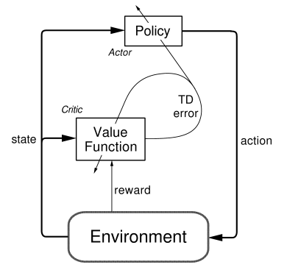
Technique 4: Async Advantage Actor-Critic (A3C)
Mnih et al. (2016)
Parallel “actors” situated in their own and independent environments to run more exploration
A3C then combines advantage updates with the actor-critic concept and relies on asynchronously updated policy and value function networks trained in parallel over several processing threads
A3C generalizes quite good in 3D mazes using visual inputs, where an agent will face a new maze in each new episode, i.e. the agent has learnt a general strategy to explore random mazes.

Slide 25
Technique 5: Direct Future Prediction (DFP)
Dosovitskiy et al. (2017) from Intel
Instead of a monolithic state and scalar reward, they consider a stream of sensory inputs {s(t)} and a stream of measurements {m(t)}, that provides rich and temporally dense supervisions that can stabilize and accelerate training
A multidimensional stream of sensations is a more appropriate model for an organism that is learning to function in an immersive environment
Supports training without a fixed goal and pursuing dynamically specified goals at test time
At test time, the agent can predict future measurements given its current sensory inputs, measurement and goal, and then simply select the action that best suits its present goal
Generalizes across environments and goals, as proven during the latest Visual Doom AI Competition where it worked well in previously unseen environments
Impressive approach: https://www.youtube.com/watch?v=rPKwMWFo7Nk

Slide 26
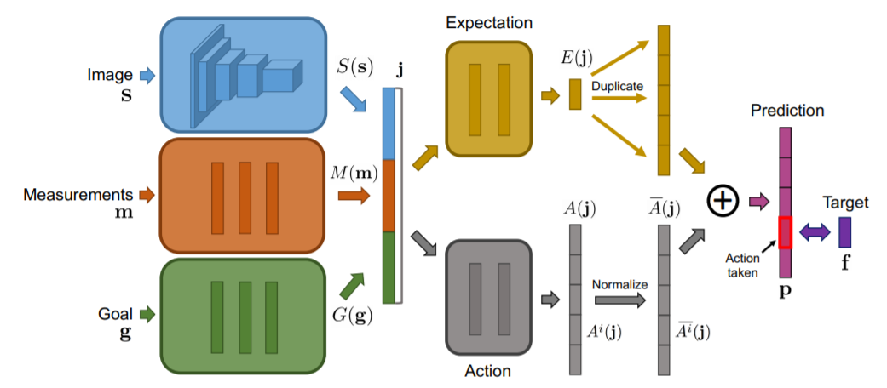
Technique 5: Direct Future Prediction (DFP)

Slide 27
Technique 6: Imitation Learning
We store the transitions observed from a human being playing the game in the replay memory
Useful starting replay memory that leads to a well trained neural network / less exploration

Slide 28
Technique 7: Deep Recurrent Q-Networks (DRQN) & Deep Attention Recurrent Q-Networks (DARQN)
Hausknecht et al. (2017)
Leverages a Recurrent Neural Network (RNN) to deal with Partially Observable MDPs by integrating information over long time periods
Recurrent connections provide an efficient means of acting conditionally on temporarily distant prior observations
Further improvements have been gained by introducing “attention”, a technique where additional connections are added from the recurrent units to lower layers
“Attention” gives a network the ability to choose which part of its next input to focus on

Slide 29
Technique 8: Hierarchical DQN (h-DQN)
Kulkarni et al. (2016)
Hierarchical Reinforcement Learning is a way to learn, plan and represent knowledge with a spatio-temporal abstraction at multiple levels
H-DQN for organizing goal-driven deep RL modules hierarchically to work at different time scales
H-DQN integrates a “top-level action” value function and a “lower level action” value function
the former learns a policy over intrinsic sub-goals or “options”
the latter learns a policy over raw actions to satisfy given sub-goals

Slide 30
Technique 9: Transfer Learning
Closing the reality gap between Deep Reinforcement Learning policies learned in simulated environments and the real-world domain
The core idea of transfer is that experience gained in simulation can help improve learning performance in a related, but different, environment

Slide 31
Conclusions
Self-learning Bots in pseudo 3D-environments = still a challenge
Even more challenging for self-driving cars where different fields are combined: computer vision, sensor fusion, artificial/simulated learning environments
Next-Best-Action in Customer Service and one-to-one Marketing for personalized and contextual customer conversations are available today (combination of predictive analytics & adaptive modeling)
www.pega.com/about

Slide 32
References
Arulkumaran Kai, Deisenroth Marc Peter, Brundage Miles, Bharath Anil Anthony, “A Brief Survey of Deep Reinforcement Learning”, Sept 28th, 2017, http://arxiv.org/pdf/1708.05866.pdf
Dosovitskiy Alexey, Koltun Vladlen, Intel Labs, “Learning to Act by Predicting the Future”, Feb 14th, 2017, https://arxiv.org/pdf/1611.01779.pdf, youtube link: https://www.youtube.com/watch?v=rPKwMWFo7Nk
Gulli Antonio, Pal Sujit, “Deep Learning with Keras”, Packt, 2017
Hausknecht Matthew, Stone Peter, “Deep Recurrent Q-Learning for Partially Observable MDPs”, Jan 11th, 2017, https://arxiv.org/abs/1507.06527
Kempka Michal, Wydmuch Marek, Runc Grzegorz, Toczek Jakub, Jaskowski Wojciech, “ViZDoom: A Doom-based AI Research Platform for Visual Reinforcement Learning”, Sep 20th, 2016, https://arxiv.org/pdf/1605.02097.pdf
Kulkarni Tejas D., Narasimhan Karthik R., Saeedi Ardavan, Tenenbaum Joshua B., “Hierarchical Deep Reinforcement Learning: Integrating Temporal Abstraction and Intrinsic Motivation”, May 31st, 2016, https://arxiv.org/abs/1604.06057
Lample Guillaume, Singh Chaplot Devendra, “Playing FPS Games with Deep Reinforcement Learning”, Sep 18th, 2016, https://arxiv.org/pdf/1609.05521.pdf
Li Yuxi, “Deep Reinforcement Learning: An Overview”, Sept 15th, 2017, http://arxiv.org/pdf/1701.07274.pdf
Mnih Volodymyr, Puigdomènech Badia Adrià, Mirza Mehdi, Graves Alex, Lillicrap Timothy P., Harley Tim, Silver David, Kavukcuoglu Koray, “Asynchronous Methods for Deep Reinforcement Learning”, June 16th, 2016, https://arxiv.org/pdf/1602.01783.pdf
Schaul Tom, Quan John, Antonoglou Ioannis, Silver David, “Prioritized Experience Replay”, Feb 25th, 2016, https://arxiv.org/pdf/1511.05952.pdf
Serban Iulian V., Sankar Chinnadhurai, Germain Mathieu, Zhang Saizheng, Lin Zhouhan, Subramanian Sandeep, Kim Taesup, Pieper Michael, Chandar Sarath, Ke Nan Rosemary, Rajeshwar Sai, de Brebisson Alexandre, Sotelo Jose M. R., Suhubdy Dendi, Michalski Vincent, Nguyen Alexandre, Pineau Joelle, Bengio Yoshua, “A Deep Reinforcement Learning Chatbot”, Nov 5th 2017, http://arxiv.org/pdf/1709.02349.pdf
Sorokin Ivan, Seleznev Alexey, Pavlov Mikhail, Fedorov Aleksandr, Ignateva Anastasiia, “Deep Attention Recurrent Q-Network”, Dec 5th, 2015, https://arxiv.org/abs/1512.01693
Sutton S. Richard, Barto G. Andrew, “Reinforcement Learning: An Introduction”, 2nd Edition in progress, Nov 5th, 2017, http://www.incompleteideas.net/book/bookdraft2017nov5.pdf
van Hasselt Hado, Guez Arthur, Silver David, “Deep Reinforcement Learning with Double Q-learning”, Dec 8th, 2015, https://arxiv.org/pdf/1509.06461.pdf
Wang Ziyu, Schaul Tom, Hessel Matteo, van Hasselt Hado, Lanctot Marc, de Freitas Nando, “Dueling Network Architectures for Deep Reinforcement Learning”, April 5th, 2016, https://arxiv.org/pdf/1511.06581.pdf

Slide 33
Resources
Github
https://github.com/Rodolphe21/AI-Bot_playingDoom
Notebook “ViZDoom Discovery”
Notebook “Basic DQN”
The link to Michal Kempka’s GitHub repo
This report in pdf format
Scenario „Basic“
Agent performs random actions: https://youtu.be/WsG09c5YHng
Standard DQN, 1 conv layer, 40 epochs: https://youtu.be/KiaKKpqLlBU
Dueling Double-DQN, 1 conv layer, 80 epochs: https://youtu.be/Ny4008kaqL0
Scenario “Health Gathering Supreme”
Agent performs random actions: https://youtu.be/jxYesqMhx1Q
Standard DQN, 1 conv layer, 40 epochs: https://youtu.be/G7LBuRdrXl0
Dueling Double-DQN, 2 conv layers, 120 epochs: https://youtu.be/nP39eapBCq4
Scenario “Deadly corridor”
Agent performs random actions: https://youtu.be/fGpUp8b1m-E
Standard DQN, 1 conv layer, 40 epochs: https://youtu.be/UbtQP0CIdJY
Dueling Double-DQN, 2 conv layers, 120 epochs: https://youtu.be/vw6cOEkcUn8

Slide 34
Acknowledgments
A BIG Thank you! to the Udacity Team for the support and for the comprehensive Machine Learning Nano Degree. This has been a great learning experience!
A BIG Thank you! to Michal Kempka & Team from the Institute of Computing Science, Poznan University of Technology, Poland for the comprehensive AI-Bot development Platform ViZDoom and for their great support: Dziękuję bardzo i tak trzymać!

