Slide 1
How computers work

Slide 2
Fundamentally, computers:

Slide 3
The romantic view

Slide 4
The romantic view, mixed with reality

Slide 5
The optimistic view

Slide 6
The sad reality

Slide 7
Issues to be raised…
How do we keep track of what we’ve done?
How do we know that what we’ve done is right?
Correct process?
Computer actually worked?
How can we do things faster/more efficiently?
How do we tell the computer what to do, anyway??

Slide 8
Issues to be raised…
How do we keep track of what we’ve done?
How do we know that what we’ve done is right?
Correct process?
Computer actually worked?
How can we do things faster/more efficiently?
How do we tell the computer what to do, anyway??

Slide 9
Issues to be raised…
How do we keep track of what we’ve done?
How do we know that what we’ve done is right?
Correct process?
Computer actually worked?
How can we do things faster/more efficiently?
How do we tell the computer what to do, anyway??

Slide 10
Efficiency
Cost/resource tradeoff.
Faster and slower ways of doing things.
Computers don’t work like people :)
Simple, automated, explicit tasks => computer
Judgement, intuition, creativity => human

Slide 11
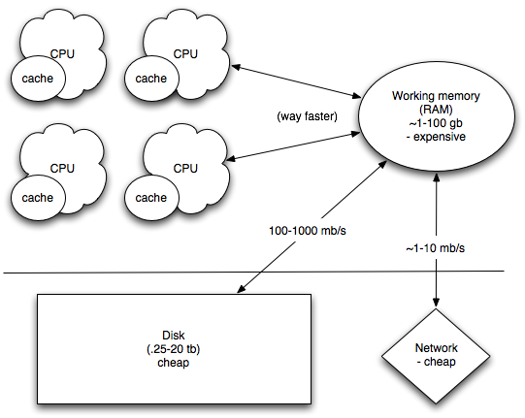
Computer architecture

Slide 12
Computer architecture
Computation is cheap

Slide 13
Computer architecture
Communication between CPUs is pretty cheap.

Slide 14
Computer architecture
Retrieving/sending data from/to the disk or the network is slow.

Slide 15
Computer architecture
Retrieving/sending data from/to the disk or the network is slow.

Slide 16
Issues to be raised…
How do we keep track of what we’ve done?
How do we know that what we’ve done is right?
Correct process?
Computer actually worked?
How can we do things faster/more efficiently?
How do we tell the computer what to do, anyway??

Slide 17
Telling the computer what to do
Translating your will => computer effort is technically challenging!
Shell commands (a few days to a few months)
Scripting (a few weeks to a few years)
Programming (a few months to a lifetime)
Have to meet the computer halfway…
Most important bit? Manipulating files and executing programs => “shell”

