Slide 1
Cloud computing

Slide 2
What is cloud computing?
(for scientists)
You can “rent” access to computers and disk space from a commercial provider of same.
This provides you with a way to scale your computation for “burst” periods, without investing in hardware.
Or you can just use a bigger, faster computer.
(I will demonstrate.)

Slide 3
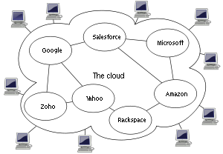
Why “cloud”?!
…because the diagram that CS people use to represent abstract compute resources looks like a cloud.

Slide 4
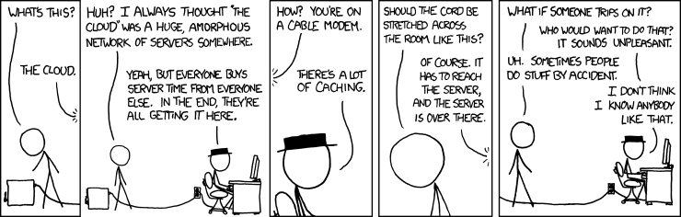
xkcd.com

Slide 5
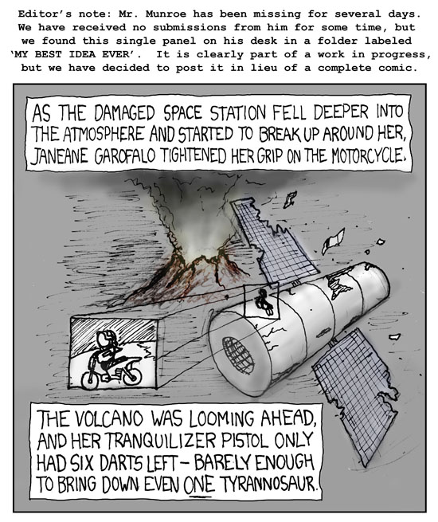

Slide 6
Amazon is a major cloud computing provider
Did you know they rent computers!?
Rumors are that it’s more lucrative than their book selling division…

Slide 7
Terms
EC2 – Elastic Cloud Computing, computer rental from Amazon.
EBS – Elastic Block Storage, virtual hard drive rental from Amazon.

Slide 8
Some quick calculations:
1 small machine, / yr:
1.7gb of RAM, a ~1.0 GHz single-core CPU, 160gb of local disk.
$.06 / hr
8760 hrs / year
=> ~$525/ year.
~a somewhat effective server replacement.

Slide 9
1 high-memory quadruple extra-large instance / yr:
68.4 gb of RAM, 8 core @ ~3.2 GHz, 1.7tb of local disk.
$1.64 / hr
8760 hrs / year
=> $14,400 / year

Slide 10
20 high-CPU extra large machines, for a day:
7gb of RAM, 8 x 2.5 GHz CPUs, 1.7tb of local disk.
$0.58 / hr
24 hrs / day
20 machines
=> ~$278/ day.

Slide 11
Why is EC2 so expensive??
They cover all hardware, power, air conditioning and network costs.
That’s actually way more expensive than you think. (Talk to your sysadmin or HPC person…)
They do not operate at 100% capacity,
They want to make $$.

Slide 12
What are we using it for?
Teaching workshops and classes.
Running our own analyses/data sets in a timely manner.
Sharing data within the lab via EBS snapshots.
Providing data to other people via S3.
Automated testing on clean machines with known software install.

Slide 13
Today’s tutorials
Create (rent) a new machine from Amazon.
Install NCBI BLAST
Download & format some databases
Run BLAST
Produce an excel spreadsheet of best hits
…
Run 2-way BLAST (ecoli x ecoli strains)
Calculate reciprocal best hits
Produce an excel spreadsheet of putative orthologs

