Slide 1
Welcome!

Slide 2
Challenge #1:
Most biologists don’t know much about computational science.
Among many biologists, there is a general fear or skepticism of computers.
This leads to shallow thinking about computational science.

Slide 3
Challenge #2:
Most computational scientists don’t know much about biology.
Extant computational solutions may not use appropriate heuristics, or default parameters.
“It works on my data…”, but their data != yours!
Solutions/programs may not be couched in the right terms for the biology, or with proper appreciation for biological complexity.

Slide 4
Challenge #3:
Both biology and computational science are deep, complex fields of study, inhabited by extremely smart people!
None of this is easy, on any side of things.
If it were easy, they wouldn’t need people as smart as all of us to do it, right??
A one week course can’t possible teach you everything.

Slide 5
Challenge #4:
Sequencing technology is changing very fast.
We don’t understand its limitations or biases very well.
The software and compute infrastructure lags behind volume of data, type of data.

Slide 6
None of this is the #1 problem you will face with bioinformatics.
Here is the #1 problem:
How do you know if your computational answer is right or wrong?

Slide 7
None of this is the #1 problem you will face with bioinformatics.
Here is the #1 problem:
How do you know if your computational answer is right or wrong?
If you can’t answer this question, then what’s the point of doing the computation?

Slide 8
Controls
Just as with experiments, you can put negative and positive controls in your bioinformatics.
e.g. with BLAST,
Do you see expected matches with the parameters and database you’re using?
Positive controls are often easier than negative, in “discovery-driven” science…

Slide 9
Internal controls
Molecules and sequences for which you have expectations.
“I know this gene comes up, based on qPCR. I expect to see it in my mRNAseq.”

Slide 10
External controls
Does the whole process work?
“I can reproduce what this other person/lab did, with their data, when I use my own software.”
This is much more rarely done…

Slide 11
Black box nature of algorithms
When you listen to a computational biologist explain their clever algorithm…
…it’s a mistake to think that they necessarily know what’s going on.
Software is full of bugs and unintended consequences.

Slide 12
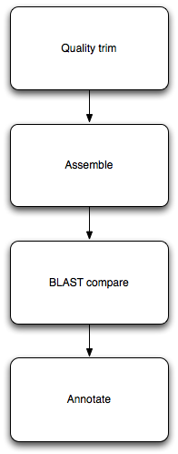
Pipelines
Each step can be understood, and tested/controlled individually.
Each step is re-usable! Just need to figure out input/output formats.
Automate, automate, automate.

Slide 13
The opportunity:
The sequence is here.
“In the land of the blind, the one eyed is king.” -- those prepared to think about how to use sequencing technology to answer their question will have a substantial leg up.
Who knows? Some of you might even like this mix!

Slide 14
Our goals
Provide a “safe place” to experiment.
Lots and lots of help (in the form of TAs)
Provide data sets, tools, scripts.

Slide 15
Our requirements of you
Nothing.
This is a requirements free zone.

Slide 16
Our expectations
Questions!
Ask for help when you need it!
A certain amount of tolerance may be needed, by you of us…

Slide 17
Our hopes
Enthusiasm!
Engagement!

Slide 18
Framing the approach
How does all this stuff work, generally?
Can we automate things and/or do them more efficiently?

Slide 19
How does this stuff work?
Typically, you need to run multiple different programs in sequence.
Each program takes in data, in files; and outputs data, in files.
(Some programs also produce pretty pictures via the Web.)
Notes:
Ipython notebook

Slide 20
Why automation & computational efficiency matter
You’ll learn to run lots of different programs here.
We’ll run into some practical problems:
Some programs take a long time to run.
Some programs take many different parameters; which are best?
Some programs don’t finish on “cheap” hardware.
How do we run many long-running programs? How do we remember what we did? How do we get our programs to finish?

Slide 21
“Heuristics”
What do computers do when the answer is either really, really hard to compute exactly, or actually impossible?
They approximate! Or guess!
The term “heuristic” refers to a guess, or shortcut procedure, that usually returns a pretty good answer.

Slide 22
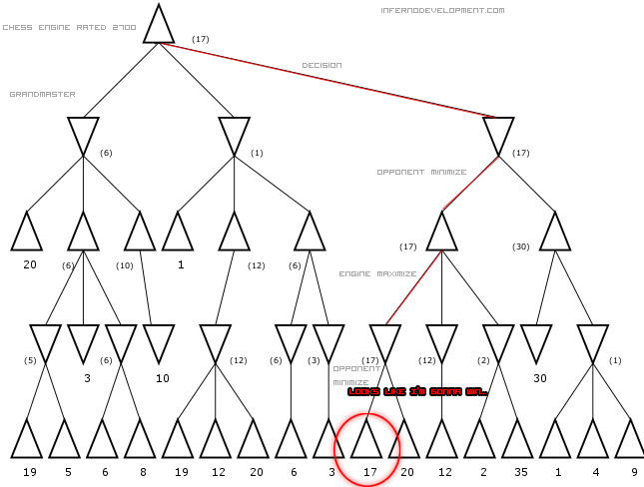
Often explicit or implicit tradeoffs between compute “amount” and quality of result
http://www.infernodevelopment.com/how-computer-chess-engines-think-minimax-tree

Slide 23
This kind of issue (heuristics; time to compute => quality) comes up a lot.
Mapping.
Assembly.
Statistics (Monte Carlo and resampling methods).
Simulations.
More generally, most “interesting” algorithms involve approximations and shortcuts. When are they (in)appropriate for your task?

Slide 24
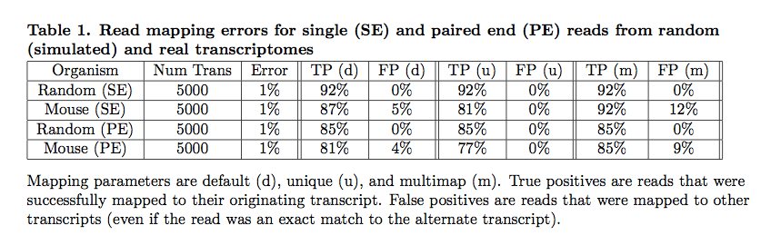
What are the limits of data + compute?
Mappers will ignore some fraction of reads due to errors.
Pyrkosz et al., unpub.

Slide 25
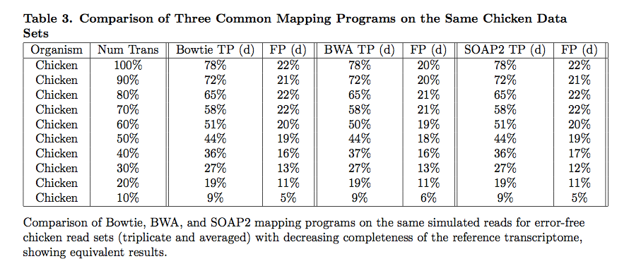
Does choice of mapper matter?
Reference completeness matters more!
Pyrkosz et al., unpub.

Slide 26
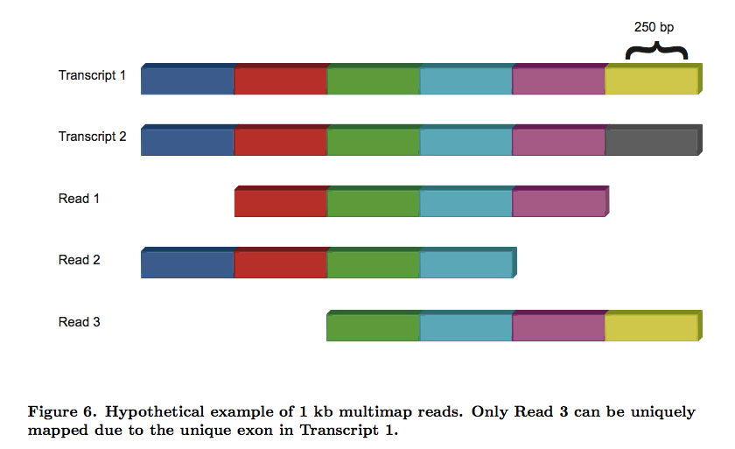
Real problem? Our data can’t uniquely specify solution!
Here, there is no direct way to know if last exon is connected to first exon.
Pyrkosz et al., unpub.

Slide 27
Concluding thoughts
There’s what you can do today, computationally, with existing programs. This is often limited by our time, experience, etc.
There’s what you could, in theory, do with the data you had. This is the upper limit on your accuracy.
Figuring these out is one of the main reasons you’re here :)

Slide 28
Any questions or comments?

