Slide 1
Mapping short reads

Slide 2
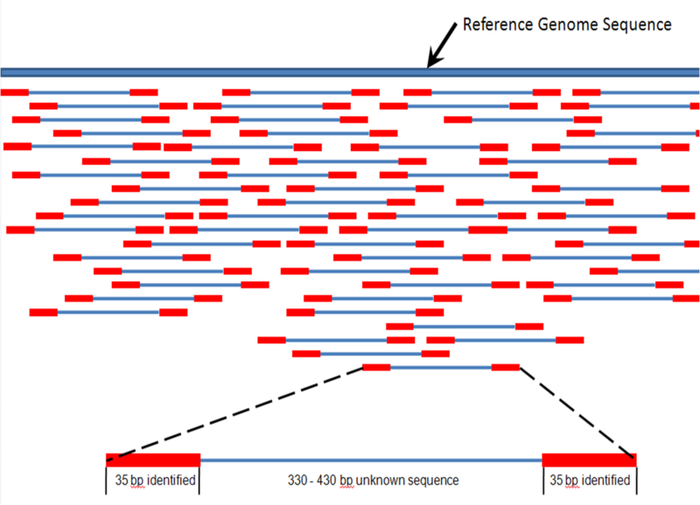
Locate reads in ref genome
http://en.wikipedia.org/wiki/File:Mapping_Reads.png

Slide 3
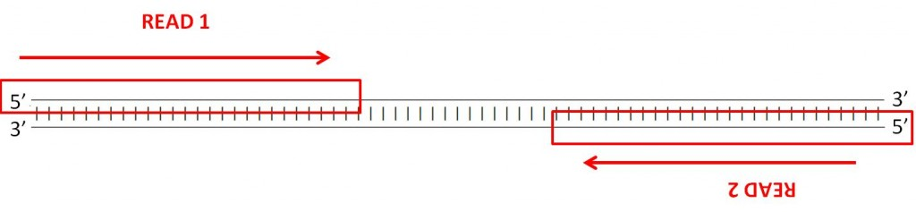
http://www.cureffi.org/2012/12/19/forward-and-reverse-reads-in-paired-end-sequencing/

Slide 4
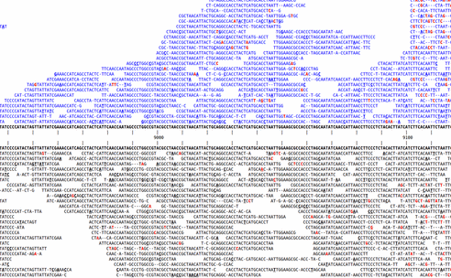
SNP calling – which variants are “real”?
http://www.kenkraaijeveld.nl/genomics/bioinformatics/

Slide 5
Note: long v short
Mapping long reads is a different problem from mapping short reads.
This is for two reasons, both of them pragmatic/practical:
The volume of data has traditionally been much less: 1m 454 reads vs 200m Illumina
Long reads are much more likely to have insertions or deletions in them

Slide 6
Long reads: BLAST vs ‘blat’
On Tues, I told you about the 11-mer heuristic that BLAST uses for DNA matches.
BLAST requires that a query sequence contains the same 11-mer as a database sequence before it attempts further alignment.
Any given 11-mer occurs only once in 2m sequences, so this filters out many database sequences quickly.
You can also store the list of all possible 11-mers in memory easily (~2mb), making it possible to keep track of everything quickly.
‘blat’ does the same thing as BLAST, but is faster because it uses longer k-mers.

Slide 7
How alignment works, and why indels are the devil
There are many alignment strategies, but most work like this:
GCGGAGatggac GCGGAGatggac
||||||...... => ||||||x.....
GCGGAGgcggac GCGGAGgcggac
At each base, try extending alignment; is total score still above threshold?

Slide 8
How alignment works, and why indels are the devil
There are many alignment strategies, but most work like this:
GCGGAGatggac GCGGAGatggac
||||||...... => ||||||xx....
GCGGAGgcggac GCGGAGgcggac
Each mismatch costs.

Slide 9
How alignment works, and why indels are the devil
Insertions/deletions introduce lots more ambiguity:
GCGGAGagaccaacc GCGGAGag-accaacc
|||||| => ||||||
GCGGAGggaaccacc GCGGAGggaacc-acc
GCGGAGagaccaacc GCGGAGaga-ccaacc
|||||| => ||||||
GCGGAGggaaccacc GCGGAGggaacca-cc

Slide 10
Mapping short reads, again
What’s hard about mapping
Three mapping programs
Decisions to be made
Color space issues

Slide 11
Mapping, defined
Exhibit A: 20m+ reads from genome/transcriptome.
Exhibit B: related genome/transcriptome, aka “the reference”
Goal: assign all reads to location(s) within reference.
Req’d for resequencing, ChIP-seq, and mRNAseq

Slide 12
Want global, not local, alignment
You do not want matches within the read, like BLAST would produce.
Do not use BLAST!

Slide 13
Mapping is “pleasantly parallel”
Goal is to assign each individual read to location(s) within the genome.
So, you can map each read separately.

Slide 14
What makes mapping challenging?
Volume of data
Garbage reads
Errors in reads, and quality scores
Repeat elements and multicopy sequence
SNPs/SNVs
Indels
Splicing (transcriptome)

Slide 15
Volume of data
Size of reference genome is not a problem: you can load essentially all genomes into memory (~3 gb).
However, doing any complicated process 20m times is generally going to require optimization!

Slide 16
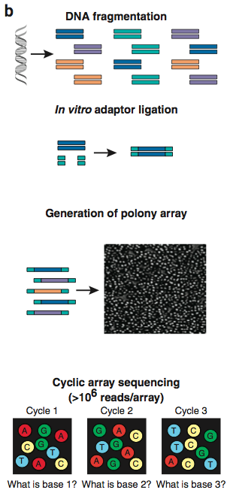
Garbage reads
Overlapping polonies result in mixed signals.
These reads will not map to anything!
Used to be ~40% of data.
Increasingly, filtered out by sequencing software.
Shendure and Ji, Nat Biotech, 2008

Slide 17
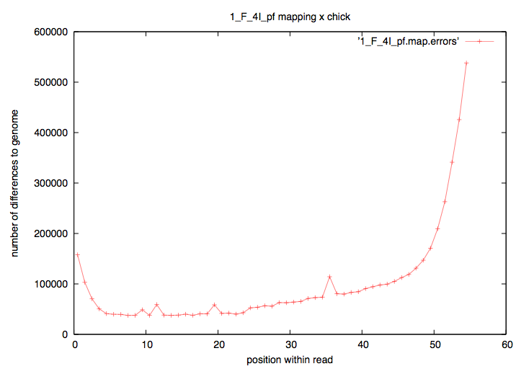
Errors in reads
When mapping, a mismatch is not necessarily “real”.

Slide 18
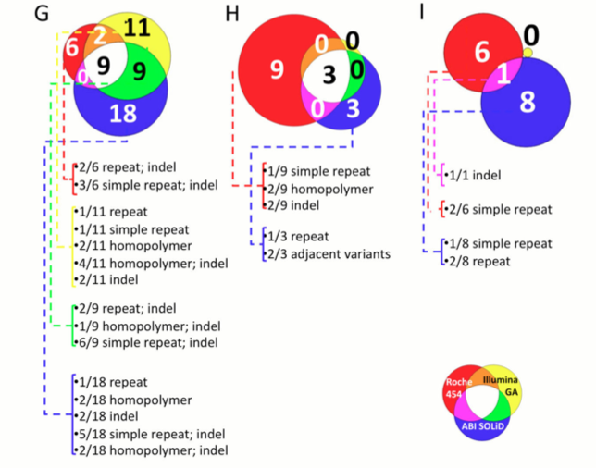
Technology-specific bias
Harismendy et al., Genome Biol. 2009, pmid: 19327155

Slide 19
Errors in reads
Quality scores are based on Sanger sequencing-style quality scores: per base.
But 454 is subject to different biases than Illumina, and the biases are not necessarily base-by-base (think: homopolymer runs)

Slide 20
Repeat/multi-copy elements
Multi-copy sequence makes it impossible to map all reads uniquely.
Repeats are particularly bad, because there are (a) lots of them and (b) they vary in sequence. They therefore may “attract” reads depending on what optimizations/heuristics you use.

Slide 21
SNP/SNVs
Genuine mismatches between reference and sequence do exist, of course.
Polymorphism
Diploidy
Population studies
You want to map these reads!
Fast heuristic approaches exist, based on fuzzy matching.
However, they are still biased towards mapping exact matches.
This can be a problem for allelotyping and population studies.
Likit will discuss next week.

Slide 22
Indels
Remember, they are the devil…?
Complicate mapping heuristics
Complicate statistics

Slide 23
Indels: ambiguity & decisions…
TGACGATATGGCGATGGACTGGACG
|x|||||||||||x||x|x||||||
TcACGATATGGCGgTGaA-TGGACG
TGACGATATGGCGATGGACTGGACG
|x|||||||||||x|x||x||||||
TcACGATATGGCGgT-GAaTGGACG

Slide 24
Splice sites
If you are mapping transcriptome reads to the genome, your reference sequence is different from your source sequence!
This is a problem if you don’t have a really good annotation.
Main technique: try to map across splice sites, build new exon models.
Another technique: assembly.

Slide 25
Two specific mapping programs
Bowtie
BWA
Both open source.
BWA is widely used now, so we’ll use that for examples.
(There are many more, too.)

Slide 26
Bowtie1
Not indel-capable.
Designed for:
Many reads have one good, valid alignment
Many reads are high quality
Small number of alignments/read
a.k.a. “sweet spot” :)

Slide 27
BWA
Uses similar strategy to Bowtie, but does gapped alignment.
Newest, hottest tool.

Slide 28
Decisions to be made by you
How many mismatches to allow?
Vary depending on biology & completeness of reference genome
Report how many matches?
Are you interested in multiple matches?
Require best match, or first/any that fit criteria?
It can be much faster to find first match that fits your criteria.
All of these decisions affect your results and how you treat your data.

Slide 29
Mapping best done on entire reference
May be tempted to optimize by doing mapping to one chr, etc. “just to see what happens”
Don’t.
Simple reason: if you allow mismatches, then many of your reads will match erroneously to what’s present.

Slide 30
Look at your mapping
Just like statistics ☺
This is a lot of what we’ll be doing today.

Slide 31
Two considerations in mapping
Building an index
Prepares your “reference”
(Not really a big deal for single microbial genomes)

Slide 32
Indexing – e.g. BLAST
BLASTN filters sequences for exact matches between “words” of length 11:
GAGGGTATGACGATATGGCGATGGAC
||x|||||x|||||||||||x|x||x
GAcGGTATcACGATATGGCGgT-Gag
What the ‘formatdb’ command does (see Tuesday’s first tutorial) is build an index (“index”) sequences by their 11-base word content – a “reverse index” of sorts.

Slide 33
Indexing – e.g. BLAST
What the ‘formatdb’ command does (see Tuesday’s first tutorial) is build an index (“index”) sequences by their 11-base word content – a “reverse index” of sorts.
Since this index only needs to be built once for each reference, it can be slower to build – what matters to most people is mapping speed.
All short-read mappers have an indexing step.

Slide 34
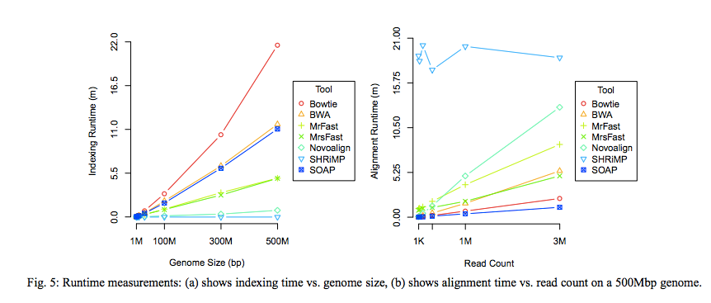
Speed of indexing & mapping.
Fig 5 of Ruffalo et al. PMID 21856737, Bioinformatics 2011.

Slide 35
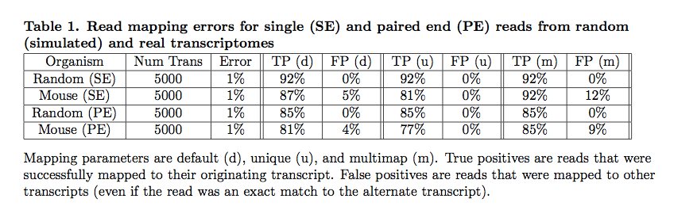
Simulations => understanding mappers
Mappers will ignore some fraction of reads due to errors.
Pyrkosz et al., unpub.; http://arxiv.org/abs/1303.2411

Slide 36
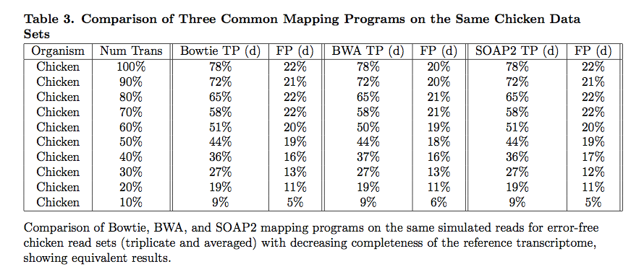
Does choice of mapper matter? Not in our experience.
Reference completeness/quality matters more!
Pyrkosz et al., unpub.; http://arxiv.org/abs/1303.2411

Slide 37
Misc points
Transcriptomes and bacterial genomes have very few repeats…
…but for transcriptomes, you need to think about shared exons.
For genotyping/association studies/ASE, you may not care about indels too much.
Variant calling is less sensitive to coverage than assembly (20x vs 100x)

Slide 38
Using quality scores?
Bowtie uses quality scores; bwa does not.
This means that bowtie can align some things in FASTQ that cannot be aligned in FASTA.
See: http://www.homolog.us/blogs/blog/2012/02/28/bowtie-alignment-with-and-without-quality-score/

Slide 39
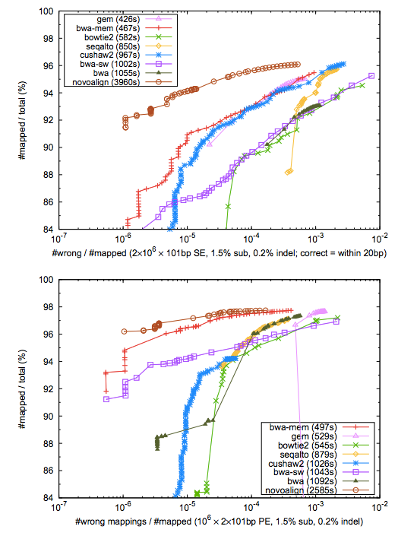
Comparative performance/SE
Heng Li, BWA-MEM: http://arxiv.org/pdf/1303.3997v2.pdf

Slide 40
Comparative performance/PE
Heng Li, BWA-MEM: http://arxiv.org/pdf/1303.3997v2.pdf

