Slide 1
Group Member
Group Facilitator: Karan Chauhan
Team Member: Karan Chauhan
LENDING CLUB CASE STUDY

Slide 2
Case Study Objectives
1. Loan Lending Organizations may choose to utilize this knowledge for its portfolio and risk assessment of new loan applicants
2. To identify these risky loan applicants, then such loans can be reduced thereby cutting down the amount of credit loss. Identification of such applicants using EDA is the aim of this case study.

Slide 3
Problem Solving Methodology
1. Understanding the Problem.
2. Uploading The Data Set
3. Data Cleaning
4. Missing Value imputation
5. Exploratory Data Analysis

Slide 4
Data Cleaning
1. Delete Columns that are not useful for us to analyze.
2. Identifying the incorrect, incomplete, inaccurate, irrelevant or missing part of the data and then remove them from the dataset
3. Filter by date period to get only the rows relevant to the analysis.

Slide 5
Missing Value Imputation
1. Fill the Null values with the Mean, Median and Mode.
2. If it is categorical data then we use Mode value to fill the null place.
3. If it is continuous data then we can use Mean or Median values.

Slide 6
Exploratory Data Analysis
1. Univariate analysis is the analysis of one variable.
2. Bivariate analysis is the analysis of exactly two variables.
3. Segmented Univariate Analysis means that the data variable is analyzed in subsets and is very useful as it can show the change metric in pattern across the different segments of the same variable.

Slide 7
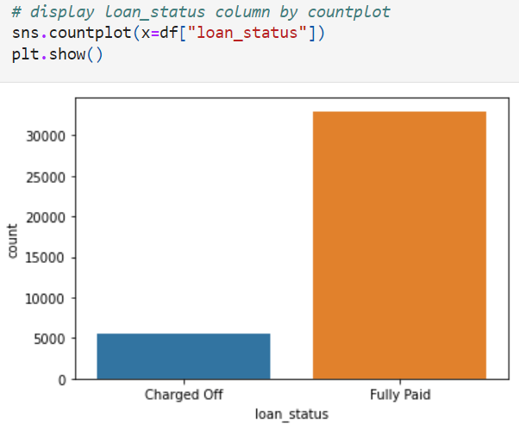
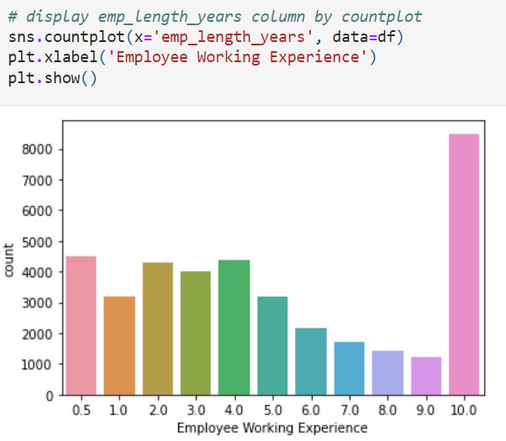
Univariate Analysis
- Most of the loans are fully paid as compare to Charged Off.
- Employee's that have 10 year of experience they are taking lots of loan.

Slide 8
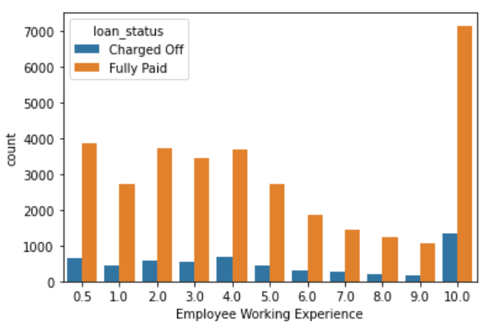
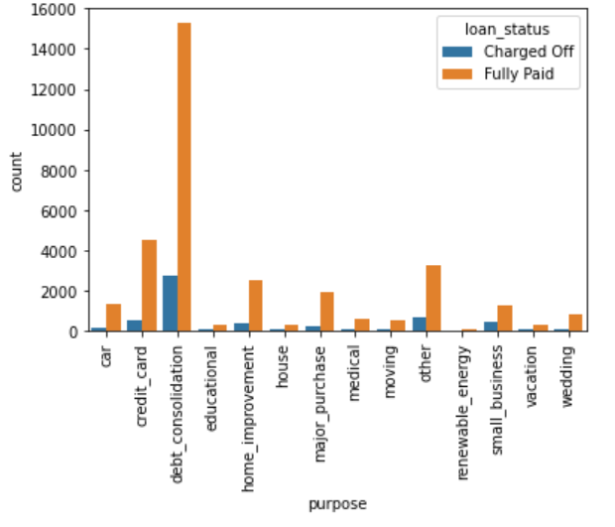
Segmented Univariate Analysis
- It divided the Employee working experience and purpose into two parts that are Charged off and fully paid.
- People are taking maximum loan for Debt Consolidation

Slide 9
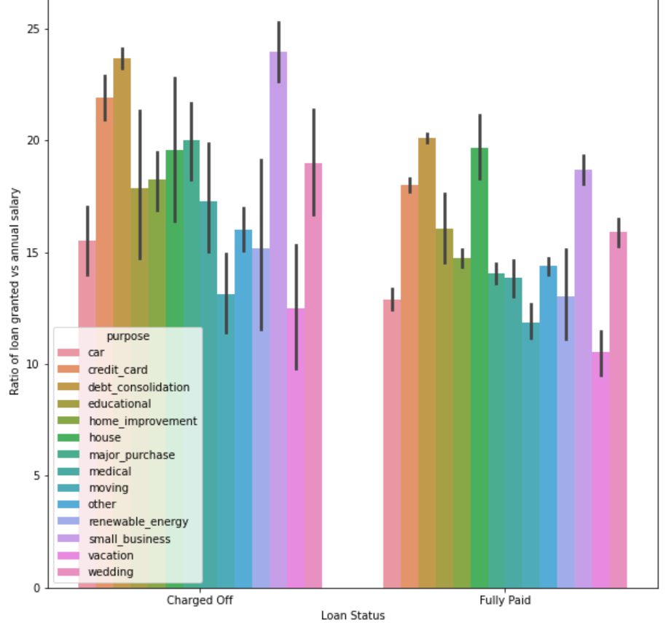
Bivariate Analysis
- Relationship between loan status and ratio of loan granted vs annual salary

Slide 10
Conclusion
1. Number of loans granted over the year has been increasing.
2. Loans having higher interest rate have more defaulters. Check the background of applicant thoroughly if interest rate is high.
3. When the purpose is debt consolidation check applicant thoroughly as it has high tendency to default.

Slide 11
Thank You!

