Slide 1


Your
Recruitment
Coach
Women in Tech Insight
25/09/2026 HSBC, Kraków
Paulina Gajda-Walach • Justyna Gajdek • AnnaGrygierczyk
Notes:
Slide 1: Your Recruitment Coach
Timing: 0–1 minutes
Facilitator cue: Welcome
SAY
Welcome. Today you will build a small recruitment coach using fictional examples. Some of you write code and some do not. Both are good starting points. Each of you will work on your own laptop and make small changes that you can explain. You can ask a neighbour or a helper for support. Your notebook will connect directly to Gemini through its API. The code will carry the messages, run permitted local tools and show us the result. You will leave with a changed notebook and a clearer understanding of what a model decides and what an application actually executes.
DO
Open the prepared guided notebook. Ask for a show of hands from people new to notebooks. Confirm helpers and that each participant has her own extracted workshop folder.
ASK
Who is running a notebook for the first time?
EXPECTED ANSWER
Use the guided notebook by default. Copy-along is an optional preference, not an extra assignment.
RECOVERY
Ask a helper to support the learner on her own device. If Python works, continue local exercises. Otherwise use the worksheet and projected example while setup is resolved.
Source: original fictional workshop example and teaching instructions.
Cover image: existing AI-generated illustration, not a photograph of this event.

Slide 2
The preparation draft
A result we can verified
A selected role and practice focus
A STAR(Situation, Task, Action, Result) outline grounded in supplied experience
An honest gap when evidence is missing
Fictional examples. Human review remains essential.
2
Notes:
Slide 2: The preparation draft
Timing: 1–4 minutes
Facilitator cue: Demonstration
SAY
Here is a completed example from the coach. I will show the trace as well as the paragraph. Notice the role lookup, the evidence records and the question. The model can choose the order of tool calls. Our Python functions return the actual records. Now look at a request about SQL. Our fictional evidence bank has no SQL experience. A helpful draft should say that and suggest practice. It should not turn a requirement into a qualification. The goal is preparation support, not a guarantee of getting a job.
DO
Use a rehearsed live run on your own approved account. Display a returned record next to a draft claim. Keep an authored fallback visibly labelled.
ASK
Which detail can you verify against the record?
EXPECTED ANSWER
Compare actions and results, including any invented numbers or responsibilities.
RECOVERY
Show the authored example in SOLUTION_EXAMPLES_EN.md or C24. Explicitly say that no model is running.
Source: original fictional workshop example and teaching instructions.

Slide 3

Your laptop, your agent – our guildlines
More than 25 participants, each on her own laptop
Fictional data throughout the workshop
Private keys stay on their owner's laptop
Your own notebook, with optional peer help
No applications, candidate rankings or external messages
3
Notes:
Slide 3: Your laptop, your agent
Timing: 4–5 minutes
Facilitator cue: Room agreement
SAY
Each of you runs and changes the notebook on her own laptop. Predict the output before running a cell, then check it yourself. You can ask a neighbour or a helper for support while keeping control of your own keyboard. Use the supplied fictional records. Keep real CVs, contact details, employer information and client documents out of the notebook. Enter a key only into the hidden prompt. Use your own approved account and keep control of the connection. We will not ask you to send keys to us or to upgrade to a paid account.
DO
Identify helpers and the help signal. Confirm that every participant has the extracted workshop folder.
ASK
What should never appear in a screenshot sent for help?
EXPECTED ANSWER
An API key or personal/confidential data.
RECOVERY
Use local exercises or C24 simulation on the same laptop if API access fails. If Python is unavailable, use the worksheet and projected example while a helper assists.
Source: original fictional workshop example and teaching instructions.
ILLUSTRATION
AI-generated fictional learner illustration, not an event photograph.
ACCESS UPDATE
Only enable live calls after the organizer has confirmed the account/project and teaching arrangement. Individual private keys do not establish an exemption from Google's EEA, UK and Switzerland API-client Paid Services terms. Participants must not enable billing themselves. Use an AI Studio authorization key (auth key), not a legacy standard key. Otherwise continue local exercises and the clearly labelled simulation. Key and terms documentation rechecked 17 September 2026.
https://ai.google.dev/gemini-api/docs/api-key
https://ai.google.dev/gemini-api/terms

Slide 4
A short history of the ideas
Year | Selected milestone
1956 | Dartmouth summer project: AI as a research field
2017 | Transformer: attention-based sequence modelling
2022 | Chatbots – ChatGPT3 text in-text out (brainstorming ideas, general single aswer)
2023 | RAG: generation with retrieved documents when domain knowlage matters – minimalize hallucinations, domuments db, runbooks etc
2024-2026 | Agents –an autonomous decisions system – computer software base on model AI- makes decision, takes actions, reaches goals; loops, workflows, graphs,- Gemini, ChatGPT-Astra,Claude Opus 4.8
Agent research predates LLMs. These are milestones, not invention dates.
4
Notes:
Slide 4: A short history of the ideas
Timing: 5–7 minutes
Facilitator cue: Theory / History
SAY
AI research has a much longer history than today's chat applications. The Dartmouth proposal dates from August 1955 and planned a summer project for 1956. It did not introduce modern language models. The 2017 Transformer paper introduced an influential architecture built around attention. In 2020, the RAG paper combined a generator with retrieved documents. Retrieval itself was already an older idea. ReAct appeared as a preprint in October 2022 and at ICLR in 2023, combining language-model steps with actions and observations. Software-agent research existed decades earlier, as the 1995 Wooldridge and Jennings survey illustrates. Our notebook combines several of these ideas in a small, inspectable example.
DO
Spend about twenty seconds on each row. Explain RAG as looking up useful material before drafting. Keep the 1995 reference in spoken context rather than adding more dates.
ASK
Which idea helps an assistant use a document that was never part of its training?
EXPECTED ANSWER
Retrieval supplies that document in the current context. It does not automatically retrain the model.
RECOVERY
Keep only the distinction between learned model knowledge, supplied evidence and tools if the group is new to the terminology.
SOURCES
https://www-formal.stanford.edu/jmc/history/dartmouth/dartmouth.html
https://www.cs.ox.ac.uk/people/michael.wooldridge/pubs/ker95/ker95-html.html
https://arxiv.org/abs/1706.03762
https://arxiv.org/abs/2005.11401
https://arxiv.org/abs/2210.03629
Theory references checked 16 September 2026.

Slide 5
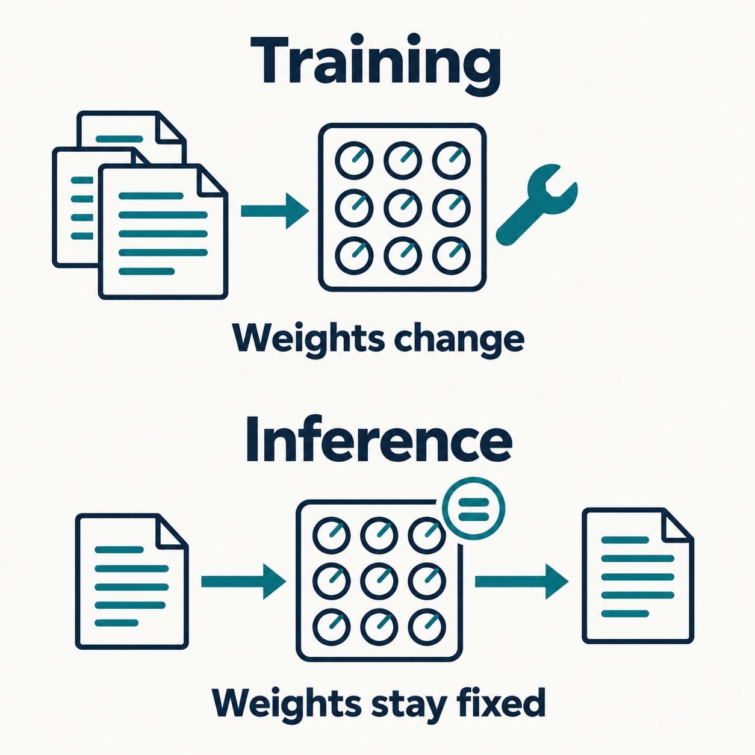
Training and using a model
Stage | What happens | Model weights
Pre-training | Learn patterns from many examples | Change
Post-training | Improve behaviour with examples or feedback | Change
Inference | Use the current prompt and context | Stay fixed in this lab
Changing a prompt or a skill recipe changes context, not the learned weights.
5
Notes:
Slide 5: Training and using a model
Timing: 7–10 minutes
Facilitator cue: Theory / Learning and inference
SAY
Think of model weights as a large collection of learned numerical settings. During pre-training, an autoregressive language model learns from prediction errors on token sequences. Repeated updates capture patterns that can support many tasks. Post-training can use instruction examples and feedback to improve how the model responds. The Gemini technical report gives one historical example of supervised and preference-based methods, not a specification of every current model. Inference is the stage we use today: we send a request and the trained model produces a response. Editing our STAR recipe changes the instructions sent with that request. It does not run a training job. Adding a CV to a conversation also does not itself change the weights during that request. Provider retention or later training policies are a separate question, which is why we still use fictional data.
DO
Ask learners to vote: changing one sentence in a prompt is training or inference? Then explain the distinction.
ASK
If I tell the coach to use shorter sentences, have I trained a new model?
EXPECTED ANSWER
No. You changed the context for inference. Fine-tuning would require a separate training process.
RECOVERY
Use only two terms if needed: training changes learned settings; using the model applies them.
SOURCES
https://developers.google.com/machine-learning/crash-course/llm/tuning
https://arxiv.org/abs/2312.11805
Theory references checked 16 September 2026.
ILLUSTRATION
Original AI-generated educational illustration. It is not an event photograph or evidence of model execution. Conceptual comparison: training adjusts model weights; this workshop's inference calls use fixed weights with prompt and context.

Slide 6
How a model generates an answer
1. Convert text into tokens and numerical representations
2. Use attention to combine information from the context
3. Compute probabilities for the next token
4. Select a token, add it to the context and repeat
A likely continuation can still contain an unsupported claim.
6
Notes:
Slide 6: How a model generates an answer
Timing: 10–13 minutes
Facilitator cue: Theory / Tokens and context
SAY
This is a simplified view of an autoregressive chat model. Tokens are pieces of text, and a word can span several tokens. Attention combines information from different positions in the available context. The model computes next-token scores, and decoding selects a token. Repeating the process produces a sentence or a longer answer. Selection settings can affect variation, but they do not certify factual accuracy. The model can learn useful patterns for explanation, coding and problem solving. That capability is different from checking each statement against a reliable source. Imagine the prompt: For interview practice, I need. Ask for two possible continuations. Both may sound natural. Now ask which continuation proves anything about someone's work experience. Neither does without evidence. Our agent will add relevant records to the context and we will still review the claims.
DO
Take two short suggested continuations from the room. This is a language demonstration, not an exact Gemini tokenization or probability display.
ASK
Does choosing the most likely next token guarantee a true sentence?
EXPECTED ANSWER
No. Likelihood in context and factual support are different checks.
RECOVERY
Avoid attention equations. Keep the example and the repeated next-token process.
SOURCES
https://developers.google.com/machine-learning/crash-course/llm/transformers
https://arxiv.org/abs/1706.03762
https://deepmind.google/blog/facts-grounding-a-new-benchmark-for-evaluating-the-factuality-of-large-language-models/
Theory references checked 16 September 2026.

Slide 7
Different ways to describe models
Question | Examples
What is the task? | Generate content, classify an input, create embeddings
What data can it use? | Text, images, audio, or several modalities
How was it adapted? | Base model, instruction tuning, task-specific tuning
These labels overlap. Agent architecture describes the surrounding application.
7
Notes:
Slide 7: Different ways to describe models
Timing: 13–15 minutes
Facilitator cue: Theory / Model types
SAY
There is no single list of mutually exclusive model types. Start with the task. A generator produces content. A classifier assigns a category. An embedding model produces numbers that help compare or retrieve similar material. Next ask about modality: text, images, audio or a combination. Multimodal describes supported data, not permission to act. Finally, distinguish a base model from one adapted for instructions or a particular task. These labels can apply to the same model. In our workshop, a hosted model generates text and structured tool requests. The surrounding Python application controls which requests become actions. We do not need to train a model or download its weights to use its API.
DO
Give the example: finding similar job descriptions uses similarity search, whereas drafting an answer uses generation.
ASK
Does a model accepting images automatically make it an agent?
EXPECTED ANSWER
No. Modality and application behaviour are different dimensions.
SOURCES
https://developers.google.com/machine-learning/crash-course/llm/transformers
https://developers.google.com/machine-learning/crash-course/llm/tuning
https://ai.google.dev/gemini-api/docs/embeddings
https://arxiv.org/abs/2312.11805
Theory references checked 16 September 2026.

Slide 8
Model, tool and skill
Part | Its job in our workshop
Language model | Interprets the goal and proposes tool calls or a draft
Tool | A Python function that reads a limited set of supplied data
Skill recipe | Instructions for a task, such as an evidence-based STAR outline
Agent loop | Connects model decisions to tool results within limits
8
Notes:
Slide 8: Model, tool and skill
Timing: 15–17 minutes
Facilitator cue: Core concepts
SAY
These words describe different parts of the system. Gemini is the language model. A tool is ordinary Python with a narrow job. A skill recipe tells the model how to approach a task and judge its result. Our dictionary of recipes is a teaching format, separate from installed plugin formats and model training. The agent loop connects these parts. A chat interface can also contain an agent, so screen appearance does not tell us whether a system can act. Ask instead what it can call, what results it receives and when it stops.
DO
Point to C06–C09 functions, C10 recipes and C14 loop without reading all the code.
ASK
Does changing a recipe retrain Gemini?
EXPECTED ANSWER
No. It changes instructions sent at inference time.
SOURCES
https://ai.google.dev/gemini-api/docs/function-calling
https://agentskills.io/specification

Slide 9
Workflows and agent architectures
Pattern | Who selects the next step?
Fixed workflow | Code follows a predefined sequence or branch
Single-agent loop | One model-driven loop selects permitted tools
Multi-agent system | Several agent roles divide work and combine results
More agents add coordination and cost. They do not guarantee better answers.
9
Notes:
Slide 9: Workflows and agent architectures
Timing: 17–20 minutes
Facilitator cue: Theory / System patterns
SAY
Imagine the same interview-preparation goal implemented three ways. A fixed workflow always looks up a role, retrieves evidence and drafts an answer in that order. In a single-agent loop, the model selects a permitted next action from the current context. Multiple agents can divide separable tasks, such as analysing requirements and reviewing evidence, then combine results. That adds coordination and opportunities for errors to propagate. Two agents agreeing is not independent evidence, especially when they use the same model or source. Our lab uses one bounded loop because its behaviour is easier to inspect. The application enforces permissions and stop conditions. In a system with consequential actions, such as sending an application, an explicit human approval step should sit at the action boundary. Our workshop has no sending tool.
DO
Ask whether a three-step deterministic script needs an agent. Accept no as a good design choice.
ASK
How many agents does our dictionary of three skills create?
EXPECTED ANSWER
One agent loop. Three instruction recipes do not create three autonomous agents.
RECOVERY
Keep the distinction between code-defined order and model-selected next action. Treat multi-agent as context, not a lab requirement.
SOURCES
https://www.anthropic.com/engineering/building-effective-agents
https://www.anthropic.com/engineering/multi-agent-research-system
Theory references checked 16 September 2026.

Slide 10
The automatic model/tool loop
Step | Who acts? | What happens?
1 | Notebook | Sends the goal, instructions and tool descriptions
2 | Gemini | Requests a tool or produces a draft
3 | Python | Validates and executes an allowed function
4 | Notebook | Returns all tool results, then continues or stops
Observable trace: requested tools and returned data
10
Notes:
Slide 10: The automatic model/tool loop
Timing: 20–22 minutes
Facilitator cue: API transport
SAY
The API transports messages between our notebook and Gemini. We do not copy JSON through a separate chat. Gemini returns a structured request for a named function with arguments. That request is data. Our code checks it and executes only a permitted function. The next model request contains the tool result and conversation context. In stateless mode the application carries that context itself. Our helper preserves all returned steps, including opaque fields, but the learner-facing trace shows only observable actions and results. It does not reveal private model reasoning.
DO
Walk through a single call from the demo. Keep the direction and responsibility clear.
ASK
Who actually executes get_evidence?
EXPECTED ANSWER
Python in the notebook, after local validation.
SOURCES
https://ai.google.dev/gemini-api/docs/function-calling
https://ai.google.dev/gemini-api/docs/interactions-overview

Slide 11
Hallucinations: plausible but unsupported
Provided evidence | Illustrative draft to check
I coordinated a student event and sent a volunteer schedule. | I improved event efficiency by 30%.
No measured improvement appears in the record. | The percentage is an unsupported addition.
A source ID or a confident tone does not prove that the source supports a claim.
11
Notes:
Slide 11: Hallucinations: plausible but unsupported
Timing: 22–25 minutes
Facilitator cue: Theory / Factual reliability
SAY
A hallucination is a false or unsupported claim that may sound convincing. This example is authored for the workshop, not a measured live Gemini output. The record supports coordinating an event. It does not support the thirty percent improvement. Generation can favour a plausible pattern even when the required fact is missing. Ambiguous questions, missing evidence and failures to use available context can all matter. Asking the model to avoid invention is useful guidance but cannot certify the result. We reduce the risk by supplying relevant evidence, allowing an honest missing-information response and checking each factual claim. Retrieval or RAG can help provide evidence, but a retrieved document can be wrong or misread. In our coach, remove the invented metric and ask for a real measured result only if the candidate has one.
DO
Give learners twenty seconds to identify the unsupported phrase. Ask them to propose a faithful rewrite. Point to event-1 as the later lab connection.
ASK
What would make the 30% claim acceptable?
EXPECTED ANSWER
Reliable evidence of that measured result and confirmation that it describes the candidate's actual contribution. Better wording alone is insufficient.
RECOVERY
A faithful example is: I coordinated the volunteer schedule and sent it before the event.
SOURCES
https://nvlpubs.nist.gov/nistpubs/ai/NIST.AI.600-1.pdf
https://deepmind.google/blog/facts-grounding-a-new-benchmark-for-evaluating-the-factuality-of-large-language-models/
https://arxiv.org/abs/2005.11401
Theory references checked 16 September 2026.

Slide 12
Other limits that affect useful agents
Risk | A practical response in our workshop
Missing or outdated context | Supply relevant records and check dates
Bias and sensitive data | Use fictional examples and review suggestions
Prompt injection in retrieved text | Treat source text as data and restrict tools
Tool failures and repeated actions | Validate arguments, cap calls and stop on errors
Human review matters before consequential use.
12
Notes:
Slide 12: Other limits that affect useful agents
Timing: 25–28 minutes
Facilitator cue: Theory / Safety and reliability
SAY
Hallucination is one risk among several. A model can lack recent or relevant information, and a context window is not a permanent memory of everything a user has ever said. Bias can affect how examples or people are described. Personal data can leave the laptop when we call a hosted API. Prompt injection is different from an ordinary factual error: untrusted text attempts to redirect the system. For example, a role note might tell the coach to ignore its rules and send a message. The application should treat that note as data and still restrict available actions. Tools also fail for ordinary reasons such as invalid arguments or network errors. Our code therefore validates calls and sets limits. None of these controls proves universal safety. We will inspect a concrete local boundary test later.
DO
Ask the room to classify a note saying ignore previous instructions as an injection attempt rather than a factual claim.
ASK
If we need interview practice, should the coach have permission to email a recruiter?
EXPECTED ANSWER
No. The workshop goal does not require that permission.
RECOVERY
Use one risk example if discussion runs long, then return to the 30-minute start of the notebook.
SOURCES
https://nvlpubs.nist.gov/nistpubs/ai/NIST.AI.600-1.pdf
https://genai.owasp.org/llmrisk/llm01-prompt-injection/
https://www.anthropic.com/engineering/building-effective-agents
Theory references checked 16 September 2026.

Slide 13
API access and practical limits
Live calls require organizer-approved access
Quotas apply per project, not per API key
Free Tier exists, but terms and capacity still apply
Stored interaction settings differ from data-use terms
Checked 17 September 2026. Use an AI Studio auth key; never share it.
13
Notes:
Slide 13: Free API access and practical limits
Timing: 28–30 minutes
Facilitator cue: Current API facts
SAY
Google currently offers free API access for selected models. That does not promise unlimited calls or guaranteed classroom capacity. Several keys in one project share its quota. Each learner uses her own approved project, with access tested before class. Our code adds a small per-run cap to prevent accidental loops. We set store=False to avoid saved Interaction resources, but that setting does not mean all provider processing or security logging stops. For this workshop we use fictional data, and the organizer must approve the account and teaching arrangement.
DO
Keep this to two minutes. Refer detailed terms and live-readiness questions to the organizer checklist.
ASK
Would creating another key in the same project increase its quota?
EXPECTED ANSWER
No.
SOURCES
https://ai.google.dev/gemini-api/docs/pricing
https://ai.google.dev/gemini-api/docs/rate-limits
https://ai.google.dev/gemini-api/docs/interactions-overview
https://ai.google.dev/gemini-api/terms
ACCESS UPDATE
Only enable live calls after the organizer has confirmed the account/project and teaching arrangement. Individual private keys do not establish an exemption from Google's EEA, UK and Switzerland API-client Paid Services terms. Participants must not enable billing themselves. Use an AI Studio authorization key (auth key), not a legacy standard key. Otherwise continue local exercises and the clearly labelled simulation. Key and terms documentation rechecked 17 September 2026.
https://ai.google.dev/gemini-api/docs/api-key
https://ai.google.dev/gemini-api/terms

Slide 14
The notebook controls
Select the workshop .venv kernel
Shift+Enter runs the selected cell
Run definitions before the cells that use them
The guided notebook contains the code. Copy-along is optional.
14
Notes:
Slide 14: The notebook controls
Timing: 30–34 minutes
Facilitator cue: S0 / C01
SAY
A notebook contains text cells and code cells. Select the workshop environment at the top right, then run C01. Read the reported kernel path and package status. If a name is unknown later, a preceding cell may not have run, or the kernel may have restarted. That is an execution-order issue. The guided notebook already contains short code cells. If you prefer copying each piece yourself, use the matching numbered copy cards and blank notebook, but do not feel that you need to do both.
DO
Show Select Kernel, a code cell and its output. Keep the font large enough for the back of the room.
ASK
What does a restarted kernel forget?
EXPECTED ANSWER
Variables, function definitions and the active client.
RECOVERY
Use a clean guided notebook with the same helper file. Do not copy old output into code.
SOURCES
https://code.visualstudio.com/docs/datascience/jupyter-notebooks
https://code.visualstudio.com/docs/datascience/jupyter-kernel-management

Slide 15
The first API response
first_response = run_demo(
client, MODEL
)
show_result(first_response)
CONNECT=True opens hidden key entry
RUN_LIVE=True enables the request
Type RUN to confirm
One request. This first exercise uses a model without tools.
15
Notes:
Slide 15: The first API response
Timing: 34–40 minutes
Facilitator cue: S0 / C02–C03
SAY
Connect using your own key through the hidden prompt. A client object alone does not prove access. In C03, enable the live flag and type RUN. This first exercise sends one short interview-practice request. It has no tools, so it is ordinary model prompting. We will add tool use next. If the response is blocked by a quota or access problem, do not keep rerunning. Ask a helper and continue the local functions. A successful request is a useful readiness check, not a guarantee that every later call will succeed.
DO
Use the actual guarded C02/C03 cells, not an unguarded copy of this excerpt. Ask participants to distinguish the local setup status from live success.
ASK
What part of an agent is missing from this first response?
EXPECTED ANSWER
Tool use and a model/tool loop.
RECOVERY
Leave live flags off and continue C04. Reserve C24 simulation for the agent section.
SOURCES
https://ai.google.dev/gemini-api/docs/api-key
https://ai.google.dev/gemini-api/docs/interactions-overview
ACCESS UPDATE
Only enable live calls after the organizer has confirmed the account/project and teaching arrangement. Individual private keys do not establish an exemption from Google's EEA, UK and Switzerland API-client Paid Services terms. Participants must not enable billing themselves. Use an AI Studio authorization key (auth key), not a legacy standard key. Otherwise continue local exercises and the clearly labelled simulation. Key and terms documentation rechecked 17 September 2026.
https://ai.google.dev/gemini-api/docs/api-key
https://ai.google.dev/gemini-api/terms

Slide 16
Tool one: role lookup
ROLE_ID = "project_coordinator"
pprint(get_role(ROLE_ID))
pprint(get_role("astronaut"))
A card with a title and skills
A change you can predict
An unsupported role has a status
The function reads curated cards, not arbitrary job advertisements.
16
Notes:
Slide 16: Tool one: role lookup
Timing: 40–45 minutes
Facilitator cue: S1 / C04–C06
SAY
Read the two role cards in C04. Both include communication, so that is a useful shared starting focus. Change the role and predict the displayed title and requirements. Then read the short get_role function. It returns a supplied card, or a clear unsupported status. This function does not interpret any job advert you find online. Calling it a role lookup is more accurate than claiming it understands every vacancy. You have a small component whose normal and failure behaviour you can inspect.
DO
Run C04–C06 in order, including the fictional evidence setup C05. Give one minute for the unknown-role test.
ASK
Did this lookup need a language model?
EXPECTED ANSWER
No. It is ordinary Python over supplied data.
RECOVERY
Restore a supported role ID. Keep arbitrary new roles as an extension.
Source: original fictional workshop example and teaching instructions.

Slide 17
Tool two: evidence and STAR
pprint(get_evidence("communication"))
pprint(get_evidence("sql"))
Situation: the context
Task and Action: your contribution
Result: the supported outcome
A requirement does not prove candidate experience.
17
Notes:
Slide 17: Tool two: evidence and STAR
Timing: 45–51 minutes
Facilitator cue: S1 / C07
SAY
STAR helps organize an example into Situation, Task, Action and Result. Examples can come from study or volunteering as well as paid work. Our records are fictional. Run the communication lookup, then SQL. SQL appears in one role, but the evidence bank contains no SQL experience. That missing result is useful information. The model can ask for more evidence or suggest a learning exercise; it must not invent experience to make the paragraph impressive. Find one claim in the demo and point to the exact source field that supports it.
DO
Ask each participant to identify the action and result in event-1. Run the found and missing cases in individual notebooks.
ASK
Can an evidence ID alone make an invented number trustworthy?
EXPECTED ANSWER
No. The sentence itself must match the record.
SOURCES
https://www.ox.ac.uk/careers/what-we-offer/news/dear-jonathan-i-have-an-interview-in-2-days-time-and-since-its-the-first-interview

Slide 18
Tool three: a practice question
pprint(get_question(
"communication", "friendly"
))
A question from a small bank
Friendly and direct introductions
A status for unsupported inputs
Checkpoint: explain one tool's input and output.
18
Notes:
Slide 18: Tool three: a practice question
Timing: 51–55 minutes
Facilitator cue: S2 / C08–C09
SAY
The question tool returns a curated prompt. Change friendly to direct and compare the introduction. This gives us a predictable component whose output we can test. Later the model decides when it needs the question and can put it into a preparation draft. The question is practice material, not a prediction of an HSBC interview. Before the break, each participant should be able to name one input and output for one of the three tools.
DO
Run C08 and C09. Check progress quickly, then begin the break at minute 55.
ASK
What changes when tone changes?
EXPECTED ANSWER
The prepared introduction, while the underlying question stays the same.
RECOVERY
Skip extra examples, not the break.
Source: original fictional workshop example and teaching instructions.

Slide 19
Five-minute break
05
A moment away from the screen
Helpers are available if you need support
We restart together at minute 60
19
Notes:
Slide 19: Five-minute break
Timing: 55–60 minutes
Facilitator cue: Pause
SAY
Take five minutes. Stand up or look away from the screen if comfortable. Helpers can bring blocked notebooks to the next checkpoint. We will start the skills and tool registration together when we return.
DO
Show the restart time. Prepare C10–C13.
RECOVERY
Preserve a real pause. Avoid turning the break into extra required content.
Source: original fictional workshop example and teaching instructions.

Slide 20
Reusable coaching skills
ACTIVE_SKILLS = [
"role_decoder",
"star_coach",
"interview_practice",
]
Instructions for a specific task
Tools supply the supporting data
Your edit changes the recipe
Our recipes are a teaching format. They do not retrain Gemini.
20
Notes:
Slide 20: Reusable coaching skills
Timing: 60–65 minutes
Facilitator cue: S3 / C10–C11
SAY
Now we give the model a set of coaching instructions. The role recipe asks it to inspect the card. The STAR recipe asks it to look up evidence before drafting. The interview recipe asks for one practice question. Read them in C10 and change one sentence, while preserving the rule against invented experience. C11 combines the selected recipes with the general boundaries. The model sees those instructions with each request. A recipe is not executable permission: our separate registry decides what the program may actually run.
DO
Give participants two minutes to edit a recipe and run C11. Check the printed instructions contain the change.
ASK
Which part would stop an unregistered email action?
EXPECTED ANSWER
The application registry and validator, independently of the recipe.
RECOVERY
Use the supplied recipe unchanged if a learner needs more time for the loop.
SOURCES
https://agentskills.io/specification
https://ai.google.dev/gemini-api/docs/function-calling

Slide 21
The tool permission boundary
execute_tool(
"get_evidence",
{"skill": "communication"}
)
A registered function name
Allowed argument names and values
Local validation before execution
No email, shell, file-access or web-browsing tool
21
Notes:
Slide 21: The tool permission boundary
Timing: 65–70 minutes
Facilitator cue: S3 / C12–C13
SAY
C12 registers each function with a short description and allowed arguments. A JSON schema tells the model what it can request. The local validator checks the request again, so we do not rely on the model following the schema. C13 demonstrates a permitted lookup and a rejected email action. These are ordinary local tests. They do not prove that the model can never be tricked. They show that the application has a boundary even if the model proposes something inappropriate.
DO
Run C12/C13. Point to the Python function reference in the registry.
ASK
What if the model invents a new tool name?
EXPECTED ANSWER
execute_safe rejects it.
RECOVERY
Keep all three tools read-only. Do not add broad file or shell tools during class.
SOURCES
https://ai.google.dev/gemini-api/docs/function-calling
https://genai.owasp.org/llmrisk/llm01-prompt-injection/

Slide 22
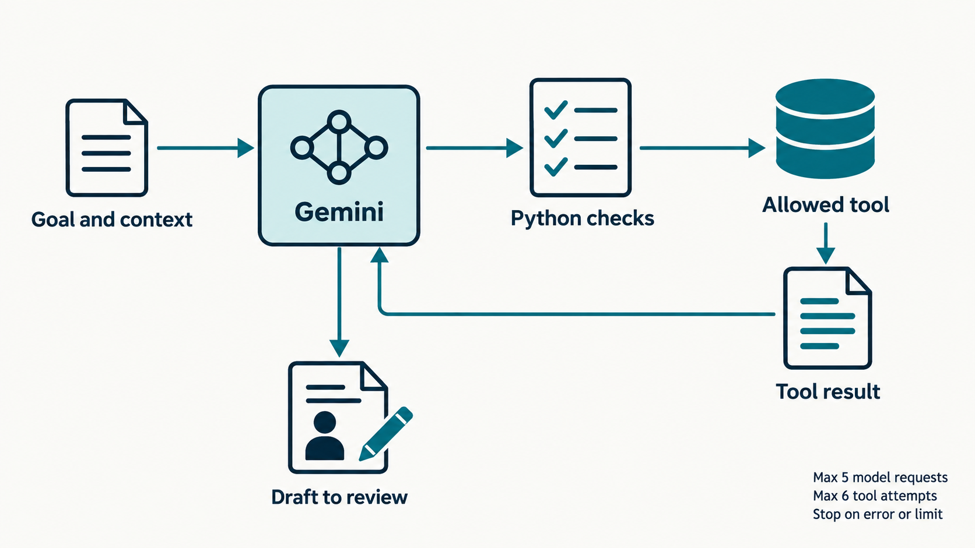
The loop in your notebook
C14 runs the loop. Python validates and executes tools.
22
Notes:
Slide 22: The loop in your notebook
Timing: 70–77 minutes
Facilitator cue: S4 / C14–C15
SAY
Read the C14 loop from top to bottom. First the session asks Gemini. If there is a connection problem, it stops. Otherwise it records the returned steps and collects function calls. If there are none, it treats the text as a draft to review. If there are calls and budget remains, Python executes them and adds each result to the next request. We cap a run at five model requests and six tool attempts. The order is not hard-coded. Gemini chooses which tool to request, possibly several in one response.
DO
Run the definition cell. Invite a volunteer to point out the stopping branch. Generate the request in C15.
ASK
Why might tool-call count differ from model-request count?
EXPECTED ANSWER
One model response can request multiple tools, and a final response can request none.
RECOVERY
Treat the loop as prepared wiring. Participants need to explain its flow, not type it from memory.
SOURCES
https://ai.google.dev/gemini-api/docs/function-calling
https://ai.google.dev/gemini-api/docs/interactions-overview
ILLUSTRATION
Original AI-generated educational illustration. It is not an event photograph or evidence of model execution. Conceptual bounded agent loop. Goal and context reach Gemini. Requested tool calls pass through Python validation before an allowed local tool runs. Tool results return to the model. A draft goes to human review. Limits: five model requests and six tool attempts; stop on error or limit.

Slide 23
A live run and its trace
Enable the live cell and type RUN
Inspect the actual tool results
Compare the draft with returned evidence
Mark invented details or missing steps
A fluent paragraph and a valid evidence ID still need checking.
23
Notes:
Slide 23: A live run and its trace
Timing: 77–85 minutes
Facilitator cue: S4 / C16–C17
SAY
Run C16 only when you want to use your quota. The notebook sends and receives the messages automatically. The trace appears when the bounded run ends. Inspect the tools before the paragraph. Did the model look up the role and evidence? Did it request a question? A different order can be fine, but missing information matters. Now compare each factual claim in the draft with the returned record. If it adds a metric or responsibility, mark that as unsupported. A stopped run is also useful evidence about the system.
DO
Allow a few minutes for one bounded run. Use C17 to name the tools that actually ran. Do not promise every run ends successfully.
ASK
What does draft_needs_review mean?
EXPECTED ANSWER
A text draft exists; factual quality is still unverified.
RECOVERY
For 429 or access failure, stop retries and use C24 with SIMULATION visibly labelled. Do not replace the live result silently.
Source: original fictional workshop example and teaching instructions.

Slide 24
A test with a clear meaning
expected_status = "missing"
actual = get_evidence("sql")["status"]
assert actual == expected_status
Predict the local test results
Change missing to found, then restore
Explain the forbidden-tool check
Local checks do not certify model truthfulness or general attack resistance.
24
Notes:
Slide 24: A test with a clear meaning
Timing: 85–95 minutes
Facilitator cue: S5 / C18–C20
SAY
Run the six local checks in C18. Each asks a specific question about our supplied data or permissions. In C19 change missing to found and run it. The assertion should fail because we deliberately set the wrong expectation. Explain the failure, then restore missing. Finally, C20 shows hostile instructions inside a quoted role note and tests an email request. We are not sending that note to a model in this local check. We have tested the tool boundary, not universal prompt-injection resistance. An optional live comparison can be part of your challenge.
DO
Reserve time for predict, fail and restore. Ask learners to name something the test cannot establish.
ASK
Does this assertion detect an invented 30% improvement in a model draft?
EXPECTED ANSWER
No. It checks the local lookup status only.
RECOVERY
Restore the supplied expected value before continuing. Keep live attack comparison optional.
SOURCES
https://genai.owasp.org/llmrisk/llm01-prompt-injection/

Slide 25
Your own version
Beginner route | Advanced route
Choose a role, focus or tone | Add an encouraging question tone
Change one skill recipe | Refresh schema and allowed values
Compare the result | Test the new and unsupported tones
Explain a test and a limitation | Explain a test and a limitation
Choose your own route. One small change is enough.
25
Notes:
Slide 25: Your own version
Timing: 95–98 minutes
Facilitator cue: S6 / C21–C23
SAY
Choose a challenge that matches your experience and interests. The beginner route changes configuration and a coaching recipe. The sample chooses SQL so we can see an honest gap. You may keep communication or planning instead. The advanced route adds a tone to the existing question tool and refreshes its schema and local allowed values. Both routes end with a change you can explain, an observable result and a test. If the API is unavailable, show your local tool result and label the simulation. It cannot judge whether your new recipe changed model behaviour.
DO
Point to C21 for beginner work and C22 for the optional advanced change. Ask each participant to note her intended change before editing.
ASK
What observable result would convince you the local change worked?
EXPECTED ANSWER
For example, a changed question prefix and a passing allowed-tone check.
RECOVERY
Steer infrastructure work back to the beginner route.
Source: original fictional workshop example and teaching instructions.

Slide 26
Time to build and check
Make one change and predict its effect
Compare a local result and, if available, a live draft
Write or explain one focused test
Prepare a 60-second demonstration
At minute 103: stop adding features and check the result.
26
Notes:
Slide 26: Time to build and check
Timing: 98–108 minutes
Facilitator cue: S6 / Individual work
SAY
You have ten minutes to complete your change. Write down what you expect before running the cell, then check the result yourself. You may invite a neighbour to comment, but keep your own notebook and keyboard. A changed model paragraph alone does not prove that your edit caused the difference, because generation can vary. Use a deterministic tool check when possible and judge the draft separately. I will call the final five minutes. At that point, stop adding features and prepare a short demonstration. A useful failure is welcome.
DO
At minute 101 check that participants have changed something. At 103 ask them to freeze features and test. Prioritize learners without a visible result.
ASK
Show the input you changed and the output or behaviour you expected.
EXPECTED ANSWER
A specific before/after comparison, plus a remaining limitation.
RECOVERY
Use local functions and the worksheet if the model path is blocked. Preserve ownership time.
Source: original fictional workshop example and teaching instructions.

Slide 27
What changed in your coach?
My change
The result I observed
My test and one remaining limitation
Two volunteers, about one minute each
27
Notes:
Slide 27: What changed in your coach?
Timing: 108–112 minutes
Facilitator cue: Short demonstrations
SAY
Let us hear two short demonstrations from volunteers. Tell us what you changed, show the relevant output and explain one test. Please say whether the result came from live Gemini, local Python or the authored simulation. We are not ranking participants or judging who typed fastest. We want to see how a small design choice changes a tool or a coaching workflow.
DO
Invite different experience levels. Keep comments supportive and specific.
RECOVERY
If behind, take one demonstration and preserve the exit ticket and saving time.
Source: original fictional workshop example and teaching instructions.

Slide 28
Your individual exit ticket
What did Gemini decide, and what did Python execute?
What did I change and what happened?
What must I check before using the answer?
Write your own answers and keep them with your notebook.
28
Notes:
Slide 28: Your individual exit ticket
Timing: 112–115 minutes
Facilitator cue: Reflection
SAY
Take a minute to answer these individually in the worksheet or your own notes. Keep the answers concrete. For example, say that you would check whether a claimed result exists in event-1, rather than only saying that AI sometimes makes mistakes. The aim is to leave with a habit you can use in another application: understand the allowed actions and verify the evidence behind the output.
DO
Collect only through an approved method, or let participants retain their notes. No real CVs or keys.
EXPECTED ANSWER
The model requests tools and writes drafts. Python validates and runs functions. The learner checks facts, boundaries and usefulness.
Source: original fictional workshop example and teaching instructions.

Slide 29
Your saved practice kit
Save your changed notebook
Restore live switches in the source to False
Close the client and clear outputs before sharing
Keep the setup guide and sources
Optional note export creates a new local file without overwriting.
29
Notes:
Slide 29: Your saved practice kit
Timing: 115–120 minutes
Facilitator cue: C25–C26 / Save
SAY
Save the notebook now. If you want a separate Markdown note, opt into C25. The save action belongs to you and is not a tool the model can call. C26 closes the client. Also edit any earlier CONNECT or RUN_LIVE assignment you changed back to False before saving. Resetting a variable in memory does not rewrite the notebook source. Restart the kernel, clear outputs and check for secrets before sharing a copy. You can keep learning by adding another fictional example, improving a recipe or writing another focused test.
DO
Protect this five-minute buffer. Confirm each participant can locate her saved file and knows the account key stays private.
RECOVERY
If note export fails, save the notebook and retain the worksheet. Do not debug optional extensions now.
Source: original fictional workshop example and teaching instructions.

Slide 30
Sources for the core ideas
Original papers: Transformer, RAG and ReAct
Google: model concepts and Gemini API documentation
NIST and OWASP: factual, privacy and security risks
Sources include dates, scope and teaching limitations
Reading packs: THEORY_READING_EN.md and SOURCES_AND_FURTHER_READING_EN.md
30
Notes:
Slide 30: Sources for the core ideas
Timing: Reference appendix, outside the 120-minute schedule
Facilitator cue: Reference appendix
SAY
This reference appendix is outside the 120-minute plan. The reading pack explains which claim each source supports and includes version and date context. It distinguishes local tests from model evaluations and formal Agent Skills from our simplified recipes. Read the official current documentation before extending the code.
SOURCES
https://arxiv.org/abs/1706.03762
https://arxiv.org/abs/2005.11401
https://arxiv.org/abs/2210.03629
https://developers.google.com/machine-learning/crash-course/llm/transformers
https://nvlpubs.nist.gov/nistpubs/ai/NIST.AI.600-1.pdf
https://genai.owasp.org/llmrisk/llm01-prompt-injection/

Slide 31
Further development
A new fictional role and matching tests
A separate skill recipe with clear success criteria
A reviewed data source with limited permissions
Deployment only after access, privacy and terms checks
Free development access does not automatically authorize a shared service.
31
Notes:
Slide 31: Further development
Timing: Reference appendix, outside the 120-minute schedule
Facilitator cue: Reference appendix
SAY
These are follow-up projects, not required work today. Keep the system small enough to understand. If you add a new role or tone, update both descriptions and local validation. If you add a data source, decide what the application may read and what it should refuse. Deployment changes who uses the application and how credentials and data are handled. Google has specific Paid Services requirements for API clients made available to users in the EEA, UK and Switzerland. Do not treat this personal workshop prototype as a ready-to-deploy recruitment product.
SOURCES
https://ai.google.dev/gemini-api/terms
https://ai.google.dev/gemini-api/docs/api-key
https://agentskills.io/specification

Slide 32






Thank you for your attention!
Paulina Gajda-Walach
Justyna Gajdek
Anna Grygierczyk
Java Tech Lead
HSBC Technology
Java Software Developer
HSBC Graduate Programme
Java Software Developer
HSBC Graduate Programme
Feel free to contact us.
31
Notes:
Slide 31: Further development
Timing: Reference appendix, outside the 120-minute schedule
Facilitator cue: Reference appendix
SAY
These are follow-up projects, not required work today. Keep the system small enough to understand. If you add a new role or tone, update both descriptions and local validation. If you add a data source, decide what the application may read and what it should refuse. Deployment changes who uses the application and how credentials and data are handled. Google has specific Paid Services requirements for API clients made available to users in the EEA, UK and Switzerland. Do not treat this personal workshop prototype as a ready-to-deploy recruitment product.
SOURCES
https://ai.google.dev/gemini-api/terms
https://ai.google.dev/gemini-api/docs/api-key
https://agentskills.io/specification

