Slide 1
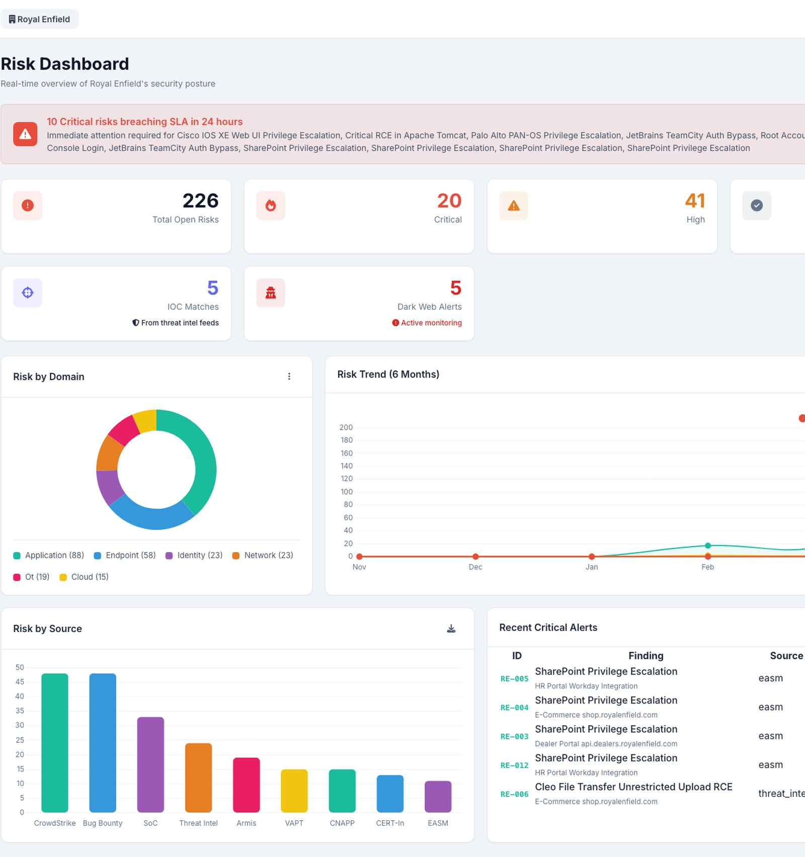
SEMANTIC GRAVITY
Unified Risk
Intelligence
Platform
From siloed security sources to one
decision-ready dashboard — with
remediation steps on every finding.
14 Risk Sources
EPSS + KEV Scoring
Confidential | May 2026

Slide 2
The Problem We're Solving
Today's security reality — and why it's broken
9 Siloed Consoles
Manual Excel Register
CrowdStrike, Armis, VAPT, CERT-In, SoC — all separate. No unified view.
Hours of copy-paste. No pending days. No auto-assignment. No accountability.
Wrong Priorities
No Remediation Steps
CVSS 9.8 theoretical vulnerability fixed first. Actively weaponized CVSS 7.2 waits.
IT team researches every fix manually. Nothing attached to each risk.
Accepted Risks Inflate Reports
Unmanaged Assets Invisible
Board reports show accepted risks as open. Leadership sees wrong posture.
Shadow IT devices on network not tracked. Unknown exposure surface.

Slide 3
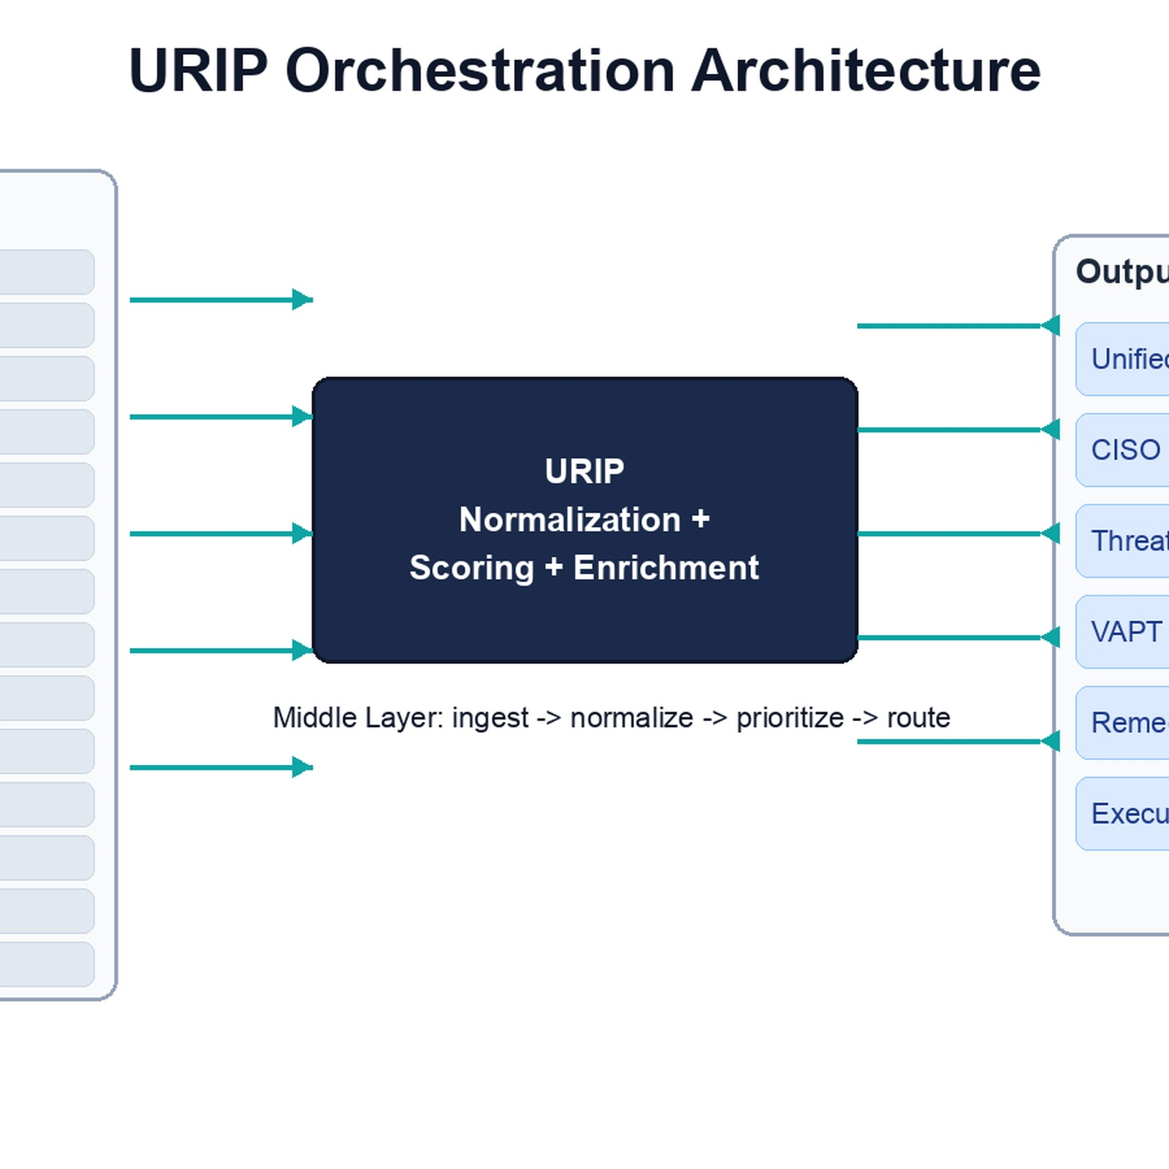
What Is URIP?
An orchestration layer — not a replacement for your existing tools
URIP connects to your existing security stack, aggregates findings from 14 sources, normalizes them to a single scoring scale, enriches each risk with exploit intelligence, and delivers one unified register — with remediation steps on every finding.
AGGREGATE
PRIORITIZE
REMEDIATE
14 sources
One register
EPSS + KEV
Not just CVSS
Steps attached
Auto-scripts P2
No existing tool is replaced. URIP reads from your current stack and adds the intelligence layer on top.

Slide 4
14 Risk Sources — Unified
9 core inputs + 5 security tool connectors added as value-add
CORE 9 — Primary Risk Sources
EXTENDED 5 — Security Tool Connectors (Value-Add)
Spotlight (VM)
Threat Intelligence
Forescout NAC / Cisco ISE
Network access control — rogue device detection
EASM
CERT-In Advisories
CyberArk PAM
Privileged access risk — shared credentials
CNAPP
Bug Bounty
Zscaler ZTA / CASB
Cloud access — shadow IT, policy violations
OT — Armis
SoC Alerts
Fortiguard Firewall
Firewall threat events and anomalies
VAPT Reports
Google Workspace
Email security — phishing and BEC alerts
All connectors use read-only API access. No existing tool is replaced or modified.

Slide 5
The Scoring Engine
Why CVSS alone fails — and how URIP prioritizes correctly
composite = max(0.0, min(10.0, 0.55 × CVSS + 2.5 × EPSS + KEV_bonus + asset_bonus))
0.55×
2.5×
+2.0
+1.0/-0.5
CVSS
EPSS
KEV
Asset Tier
Base severity
(0.0 — 5.5)
Exploit probability
FIRST.org live
CISA confirmed
active exploitation
Critical asset =
higher priority
CVSS 9.8 — theoretical, nobody exploiting
CVSS 7.2 — CISA KEV + APT28 targeting
Composite: 3.3 → SSVC: TRACK
Composite: 9.3 → SSVC: ACT NOW
Nobody is exploiting this right now
Actively weaponized in manufacturing sector

Slide 6
Managed vs Unmanaged Assets
Full visibility across known and unknown attack surface
MANAGED
Per Asset — URIP Shows:
Registered in asset management + endpoint agent present. IT team controls it.
Internal IP address
✓ Asset tag: MANAGED — standard priority
External / Public IP
UNMANAGED
Named product owner
On the network but not registered. Shadow IT — rogue devices, personal laptops.
Asset criticality tier
⚠ Asset tag: UNMANAGED — high risk, investigate
Managed / Unmanaged tag
UNKNOWN EXTERNAL
Source: Agent / CMDB
Subdomains and IPs exposed to the internet that the IT team may not know about.
⚑ Asset tag: UNKNOWN EXTERNAL — investigate immediately

Slide 7
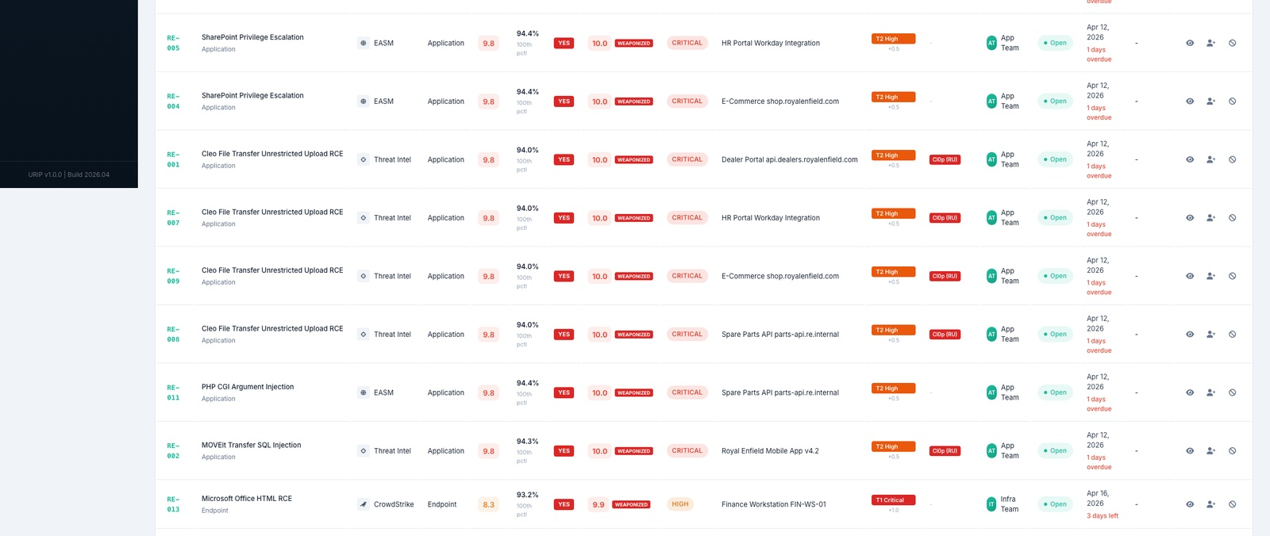
The Risk Register — Live
Every finding: scored, enriched, assigned, with remediation steps
25 columns fully auto-populated from 14 sources • Sorted by composite score (worst first) • No manual entry required

Slide 8
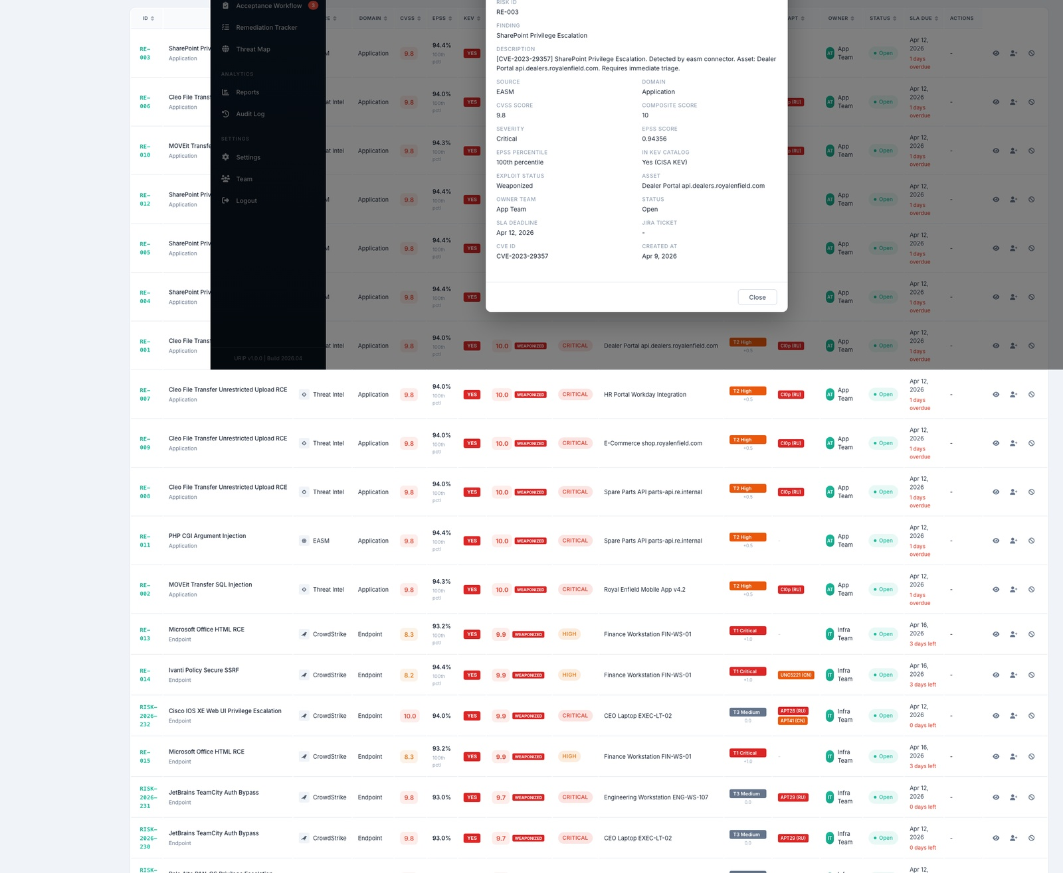
Risk Detail — What Teams See
Every risk expanded: full context + step-by-step remediation
Raised Date
Apr 5, 2026
Pending Days
8 days ⚠
Composite Score
10.0 / CRITICAL
SSVC Label
ACT NOW
Advisory Status
Patch Available
Exploit Status
Weaponized
Remediation Steps (auto-attached):
1. Apply vendor patch
2. Disable anonymous access on affected service
3. Enable MFA on all admin accounts
4. Request vendor re-test after fix

Slide 9
Raised Date & Pending Days
Real-time accountability — not a static deadline, a live counter
Every risk shows exactly how long it has been open. No ambiguity — just facts.
Risk ID
Finding
Raised
Pending
Score
Status
VUL-001
RCE — Public Web App
Apr 1
12 days
10.0
Open
VUL-002
Log4j — Production Server
Apr 3
10 days
9.8
In Progress
VUL-003
SharePoint Priv. Escalation
Apr 5
8 days
10.0
Open
VUL-004
CERT-In Advisory 2026
Apr 9
4 days
7.8
Open
VUL-005
Shared Admin Credential
Apr 10
3 days
6.5
Accepted
⚠ Critical risks with pending days > 7 auto-escalate to security leadership

Slide 10
Remediation Engine
Step-by-step fix on every risk — auto-fetched, never manual
CVE Findings
CERT-In Advisory
Source: NVD + Vendor APIs
Source: Advisory text parsed
Apply vendor patch. Disable anonymous access. Enable MFA on all accounts.
Update affected package to latest version. Restart services. Verify with version check.
VAPT Reports
Bug Bounty
Source: Vendor recommendation
Source: Researcher submission
Sanitize input on vulnerable endpoint. Add file type whitelist. Re-test required.
Add authorization check on resource endpoint before returning user data.
SoC Alerts
IOC Match
Source: Playbook rule map
Source: OTX context + playbook
Isolate device via NAC. Identify owner. Verify registration or remove from network.
Block IP at firewall. Revoke active sessions. Check for lateral movement in logs.

Slide 11
Auto-Remediation Engine
URIP pushes the fix automatically. No human intervention required.
Risk
Registered
Patch
Available?
Implication
Check
Script
Executed
Re-test
Runs
Risk
Closed
Executes via:
CrowdStrike RTR
Ansible Playbook
CyberArk API
Real Time Response — patches endpoints remotely without user interaction
Server config fixes — firewall rules, service restarts, OS patches
Credential rotation — auto-reset compromised admin passwords
⚑ Implication Check runs before any script — shows affected services, expected downtime, and rollback plan. Security team configures which categories auto-execute vs require manual approval.

Slide 12
Threat Intelligence Layer
Who is attacking, how, and are they targeting your sector
✅ LIVE
✅ LIVE
✅ WIRED
EPSS — FIRST.org
CISA KEV Catalog
MITRE ATT&CK
Live daily refresh
Daily refresh
187 APT groups
Exploit probability per CVE. 0.97 = 97% chance in next 30 days.
Confirmed exploited vulnerabilities. +2.0 boost on composite score.
CVE → TTP → APT group → sector targeting. On every risk row.
✅ WIRED
✅ LIVE
⚠ SIMULATED
AlienVault OTX
Geo Threat Map
Dark Web Monitor
IOC feeds
Sector focus
Simulated for demo
Live malicious IPs, hashes, domains. IOC match → CRITICAL risk.
Visual map of attacks targeting your industry sector. Live cluster data.
Credential exposure detection. Real deployment requires paid service.

Slide 13
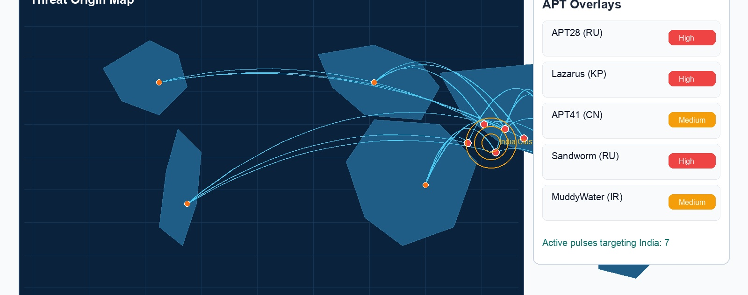
Geo Threat Map
Live visualization of who is attacking your sector — right now
💡 Recommended: 3 Word Clouds alongside map — Top Threat Actors | Top Attack Techniques | Top Targeted Sectors

Slide 14
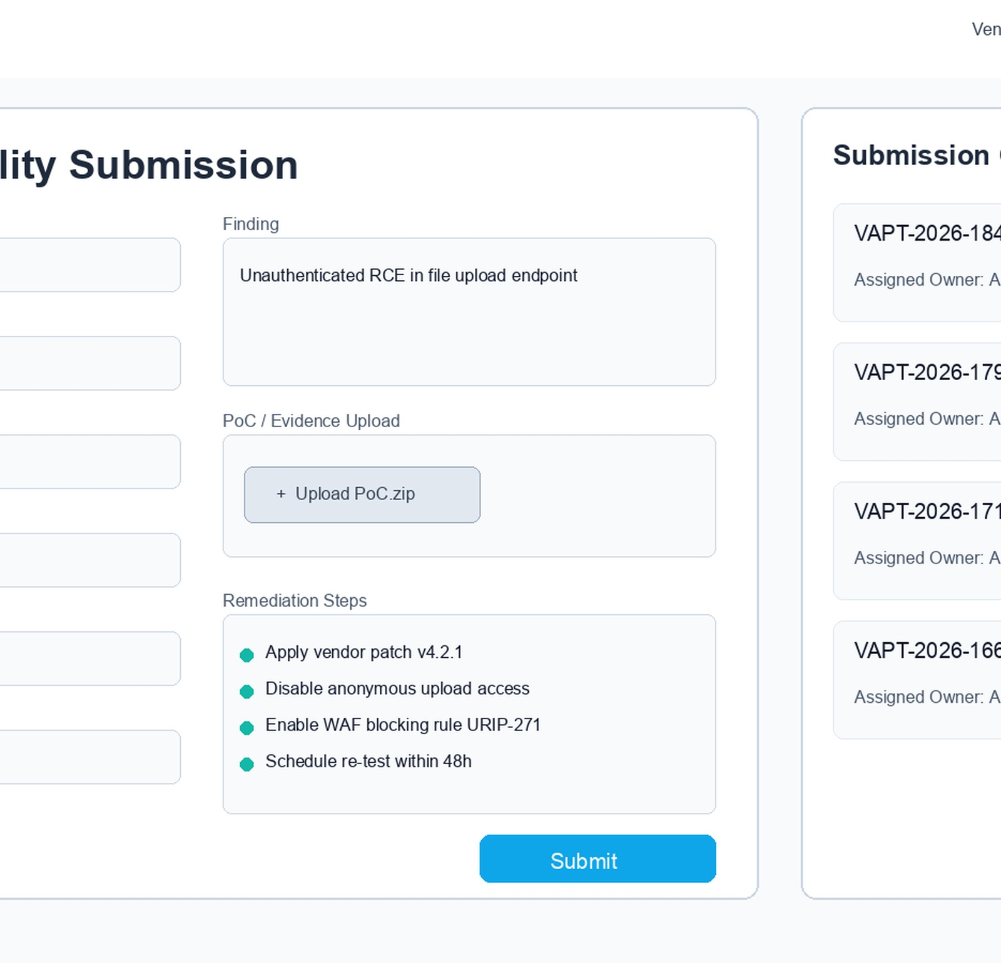
VAPT Vendor Portal
Structured submission — no more PDF emails and manual data entry
1
Vendor Login
Guest role assigned. Scoped — sees only own submissions.
2
Structured Entry
Form: CVE ID, CVSS, Asset, Exploit Maturity, PoC evidence upload. Real-time validation.
3
Auto-Processing
EPSS + KEV enrichment runs. Owner assigned. Raised Date set. Pending Days starts.
4
Re-test Flow
Team fixes → Request Re-test → Vendor confirms → Auto-close on Pass.

Slide 15
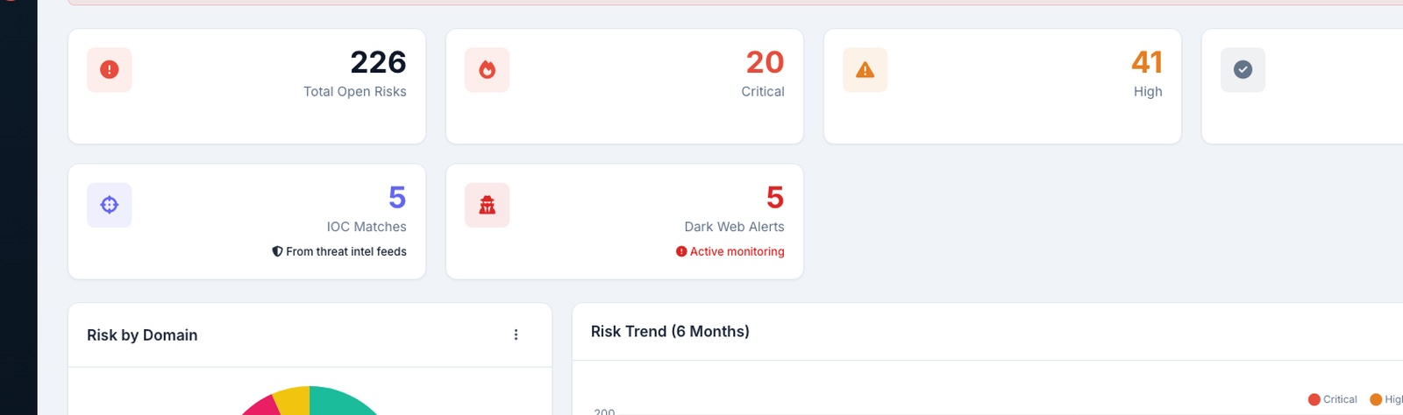
Security Posture Dashboard
One view for CISO, IT Team, and Board — accepted risks excluded
14
3,220
465
8.3
Sources Connected
Risks Enriched
KEV Weaponized
Avg Pending Days
(Critical)

Slide 16
Role-Based Access Control
Everyone sees exactly what they need — nothing more
Role
Can See
Cannot See
CISO / Admin
All 14 sources, all risks, all vendors, full register, all reports
—
IT Team / SPOC
Risks assigned to their domain only
Other domains, vendor details
Vendor (Guest)
Only their own submissions and re-test requests
All internal data
Executive / Board
Dashboard KPIs + board report — no raw data
Individual finding details

Slide 17
End-to-End Workflow
From detection to remediation — fully automated
DETECT
NORMALIZE
DEDUPLICATE
ENRICH
SCORE
ASSIGN
REMEDIATE
REPORT
14 sources
One 0-10 scale
Fingerprinting
EPSS+KEV+APT
Composite+SSVC
Owner+Days
Steps+Scripts
CISO+Board
vs. Current State:
Today
Manual copy-paste • No scoring • No assignment • No remediation steps • No pending day tracking
With URIP
Auto-aggregated • Composite-scored • Auto-assigned • Remediation attached • Pending days live
Auto-Remediation
Scripts pushed • Scripts via CrowdStrike RTR + Ansible • Risk auto-closed after re-test

Slide 18
Why URIP — Key Differentiators
What no other platform currently offers in one solution
Remediation per risk
Raised Date + Pending Days
✓
Every finding has step-by-step fix attached. No manual research by IT team.
✓
Live accountability counter. Not a static deadline — a real-time open tracker.
Managed vs Unmanaged assets
Advisory applicability check
✓
Shadow IT and rogue assets surfaced automatically. Full exposure visibility.
✓
Valid / Patch Available / Expired / Redundant — no stale or irrelevant alerts.
No tool replacement
Auto-Remediation
✓
Works on top of existing stack. Nothing replaced.
✓
Risk → fix script pushed via RTR or Ansible. Auto-closed on pass.

Slide 19
What We Need — Next Steps
Inputs required to finalize and begin development
01
API Access
02
OT Network Decision
Endpoint agent + cloud + SoC SIEM — read-only API keys
On-Premise Collector or Secure API Gateway for isolated segment?
03
Asset Tags / CMDB
04
VAPT Sample Report
Asset criticality tags or CMDB Business Criticality field access
One sample PDF/Excel — to finalize import parser
05
Scoring Confirmation
06
Ticketing Tool
How do you rate Bug Bounty and SoC alerts currently?
Jira or ServiceNow? Board/project structure for tickets?
07
Product Owner Matrix
08
Competitor Quotes
Who is responsible for which asset and domain?
Quotes from other vendors — for commercial benchmarking

Slide 20
APT Groups, IOCs & TTPs — On Every Risk
Who is attacking, what fingerprints they leave, and how they do it
APT
Advanced Persistent Threat
IOC
Indicator of Compromise
TTP
Tactics, Techniques & Procedures
Professional hacker armies — often nation-state funded. Examples: APT28 (Russia), APT41 (China), Lazarus (North Korea). URIP maps which APT group uses each CVE.
Digital fingerprints left by attackers — malicious IP addresses, file hashes, domains. When an IOC is found in your network, URIP auto-creates a CRITICAL risk.
HOW attackers operate. Mapped from MITRE ATT&CK framework. Example: T1190 = Exploit Public-Facing App. Tells the team exactly what the attacker did.
How it appears on every risk row:
CVE-2023-20198 | CVSS 7.2 | EPSS 95% | KEV: Yes | Asset: Dealer Portal | Composite: 9.3
APT28, APT41
T1190
WEAPONIZED • 3 IOCs matched
Sector: Manufacturing, Defense — HIGH MATCH
SSVC: ACT NOW
All tags auto-generated. Zero manual tagging by security team.

Slide 21
Industry Standards — How URIP Connects
MITRE, CISA, NIST — live APIs, not manual lookups
MITRE
MITRE Corporation
CISA
Cybersecurity & Infrastructure Security Agency
The Librarian
The Police Chief
Creates and maintains the CVE naming system + ATT&CK framework of APT tactics and techniques. URIP pulls live CVE data and maps every finding to MITRE TTPs automatically.
US government agency that publishes the KEV (Known Exploited Vulnerabilities) catalog — an official list of CVEs confirmed being actively exploited right now. URIP fetches this daily.
API: attack.mitre.org / cve.mitre.org
CVE IDs + APT group profiles + TTP mapping
API: cisa.gov/known_exploited_vulnerabilities.json
KEV catalog → +2.0 boost on composite score
NIST
National Institute of Standards & Technology
FIRST
Forum of Incident Response & Security Teams
The Standard Setter
The Score Keeper
Manages the NVD (National Vulnerability Database) — the most comprehensive source of CVE details, CVSS scores, and patch information. URIP queries NVD to fetch remediation steps per CVE.
Manages the EPSS (Exploit Prediction Scoring System) — a daily machine-learning model that predicts the probability any CVE will be exploited in the next 30 days. URIP fetches this live.
API: nvd.nist.gov/developers/vulnerabilities
CVSS scores + patch details + remediation data
API: api.first.org/data/v1/epss
EPSS score → 2.5× weight in composite formula

Slide 22
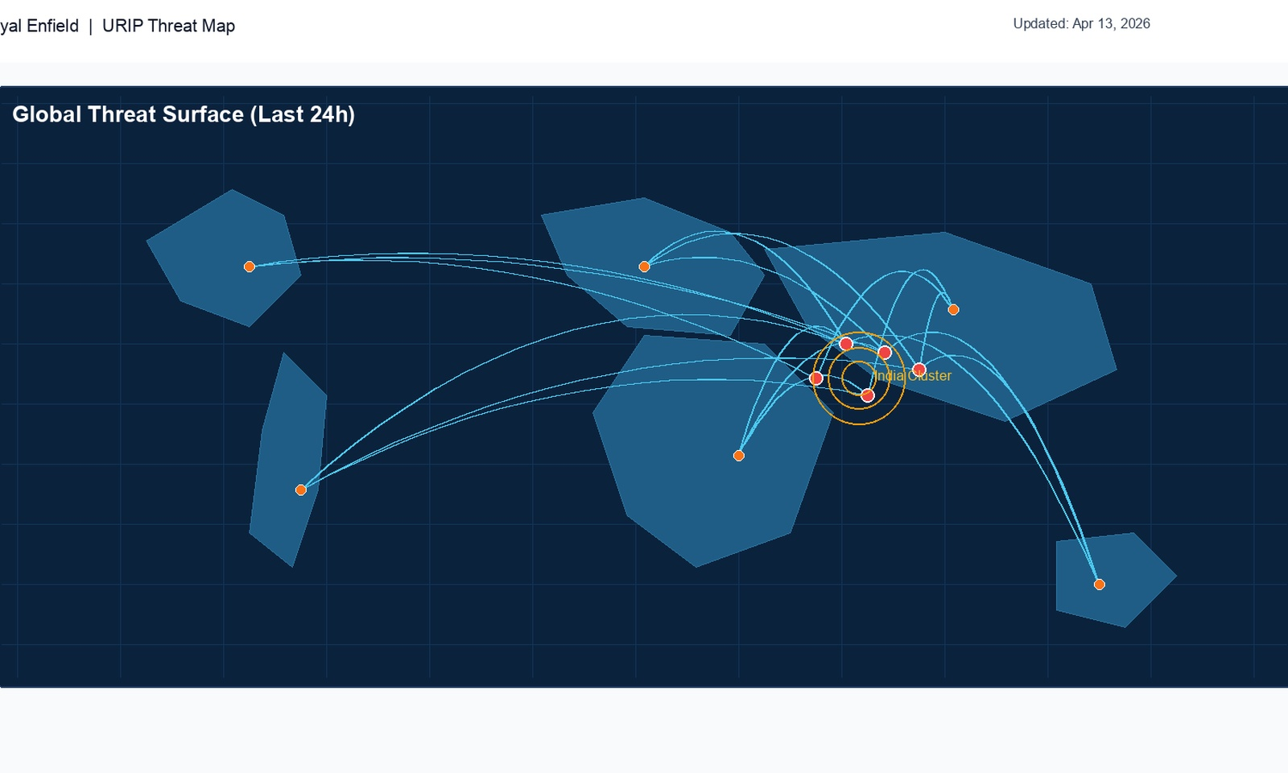
Live Threat Map
Geographic visualization of active attacks targeting your sector
What the map shows:
Attack Origins
Geographic source of active attacks targeting manufacturing sector
APT Campaigns
Named threat groups and their active campaigns overlaid on map
India Threat Focus
7 active threat pulses targeting Indian manufacturing right now
Sector Heatmap
Which industries are most targeted by current APT activity
IOC Cluster
Malicious IPs / domains linked to active campaigns
💡 Three Word Clouds alongside map: Top Threat Actors (APT28, Lazarus...) | Top Attack Techniques (RCE, Phishing...) | Top Targeted Sectors (Manufacturing, Defense...)

Slide 23
SEMANTIC GRAVITY
Let's Build It.
From scattered, siloed security data to one intelligent platform —
with remediation steps, pending days, and auto-remediation built in.
14 Sources
Composite Score
Remediation per Risk
Pending Days Live
contact@semanticgravity.in | Demo: May 2026

