Slide 1
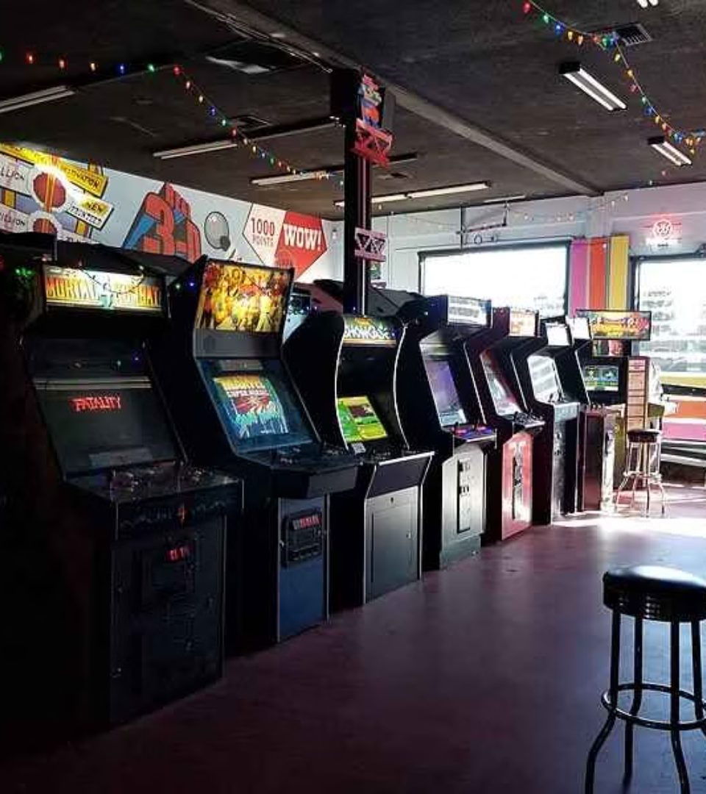

Games-Arcade
Prepared by: Kakani Niharkumar Kishorbhai
Enrollment no: 24002170110071
Branch : CE
Batch : D1

Slide 2


Introduction
1
What is Game Arcade?
A collection of three interactive games built using Java. Provides a fun and engaging experience through command-line gameplay.
2
Purpose:
To develop a Java-based game system using Object-Oriented Programming (OOP). Enhance coding skills by implementing game logic and user interaction.

Slide 3

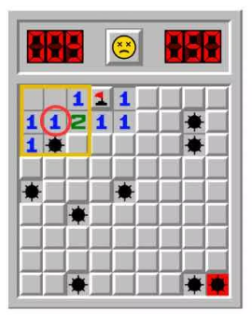
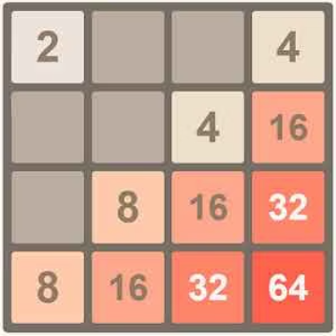
Games Included
Minesweeper
2048
Tic-Tac-Toe
A board-based game with hidden mines. Players reveal squares; numbers indicate how many mines are nearby. Objective: Clear the board without hitting a mine. Difficulty Modes: Easy (6x6), Moderate (9x9), Hard (9x9 with more mines).
A number puzzle game where players merge tiles to reach 2048. Moves: Up, Down, Left, Right. The game ends when no moves are left.
A two-player game where players take turns marking ‘X’ or ‘O’ on a 3x3 grid. The goal is to form a row, column, or diagonal of the same symbol to win. Can be played against another player or the computer.

Slide 4





Technology Used
Programming Language: Java
Classes
Recursive Methods
Data Validation
Object-Oriented Programming
Implemented for game logic
Ensuring correct user input
Random Numbers
Command-line Input
Math.random() for game events
Scanner class for user interaction

Slide 5
Strong Points & Registration/Login System
Strong Points of the Code:
Registration & Login System:
Well-structured using OOP principles.
Users can register using mobile number or email.
Efficient data validation to ensure correct user inputs.
OTP-based verification for secure registration.
Username & password validation to ensure security.
Use of recursion for user input validation and game logic.
User authentication before accessing games
Proper error handling for invalid inputs.

Slide 6





Future Improvements
Graphical User Interface (GUI)
Multiplayer Mode
Instead of a command-line display.
Over a network.
Save and Load Game States
Enhanced Game AI
For resuming later.
For better computer opponent behavior.

Slide 7
Conclusion
1
What I Learned
2
Summary
Strengthened Java programming skills
Built a fully functional Game Arcade with three games
Improved problem-solving abilities
Identified key challenges and worked on improvements

Slide 8
Thank You!
Questions?

