Slide 1



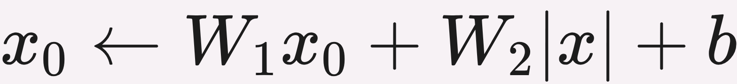
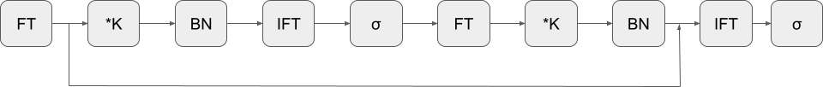
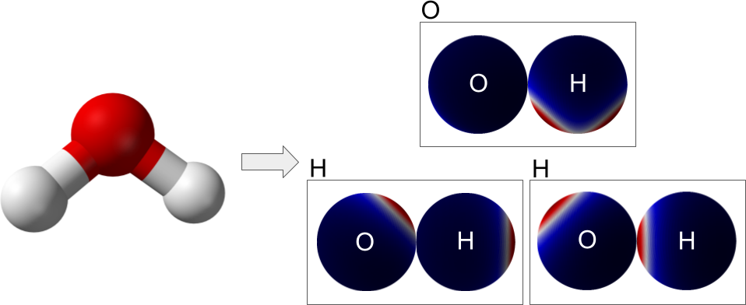


Scaling Spherical CNNs
Carlos Esteves¹, Jean-Jacques Slotine², Ameesh Makadia¹
¹ Google Research ² MIT
PROBLEM
METHOD
ABLATION
Spherical CNNs compute convolutions in
the spectral domain — far costlier than
planar convolution — so applications
stayed confined to small, low-resolution,
low-capacity problems.
Phase collapse nonlinearity: the modulus |x| collapses phase to
restore rotation invariance without information loss.
COMPONENT
Δ STEPS/S
Δ RMSE
Phase collapse
−4.6%
−8.0%
Spectral batch norm, spectral pooling, and an efficient residual block with a Fourier-
space skip connection (Figure 2).
Efficient residual
+19.3%
−2.4%
TPU-tuned JAX rewrite: Fourier transforms run as dense matrix multiplies (DFT),
not FFTs, across up to 32 TPUs.
No spherical CNN existed at the scale
of planar nets like VGG-19, blocking
large scientific datasets.
HEADLINE NUMBERS
phase collapse activation — the modulus term restores rotation invariance
10×
8/12
QM9 SOTA
targets (Split 1)
Larger spherical
CNNs (ops &
resolution)
−8.0%
RMSE from
phase
collapse
MOTIVATION
~100×
faster on 32
TPUs
Molecular property prediction and
weather forecasting are naturally
spherical and rotation-related — a
perfect fit for rotation-equivariant
spherical CNNs.
Figure 2. The efficient residual block: spin-weighted Fourier transforms (FT/IFT), filter multiply (∗K), activation (σ), and spectral
batch norm (BN). The skip connection happens in Fourier space.
TAKEAWAY
DATASET / BENCHMARK
KEY RESULTS
Redesigned components plus a TPU-
tuned JAX rewrite let spherical CNNs
finally reach state-of-the-art molecular
prediction.
A molecule's properties are invariant to
rotation and the atmosphere is a signal
on a sphere — equivariance should be a
decisive inductive bias.
QM9 · 134K molecules
WeatherBench
ERA5
QM9 (Split 1)
ϵ_{gap}
zpve
U₀
H
DimeNet++
32.6
1.21
6.32
6.53
TorchMD-Net
36.1
1.84
6.15
6.16
The first demonstration that
spherical CNNs are viable,
competitive neural weather models.
Yet the field was dominated by
equivariant GNNs and transformers;
prior spherical CNNs were stuck on tiny
sets like QM7, 18× smaller than QM9.
Ours
28.8
1.15
5.65
5.69
SOTA on 8/12 (Split 1) and 9/12 (Split 2) QM9
targets · lower is better (meV)
Molecules encoded as spherical functions per atom, from
physically-based atom-pair interactions; QM9 regression + 3–
28 day weather forecasting.
SO WHAT → Beats the previously dominant GNNs and transformers, and outperforms the WeatherBench baseline on all metrics in the 2-predictor setting.
SCAN TO
READ
To compete, models must scale to QM9
(134K molecules) and high-resolution
ERA5 grids.
Paper & Code
arxiv.org/abs/2306.05420
Paper
Code

