Slide 1


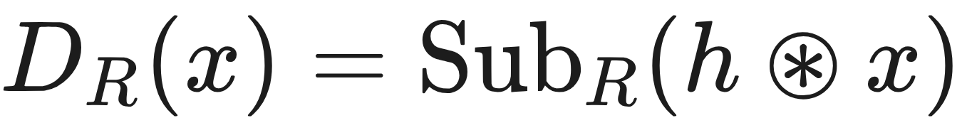
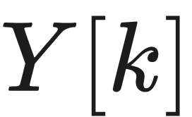
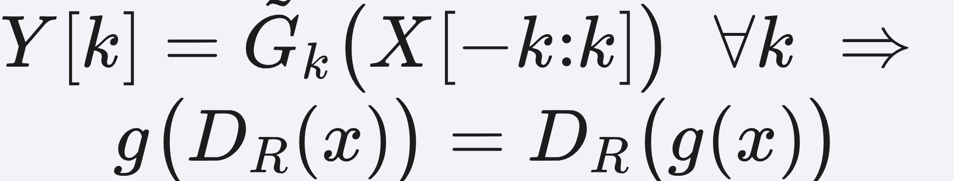
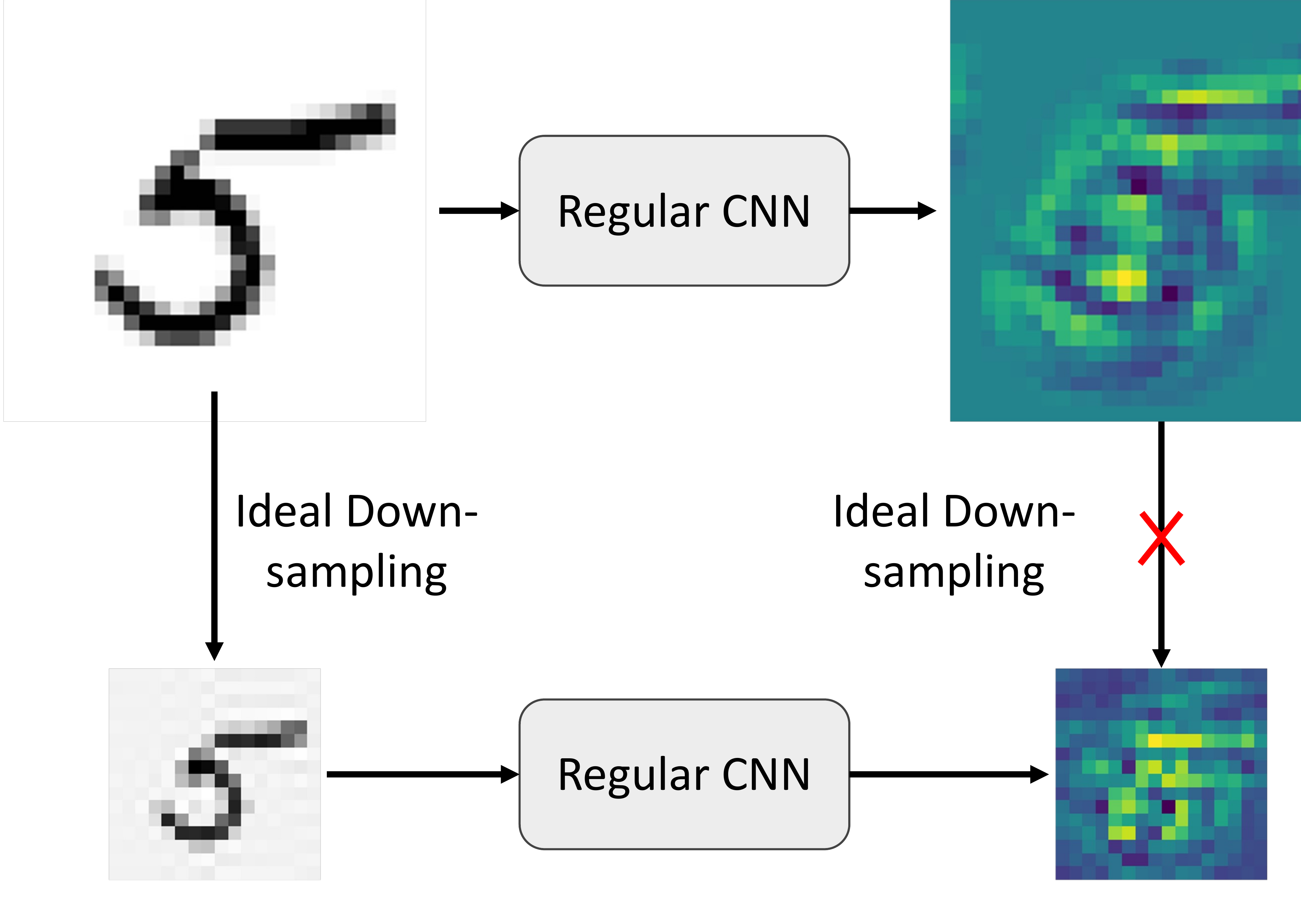
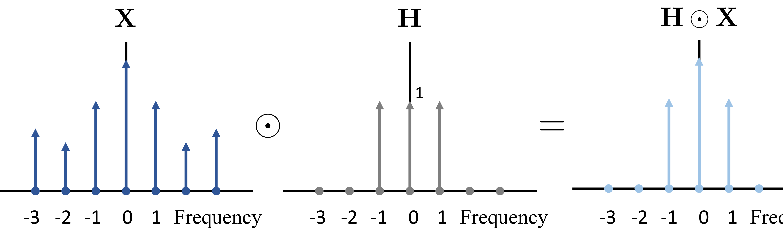
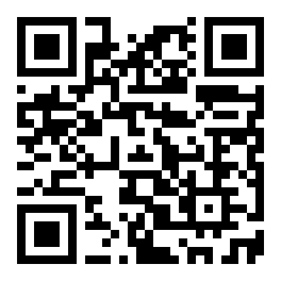
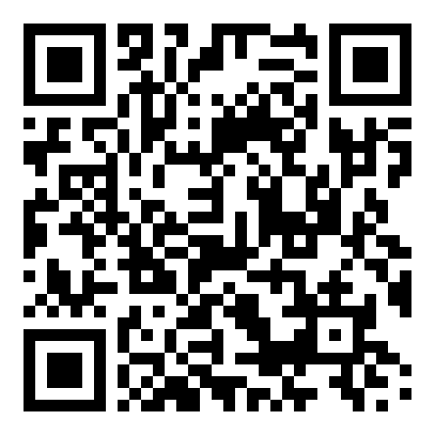
Truly Scale-Equivariant Deep Nets with Fourier
Layers
Md Ashiqur Rahman¹, Raymond A. Yeh¹
¹ Department of Computer Science, Purdue University
Problem
Method
Dataset / Benchmark
Headline Numbers
Scale-equivariant CNNs are not truly scale-
equivariant: weight-sharing and kernel
resizing still leave a non-negligible
equivariance error in practice.
Define down-scaling as ideal downsampling : an ideal low-pass filter, then subsampling.
MNIST-scale (8×8→28×28) and STL10-scale
(48→97) — standard scale-equivariance
benchmarks, tested under ideal and non-ideal
(Gibbs-ringing) downsampling, unseen scales, and
low data.
0.00
0.9889
MNIST-
scale acc
End-to-end scale-
equivariance error
0.7332
STL10-
scale acc
Derived in the continuous domain, then
discretized — the gap surfaces as
residual error.
Claim 1: a net is scale-equivariant iff every output frequency depends only on equal-or-lower input frequencies.
exact, by construction
0.9716
scale-
consistency
MNIST-scale
STL10-scale
ideal
non-ideal
Redesign every module — a spatially-local Fourier
convolution, a frequency-aware non-linearity, and
Fourier pooling — to satisfy the condition.
Takeaway
Ablation Study
Motivation
Formulate down-scaling as ideal, anti-
aliased downsampling and enforce the
frequency-dependency rule via Fourier
layers: the network becomes exactly scale-
equivariant, not merely approximately.
CONSISTENCY LOSS
SC-CON W/O↑
SC-CON W/↑
Down-scaling a discrete signal is a
signal-processing operation: the Nyquist
theorem requires an anti-aliasing filter
before subsampling.
5000 samples
0.9150
0.9296
2500 samples
0.8633
0.8906
each output frequency uses only equal-or-lower input frequencies ⇒ exact scale-equivariance
1000 samples
0.8144
0.8183
Prior continuous-domain methods
have no anti-aliasing, so high
frequencies alias into low ones and
break equivariance.
SO WHAT → The hinge consistency loss lifts accuracy and scale-consistency at every training-set size.
Get the signal processing right, and
approximate equivariance becomes
provable, absolute equivariance.
Key Results
PROVABLE
To be truly equivariant, formulate down-
scaling directly in the discrete domain,
with anti-aliasing built in.
Zero equivariance error by
construction, and the most data-
efficient scale-equivariant net.
MNIST-SCALE (IDEAL)
ACC↑
SC-CON↑
EQ-ERR↓
DISCO
0.9856
0.5585
0.44
Fourier CNN
0.9713
0.2421
0.28
Ours
0.9889
0.9716
0.00
Scan to Read
0.7332
+15pt
0.00
STL10-scale acc
over next best
equi-error
Ideal low-pass (anti-aliasing) filter H zeros
frequencies above the new Nyquist limit before
subsampling.
Downsampling our high-res feature reproduces the low-res
feature exactly; a regular CNN's features diverge across
resolutions.
SO WHAT → Best on every metric, with a ~15-pt margin on STL10-scale.
Paper
Code

