Slide 1


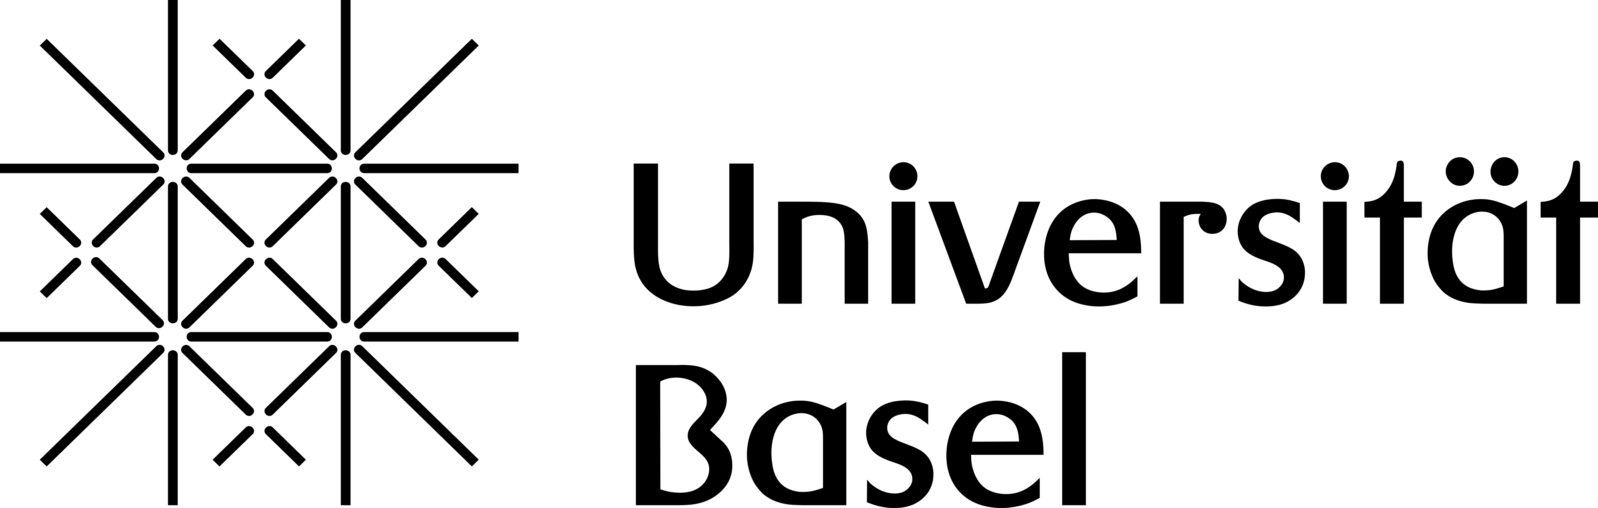
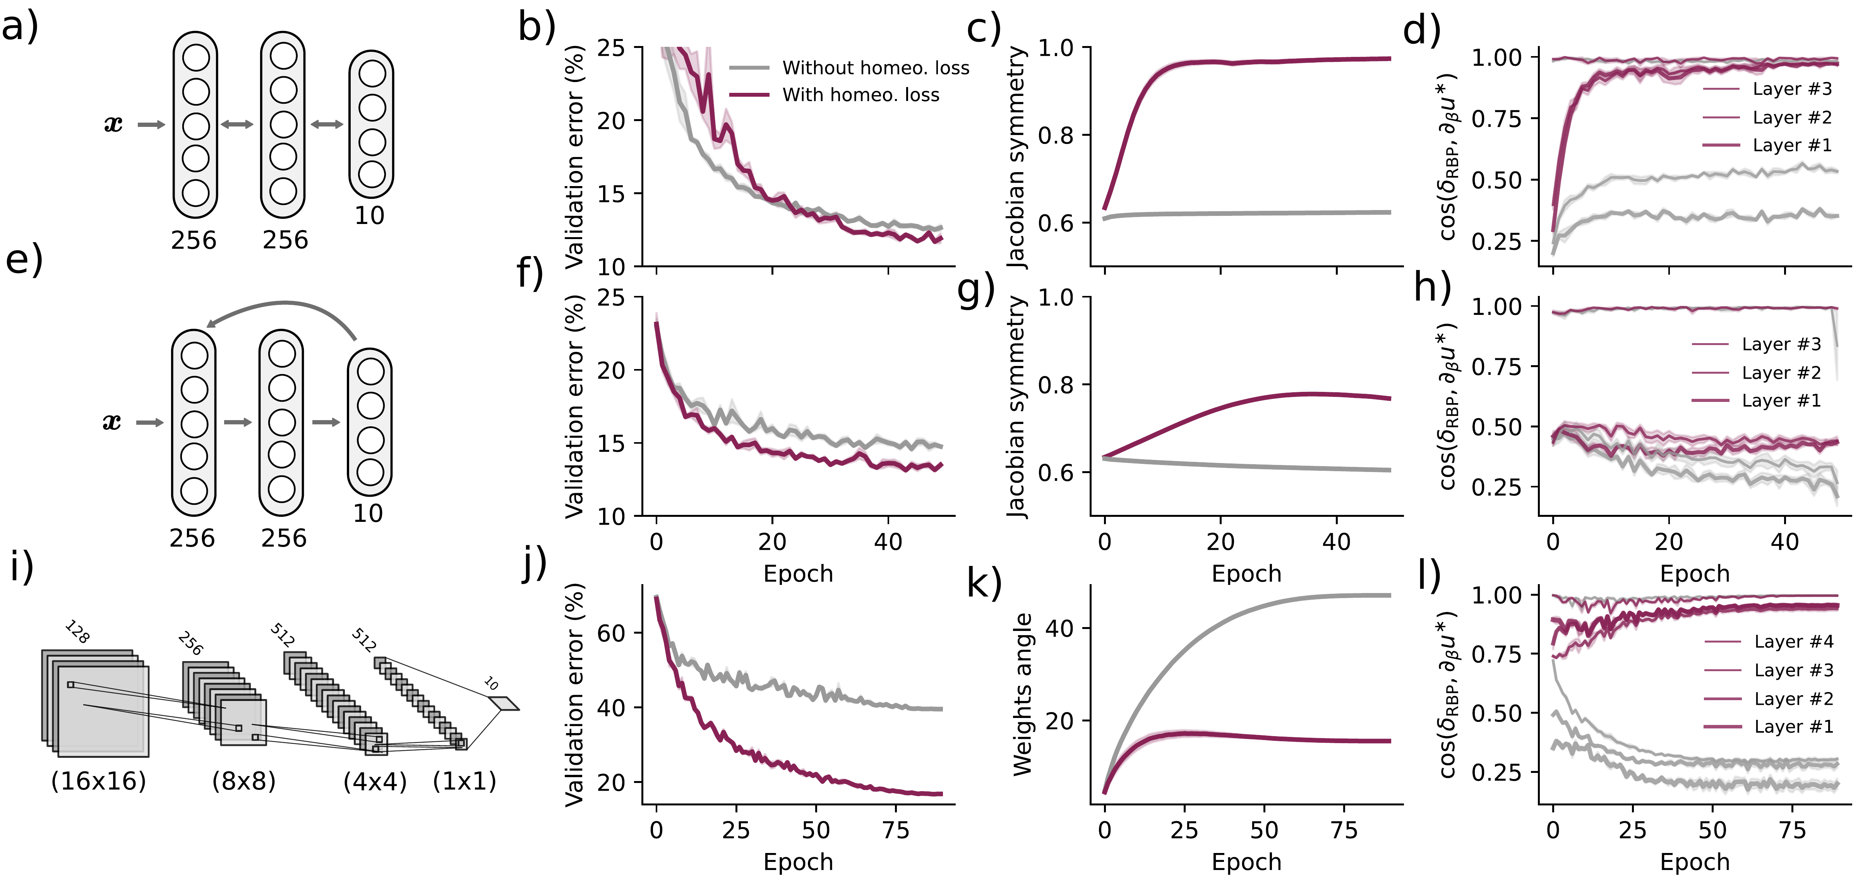
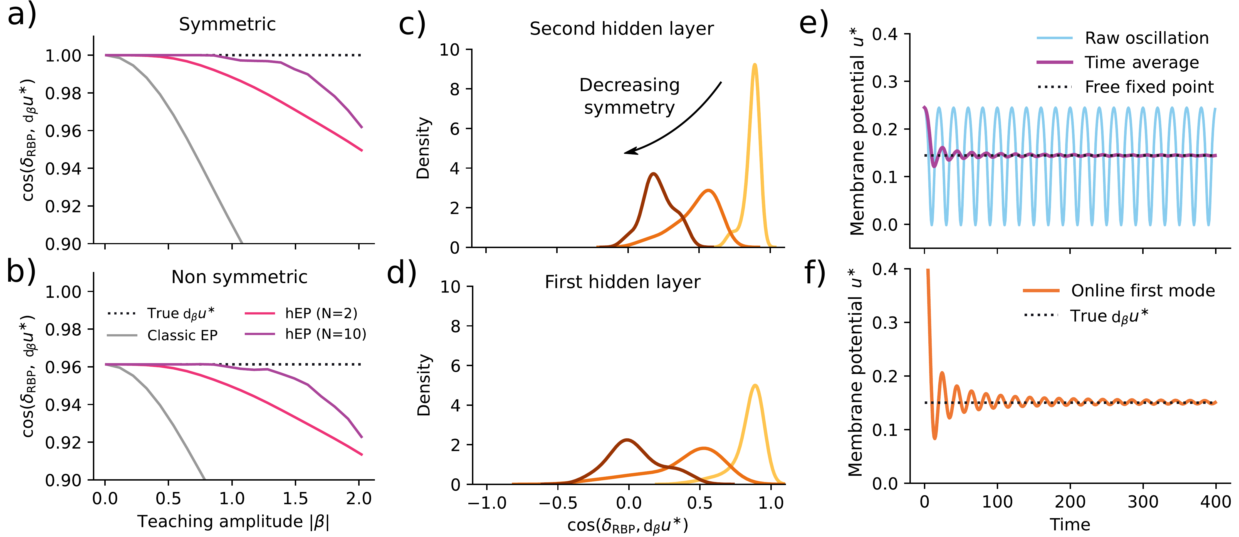
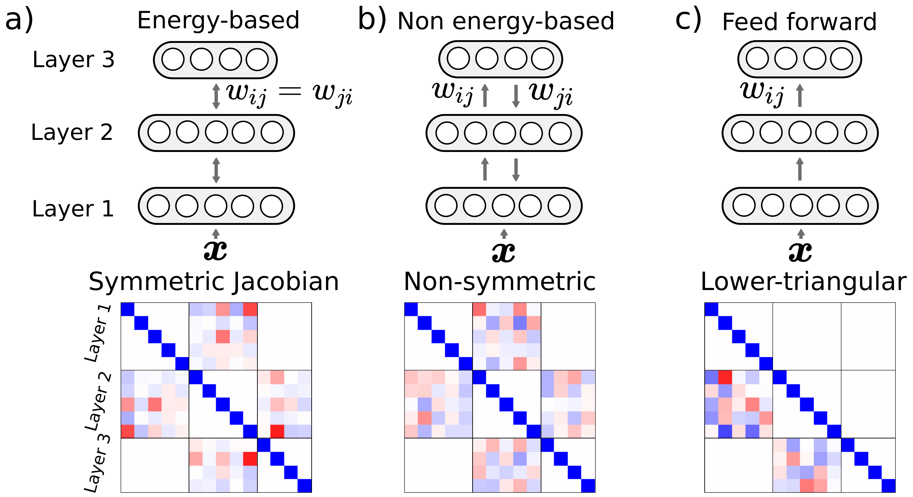
Improving Equilibrium Propagation without Weight Symmetry through Jacobian
Homeostasis
Axel Laborieux¹, Friedemann Zenke^{1,2}
¹ Friedrich Miescher Institute for Biomedical Research, Basel · ² University of Basel
Problem
Method
Key Results
Equilibrium propagation (EP) computes gradients from a network's
own relaxation, but stays unbiased only under two conditions
physical hardware cannot meet: perfectly symmetric weights and
an infinitesimal nudge.
Generalized holomorphic EP drives the net with an oscillating
teaching signal β(t) and reads the exact neuronal error via a
Cauchy integral — killing finite-nudge bias even for asymmetric
Jacobians, in continuous time without separate free/nudged
phases.
Asymmetric hEP
C-10
C-100
IN 32²
w/o ℒ_{homeo}
60.4
35.2
—
+ ℒ_{homeo} (ours)
84.3
53.8
31.4
Asymmetry's true cost had never been isolated — it hides
behind the finite nudge.
A new homeostatic loss penalizes the skew-symmetric part A
of the free-fixed-point Jacobian, improving functional symmetry
without ever tying the weights.
Motivation
Physical substrates (brains, analog chips) could train at a
fraction of digital energy, yet backprop needs the exact
transpose of every weight they cannot provide.
Penalizes the skew-symmetric part of the Jacobian, estimated with the Hutchinson trace trick.
Generalized (asymmetric) EP had only worked on MNIST and
failed outright on CIFAR-10 — an unexplained scaling failure.
Homeostatic loss lifts symmetry and error alignment across datasets.
Headline Numbers
84.3%
31.4%
ImageNet 32² Top-1
CIFAR-10 Top-1, asymmetric hEP
55.2%
ImageNet 32² Top-5
up from 60.4% without the homeostatic loss — a +23.9-
point jump that lands within just 4.3 points of the fully
symmetric network
14.3%
F-MNIST err |β|=.5
The Cauchy integral recovers the exact error at finite nudge, even for
asymmetric Jacobians.
Takeaway
Datasets
Bias is first isolated on small MLPs, then hEP is scaled on a
recurrent convolutional net with genuinely asymmetric feedback
weights.
Equilibrium propagation does not need symmetric weights:
removing finite-nudge bias with a Cauchy integral and penalizing
Jacobian asymmetry lets asymmetric networks reach ImageNet-
scale accuracy near the symmetric ceiling — a biologically
plausible route toward training physical neural substrates.
Energy-based nets force weight symmetry (symmetric Jacobian); dropping
it breaks symmetry, while feedforward nets stay lower-triangular.
Fashion-MNIST
CIFAR-10
CIFAR-100
ImageNet 32×32

