Slide 1


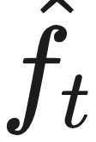
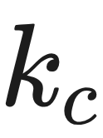
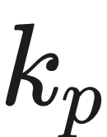
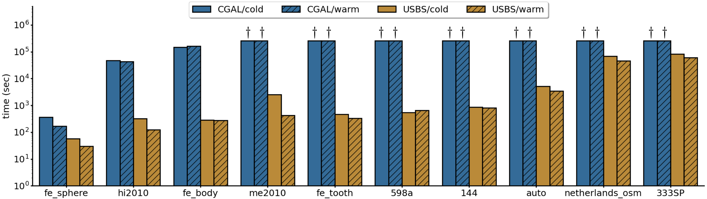
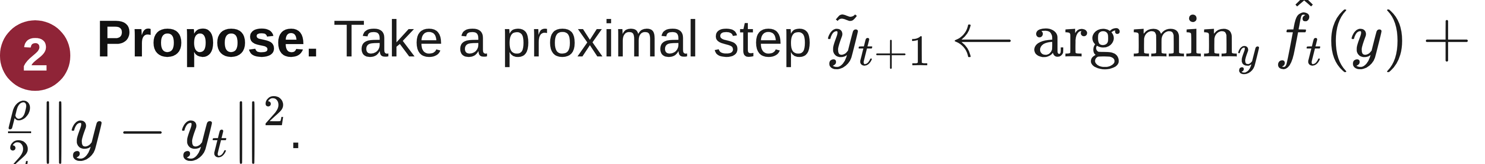
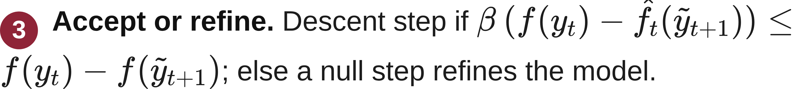
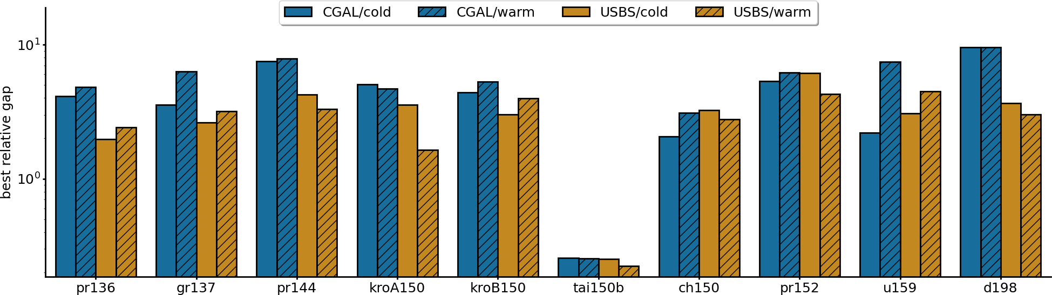
Fast, Scalable, Warm-Start Semidefinite Programming with Spectral Bundling &
Sketching
Rico Angell · Andrew McCallum
Manning College of Information & Computer Sciences, University of Massachusetts Amherst
Problem
Method
Key Results
Classic SDP solvers project onto the PSD cone via a full
eigendecomposition that scales cubically, so large SDPs are
widely dismissed as intractable at scale.
USBS minimizes a penalized reformulation of the dual using a
proximal bundle method:
METRIC
CGAL
USBS
MaxCut solved (≤28 h)
3 / 10
10 / 10
>2B-variable instance
fails (72 h)
500× faster
Sketching solvers (CGAL) scale further but need more
iterations as size grows, and block warm-starting.
the penalized dual: largest-eigenvalue term + linear term + inequality indicator.
Warm-start speedup
unreliable
>100×
1
Model. Build a cheap lower model over a low-dim subspace of current ( ) + past ( ) max-eigenvectors.
Motivation
2
Propose. Take a proximal step .
SDPs are rarely solved once: incremental data and mixed-integer
loops pose long sequences of closely related, nearly-identical
subproblems to solve.
3
Accept or refine. Descent step if ; else a null step refines the model.
Warm-starting is the prize — but scalable solvers
rarely exploit it.
MaxCut time: USBS solves all 10 graphs; CGAL fails on 7/10 (†).
4
Sketch. Store only a low-rank sketch of the primal matrix →
memory stays bounded, scaling to billions of variables.
SO WHAT → Margin over CGAL widens with problem size.
PRIOR SPECTRAL BUNDLE
vs.
USBS (OURS)
Headline Numbers
Equality or inequality only;
no large-scale solver.
Both, plus sketching for
scale and warm-starting.
Dataset / Benchmark
500×
>100×
warm-start convergence
speedup
Evaluated across three problem families; each warm start is built
from a slightly smaller, closely related instance.
10 /
10
faster than CGAL on a >2B-
variable instance
MaxCut solved (CGAL: 3 /
10)
Contribution
n = 16K–3.7M
vs. prior state-of-the-art scalable solver
10¹³
decision variables scaled
FIRST
n = 136–198
Entity resolution
PubMed
QIAN
SCAD-zbMATH
Spectral bundle method for general SDPs — equality and
inequality in one solver.
Takeaway
Sketching for scale — an optional low-rank sketch bounds
memory at billions of variables.
Large-scale SDP need not be slow or narrow: USBS unifies
equality & inequality constraints, adds optional sketching,
and makes warm-starting actually work — a provably-
correct, pure-JAX solver (CPU/GPU/TPU) for incremental
optimization. Open: github.com/rangell/usbs
Reliable warm-starting — reuses a previous solution where
scalable solvers cannot.
QAP best relative gap: USBS beats CGAL, exploits warm starts.

