Slide 1





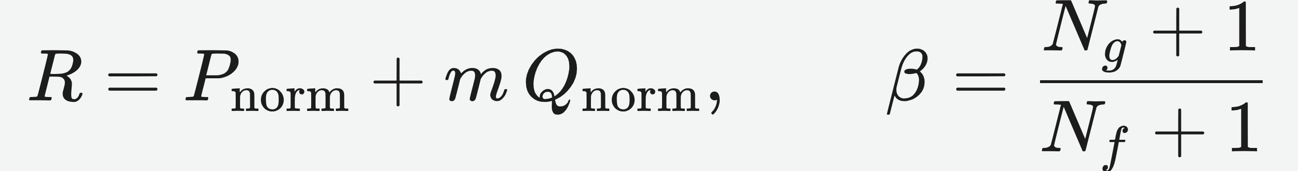
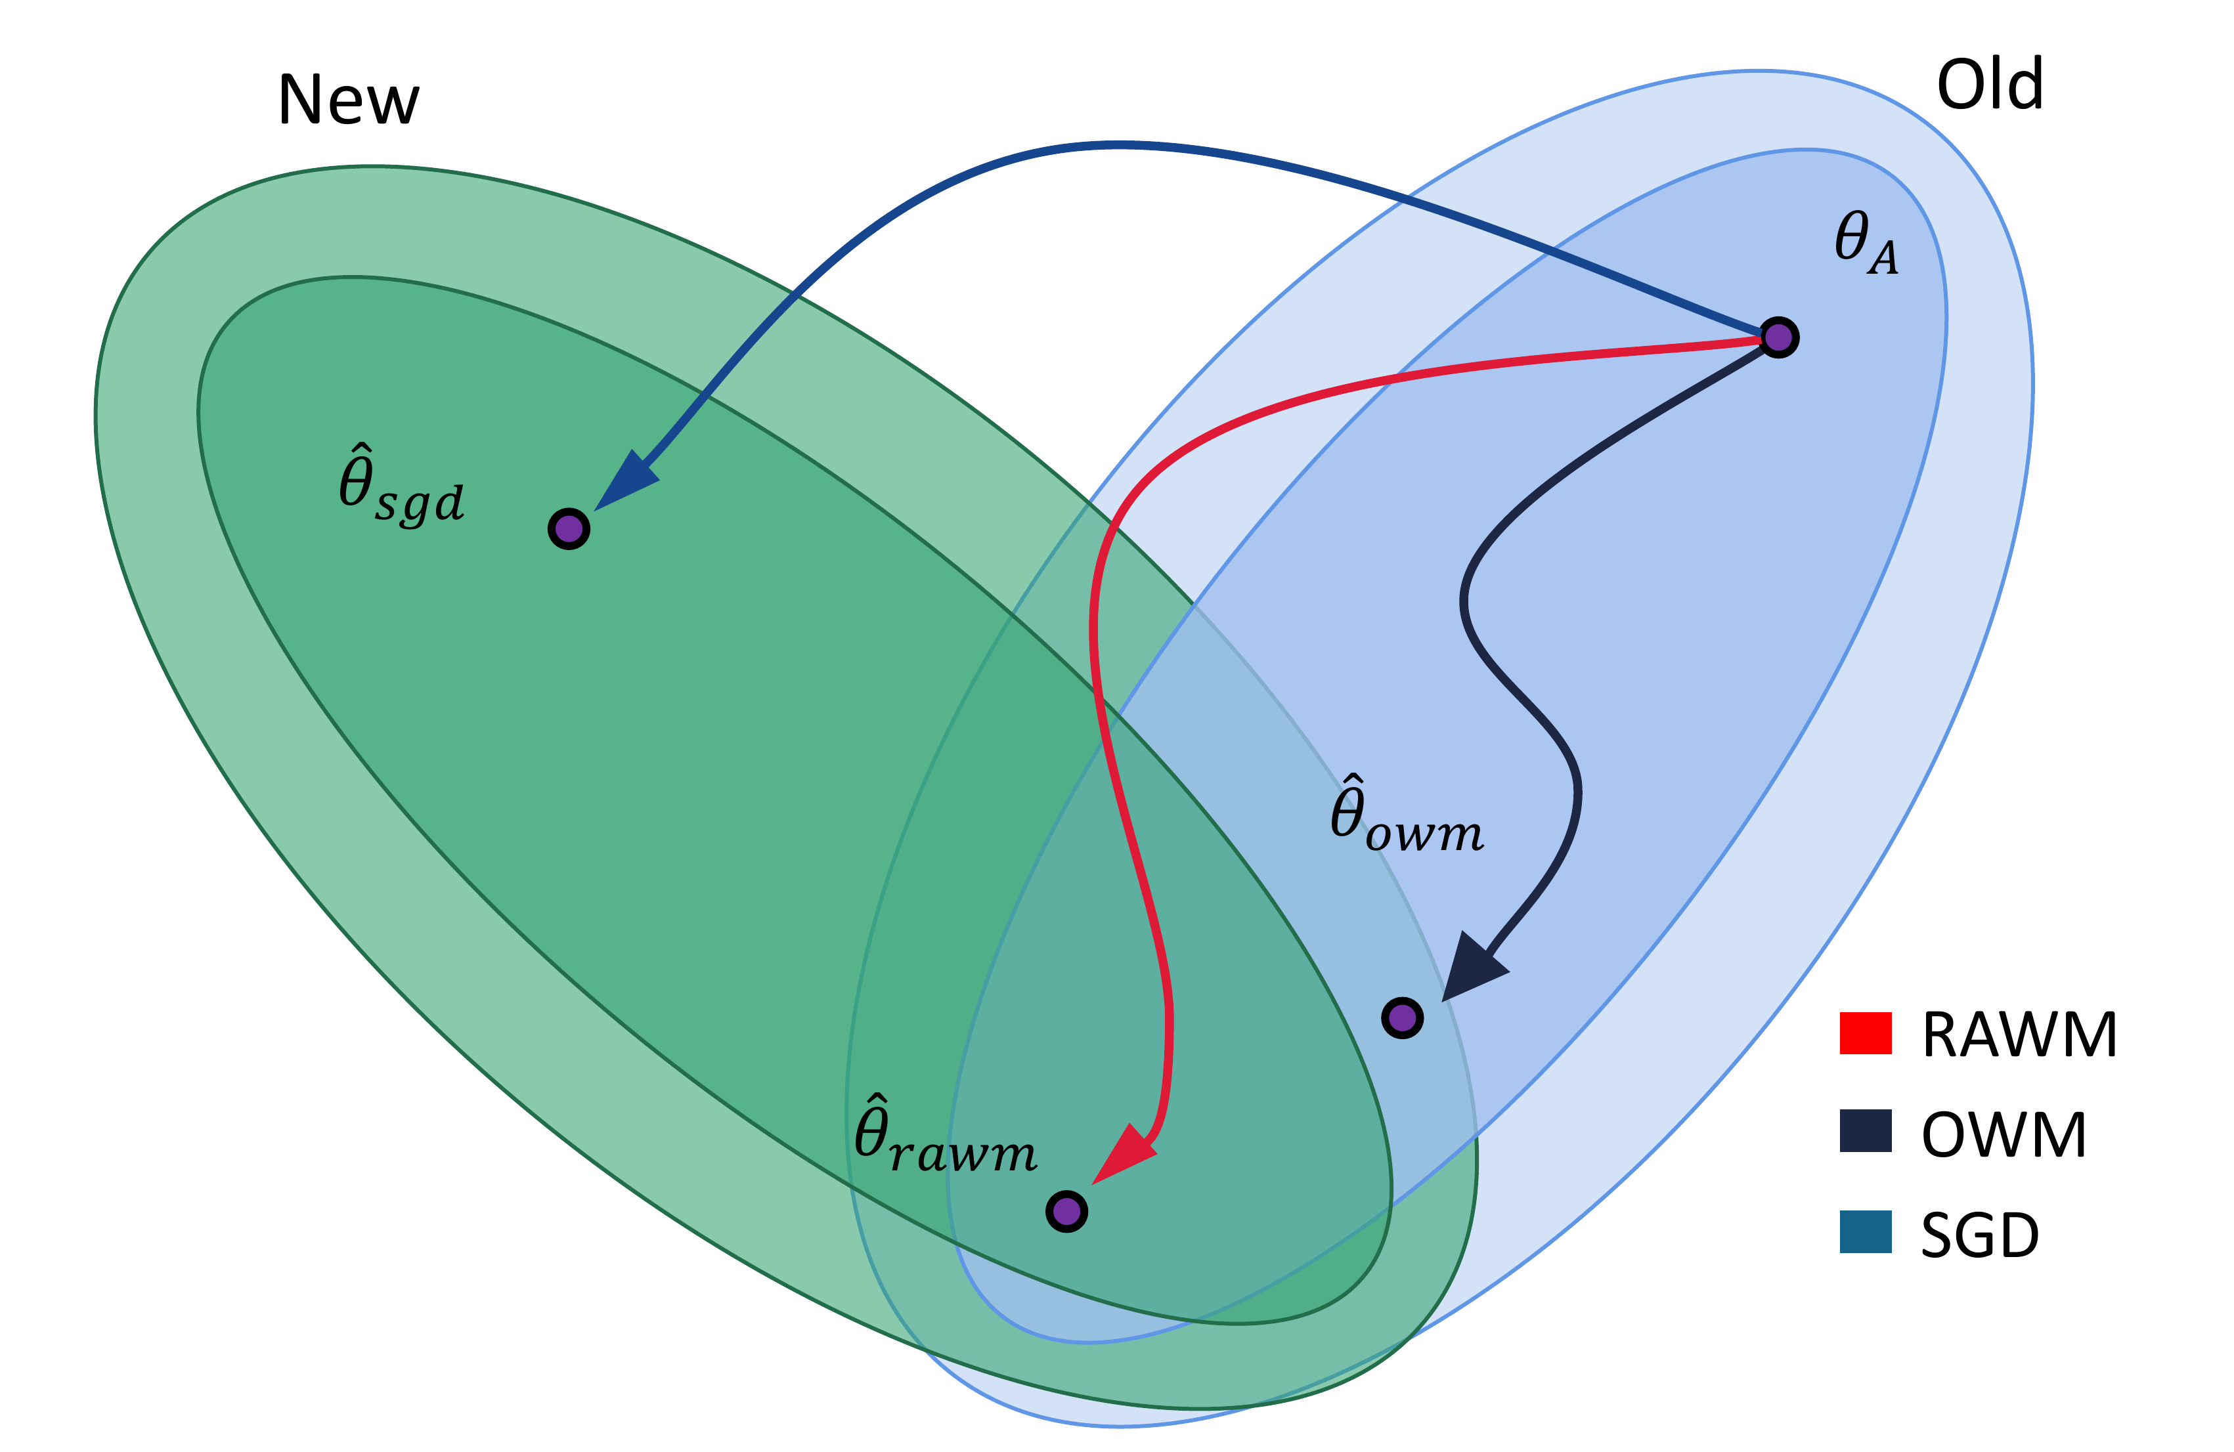


Do You Remember? Overcoming Catastrophic Forgetting for Fake Audio Detection
Xiaohui Zhang^{1,2} Jiangyan Yi¹ Jianhua Tao³ Chenglong Wang^{1,4} Chuyuan Zhang¹
¹ Institute of Automation, CAS ² Beijing Jiaotong University ³ Tsinghua University ⁴ USTC
Problem
Method
Dataset / Benchmark
Headline Numbers
Fake audio detectors are accurate on their
training set but degrade sharply on audio
from another dataset. Naively fine-tuning
on new data makes the network forget the
old — catastrophic forgetting.
1
Start from OWM's projector P (orthogonal to past
inputs); add a projector Q ⊥ P, scaled by β, the batch's
genuine-to-fake ratio.
Four fake-audio sets trained in sequence — source S
then fine-tuned S→T₁→T₂→T₃, each a distinct
condition; scored by Equal Error Rate (EER, %)
over Wav2vec 2.0 features.
10×
0.50
optimal η
weight
less forgetting than
fine-tuning
0.92
few-sample
EER, old set
2
Combine into direction R; update W ← W + R·G —
a genuine-heavy batch preserves old knowledge, else
learns new.
new-dataset EER roughly
halved — zero replayed data
54.2%
IEMOCAP
accuracy,
best
Prior fixes replay old samples —
unavailable for a released model.
ASVspoof2019LA (S)
ASVspoof2015 (T1)
VCC2020 (T2)
In-the-Wild (T3)
MSP-Podcast
3
Regularize: a frozen teacher makes the student
match softened outputs, keeping the old distribution.
No replay.
IEMOCAP
CLEAR-10
Takeaway
Motivation
Breadth is stress-tested beyond audio: 4-class speech
emotion recognition (blue) and 10-experience image
recognition (gray).
Adapt the weight-update direction to the
genuine-vs-fake ratio and regularize
against the old inference distribution —
and a detector learns new datasets
without forgetting the old, keeping
none of the past data.
Weight-modification methods like OWM
avoid forgetting without replay, but
constrain every input the same way —
ignoring a key regularity of fake audio
detection: genuine speech looks similar
across datasets while the fake speech
varies widely.
Key Results
Four-dataset sequence (S→T₁→T₂→T₃) at best
η = 0.50 — EER (%), lower is better:
NO REPLAY
EVAL SET
NAÏVE FT
RAWM
Practical for released detectors that
can't reach their original data — and,
being general, it transfers to speech-
emotion & image recognition.
OWM (UNIFORM)
vs.
RAWM (ADAPTIVE)
ASVspoof2015 (T₁)
24.5
0.641
One update rule
for genuine &
fake — wastes
shared structure.
Steer the update
by the genuine-
to-fake ratio per
batch.
VCC2020 (T₂)
46.5
3.850
In-the-Wild (T₃)
91.5
3.163
Forgetting cut to ~1/10 of fine-tuning and new-
dataset EER roughly halved — best on both old
and new sets vs EWC, LwF, OWM & DFWF.
Scan to Read
Yet some sets record genuine audio under
conditions so different that a purely
adaptive rule backfires — motivating an
extra regularization safeguard.
Fig. 1 — RAWM finds weights strong on both old (blue) and
new (green) data via a projector orthogonal to OWM's P.
SO WHAT → RAWM stays low across all four datasets even as the baseline collapses to 91.5 EER on T₃, and holds the source at just 1.508.
Paper
Code

