Slide 1








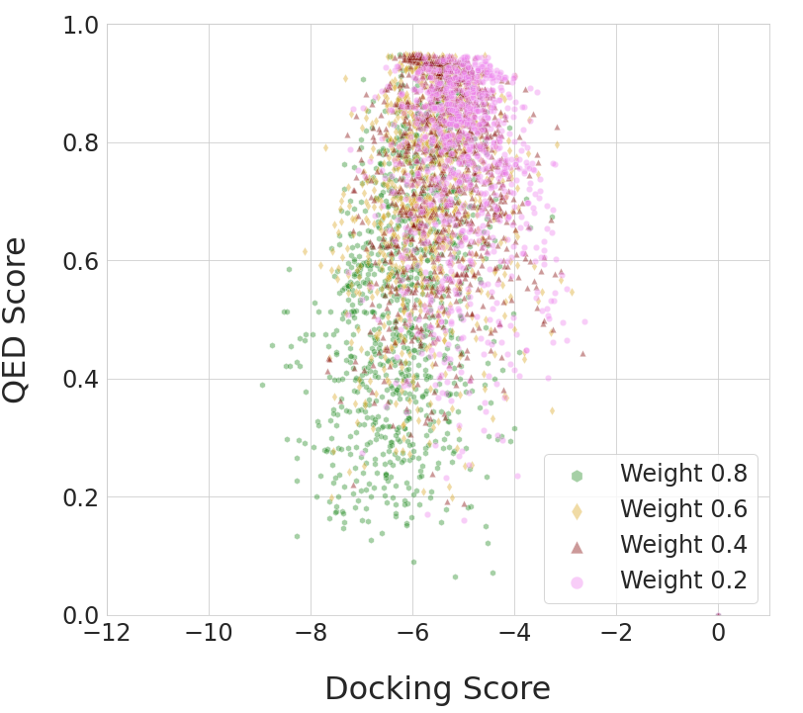
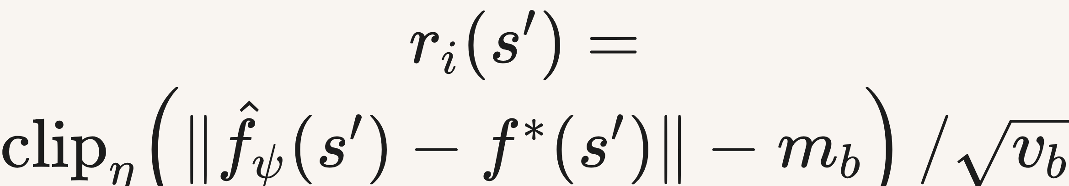
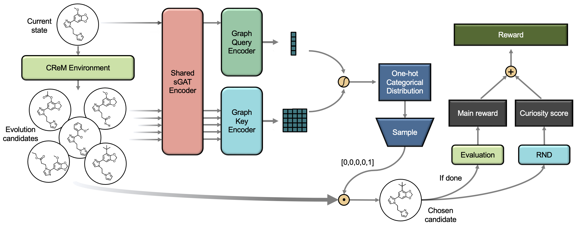
Spatial Graph Attention and Curiosity-driven Policy for Antiviral
Drug Discovery
ICLR
2022
Yulun Wu^{1,2}, Mikaela Cashman^{3,2}, Nicholas Choma^{4,2}, Érica T. Prates^{3,2}, Verónica Melesse Vergara^{5,3}, Manesh Shah⁵, Andrew Chen^{4,2}, Austin
Clyde⁶, Thomas S. Brettin⁷, Wibe A. de Jong^{4,2}, Neeraj Kumar^{8,2}, Martha S. Head^{3,2}, Rick L. Stevens^{6,7}, Peter Nugent^{4,2}, Daniel A. Jacobson^{5,3,2},
James B. Brown^{1,4,2}
Paper
Code
¹ UC Berkeley ² National Virtual Biotechnology Lab, US DOE ³ Oak Ridge Nat. Lab ⁴ Lawrence Berkeley Nat. Lab ⁵ Univ. of Tennessee, Knoxville ⁶ Univ. of Chicago ⁷ Argonne Nat. Lab ⁸
Pacific Northwest Nat. Lab
Problem
Method
Key Results
Ablation Study
Designing molecules that optimize a target
property is hard: chemical space is discrete
and vast, and molecular graphs resist
faithful encoding.
Fragment MDP. CReM proposes valid fragment-
swap candidates; an attentional policy picks the next
molecule — every step stays valid and
synthesizable.
NSP15 DOCKING
TOP ↓
MEAN ↓
Spatial channel. Spatial convolution
strongly improves supervised
representation learning.
MolDQN (2nd best)
−8.01
−5.38
DGAPN (ours)
−10.07
−6.77
Curiosity. Innovation rewards lift
docking; DGAPN even beats a greedy
docking oracle.
Vast discrete space; molecular graphs
resist faithful encoding.
sGAT state encoder. Self-attends over node/edge
attributes and adds a spatial convolution on a
sparsified inverse-distance matrix, fusing chemistry
with geometry.
−10.07 best docking vs MolDQN's −8.01 · p =
8.55×10⁻²⁰⁹ (Welch's t-test)
−10.07
−9.19
40
Motivation
DGAPN top
no curiosity
sGAT runs
Prior models under-encode molecules,
ignoring bond attributes and 3D
structure, though shape decides binding.
Curiosity-driven RL. PPO actor-critic; random
network distillation supplies an innovation reward
driving exploration toward novel states.
Headline Numbers
−10.07
−6.77
mean
docking
Atom-by-atom action spaces yield long,
unstable trajectories and hard-to-
synthesize molecules.
10⁻²⁰⁹
Best docking score ·
NSP15
significance
Innovation reward: normalized RND prediction error rewards visiting novel molecular states.
vs −8.01 for MolDQN (2nd
best)
0.72
QED (ω = 0.6)
Contribution
Takeaway
1
sGAT — self-attention over node &
edge attributes plus 3D structure.
By encoding 3D structure with spatial
graph attention and rewarding novelty via
RND curiosity, DGAPN generates higher-
affinity, more synthesizable candidates
than prior SOTA generators.
2
GAPN — attentional policy over a
fragment-based action space (PPO).
DGAPN in one generation step: CReM proposes candidates,
a shared sGAT encoder feeds graph query/key encoders, the
policy samples the next molecule, and reward combines
evaluation with an RND curiosity score.
QED vs docking score for molecules under each weight ω —
DGAPN keeps strong binders drug-like.
3
RND curiosity — innovation rewards
via random network distillation.
SO WHAT → Beats five SOTA generators on binding affinity, with more synthesizable molecules.
Spatial structure + curiosity →
tighter binders and easier synthesis.

