Slide 1
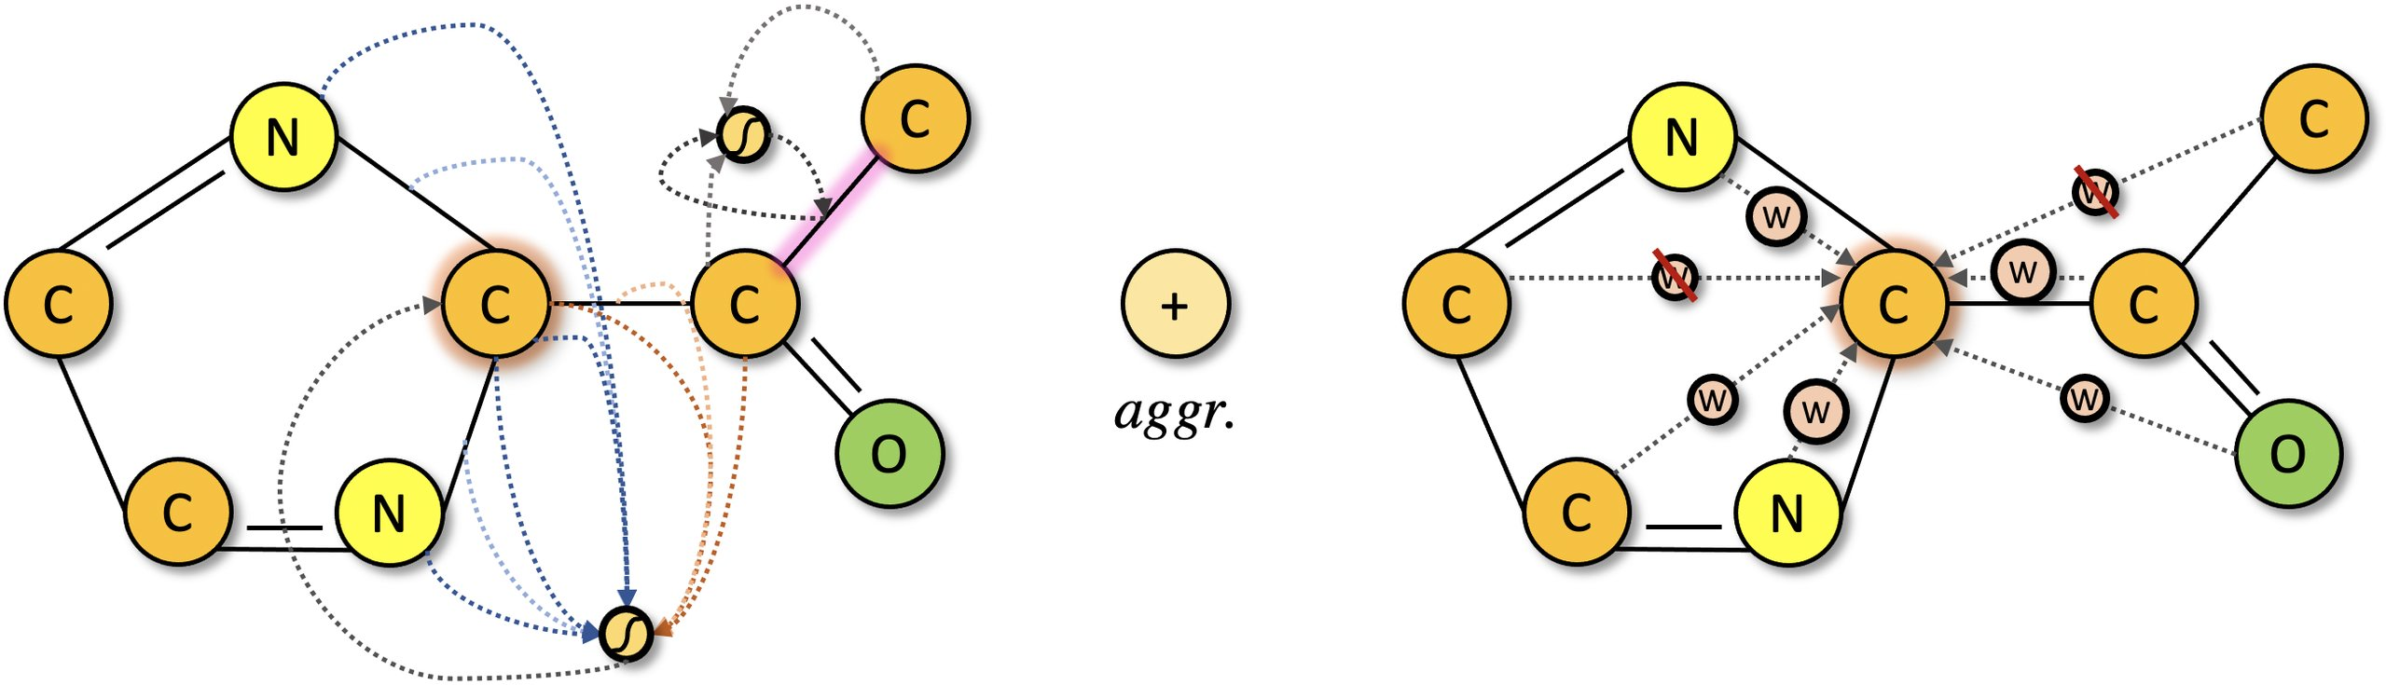


PAPER · DEEP READ
SARS-CoV-2 · NSP15 TARGET
ICLR 2022 · arXiv:2106.02190
DGAPN
Distilled Graph Attention Policy Network
A reinforcement-learning framework that generates novel, drug-like
Spatial graph attention over atoms, bonds & 3D structure
molecules binding antiviral targets — beating prior generators on affinity.
Yulun Wu, Mikaela Cashman, Nicholas Choma, … , James B. Brown
UC Berkeley · Oak Ridge · Lawrence Berkeley · Argonne · U. Chicago · PNNL · US DOE
PAPER
CODE
Drop node-by-node building. Encode
sGAT
GAPN
RND
3D structure. Reward curiosity.
Spatial graph attention
Attentional policy over
Curiosity bonus from
encodes chemistry + 3D
fragment action space
random net distillation
01
Notes:
This paper introduces DGAPN, the Distilled Graph Attention Policy Network, a reinforcement learning framework for generating drug-like molecules that bind antiviral targets. It combines spatial graph attention encoding chemistry and 3D structure, a fragment-based attentional policy, and a curiosity bonus from random network distillation, beating prior generators on binding affinity.

Slide 2
A central goal that resists automation
PROBLEM · OPTIMIZING MOLECULAR PROPERTIES
The design objective
Two intertwined obstacles
1
2
Find a molecule that maximizes a target property
Both must be solved at once
Designing molecules that optimize a
A · Vast, discrete search space
desired property — such as binding
Chemical space is discrete and
tightly to a viral protein — is a
astronomically large, so efficient
central goal in drug discovery.
exploration is a serious challenge.
B · Faithful representation
THE CATCH
Compressing a molecule — a connected
It is extremely difficult to automate —
graph of atoms and bonds — into a
manual discovery is slow and expensive.
learnable feature vector is nontrivial.
DGAPN · Spatial Graph Attention and Curiosity-driven Policy for Antiviral Drug Discovery
02
Notes:
Designing molecules that optimize a property, like binding tightly to a viral protein, is a central goal in drug discovery, yet hard to automate. The chemical space is discrete and astronomically large, making exploration difficult, and compressing a molecule's atom-and-bond graph into a faithful, learnable representation is itself nontrivial.

Slide 3
Where prior generators leave value on the table
MOTIVATION · TWO GAPS IN EARLIER APPROACHES
Prior generators fall short in two ways.
GAP 1 · REPRESENTATION
GAP 2 · ACTION SPACE
Under-encoded molecules
Atom-by-atom building
Most graph networks encode only atom
Many RL generators build molecules atom
attributes and adjacency — ignoring bond
by atom and bond by bond, giving long,
attributes and 3D spatial arrangement.
unstable generation trajectories.
Yet shape and chemical complementarity
The result: molecules that are hard to
to the receptor pocket are exactly what
synthesize, and poor exploration of the
make a molecule a good binder.
chemical space.
DESIGN IMPLICATION
Encode 3D structure and edge info; act over whole fragments.
DGAPN · Spatial Graph Attention and Curiosity-driven Policy for Antiviral Drug Discovery
03
Notes:
Prior methods leave value on the table twice. First, most graph networks encode only atom attributes and adjacency, ignoring bond features and 3D geometry, even though shape and complementarity to the receptor pocket make a good binder. Second, building molecules atom by atom gives long, unstable trajectories and hard-to-synthesize products. This motivates encoding spatial structure while acting over whole fragments.

Slide 4
Three contributions that form DGAPN
CONTRIBUTION · sGAT + GAPN + CURIOSITY
Three components combine into DGAPN.
1
sGAT
2
GAPN
3
RND
Spatial Graph Attn
Attentional policy
Curiosity bonus
A hybrid GNN that self-
A policy tailored to a
Curiosity-driven exploration
attends over both node and
dynamic, fragment-based
by adapting random network
edge attributes.
action space.
distillation to graphs.
Encodes the molecule's 3D
It scores candidate molecules
Produces surrogate innovation
spatial structure through an
by attention and is trained
rewards that push the agent
inverse distance matrix.
with proximal policy opt.
toward novel molecules.
CHEMISTRY + GEOMETRY
PPO · ACTOR–CRITIC
INNOVATION REWARD
in one representation
stable fragment selection
rewards genuine novelty
DGAPN · Spatial Graph Attention and Curiosity-driven Policy for Antiviral Drug Discovery
04
Notes:
DGAPN makes three contributions. First, spatial Graph Attention, a GNN that self-attends over node and edge attributes and encodes 3D structure via an inverse distance matrix. Second, the Graph Attention Policy Network, an attentional policy over a dynamic fragment action space trained with PPO. Third, a random-network-distillation curiosity bonus giving innovation rewards for high-affinity, synthesizable molecules.

Slide 5
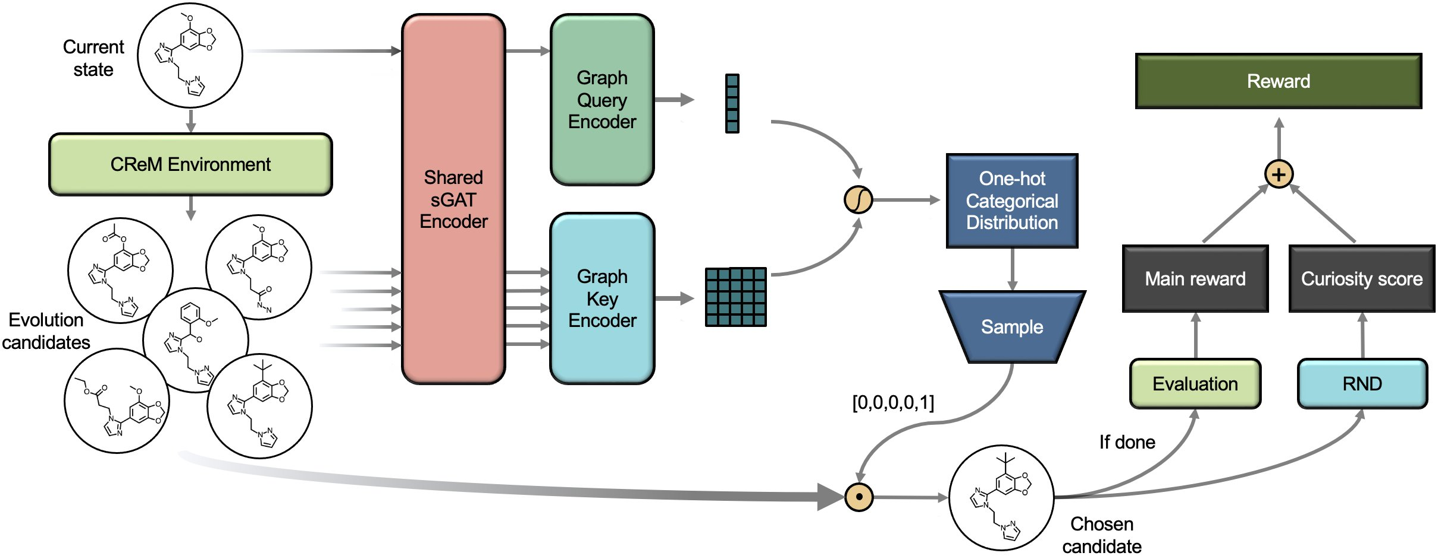
One generation step, end to end
METHOD · DGAPN AS A MARKOV DECISION PROCESS
Figure 2 · DGAPN during a single generation step — CReM candidates → sGAT encoder → attentional policy → reward = main + curiosity
1 · CReM ENVIRONMENT
2 · sGAT ENCODER
3 · ATTENTIONAL POLICY
4 · RND REWARD
Generation is a Markov
Each candidate is embedded
The policy scores candidates
A predictor network learns to
decision process. CReM
by attention over atom and
by their attention to the
match a fixed random target.
proposes valid molecules
bond attributes plus a spatial
current state and samples the
Its running prediction error
via a single fragment swap,
convolution on a sparsified
next molecule — trained with
becomes a surrogate reward
so candidates stay valid.
inverse distance matrix.
PPO for stability.
for exploring novel states.
DGAPN · Spatial Graph Attention and Curiosity-driven Policy for Antiviral Drug Discovery
05
Notes:
DGAPN casts molecule generation as a Markov decision process. At each step, the CReM library proposes valid molecules reachable by swapping one fragment, guaranteeing synthesizable candidates. Spatial Graph Attention embeds each candidate, combining attention over atom and bond attributes with a spatial convolution from a sparsified inverse distance matrix, so chemistry and geometry both inform the representation. An attentional policy scores candidates and samples the next molecule, trained with PPO. Finally, random network distillation supplies an innovation reward whose error rewards exploring novel states.

Slide 6
Benchmark: inhibitors for SARS-CoV-2 NSP15
DATASET / BENCHMARK · DOCKING + QED + LOGP
PRIMARY TARGET
SCORING SIGNAL
STANDARD TASKS
NSP15 site
GPU docking
QED & LogP
The main task is to design
Binding affinity is estimated
To complement the single
novel inhibitors that bind
by molecular docking, with a
docking objective, DGAPN is
the NSP15 functional site of
GPU-accelerated tool using the
also evaluated on two common
the SARS-CoV-2 virus.
3D protein structure.
ML generation tasks.
WHY IT MATTERS
STARTING DATA
QED — the drug-likeness score
A concrete, high-stakes
A dataset of purchasable
penalized LogP — a standard
antiviral drug-design
molecules together with their
property-optimization value
objective.
NSP15 docking scores.
DGAPN · Spatial Graph Attention and Curiosity-driven Policy for Antiviral Drug Discovery
06
Notes:
The primary benchmark designs novel inhibitors binding the NSP15 site of SARS-CoV-2. Binding affinity is estimated by molecular docking, using a GPU-accelerated tool on the protein's 3D structure, starting from a dataset of purchasable molecules with NSP15 docking scores. The method is also tested on standard QED and penalized LogP optimization tasks.

Slide 7
State-of-the-art docking on NSP15
KEY RESULT · DGAPN VS FIVE BASELINES
DOCKING SCORE (LOWER = BETTER)
BEYOND RAW BINDING
MODEL
BEST
MEAN
Constrained optimization
DGAPN
-10.07
-6.77
DGAPN gives the largest property
this work
improvements across every
similarity threshold, versus
MolDQN
MolDQN and MARS.
-8.01
-5.38
second-best baseline
Also beaten: REINVENT · JTVAE · GCPN · MARS
Multi-objective (ω = 0.6)
Trades a little affinity for markedly
STATISTICALLY OVERWHELMING
better drug-likeness and synthetic
The improvement over the second-best model
accessibility — QED 0.72, SA 2.20 —
carries a p-value of about
while keeping mean docking −5.69,
p = 8.55 × 10⁻²⁰⁹ (Welch's t-test)
still better than every single-
objective baseline on docking.
Source: DGAPN, single-objective docking vs REINVENT · JTVAE · GCPN · MolDQN · MARS
07
Notes:
On docking against NSP15, DGAPN clearly beats five state-of-the-art baselines, reaching a best score near minus ten and a mean of minus six point seven seven, well ahead of MolDQN, with an astronomically small p-value under Welch's t-test. It also wins constrained optimization at every similarity threshold, and in multi-objective mode trades slight affinity for markedly better drug-likeness and synthesizability.

Slide 8
Each component earns its place
ABLATION STUDY · ISOLATING THE PIECES
Three targeted ablations, one clear verdict.
A · SPATIAL CONVOLUTION
B · INNOVATION REWARD
C · ENVIRONMENT DESIGN
Better representations
Curiosity helps
Beats a greedy oracle
Isolated in a purely supervised
Full DGAPN vs GAPN without the
Remarkably, DGAPN even
setting on the NSP15 dataset,
innovation reward: the curiosity
outperforms a greedy CReM
loss curves over 40 runs show
bonus improves best docking.
oracle that has access to
a clear benefit.
intermediate docking rewards.
GAPN best
DGAPN best
FINDING
-9.19
-10.07
WHY IT MATTERS
Spatial convolution has a
Environment design and
strong positive effect on
Trade-off: it slightly worsens
action-space stochasticity
learning molecular feature
synthetic accessibility (SA) —
alone are powerful drivers
representations.
a docking-vs-SA balance.
of exploration.
DGAPN · Spatial Graph Attention and Curiosity-driven Policy for Antiviral Drug Discovery
08
Notes:
The authors ablate each component. In a supervised setting on NSP15, loss curves over forty runs show spatial convolution strongly improves molecular representation learning. Comparing full DGAPN against GAPN without the innovation reward, the curiosity bonus lifts the best docking score, though it slightly worsens synthetic accessibility. Remarkably, DGAPN even beats a greedy CReM oracle that sees intermediate docking rewards.

Slide 9
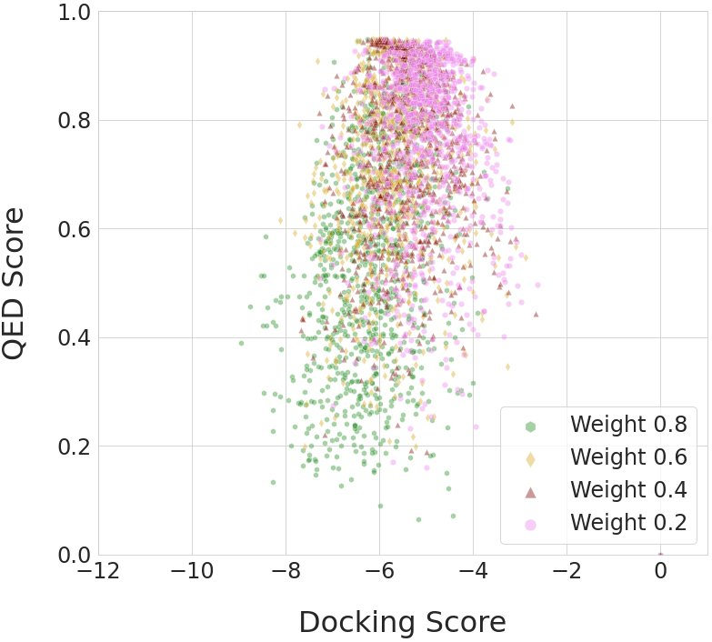
The numbers that capture the impact
HEADLINE NUMBERS · NSP15 DOCKING + MULTI-OBJECTIVE
DOCKING SCORE · DGAPN VS BEST BASELINE
-10.07
-8.01
-5.38
baseline best
baseline mean
best (mean -6.77)
SIGNIFICANCE VS SECOND-BEST MODEL
p ≈ 10⁻²⁰⁹
exact p = 8.55 × 10⁻²⁰⁹ · Welch's t-test
MULTI-OBJECTIVE MODE (ω = 0.6)
0.72
2.20
-5.69
QED · drug-likeness
SA · synthesizability
mean docking
Figure 3 · QED vs docking score across objective weights (ω)
DGAPN · Spatial Graph Attention and Curiosity-driven Policy for Antiviral Drug Discovery
09
Notes:
On NSP15 docking, DGAPN reaches a best score near minus ten and a mean of minus six point seven seven, versus roughly minus eight and minus five for the strongest baseline. The gap over the second-best model is statistically overwhelming, p around ten to the minus two hundred ninth. In multi-objective mode it yields QED zero point seven two and synthetic accessibility two point two.

Slide 10
Spatial structure + curiosity pays off
TAKEAWAY
THE BOTTOM LINE
Combining spatial structure with curiosity generates drug candidates
that bind more tightly and are easier to synthesize than prior
state-of-the-art generators.
1 · ENCODE GEOMETRY
2 · FRAGMENTS + NOVELTY
3 · USER-DEFINED OBJECTIVE
Spatial graph attention
Acting over whole fragments
Practitioners can dial between
captures a molecule's
keeps molecules valid; RND
pure binding affinity and a
3D structure and chemistry.
rewards exploring novelty.
balanced, more drug-like result.
DGAPN · ICLR 2022 · arXiv:2106.02190 · github.com/yulun-rayn/DGAPN
10
Notes:
The takeaway: combining spatial structure with curiosity pays off for molecular design. By encoding 3D geometry through spatial graph attention, acting over whole fragments for synthesizability, and rewarding novelty with random network distillation, DGAPN designs tighter-binding, more synthesizable drug candidates than prior methods, with a user-defined objective that dials between affinity and drug-likeness.

