Slide 1



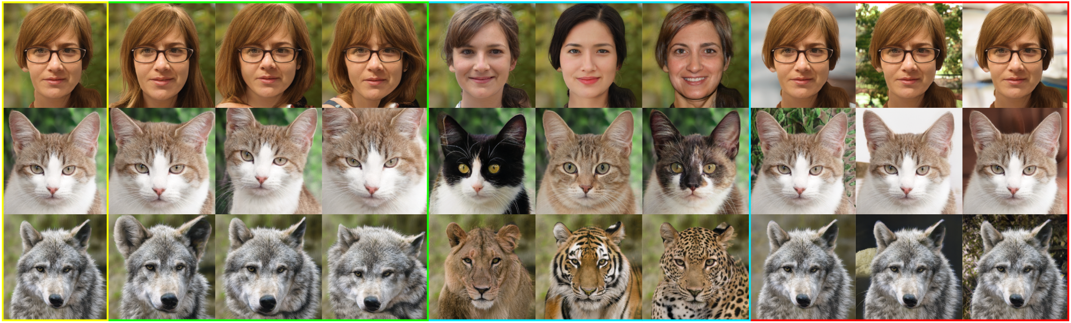
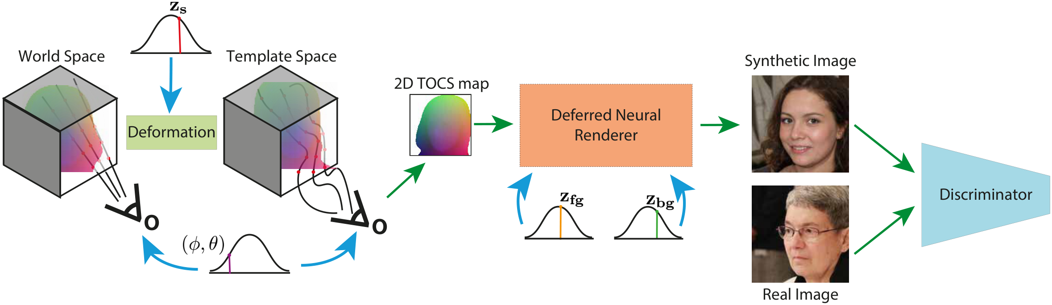
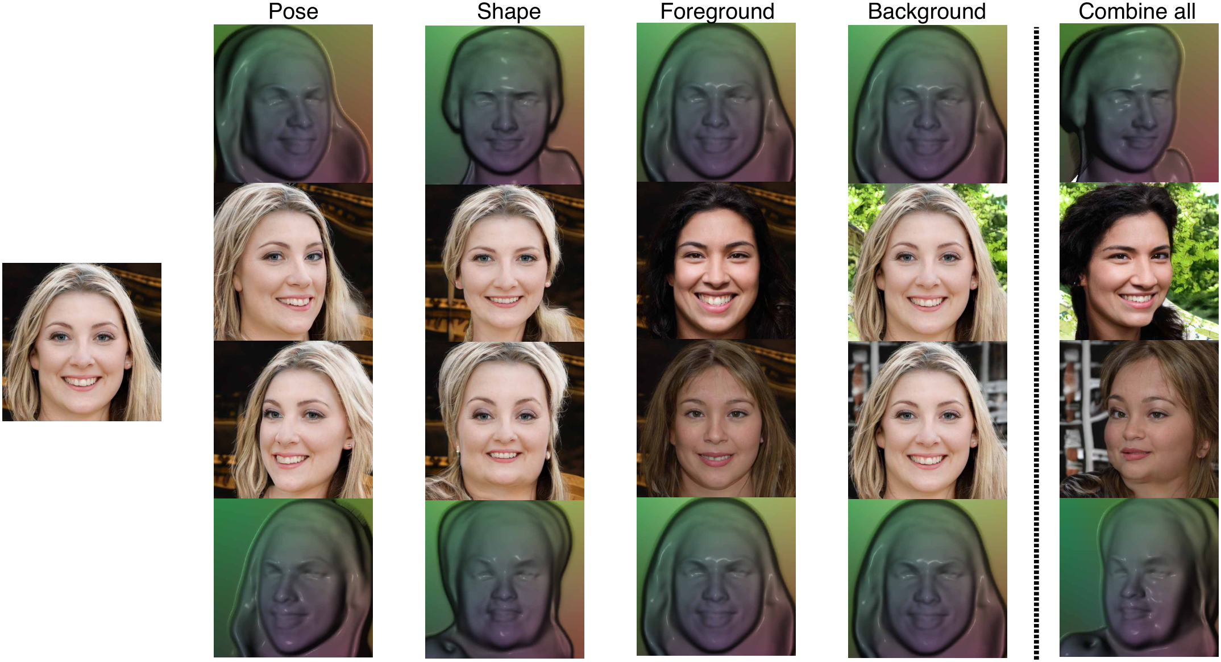
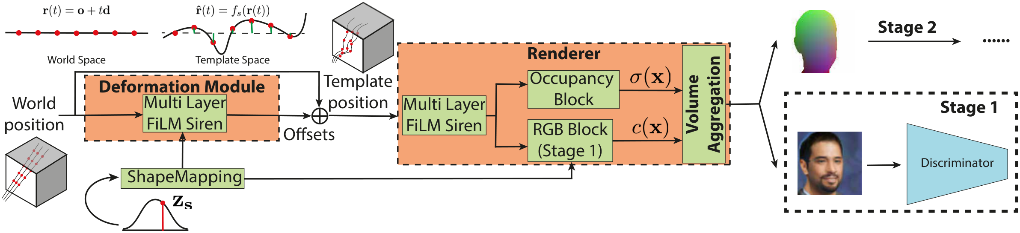
StyleMorph: Disentangled 3D-Aware Image
Synthesis with a 3D Morphable StyleGAN
Eric-Tuan Le¹, Edward Bartrum^{1,2}, Iasonas Kokkinos¹
¹ University College London ² Alan Turing Institute
Problem
Method
Key Results
Existing 3D-aware GANs render high-quality images but entangle
geometry with appearance — shape, camera pose, object texture,
and background cannot be controlled independently during
synthesis.
A Morphable Renderer warps camera rays into a canonical
template space via a SIREN deformation field, integrating
template coordinates into a low-res 2D TOCS map that
bottlenecks all geometric variation (shape, pose, projection).
METHOD (FID ↓, 256²)
FFHQ
CATS
Disentangled3D
28.18
—
GIRAFFE-HD
11.93
12.36
StyleMorph (Ours)
7.91
4.29
Edit one factor and it bleeds into the others: the hybrid design
fuses geometry and appearance.
The TOCS map plus separate foreground and background
appearance codes condition a StyleGAN2 deferred neural
renderer, which synthesizes and alpha-composites the final high-
resolution image.
Motivation
3D morphable models give creators clean, separate dials for
pose, shape, and appearance — but classically need 3D scans
and manual alignment.
Bringing that control to 3D-aware GANs without any 3D
supervision unlocks editable synthesis far beyond human faces.
A shape-code-driven offset field g_{s} warps each world-space ray into deformation-free template space.
Disentangled appearance control from a source sample (yellow) over shape
(green), foreground (blue) and background (red).
SO WHAT → Disentanglement costs no quality: StyleMorph rivals the best non-disentangled 3D-GANs while adding four-way control.
Classical 3DMM: 3D scans, faces only. StyleMorph: 2D images,
any category.
Headline Numbers
7.91
4.29
Cats FID
Overview: geometric modelling (template shape, deformation z_{s}, pose φ,θ,
projection) yields a 2D TOCS map that, with foreground/background codes,
conditions the Deferred Neural Renderer.
FFHQ FID · 256²
3.49
Wild FID
vs 28.18 for Disentangled3D
4
factors
Takeaway
By morphing a learned 3D template into a geometric TOCS map that
conditions a StyleGAN renderer, StyleMorph achieves state-of-the-
art synthesis with fully disentangled control over shape, pose, and
appearance — all from 2D images alone.
Morphable renderer: a 3D deformation field warps camera rays into template
coordinates, where occupancy and appearance are modelled in a
deformation-free frame.
An unsupervised 3D morphable model for general
categories — VFX-style control, no 3D supervision.
Disentangled control: from a synthesized sample we change one factor at a
time — pose, shape, foreground, background — then compound all.

