Slide 1
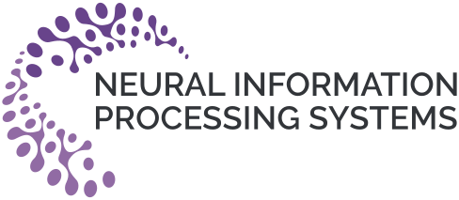

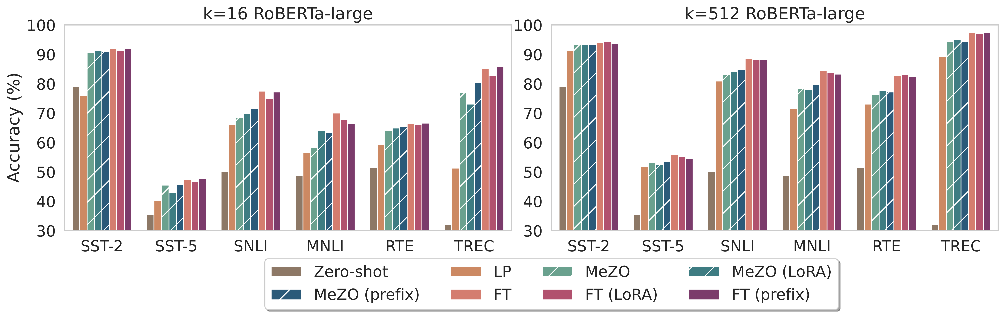
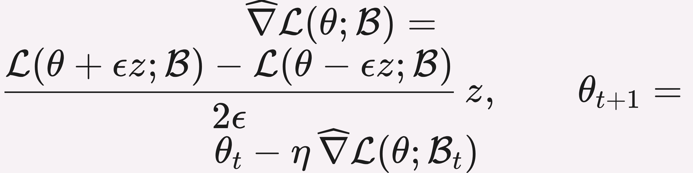
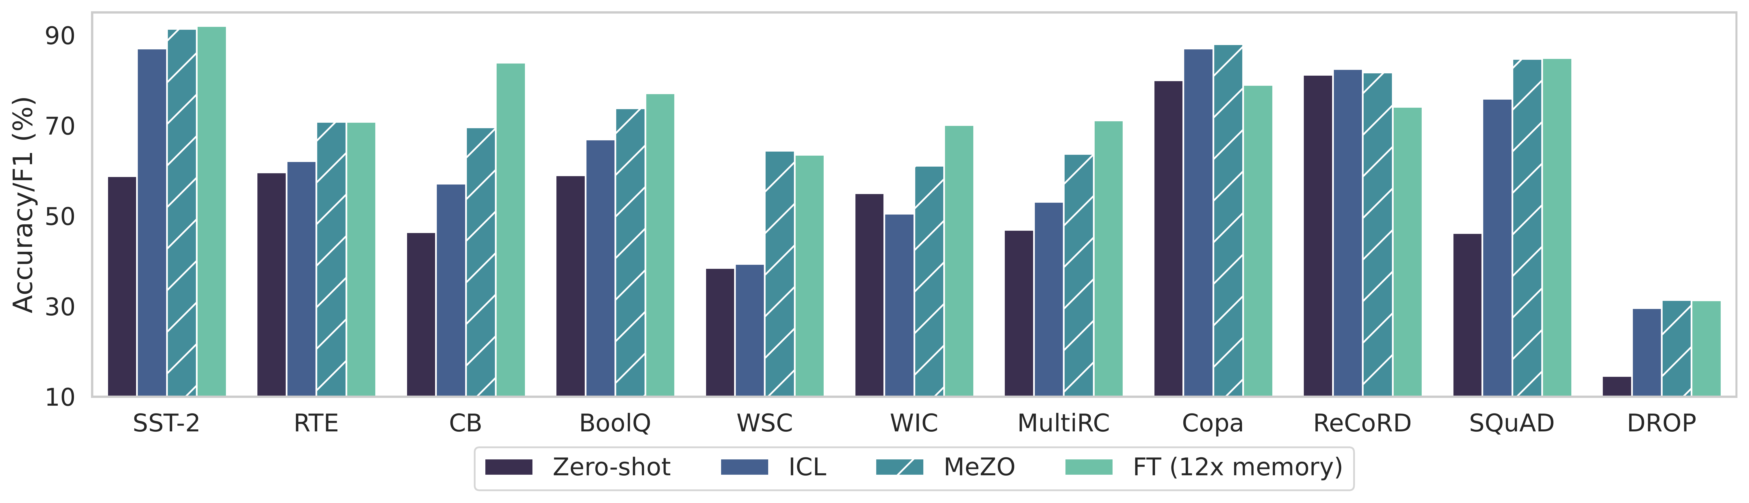
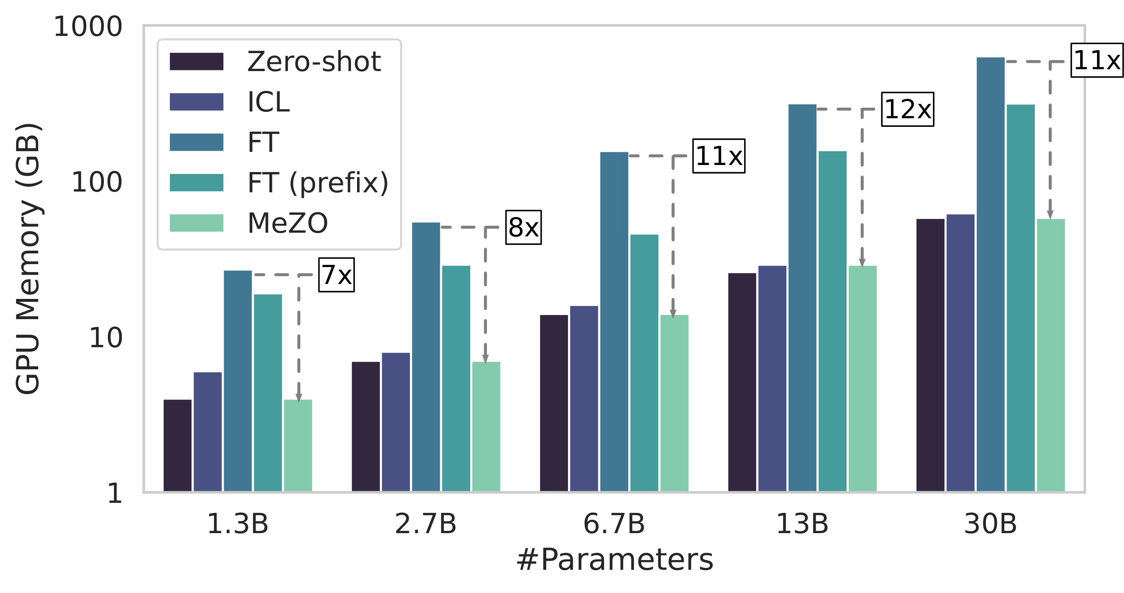


Fine-Tuning Language Models with Just Forward Passes
Sadhika Malladi, Tianyu Gao, Eshaan Nichani, Alex Damian, Jason D. Lee, Danqi Chen, Sanjeev Arora
¹ Princeton University
Problem
Method
Datasets & Setup
Ablation Study
As language models scale, fine-tuning with backpropagation needs prohibitive memory: it caches activations and stores gradients and optimizer states — up to 12× the memory of plain inference.
MeZO adapts zeroth-order SGD (SPSA) to run in place — a step costs inference-level memory.
2
350M–66B
11+
PEFT-ready. MeZO + LoRA and prefix-tuning match full-parameter MeZO.
model families
parameter scale
tasks
Beyond gradients. Optimizes non-differentiable accuracy / F1 directly, and beats prior ZO baseline BBTv2 by up to 11%. Best with a single perturbation per step (n=1).
1
Sample one random direction z ∼ 𝒩(0, I) — regenerable from a stored random seed.
RoBERTa-large
OPT 1.3B–66B
SST-2
SNLI
MNLI
RTE
TREC
BoolQ
WSC
WIC
MultiRC
On a single 80GB A100, inference runs a 30B model — but Adam fine-tuning fits only a 2.7B one.
2
Perturb ±. Evaluate the loss at θ+εz and θ−εz — just two forward passes.
COPA
ReCoRD
SQuAD
DROP
SO WHAT → Baselines: zero-shot, in-context learning (ICL), linear probing (LP), and full Adam fine-tuning (FT).
3
Update in place. Regenerate z from the same seed and step along it — store only the seed, never z.
Motivation
Key Results
Just forward passes. Zeroth-order (ZO) methods estimate a gradient from only two forward passes — no backprop, no activation cache.
RoBERTa-large: MeZO (full / LoRA / prefix) approaches FT within ~5% at k=512.
SPSA gradient estimate + the in-place SGD update
The catch. Classical theory says ZO convergence slows ∝ the number of parameters — seemingly hopeless at billions. Does that pessimism really hold for a strong pre-trained model?
Reusing the seed avoids the 2× memory of vanilla ZO-SGD and plugs directly into SGD or Adam.
Takeaway
Why it converges. Convergence tracks the loss's effective local rank, not the raw parameter count — overturning classical ZO pessimism and keeping MeZO fast at billion-parameter scale.
OPT-13B: MeZO beats zero-shot & ICL and matches Adam FT (within 1%) on 7/11 tasks — using 1/12 the memory.
Fine-tune huge LMs with just forward passes: MeZO matches backprop quality at inference memory.
7 / 11
OPT-13B tasks within 1% of full Adam fine-tuning
Backprop is optional — train 10× larger models on one GPU.
Headline Numbers
30B
on one 80GB A100 (vs 2.7B backprop)
~5%
2×
66B
Scan
to
Read
12×
7/11
OPT-13B tasks within 1% of FT
gap to FT on RoBERTa, k=512
fewer GPU-hours at 30B
largest OPT optimized
Code
github.com/
princeton-nl
p/MeZO
less memory vs Adam FT
2×
fewer GPU-hours at 30B scale
SO WHAT → MeZO beats zero-shot, ICL, and linear probing across the board.
GPU memory (MultiRC): MeZO uses inference-level memory — up to 12× less than full FT.
+11%
Paper
Code
over prior ZO (BBTv2)

