Slide 1





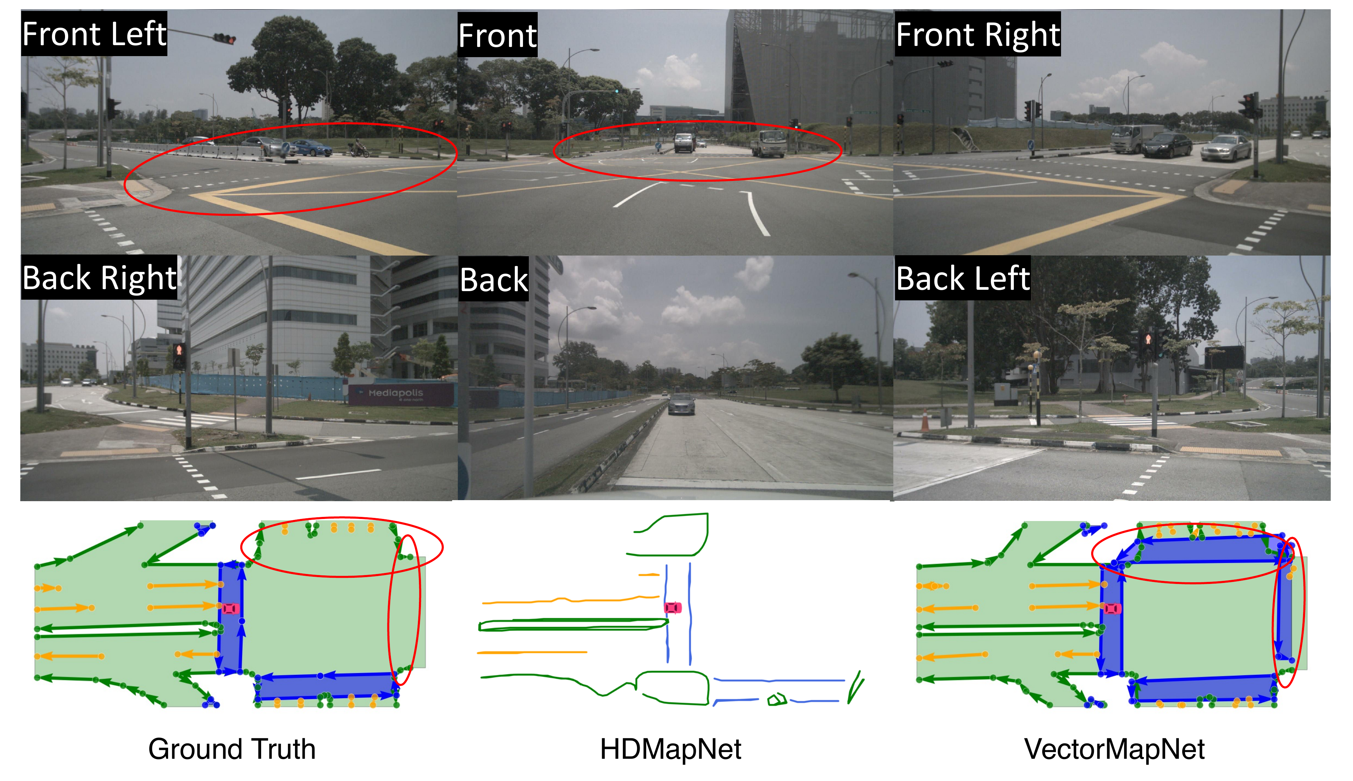
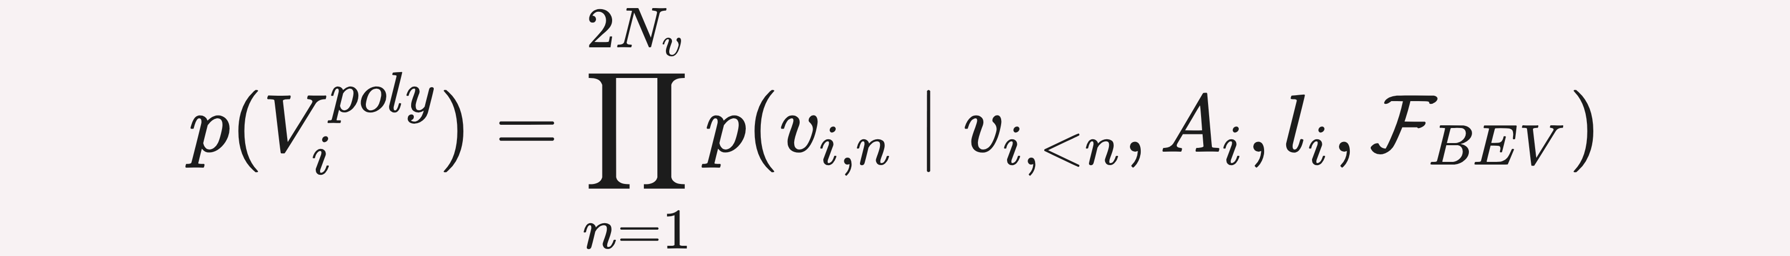

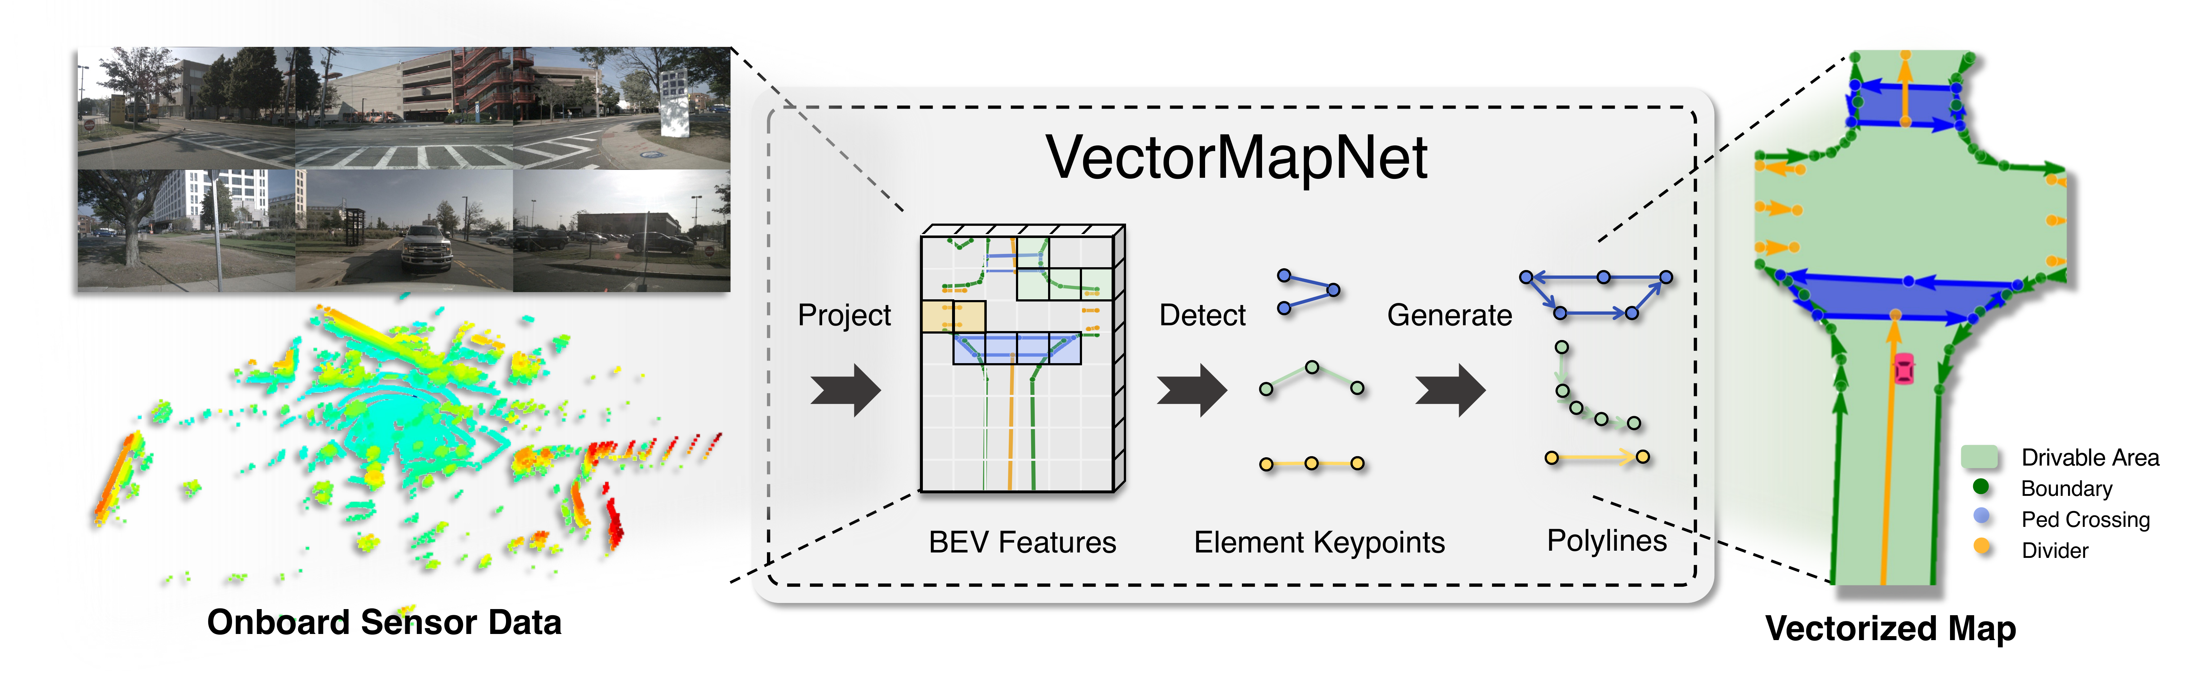
VectorMapNet: End-to-end Vectorized HD Map Learning
Yicheng Liu^{1,2}, Tianyuan Yuan², Yue Wang³, Yilun Wang⁴, Hang Zhao^{1,2†}
¹ Shanghai Qi Zhi Institute ² Tsinghua University ³ MIT ⁴ Li Auto
Problem
Method
Key Results
Autonomous driving needs vectorized HD semantic maps, yet
manual annotation does not scale and existing learners output only
dense rasterized segmentations needing brittle post-processing.
1
BEV feature extractor lifts camera (ResNet + IPM) and LiDAR
(PointPillars) into a shared BEV space.
53.7
+14.6
mAP Argoverse2
mAP · nuScenes (Fusion + fine-tune)
+17.9
mAP camera-only
FIRST
2
Map element detector — a DETR-style decoder with element
queries predicts each element's keypoints + class.
vs 31.0 HDMapNet · +14.2 mAP
+9.9
mAP LiDAR-only
The first end-to-end vectorized HD-map learner: no
rasterization, no post-processing.
3
Polyline generator — an autoregressive Transformer decodes
each element into ordered vertices.
Motivation
RASTERIZE → VECTORIZE
vs.
VECTORMAPNET
Dense pixel grid + fragile
post-processing.
Sparse directional polylines.
Online mapping from onboard sensors sidesteps the labor and
meter-level localization error of offline HD maps.
Prior SOTA (HDMapNet) still rasterizes, then post-processes
vectors by hand, capping accuracy and scalability.
Fig 4 · Camera-only: sharp corners, no self-loops (red = missing in GT).
+14.2 mAP vs HDMapNet (nuScenes) · +14.6 mAP
(Argoverse2)
Ablation Study
Bounding Box (k=2) keypoints beat SME (k=3) and Extreme
Points (k=4) by +2.0 Fréchet mAP and +7.3 Chamfer mAP.
Fig 1 · End-to-end pipeline: sensors → BEV features → element keypoints
→ polylines.
Takeaway
Two-stage training (teacher forcing, then fine-tuning on predicted
keypoints) adds +6.9 mAP (Camera) and +8.5 mAP (Fusion).
Dataset / Benchmark
Frame HD mapping as detection → polyline generation:
one end-to-end network predicts clean, directional vector
maps straight from sensors.
Evaluated on nuScenes and Argoverse2 (z-axis annotations
enable 2D and 3D evaluation), scoring polylines with an order-
aware Fréchet AP alongside Chamfer AP.
+7.3
+8.5
0.826
Polylines are a versatile primitive: the same model extends to
centerline prediction with no structural change, and its predicted
maps measurably sharpen a downstream motion-forecasting
baseline (minADE 0.909 → 0.826).
Chamfer mAP · box vs alt
mAP · 2-stage (Fusion)
minADE · pred map
Predicted maps sharpen a downstream motion-forecasting
baseline — near the GT-map ceiling.
nuScenes
Argoverse2
Ped Crossing
Lane Divider
Road Boundary

