Slide 1
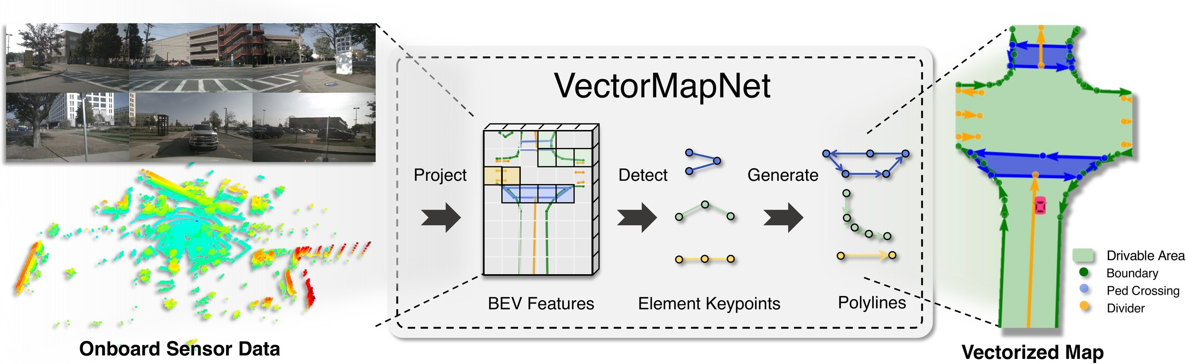




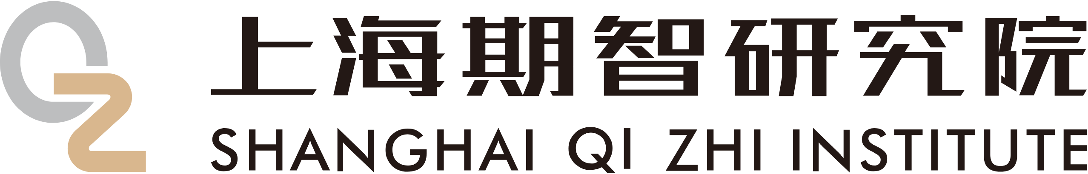
ICML 2023
End-to-end HD Map Learning
NEW STATE OF THE ART
VectorMapNet
+14.2
/ +14.6
mAP over HDMapNet
End-to-end Vectorized HD Map Learning
nuScenes · Argoverse2
Yicheng Liu · Tianyuan Yuan · Yue Wang · Yilun Wang · Hang Zhao
Shanghai Qi Zhi Institute · Tsinghua University · MIT · Li Auto
Figure 1 · Sensor data → BEV features → sparse polylines
Code
Paper
Notes:
VectorMapNet is the first end-to-end pipeline that reads onboard camera and LiDAR data and directly predicts a sparse set of polylines, the vectorized map primitive planners actually use. It skips rasterization entirely and sets a new state of the art.

Slide 2
PROBLEM
Rasterized maps are not what a planner wants
01
02
03
What driving needs
Annotated by hand
Dense pixel grids
Self-driving cars need HD semantic maps that mark lanes, road boundaries, and pedestrian crossings.
Today these maps are mostly built manually — expensive and impossible to scale across the world's cities.
A BEV pixel grid carries no individual elements, is hard to keep consistent, and needs brittle post-processing before a planner can use it.
Notes:
Self-driving cars need HD maps marking lanes, boundaries, and crosswalks. Today these are annotated by hand, which is costly and does not scale. Learning methods instead predict a dense pixel grid, but a grid carries no individual elements and needs brittle post-processing before a planner can use it.

Slide 3
MOTIVATION
Predict geometry, end to end
Mapping should happen online — from the car's own
cameras and LiDAR — and the model should output
the final vector map directly.
PRIOR · HDMapNet
Sensors
Rasterized map
Hand-designed
Vectors
the detour
post-processing
VECTORMAPNET
direct — no rasterization
Sensors
Vectors
Notes:
The authors argue mapping should happen online, from the car's own sensors, avoiding the annotation burden and localization errors, and the model should output the final representation directly. Prior methods rasterize then vectorize with a hand-designed step; VectorMapNet removes that detour and predicts geometry end to end.

Slide 4
CONTRIBUTION
Three contributions
One end-to-end system, one flexible primitive, one detector adapted to BEV.
01
02
03
Direct vector output
Polyline primitive
Detection in BEV
Predicts vectorized outputs directly from sensor data — no rasterization and no post-processing step.
One polyline represents points, lines, curves, and polygons, and its vertex order encodes direction.
Adapts detection transformers to locate deformable map elements of varying size in bird's-eye-view space.
Notes:
VectorMapNet makes three contributions. It predicts vectorized outputs directly from sensors, with no rasterization or post-processing. It uses the polyline as one flexible primitive for points, lines, curves, and polygons, whose vertex order encodes direction. And it adapts detection transformers to locate elements in bird's-eye view.

Slide 5
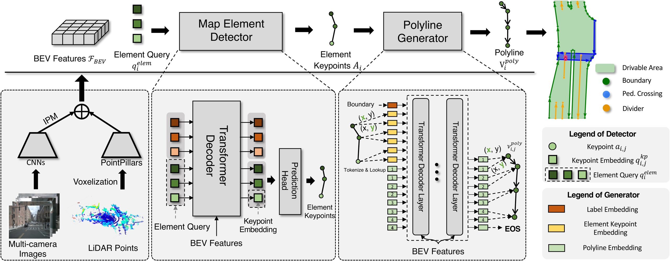
METHOD
A three-stage pipeline
Figure 2 · Network architecture
BEV feature extractor
1
Camera (ResNet + IPM) and LiDAR (PointPillars), fused into a shared BEV.
Map element detector
2
DETR-style element queries and deformable attention predict each element's keypoints and class.
Polyline generator
ℒ = ℒdet + ℒgen
3
An autoregressive Transformer decodes each element into ordered vertices, one coordinate at a time.
Bipartite-matching detection loss + polyline generation loss,
trained end to end.
Notes:
VectorMapNet has three stages. A bird's-eye-view extractor maps each modality into a shared top-down space: cameras through a ResNet and inverse perspective mapping, LiDAR through PointPillars, fused by concatenation. A detection transformer with element queries locates each element as keypoints. An autoregressive polyline generator then emits ordered vertices, trained with a matching detection loss and a generation loss.

Slide 6
DATASET · BENCHMARK
Two datasets, order-aware metrics
Datasets
Elements evaluated
Metrics
nuScenes
Pedestrian crossings
Chamfer-distance AP
Argoverse2
Lane dividers
Fréchet-distance AP
includes height → 2D and 3D eval
new — respects vertex order
Road boundaries
Two public autonomous- driving datasets.
3D eval (Argoverse2)
Predicted polylines compared to ground truth, following HDMapNet.
AP at 0.5 / 1.0 / 1.5 m matching thresholds.
Notes:
VectorMapNet is evaluated on nuScenes and Argoverse2. Following HDMapNet, predicted polylines are compared to ground truth for crosswalks, lane dividers, and road boundaries. It reports Chamfer-distance average precision and a new Fréchet-distance AP that respects vertex order, plus 3D evaluation on Argoverse2.

Slide 7
KEY RESULT
A new state of the art
Beats HDMapNet by +14.2 mAP on nuScenes and +14.6 on Argoverse2.
Gains across sensors (Δ mAP)
Fusion + fine-tuning (mAP)
+17.9
53.7
+14.2
+9.9
31.0
Camera
LiDAR
Fusion
VectorMapNet
HDMapNet
Notes:
VectorMapNet sets a new state of the art. It beats HDMapNet by 14.2 mAP on nuScenes and 14.6 on Argoverse2. Gains hold across sensors: nearly eighteen points camera-only, about ten LiDAR-only, over fourteen with fusion. Two-stage fine-tuning pushes fusion to 53.7 mAP versus 31.0.

Slide 8
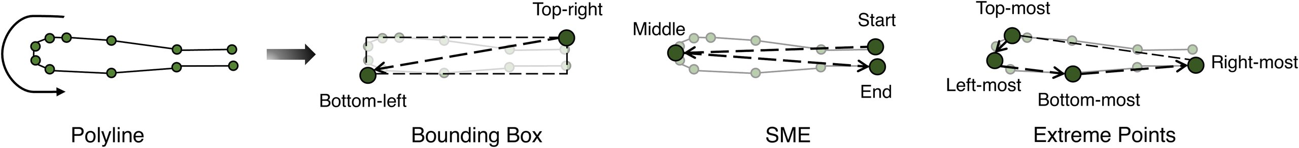
ABLATION STUDY
Two ablations stand out
Figure 3 · Keypoint representations — Bounding Box (k=2), SME (k=3), Extreme (k=4)
Bounding box (k=2) wins — +2.0 Fréchet and +7.3 Chamfer mAP over SME and Extreme.
Two-stage training
Teacher forcing, then fine-tuning on the model's own
+6.9
+8.5
predicted keypoints, cuts exposure bias.
mAP · camera
mAP · fusion
Notes:
Two ablations stand out. Representing each element by a bounding box with two keypoints beats start-middle-end and extreme-point alternatives by two Fréchet and over seven Chamfer points. Two-stage training, teacher forcing then fine-tuning on predicted keypoints, adds about seven mAP for camera and over eight for fusion.

Slide 9
HEADLINE NUMBERS
By the numbers
OVER PREVIOUS SOTA
BEST CONFIGURATION
+14.2 / +14.6
53.7
vs 31.0
mAP · nuScenes / Argoverse2
mAP · fusion + fine-tuning
GAINS SPAN SENSORS (mAP)
DESIGN WINS
+18
+10
+14
+7.3
Chamfer mAP · bbox (k=2)
+8.5
Camera
LiDAR
Fusion
mAP · two-stage fusion
Notes:
To summarize: VectorMapNet exceeds the previous state of the art by 14.2 mAP on nuScenes and 14.6 on Argoverse2. Its best configuration, fusion with fine-tuning, reaches 53.7 mAP where HDMapNet reaches 31. Gains span sensors: about eighteen for camera, ten for LiDAR, fourteen for fusion.

Slide 10
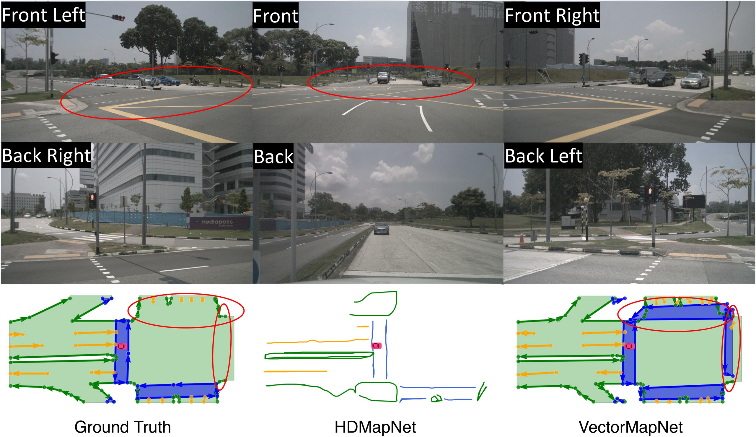
TAKEAWAY
No detour needed
Figure 4 · Detecting an unlabeled crossing
HD mapping needs no
rasterize-then-vectorize detour.
Treating map construction as detection plus autoregressive polyline generation yields clean, directional vector maps straight from cameras and LiDAR — beating rasterized pipelines by double digits, and even extending to centerlines unchanged.
arxiv.org/abs/2206.08920 · github.com/Mrmoore98/VectorMapNet_code
Notes:
The takeaway: HD mapping needs no rasterize-then-vectorize detour. Treating mapping as detection plus autoregressive polyline generation, VectorMapNet produces directional vector maps directly from sensors, beats rasterized pipelines by double digits, and even extends to centerlines with no architectural change.

