Slide 1



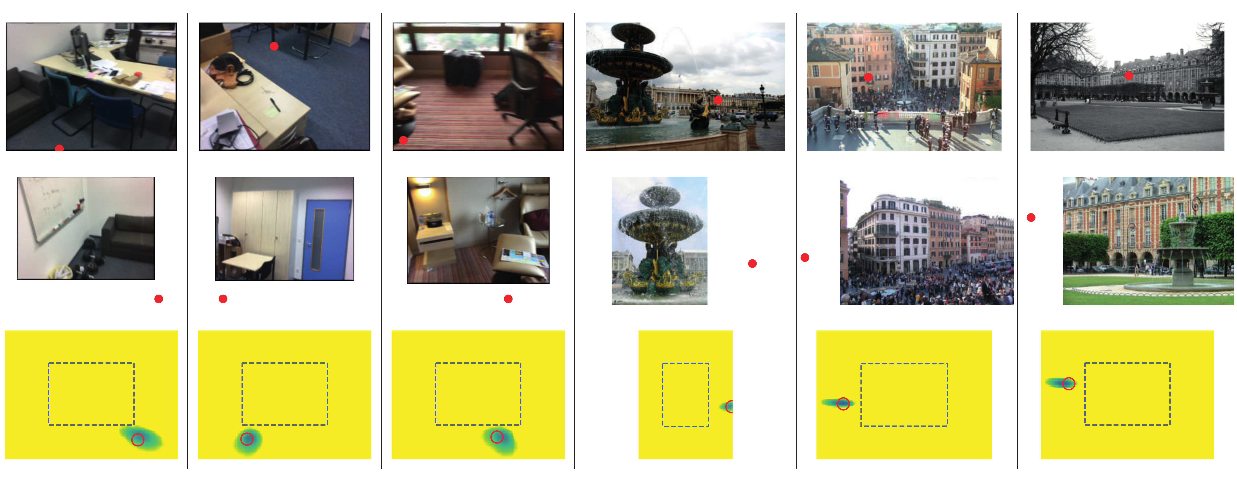
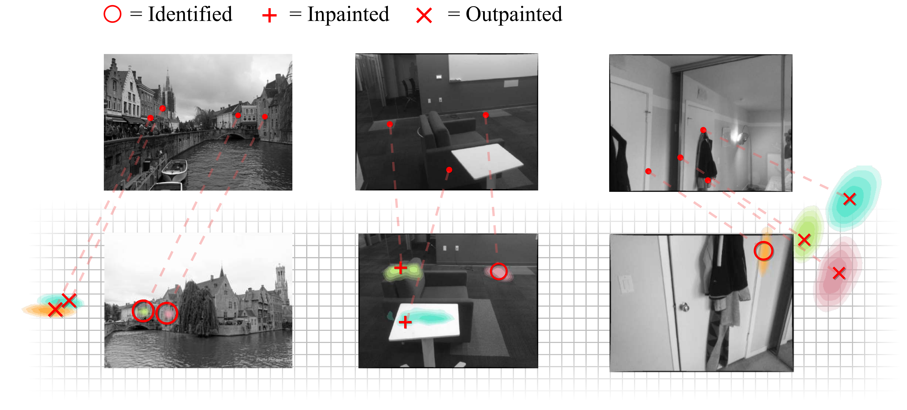
Visual Correspondence Hallucination
Hugo Germain¹ · Vincent Lepetit¹ · Guillaume Bourmaud²
¹ LIGM, École des Ponts, Univ Gustave Eiffel, CNRS ² IMS, Univ. of Bordeaux, Bordeaux INP, CNRS
Problem
Method
Key Results
Local feature matching locates a keypoint's correspondent only
when it is actually visible in the second image. Occluded or out-
of-frame correspondents are treated as noise, so matching
collapses on low-overlap pairs where few keypoints are covisible.
A siamese CNN backbone produces dense descriptor maps for
source and target; the target map is padded with a learnable
vector λ to represent locations outside the field of view.
HALLUCINATION TASK
SOTA MATCHERS
NEURHAL
Identify · visible
✓
✓
Inpaint · occluded
poor
✓
A cross-attention backbone with positional encoding lets
source and target descriptors communicate; each
correspondence map is a 1×1 convolution of the target features
by the keypoint feature, then a 2D softmax.
Outpaint · out-of-frame
✗
✓
FIRST
The first method to predict correspondences at non-covisible
locations — occluded & out-of-frame regions become signal,
not noise.
Motivation
reprojected location ; training minimizes the sum of NRE terms by SGD — no covisibility labels.
State-of-the-art localization is built on keypoint matches, yet
matchers break down precisely on the low-overlap pairs where
most locations are occluded or outside the field of view.
Qualitative hallucination on unseen scenes: (top) outpainting, (bottom)
inpainting. Red = ground-truth correspondent; dashed box = target
borders.
Humans instead reason about scene geometry to hallucinate
where a non-covisible correspondent lies — a capability prior
matchers lack.
SO WHAT → NeurHal's argmax errors sit far below random guessing; SOTA matchers cannot outpaint at all.
Geometry has only been used a posteriori (RANSAC-style
outlier removal), never to predict non-covisible correspondents.
Headline Numbers
Overview of NeurHal: siamese CNN descriptors + learnable out-of-FOV
padding + cross-attention yield one correspondence map per keypoint.
Outpaint
2,500
held-out ScanNet pose pairs
correspondents beyond the target
image border
<20°
rotation-error threshold
Dataset / Benchmark
the first matcher able to predict out-of-frame
matches
<1.5m
translation-error threshold
Indoor: trained on ScanNet; tested on held-out ScanNet
scenes and NYU Depth.
Outdoor: trained on MegaDepth; tested on held-out
MegaDepth scenes and ETH-3D — every test scene unseen at
training time.
Takeaway
A single network can hallucinate keypoint
correspondences — visible, occluded, or out-of-frame —
making absolute camera pose estimation markedly more
robust on low-overlap pairs.
For each source keypoint, NeurHal predicts a distribution over its target
correspondent — identified, inpainted, or outpainted — on unseen scenes.
ScanNet
MegaDepth
NYU Depth
ETH-3D

