Slide 1



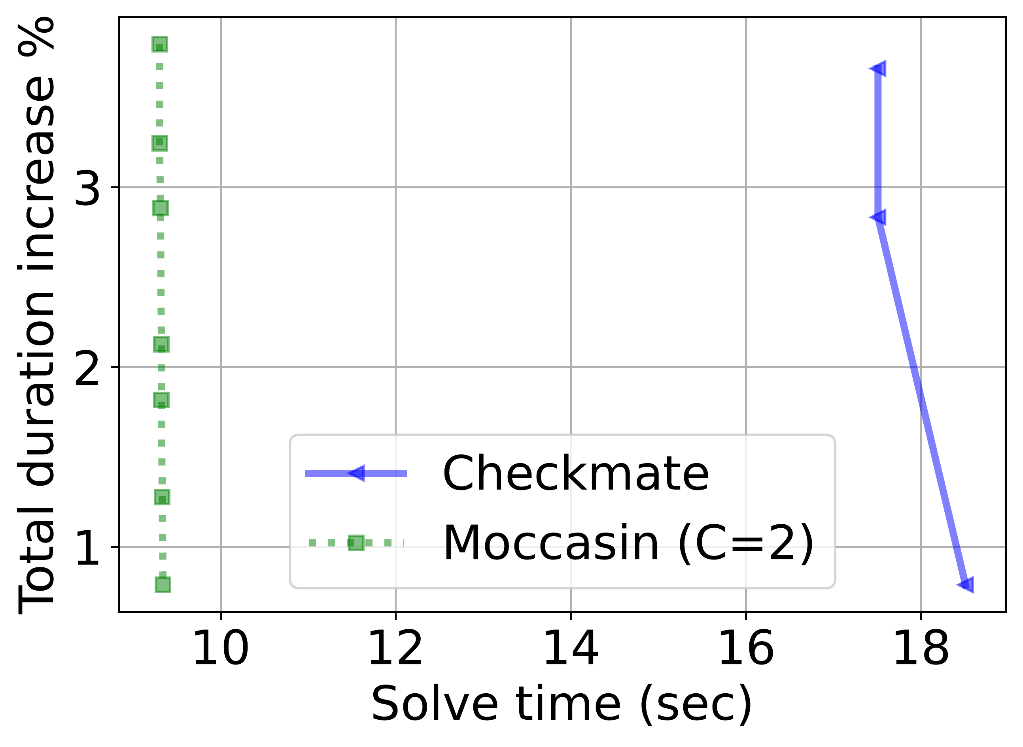
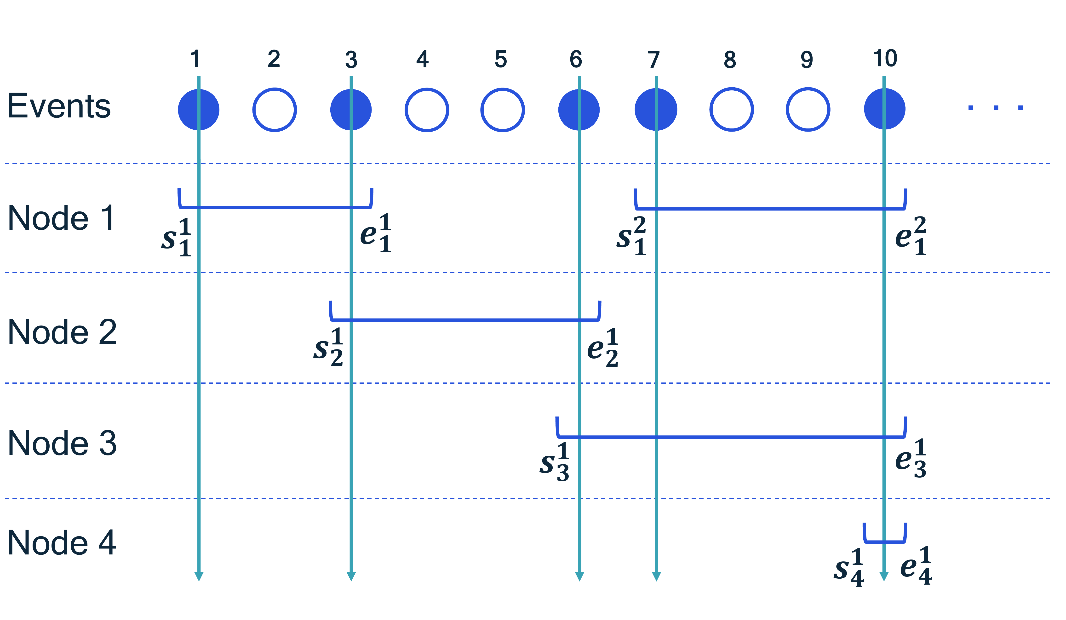
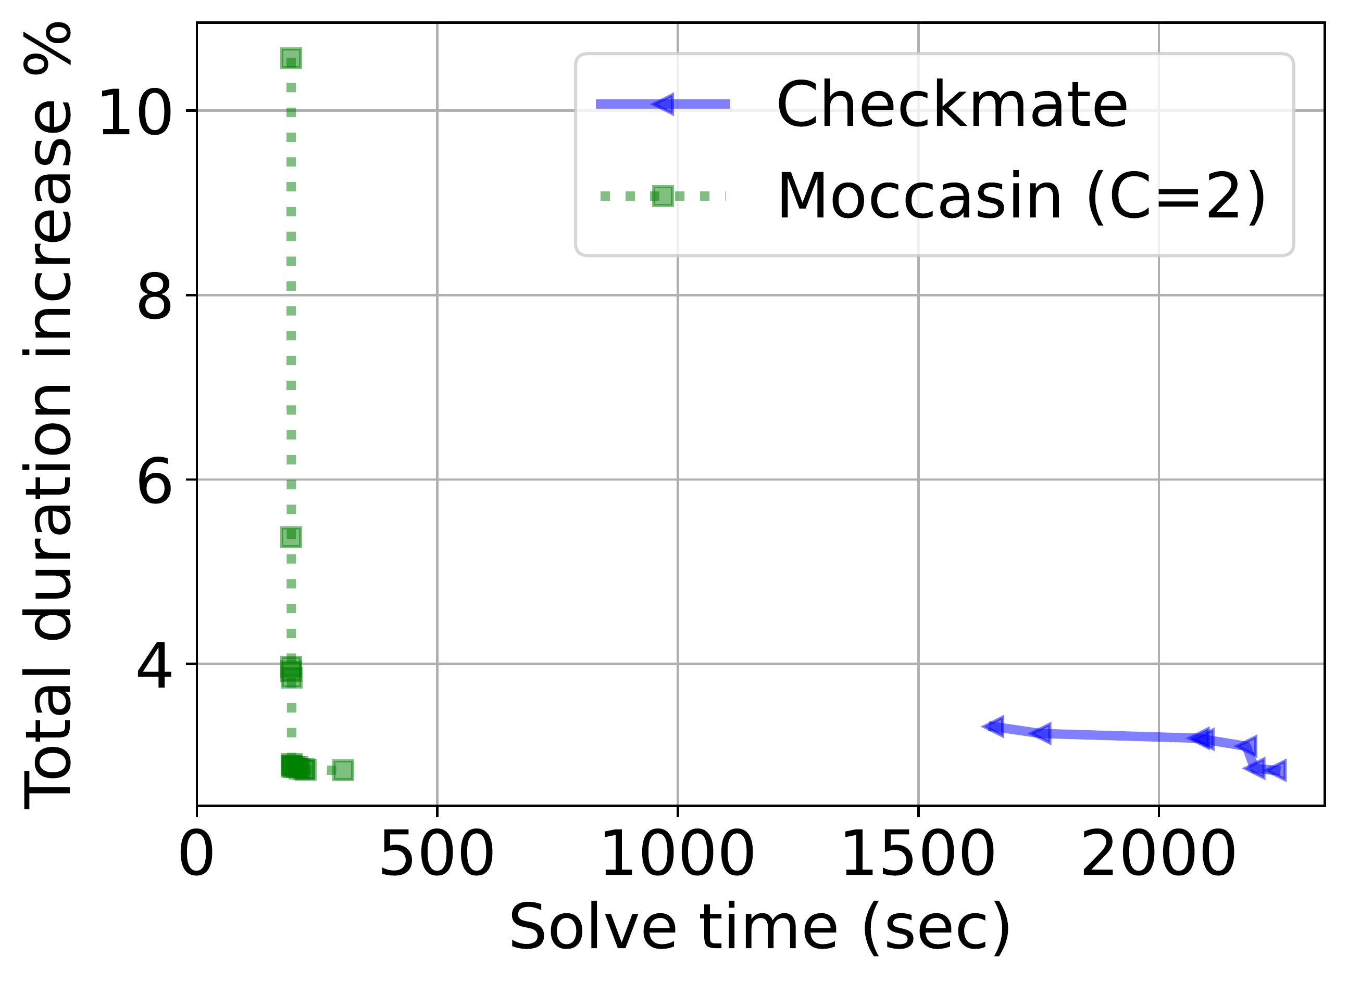
Moccasin: Efficient Tensor Rematerialization for
Neural Networks
Burak Bartan¹, Haoming Li², Harris Teague¹, Christopher Lott¹, Bistra Dilkina²
¹ Qualcomm AI Research ² University of Southern California
Problem
Method
Key Results
Given a compute graph and a fixed memory budget, decide
which tensors to keep versus recompute so total execution time
is minimized while peak memory stays within budget.
Each node's tensor = up to C_{v} retention intervals (start s, end
e, flag a).
METHOD
SOLVE TIME
DUR. INC.
Checkmate (MILP)
~2000 s / OOM
~3%
CP cumulative + reservoir constraints; solved by OR-Tools
CP-SAT with O(Cn) variables.
Moccasin (C=2)
~200 s / <1 h
<5%
The schedule search is PSPACE-complete — and memory is
the primary limit for on-device training.
Motivation
minimize recompute time subject to the memory budget M
Checkmate (prior SOTA) casts rematerialization as a MILP with
O(n²) Boolean variables.
That quadratic growth is a wall: large graphs time out or
exhaust memory, and cannot scale past a few hundred nodes.
Retention intervals: each node's tensor lifetime as a small set of
[start, end] event intervals (s, e).
Solve progress on random layered graphs: Moccasin (green, ~9.5 s)
reaches a low-overhead solution far sooner than Checkmate (blue, ~18 s).
Takeaway
SO WHAT → On G3/G4 Checkmate returns no solution in 3 h and hits OOM; Moccasin finishes under an hour.
Reformulating rematerialization over retention intervals
cuts discrete variables from quadratic to linear — solving
far larger graphs up to 10× faster, overhead under 5%.
Headline Numbers
The variable count grows only linearly in graph size; the solved
sequence is hardware-agnostic and runs unchanged on any CPU
or GPU.
10×
O(n)
integer vars (vs O(n²))
<5%
duration overhead
On a real graph (n=442, m=1247), Checkmate needs ~2000 s while
Moccasin (green) converges near ~200 s.
faster solve on large graphs
1000
nodes, m=5875 solved
vs. Checkmate, up to an order of magnitude faster on
the largest graphs tested
C=2
intervals per node

