Slide 1



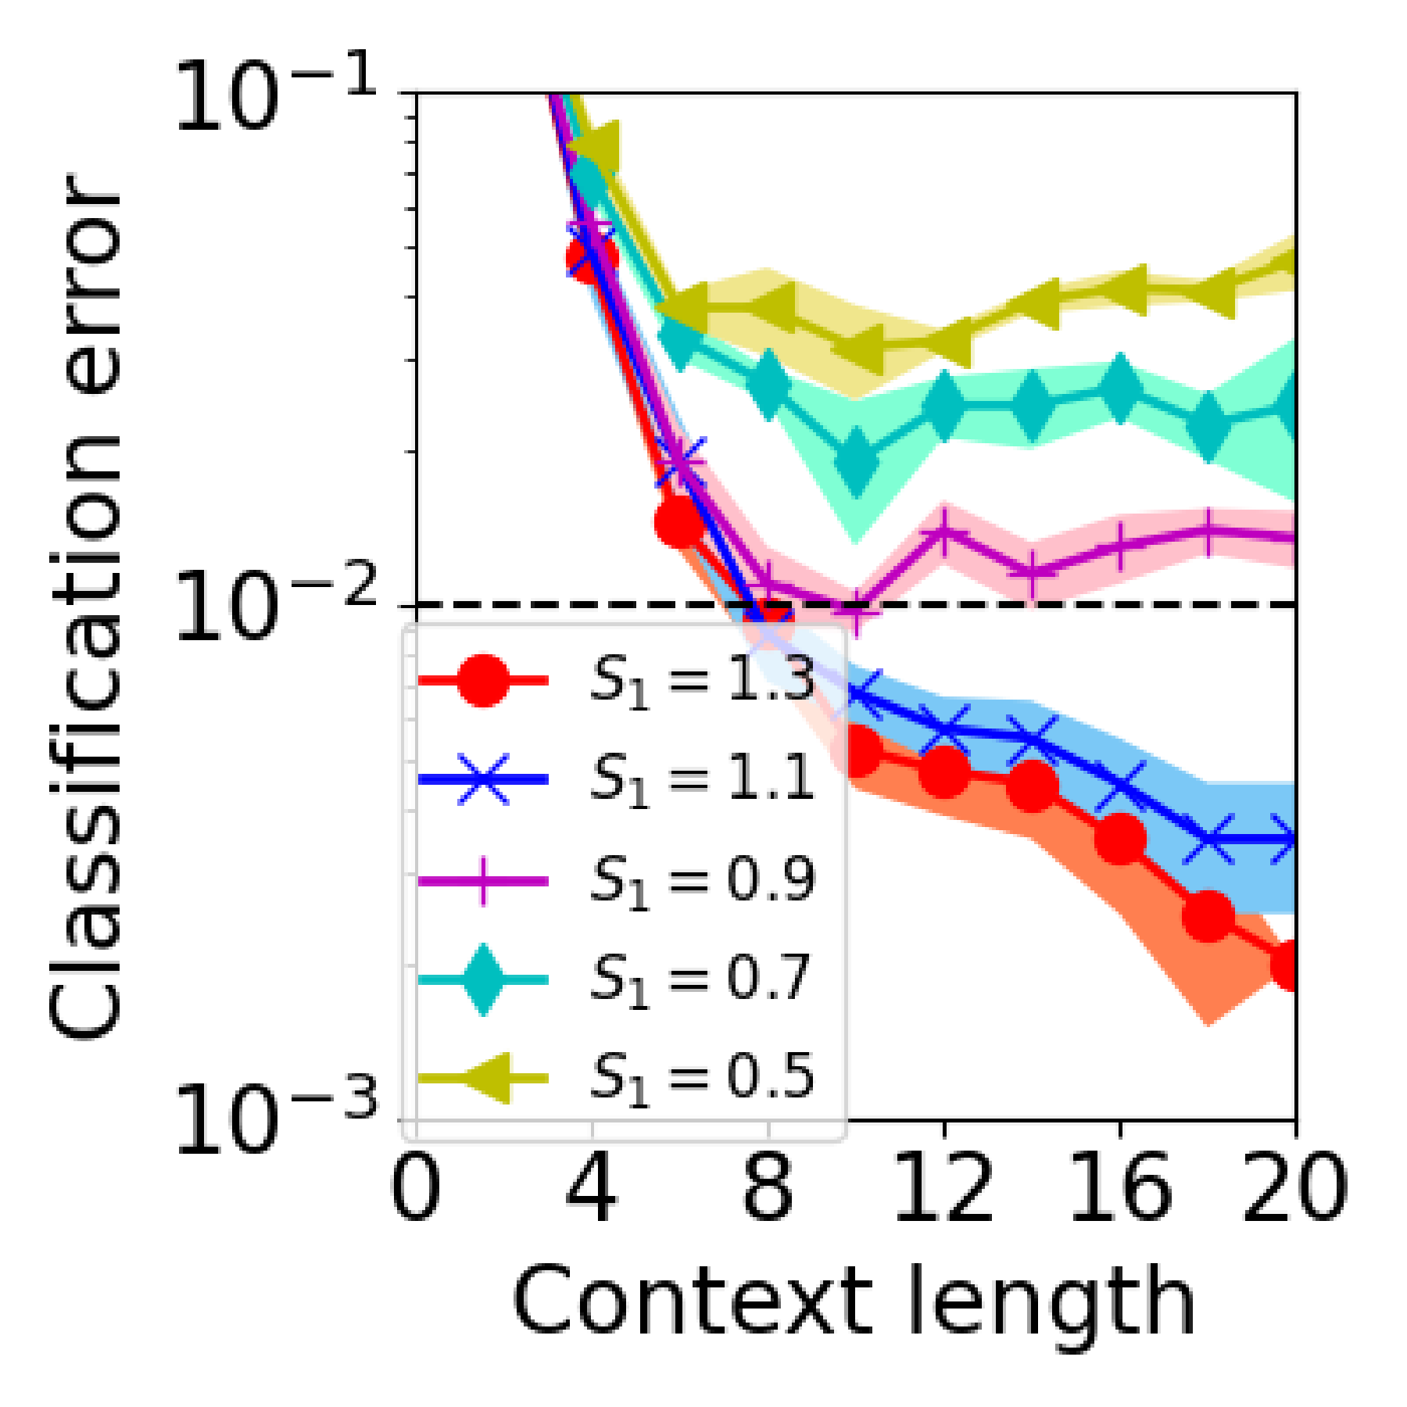
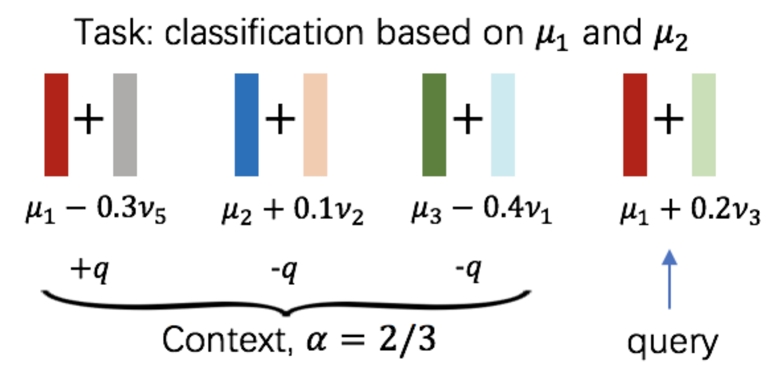
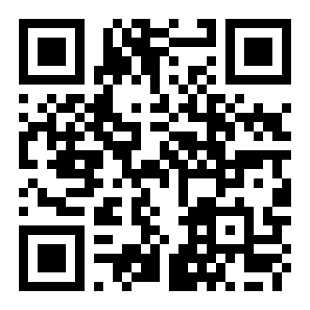
How Do Nonlinear Transformers Learn and
Generalize in In-Context Learning?
Hongkang Li¹, Meng Wang¹, Songtao Lu², Xiaodong Cui², Pin-Yu Chen²
¹ Rensselaer Polytechnic Institute ² IBM Thomas J. Watson Research Center
Problem
Method
Key Results
Headline Numbers
In-context learning (ICL) lets a pretrained
Transformer solve new tasks from a few
examples, with no fine-tuning. Yet why
training yields ICL and how it
generalizes stay unknown: softmax
attention and a ReLU MLP make the
objective nonconvex and hard to analyze.
A single-head, one-layer Transformer — softmax self-
attention plus a two-layer ReLU MLP — is trained by
minimizing hinge loss over prompts drawn from a subset
of binary classification tasks.
REGIME
CONDITION
CLS.
ERROR
α^{−2/3}
iters &
samples
scale
In-domain
Θ(α^{−2/3}) iters & samples
O(ε)
~15%
Out-of-
domain
S₁ ≥ 1 (linear-combo
patterns)
< 0.01
Wₒ neurons
prunable
α⁻¹
context length
scales
Each input carries label-deciding IDR patterns plus
irrelevant patterns; we follow the gradient-descent
trajectory of the attention and MLP weights and test
both in-domain and out-of-domain.
near-lossless ICL
<0.01
OOD error,
S₁≥1
FIRST
Takeaway
First analysis of a fully nonlinear
Transformer.
Two quantities drive every guarantee: α, the fraction of
context sharing the query's IDR pattern, and β, the norm
of the relevant patterns.
A one-layer Transformer with genuinely
nonlinear attention and MLP can be
provably trained for ICL that generalizes
in-domain and under distribution shift, at
a cost set by the relevant-context fraction,
while its low-magnitude MLP neurons
prune almost for free — a principled
reason magnitude pruning preserves ICL.
Motivation
Prior ICL theory drops the hard parts
— it removes nonlinear attention or
uses a linear MLP, and studies only
linear regression.
attn(Ψ;P,i)=softmax((W_{K}p_{i})⊤W_{Q}p_{query}) — nonlinear attention + ReLU MLP. Gradient descent drives it to O(ε) ICL error in T = Θ(α^{−2/3}) iterations on N = BT samples.
None explain training under
distribution shift, nor how model
pruning, now routine for cheaper LLM
inference, affects ICL.
ICL in a nonlinear Transformer is
not a black box: attention finds the
matching context, the ReLU MLP
amplifies its label.
PRIOR ICL
THEORY
vs.
THIS WORK
Out-of-domain error vs. context length for combination
strengths S₁: error falls below the 0.01 line (dashed) exactly
when S₁ ≥ 1.
Linear attention
or a linear MLP;
regression only;
no shift and no
pruning.
Fully nonlinear
model; provable
in- & out-of-
domain ICL; first
pruning theory.
SO WHAT → One trained model generalizes in-domain and to shifted tasks whose relevant patterns are linear combinations of the training ones.
Trained-model mechanism: attention concentrates on context
tokens sharing the query's IDR pattern (score 0.8); the ReLU
MLP's large-magnitude neurons then promote the matching label,
so the prediction reads the query-varying part of the label.
Trained on only a vanishing fraction of in-domain
tasks, yet generalizes to the rest.
Scan to read the full paper
arxiv.org/abs/2402.15607

