Slide 1




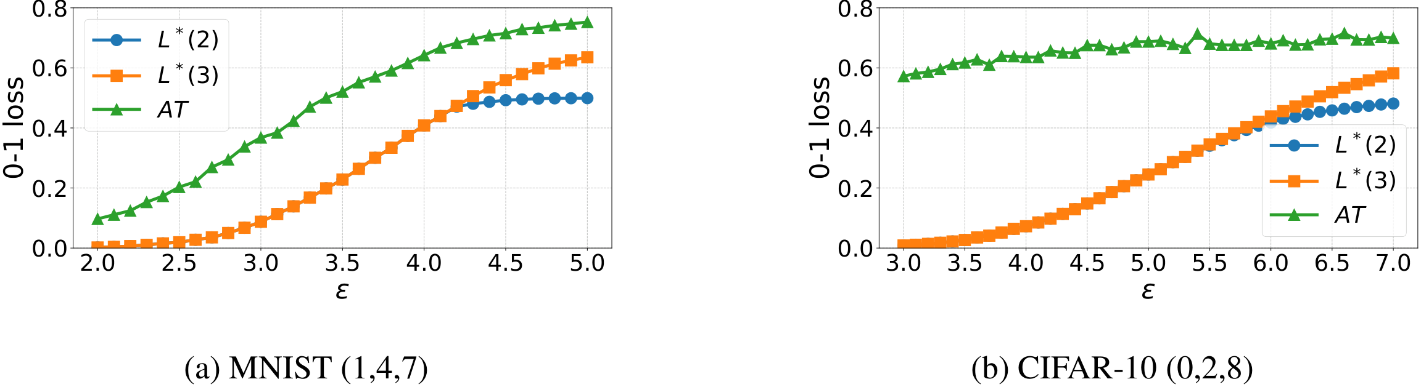
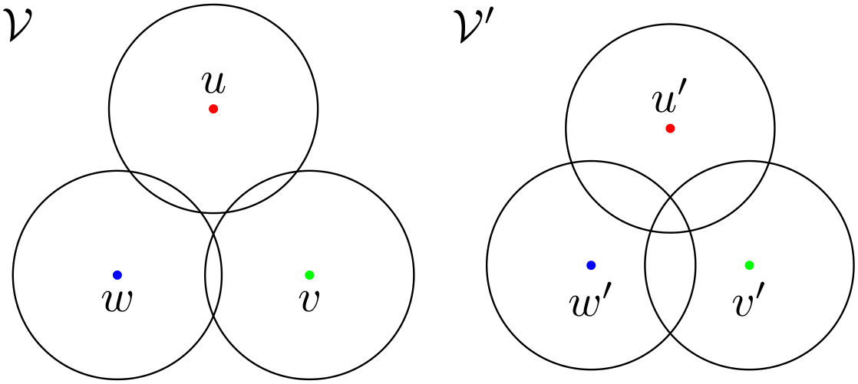
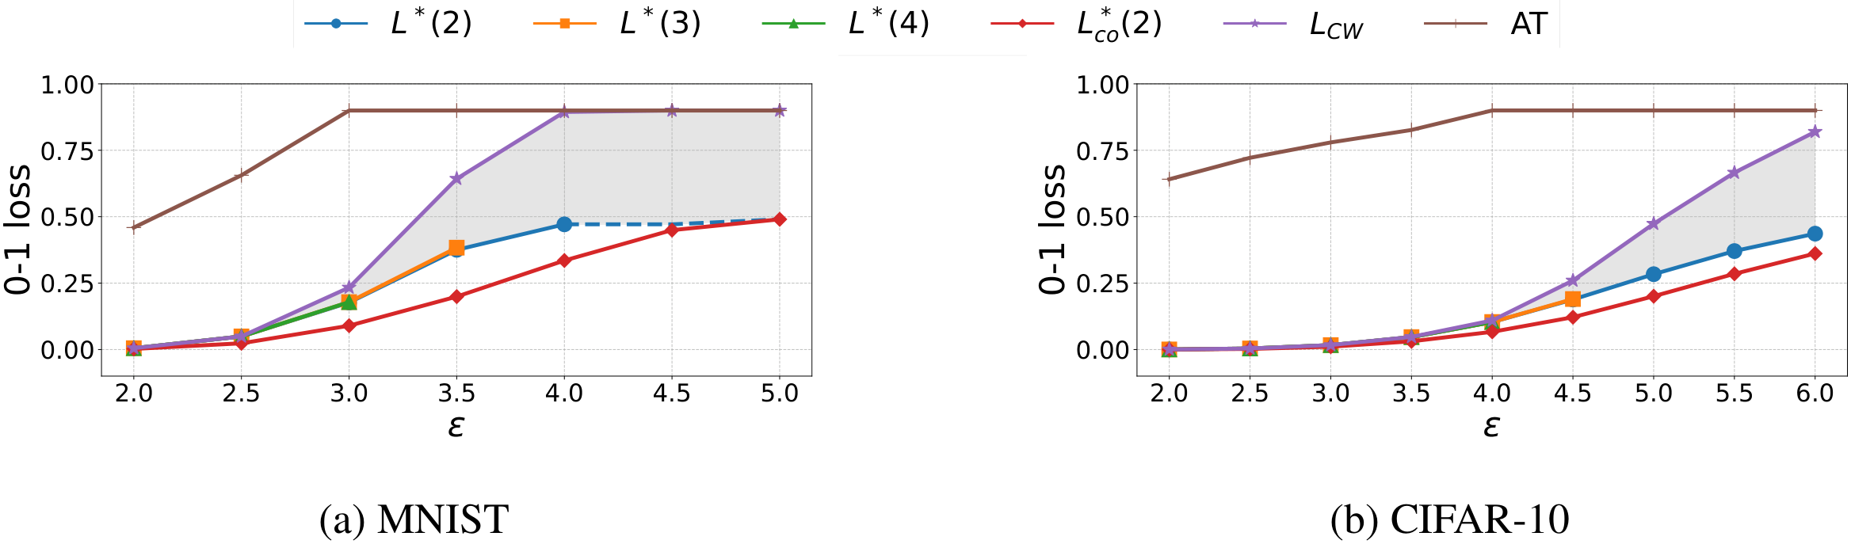


Characterizing the Optimal 0-1 Loss for Multi-class
Classification with a Test-time Attacker
Sihui Dai¹, Wenxin Ding², Arjun Nitin Bhagoji², Daniel Cullina³, Ben Y. Zhao², Haitao Zheng², Prateek Mittal¹
¹ Princeton University ² University of Chicago ³ Pennsylvania State University
Problem
Method
Dataset / Benchmark
Ablation Study
No method existed to compute the lowest
achievable 0-1 loss under a test-time
attacker for multi-class classification; prior
results covered the binary case alone.
Build a conflict hypergraph: vertices are data points; a
hyperedge links same-neighborhood examples of
different classes that an attacker can collapse.
MNIST
CIFAR-10
3-class
Full 10-class
Higher-degree hyperedges barely move
it: L*(2), L*(3), L*(4) coincide until the
loss passes ~0.4.
L2 attacker
TRADES / APGD-CE
3-class studies use 1000 samples/class (MNIST digits
1·4·7; CIFAR-10 plane·bird·ship). Baselines: TRADES
adversarial training (3-layer CNN / WRN-28-10)
evaluated with strong APGD-CE. The full 10-class
bounds use the complete training sets.
At ε=3, the CIFAR-10 bound is
completely unchanged despite millions
of degree-3 and degree-4 hyperedges.
The optimal robust loss is a linear program over
achievable correct-classification probabilities; its dual is a
fractional vertex cover that gives the worst-case
attacker’s play.
With no absolute optimum, one cannot
tell whether a robust model is near-
optimal.
Edge-only bounds pin the optimum
tightly.
Motivation
To scale, truncate the hypergraph to degree m for L*(m),
aggregate binary bounds into L*_{CO}(2), and add a Caro-
Wei upper bound.
Key Results
A dataset- and attacker-specific lower
bound makes robustness an absolute
measure — progress against the true
optimum, not other defenses.
Headline Numbers
The exact LP is intractable at 10 classes, so the efficient
lower and upper bounds bracket the range in which the
true optimum must lie.
0.44
MNIST cert ·
ε=2.0
0.60
AT loss · 3-class
CIFAR-10
0.80
CIFAR cert ·
ε=2.0
With three or more classes, examples
interact in higher-order ways that binary
analysis cannot capture, changing what
optimal robustness looks like.
Fig 2 · Optimal error L*(3) for 3-class MNIST & CIFAR-10 vs
adversarially trained (AT) models.
optimal L* ≈ 0
13M
hyperedges, no
effect
BEST ROBUST MODEL
0-1 LOSS
OPTIMAL L*
Takeaway
Prior optimal-loss results were
characterized for the binary case only.
LP form: maximize correctly-classified mass p·q under the hyperedge-incidence constraints B
MNIST cert · ε=2.0
0.44
≈0
CIFAR-10 cert · ε=2.0
0.80
≈0
Multi-class robustness has a large, now-
measurable gap to the optimum — far
worse than binary.
It reveals whether the bottleneck is the
training method or a fundamental limit
of the data.
A fast diagnostic for the robustness
headroom left on the table.
BINARY (PRIOR
WORK)
vs.
MULTI-CLASS
(OURS)
Optimal robust
loss known —
but only two
classes.
Higher-order
conflicts; the
optimum was
uncharacterized.
Fig 3 · Lower bounds L*(2/3/4) and coupling L*_{CO}(2) vs the
Caro-Wei upper bound L_{CW} localize the true 10-class
optimum (grey band).
Scan to Read
Fig 1 · Two conflict structures over three examples of different
classes; the size-three hyperedge (right) changes the optimal loss
only when all example probabilities are near-balanced.
SO WHAT → The gap is large even at small ε — far wider than the binary case.
Paper
Code

