Slide 1




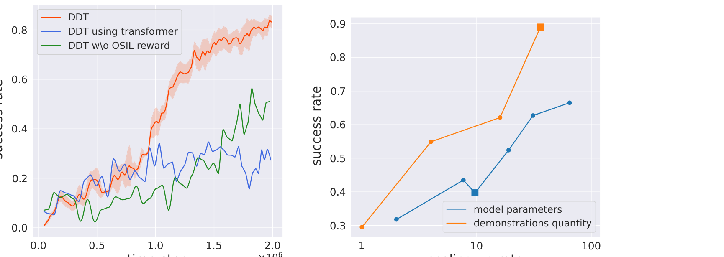
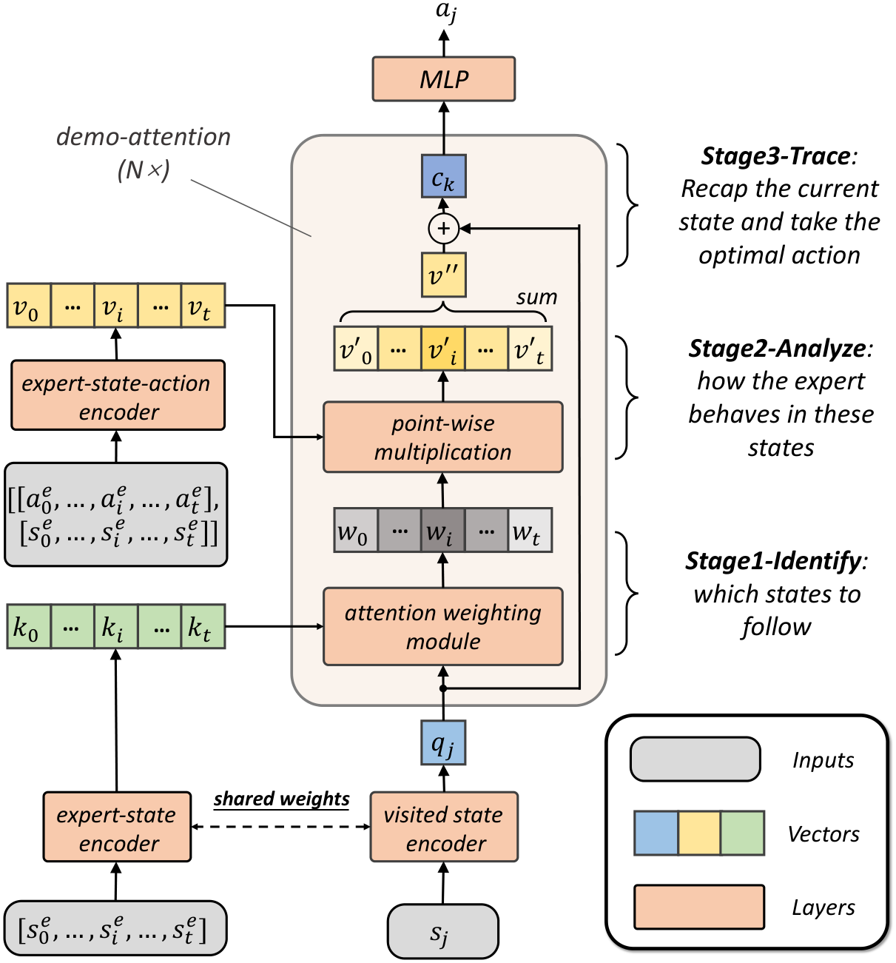
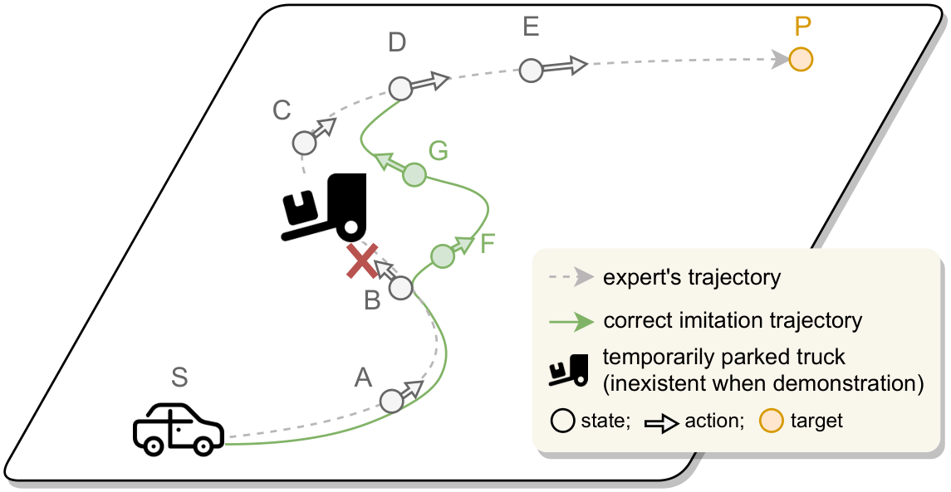
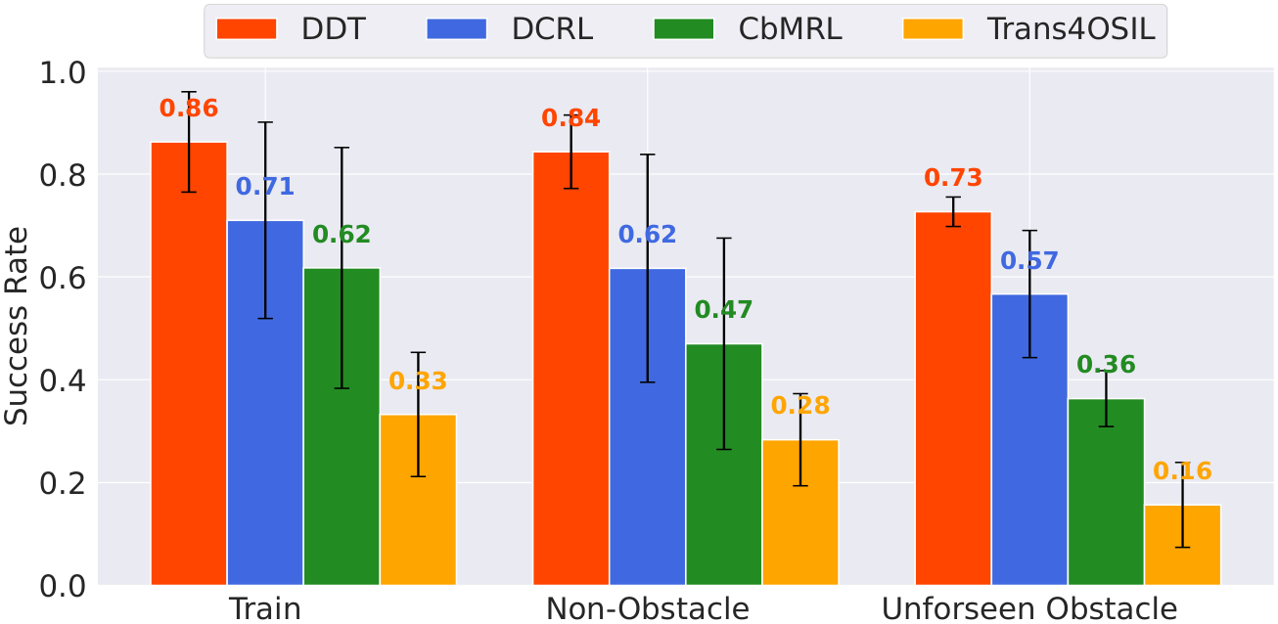
Deep Demonstration Tracing: Learning a Generalizable Imitator Policy from a
Single Demonstration
Xiong-Hui Chen^{1,2,*}, Junyin Ye^{1,2,*}, Hang Zhao^{3,2}, Yi-Chen Li^{1,2}, Xu-Hui Liu^{1,2}, Haoran Shi², Yu-Yan Xu², Zhihao Ye^{1,2}, Si-Hang Yang^{1,2}, Yang Yu^{1,2,†}, Anqi Huang^{4,2}, Kai Xu³,
Zongzhang Zhang¹
¹ Nanjing University ² Polixir Technologies ³ National University of Defense Technology ⁴ Nanjing University of Science and Technology
Problem
Method
Dataset / Benchmark
Ablation Study
One-shot imitation learning (OSIL)
learns a task from a single
demonstration, but prior methods
assume deployment matches the demo
and fail under unforeseen changes.
1
Identify relevant demo states — attention.
VPAM (Valet Parking Assist in Maze): reach a
target from local 8-ray × 5-step views; obstacles
are absent from the demo.
ABLATED PART
EFFECT
2
Analyze the expert there — point-wise mult.
Std. transformer
↓ final perf.
No OSIL reward
↓ learn speed
3
Trace back and take the action.
Single/Multi-map
Obstacle / None
An obstacle or disturbance after the
demo pushes the agent into
unshown states where naive replay
fails.
Coords / None
Meta-World
Reacher
Pusher
MuJoCo
Key Results
Left: DDT (orange) learns faster and higher
than its ablated variants. Right: success
scales log-linearly (~2×) with data and
model size.
Motivation
Method
Train
Non-Obs
Obstacle
Trans4OSIL
0.33
0.28
0.16
A human detours around an
obstacle, then rejoins the
demonstrated route — agents need
adaptive tracing, not blind replay.
CbMRL
0.62
0.47
0.36
Headline Numbers
DCRL
0.71
0.62
0.57
DDT (ours)
0.86
0.84
0.73
0.73
−15%
robustness
drop
Prior OSIL embeds the demo as a
context vector and clones actions —
no guarantee in unseen states.
Best in every setting; only −15% drop under
obstacles vs −20/−33/−52% for baselines.
success under
unforeseen
obstacles
0.61
Meta-World
unseen
the strongest baseline
reaches only 0.57
~2×
from scaling
Takeaway
DDT traces one demonstration via a
meta-RL-trained transformer to stay
robust under unforeseen changes.
Trace, don't replay: one
demonstration is enough when
the agent detours and rejoins.
Humans handle OSIL under unforeseen
change: detour around a temporarily parked
truck, then trace back to the expert path.
Success rate across VPAM settings: DDT (red) beats
DCRL, CbMRL, and Trans4OSIL in every condition.
Demonstration transformer (identify → analyze → trace).

