Slide 1


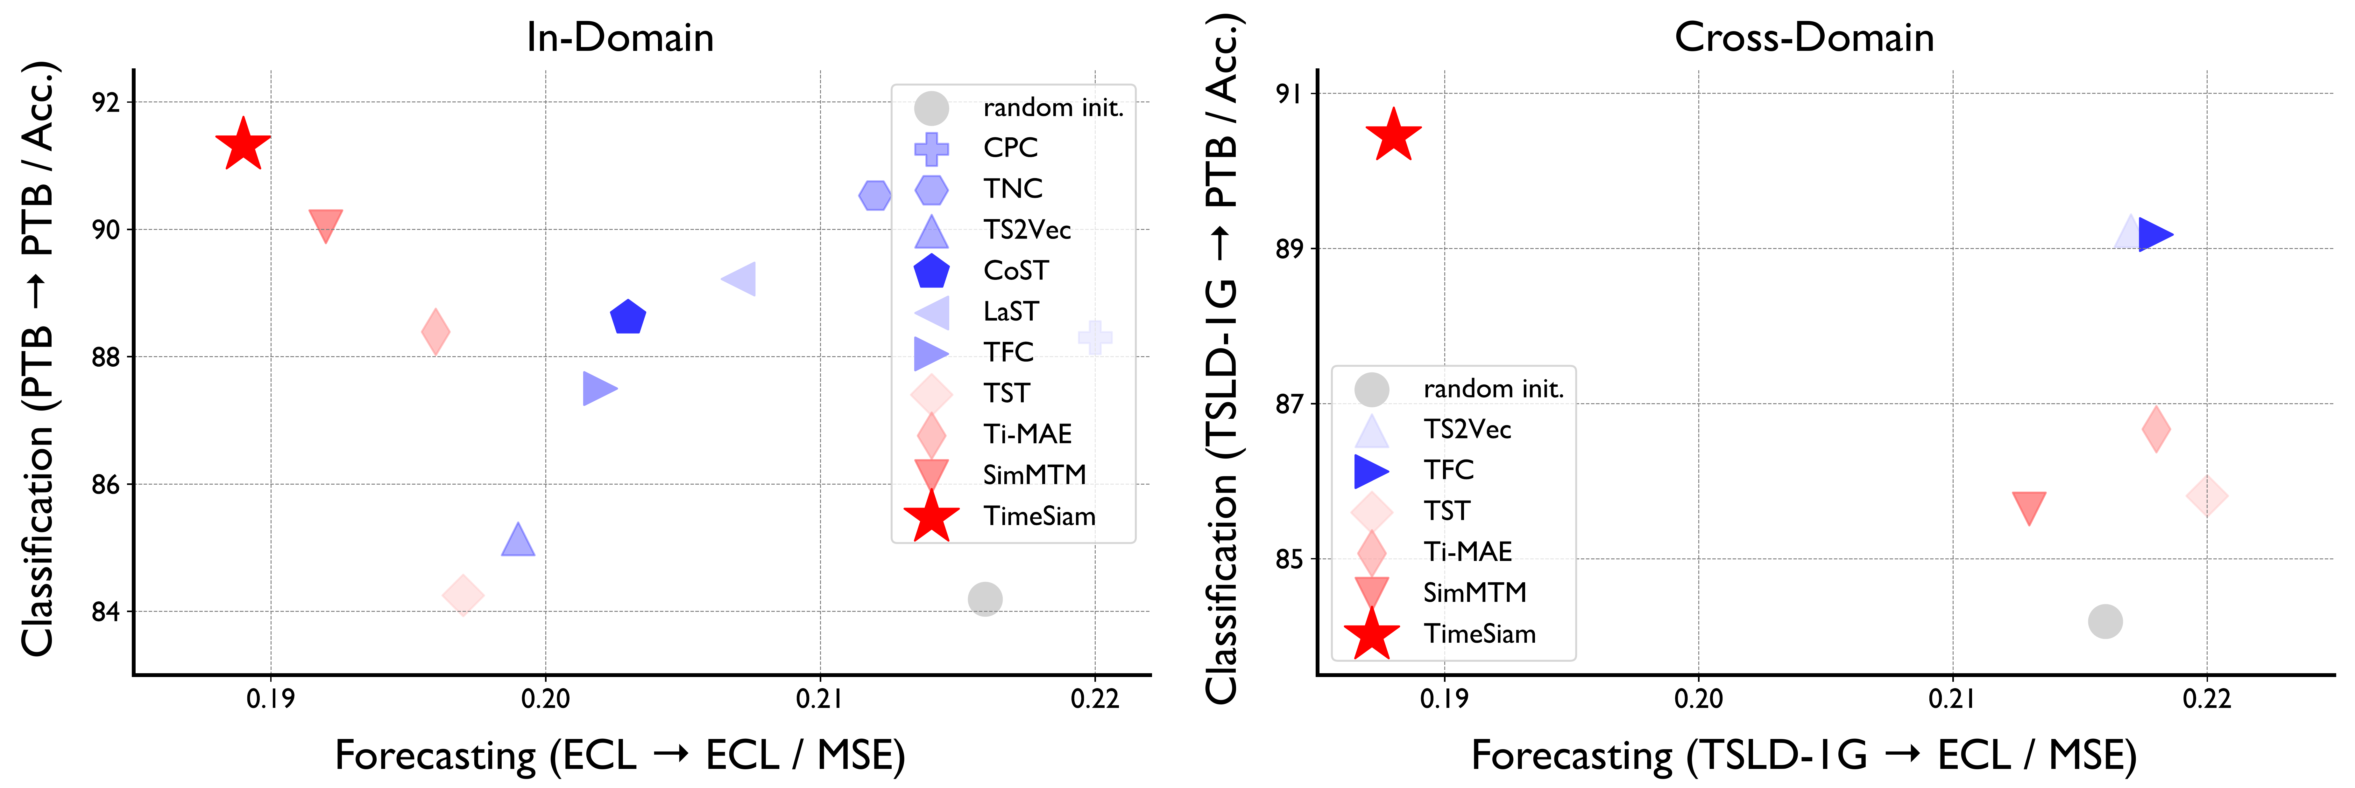
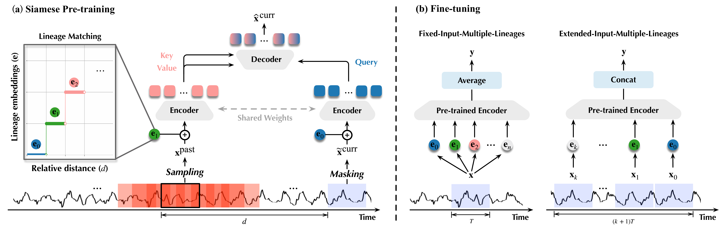
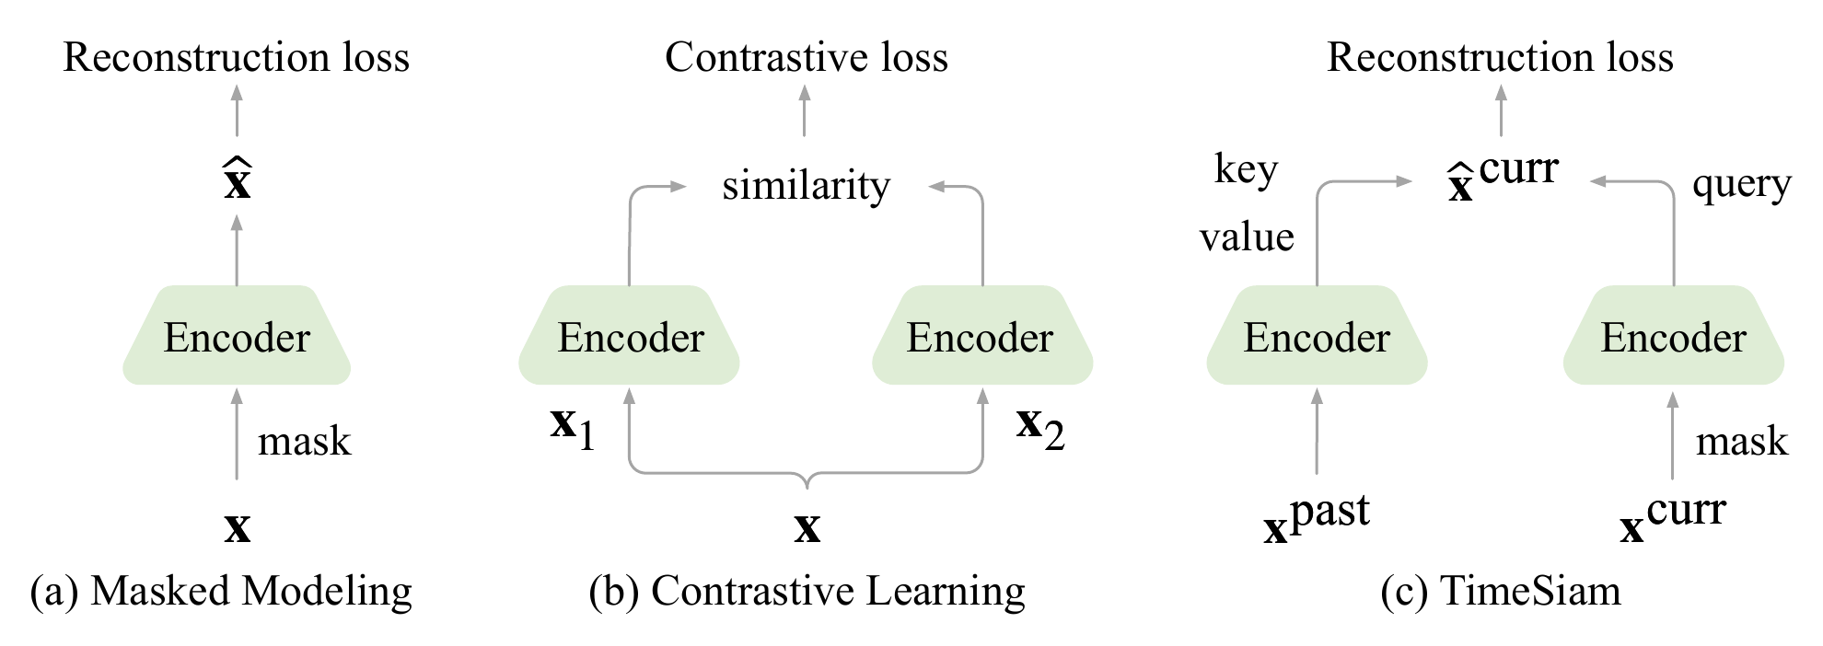
TimeSiam: A Pre-Training Framework for Siamese
Time-Series Modeling
Jiaxiang Dong, Haixu Wu, Yuxuan Wang, Yunzhong Qiu, Li Zhang, Jianmin Wang, Mingsheng Long
School of Software, BNRist, Tsinghua University
Problem
Method
Key Results
Self-supervised pre-training reuses masked modeling and
contrastive learning from vision and language. On time series
both misfire: randomly masking a series or scoring series-wise
similarity distorts or neglects the temporal correlations intrinsic
and crucial to time-series data.
1
Sample a past and current subseries from the same series.
In-domain forecast (avg MSE↓)
Random init.
TimeSiam
2
Mask the current subseries with a simple augmentation.
ETTh1
0.473
0.429
ETTm1
0.390
0.374
3
Reconstruct: shared Siamese encoders + a cross-attention
decoder rebuild the current series from the past.
Traffic
0.490
0.453
Masking shatters smooth temporal structure; contrastive
learning ignores fine-grained within-series correlations and
needs augmentations hard to design for time series.
4
Lineage embeddings indexed by past→current distance span
many temporal gaps.
Motivation
Unlabeled data is exploding. IoT sensors and wearables
stream ever-growing volumes of time series, ready for label-free
pre-training at scale.
Past-to-current reconstruction is the sole objective — forcing the model to internalize how distant moments correlate.
TimeSiam (red star) beats 8 SSL baselines on forecasting (MSE↓) and
classification (Acc↑), in- and cross-domain.
Prior work wastes the signal. Each subseries is treated in
isolation, overlooking the chronological relationship between
temporally distanced observations.
Headline Numbers
+11.5%
−5.7%
forecast MSE (PatchTST)
A method that explicitly emphasizes temporal-correlation
modeling could unlock this data for downstream tasks.
average classification-accuracy
gain, in-domain
13
benchmarks covered
TimeSiam pre-trains shared Siamese encoders on past/current subseries
and fuses learnable lineage embeddings; fine-tuning averages (fixed input)
or concatenates (extended input) the lineages.
vs random initialization, averaged across the AD,
TDBrain and PTB medical classification benchmarks
8
SSL baselines beaten
Dataset / Benchmark
Takeaway
13 benchmarks over two tasks, plus two newly constructed large-
scale multi-domain corpora (TSLD-500M, TSLD-1G with 13.9M
examples) for cross-domain pre-training.
Reframe time-series pre-training as past-to-current
reconstruction between Siamese subseries with learnable
lineage embeddings — capturing the temporal correlations
masking and contrastive methods miss, for simple,
general, state-of-the-art transfer across tasks and domains.
Backbone-agnostic on iTransformer, PatchTST and TCN.
Time-series pre-training paradigms: (a) masked modeling reconstructs a
masked series; (b) contrastive learning scores similarity; (c) TimeSiam
reconstructs the masked current series from a sampled past observation.
ETT×4
Weather
Electricity
Traffic
Exchange
AD
TDBrain
PTB
TSLD-500M
TSLD-1G

