Slide 1


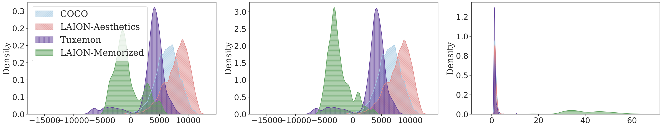


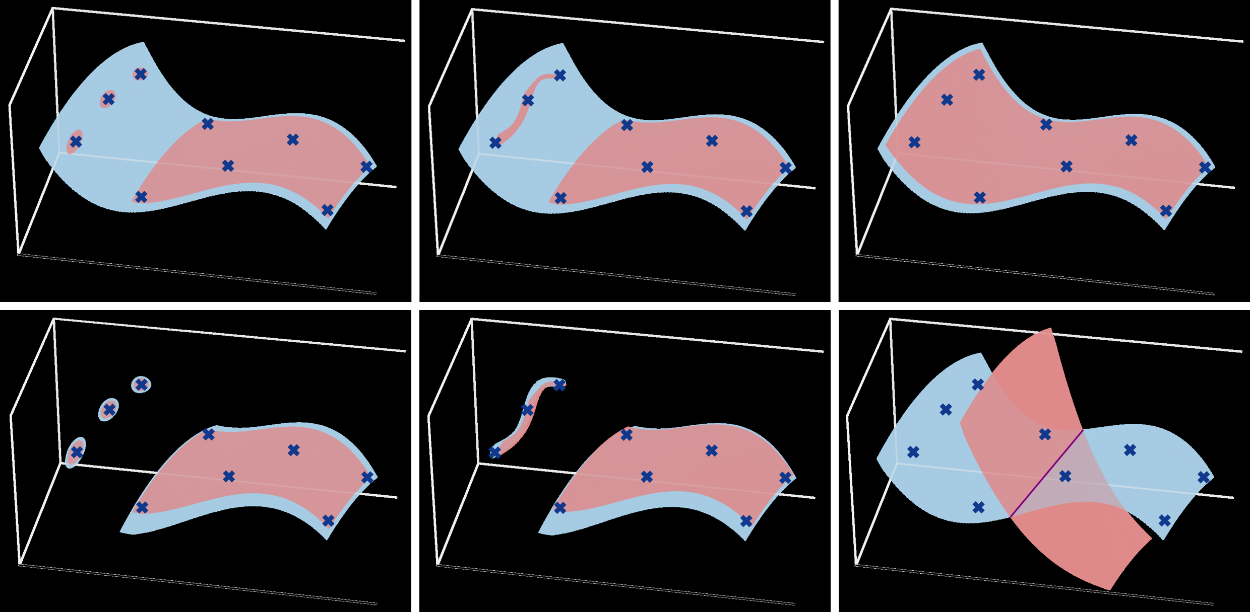
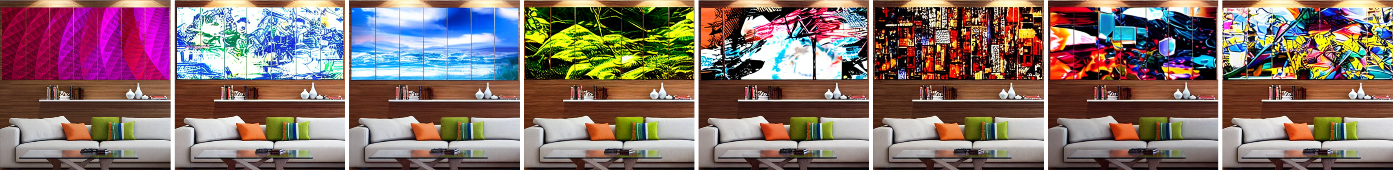
A Geometric Framework for Understanding
Memorization in Generative Models
Brendan Leigh Ross, Hamidreza Kamkari, Tongzi Wu, Rasa Hosseinzadeh, Zhaoyan Liu, George Stein, Jesse C. Cresswell, Gabriel Loaiza-Ganem
¹ Layer 6 AI
Problem
Method
Key Results
Deep generative models — diffusion models especially — memorize and reproduce training datapoints, a real privacy and copyright risk. The field has no unified, formal language for how memorized a sample is: prior pixel-distance definitions miss reconstructive memorization (copied layout / style) and don't scale to LAION-2B.
Local intrinsic dimension LID(x) counts a manifold's degrees of freedom: with ℓ active constraints, LID(x)=d−ℓ. A perfectly copied training image sits on a 0-dimensional point mass.
MEMORIZATION DETECTOR
CAPTION-FREE
FLAGS MEMORIZED
CFG vector norm (Wen 2023)
✗
✓
Unconditional LID_{θ} (ours)
✓
✓
The Manifold Memorization Hypothesis (MMH) compares the model's LID_{θ}(x) to the ground-truth LID*(x): OD-Mem = model over-constrained (a generalization failure); DD-Mem = dimension intrinsically low even when the fit is correct.
Goal: one formal, geometric standard for “how memorized” a datapoint is — computable up to Stable Diffusion.
Three tractable proxies estimate LID_{θ} at scale — unconditional (FLIPD), conditional LID_{θ}(·|c), and the CFG vector norm.
Memorized LAION (green) separates on every metric: low LID_{θ} / conditional LID_{θ}, high CFG-norm tail vs. COCO / LAION-Aesthetics / Tuxemon.
Motivation
SO WHAT → LID tracks memorization from 2D data up to Stable Diffusion — confirming the MMH.
The manifold hypothesis — realistic data lives on a low-dimensional manifold — is the right lens: it ties memorization to a single geometric quantity, local intrinsic dimension.
Headline Numbers
It unifies scattered empirical memorization phenomena — duplication, low complexity, specific conditioning — under one framework.
OD-Mem: (overfitting) · DD-Mem: LID low even when (data-driven). Conditioning can only lower LID, so specific prompts drive memorization.
3
LIDθ proxies
86
4,251
non-mem. controls
verbatim-memorized LAION-2B images
2D→SD
validation scale
→
flagged by low LIDθ, caption-free
1–8
tokens rephrased
PROBABILISTIC VIEW
GEOMETRIC VIEW (OURS)
Needs the full training set + huge sample counts — intractable at LAION scale.
One measurable quantity (LID) with estimators that scale to Stable Diffusion.
Takeaway
2D von Mises
CIFAR10
Stable Diffusion v1.5
LAION-2B
Memorization is geometric: when a model's local intrinsic dimension collapses too low, that point is memorized — from overfitting (OD-Mem) or intrinsically simple data (DD-Mem). Because LID_{θ} is estimable at scale, one quantity both detects memorized images (even caption-free) and mitigates it at sample time by steering toward higher-LID regions.
Eight images along a low-dimensional manifold learned by Stable Diffusion v1.5 — the first is a real memorized LAION image, the rest are generated near-duplicates.
LID and memorization: (a,d) 0-dim point masses = memorization — (a) overfitting-driven, (d) data-driven; only (c), a 2-dim manifold, generalizes.

