Slide 1


ICLR 2025 · LAYER 6 AI
A Geometric Framework for
Understanding Memorization
The Manifold Memorization Hypothesis
Ross · Kamkari · Wu · Hosseinzadeh · Liu · Stein · Cresswell · Loaiza-Ganem
Code
Validated across scales, from 2D synthetic data and CIFAR-10 up to Stable Diffusion 1.5.
The Risk
The Proposal
What It Delivers
As generative models grow more
The manifold memorization
A formal standard for how
capable, they memorize and
hypothesis: reason about
memorized a point is · separates
reproduce their training data —
memorization through the local
overfitting- from data-driven
raising serious privacy and
intrinsic dimension of the data
memorization · scalable detection
copyright concerns.
and model manifolds.
and mitigation up to SD.
A Geometric Framework for Understanding Memorization in Generative Models — Layer 6 AI · ICLR 2025
01 / 08

Slide 2
02 · PROBLEM
02 / 08
Powerful models memorize — and we cannot measure it
1 · Deployed at scale
2 · Real-world harm
Generative models — and diffusion models in
Memorized samples can expose private
particular — are increasingly deployed in
information and reproduce copyrighted
public-facing applications.
works.
With enough capacity, they memorize their
That exposes model builders to real legal
training data.
liability.
3 · No formal yardstick
4 · Pixel distance fails
The community has lacked a single formal
Past definitions use distance to the nearest
framework to say precisely how memorized
training image in pixel space.
a datapoint actually is.
It misses subtler memorization and cannot
Memorization comes in many subtle forms,
be computed at the scale of models like
not just exact copies.
Stable Diffusion.
A Geometric Framework for Understanding Memorization — Problem

Slide 3
03 · MOTIVATION
03 / 08
Geometry is the right lens for memorization
The manifold hypothesis
Our claim
Realistic data lives on a low-dimensional
This geometry is exactly the right lens for
manifold embedded in a high-dimensional
reasoning about memorization.
space.
A memorized point is one whose manifold
Only a few directions really vary — the rest
has collapsed to very few — or zero —
is structure.
degrees of freedom.
Why not probability
The geometric payoff
Purely probabilistic frameworks demand the
A geometric framing ties memorization to
whole training dataset and enormous
one quantity — local intrinsic dimension.
sample counts.
Practical estimators for it already exist,
That is hopeless at LAION scale — hundreds
even for large diffusion models like Stable
of millions of images.
Diffusion.
A Geometric Framework for Understanding Memorization — Motivation

Slide 4
04 · METHOD
04 / 08
Memorization = low local intrinsic dimension
1 · The quantity: LID
2 · Overfitting-driven
Local intrinsic dimension = the degrees of
When the model's manifold is too
freedom a point has on its manifold.
constrained relative to the truth.
A perfectly reproduced image sits on a
A genuine modelling failure — the model
0-dimensional manifold — a point mass.
itself has collapsed the manifold.
3 · Data-driven
4 · Estimating at scale
When LID is intrinsically small even for a
True LID is intractable at SD scale, so use
correct model — e.g. a highly specific prompt.
three proxies: unconditional FLIPD LID,
Invisible to a comparison of train- and
conditional LID, and the CFG vector norm.
test-set likelihoods.
They prove conditioning can only reduce LID.
THE MANIFOLD MEMORIZATION HYPOTHESIS
A point x is memorized when its model local dimension LID_θ(x) is small.
Overfitting-driven: LID_θ(x) ≪ LID*(x) Data-driven: LID*(x) is itself small
Method

Slide 5
05 · DATASET / BENCHMARK
05 / 08
One framework, validated across every scale
The experiments deliberately sweep across scales
From toy data where ground truth is exactly computable, all the way up to Stable Diffusion.
SMALL SCALE
MIDDLE SCALE
LARGE SCALE
2D synthetic
CIFAR-10
Stable Diffusion 1.5
Two-dimensional synthetic
A StyleGAN2-ADA model
86 verbatim-memorized
von Mises mixtures.
and an iDDPM diffusion
LAION images studied
model.
against thousands of
Ground-truth local
non-memorized images.
dimension can be computed
Both trained on CIFAR-10 —
exactly — a clean sanity
two model families at a
Drawn from LAION Aesthetics,
check for the theory.
realistic mid scale.
COCO, and Tuxemon.
A Geometric Framework for Understanding Memorization — Datasets & Benchmarks

Slide 6
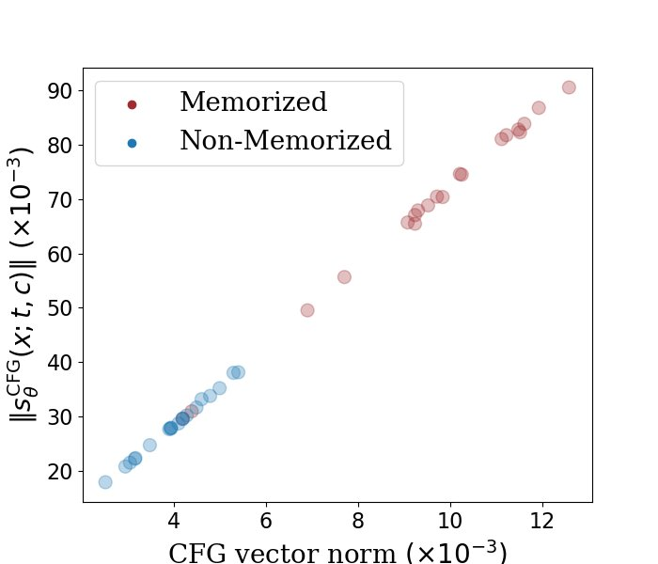
06 · KEY RESULT
06 / 08
Local intrinsic dimension tracks memorization
Universal signal
FIGURE 3 · LID vs CFG-NORM
LID tracks memorization everywhere the
authors look — from 2D data to Stable Diffusion.
The signature
Memorized images reliably get low LID
estimates and high CFG vector norms.
Caption-free detection
The unconditional LID estimate flags
memorized images without their captions.
Beyond prior art
Genuinely new: the prior best signal, the CFG
Memorized points (low LID, high CFG norm) separate
vector norm, needs the caption in hand.
cleanly from non-memorized ones.
A Geometric Framework for Understanding Memorization — Key Result

Slide 7
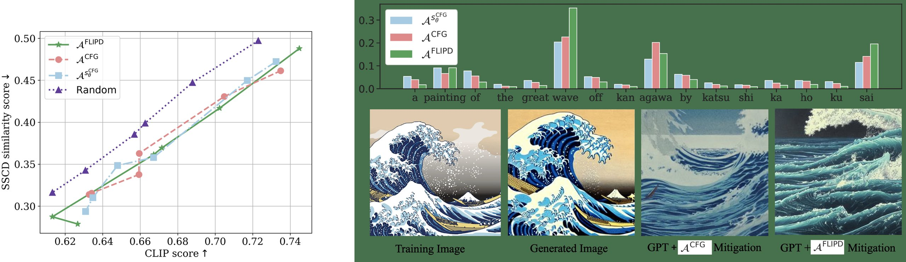
07 · ABLATION STUDY
07 / 08
Mitigation: rephrase the tokens that memorize
Attribute → rephrase
The method attributes
memorization to specific
prompt tokens, then
rephrases them with GPT-4.
Fig 7 · per-token
memorization attribution.
Clean trade-off
Attribution beats random
New metrics work too
Perturbing more tokens
Choosing tokens by
Attribution metrics built on
reduces memorization —
attribution reaches lower
the score norm and on
but also reduces image
training-image similarity —
FLIPD perform about as
fidelity.
at a higher CLIP score
well as the original
than random selection.
guidance-based metric.
1 → 8 tokens, ×5 repeats.
A Geometric Framework for Understanding Memorization — Ablation Study

Slide 8
08 · TAKEAWAY
08 / 08
Memorization is geometric — and measurable
THE ONE IDEA
Memorization is geometric.
A fuzzy, much-debated phenomenon becomes one measurable quantity — detect it, measure it, reduce it.
One test
Two tools
One hypothesis
If the model's local intrinsic
Because LID is estimable at
The manifold memorization
dimension around a point is
scale, you can detect
hypothesis turns a fuzzy,
too small, that point is
memorized images — even
much-debated phenomenon
memorized.
without their captions.
into a measurable geometric
quantity.
Holds whether the cause is
And mitigate memorization by
overfitting or the data being
steering generation toward
Detect it, measure it,
inherently simple.
higher-dimensional regions.
reduce it.
A Geometric Framework for Understanding Memorization — Layer 6 AI · ICLR 2025 · github.com/layer6ai-labs/dgm_geometry

