Slide 1


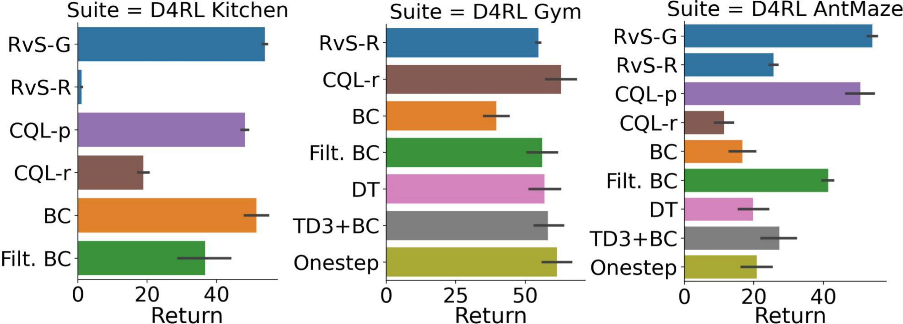
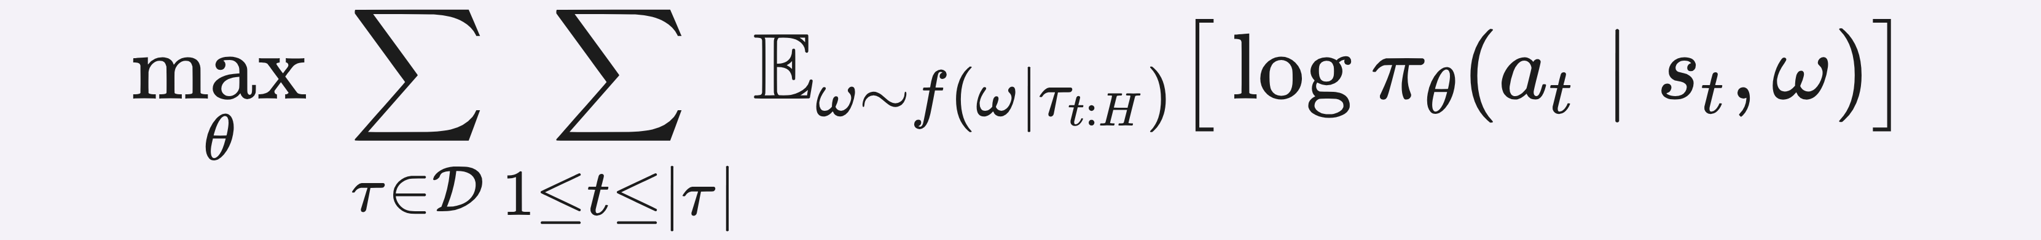

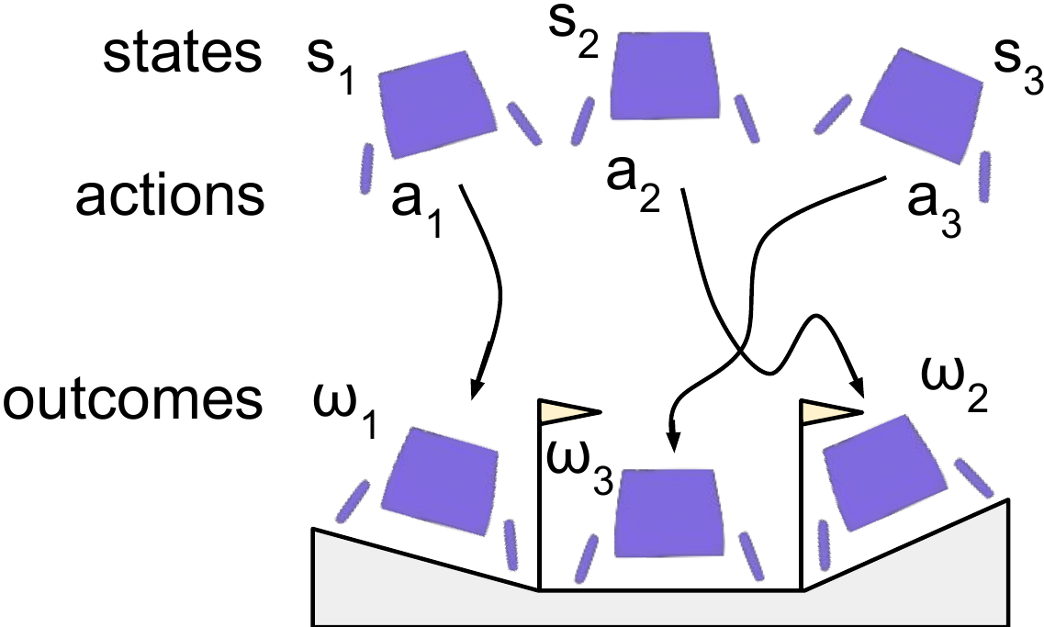
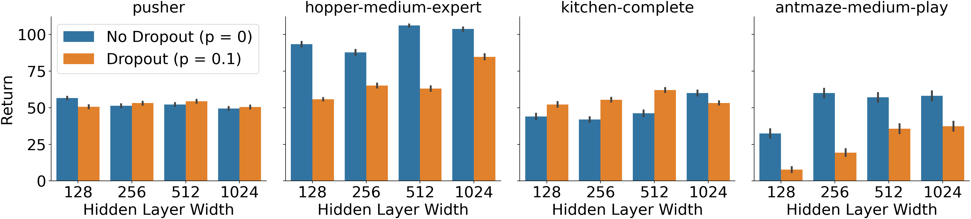
RvS: What is Essential for Offline RL via Supervised
Learning?
Scott Emmons¹, Benjamin Eysenbach², Ilya Kostrikov¹, Sergey Levine¹
¹UC Berkeley ²Carnegie Mellon University
Problem
Method
Key Results
Supervised learning can solve offline RL without TD
bootstrapping, but it was unclear when it works and which
algorithmic components are essential. Prior RvS methods even
disagree on whether advantage weighting or Transformer
sequence models are needed for good performance.
Train an outcome-conditioned policy π_{θ}(a | s, ω) as a plain two-
layer MLP, maximizing the log-likelihood of the observed
actions.
Suite
RvS (ours)
Best prior
AntMaze
53.5
50.6 CQL-p
Kitchen
54.0
51.5 BC
Hindsight relabeling makes every action a demonstration for
the outcome it achieved. No advantage weighting, no TD
learning, no Transformer.
GCSL
62.0
58.0 GCSL
Gym
54.7
57.0 DT
Core question: which pieces of the RvS recipe are essential,
and which are incidental complexity? This paper isolates the
answer empirically.
Supervised learning + an MLP — no TD, no Transformer.
Two design choices are decisive: network capacity (wider is
better, up to 1024 units) and dropout, whose benefit depends on
the dataset.
Motivation
Value-based offline RL works but is hard to use: many tricks,
delicate tuning.
Recasting RL as conditional imitation learning is a simpler,
more robust alternative.
outcome = a future goal state (RvS-G) or average future return (RvS-R), concatenated onto the input state
Per-suite averages: RvS matches TD-learning and Transformer
methods.
Takeaway
A plain two-layer MLP trained to maximize likelihood is a state-of-
the-art offline RL method — provided you tune capacity and
regularization and choose the right conditioning variable (goals vs
rewards). Roughly 1024-unit layers suffice. The recipe: grow width
until performance saturates, then add light dropout — a
dependable field guide for offline RL.
Wider nets help; dropout varies by dataset.
Headline Numbers
53.5
54.0
Kitchen avg (SOTA)
No advantage weighting or Transformer required — but on
purely random data, TD learning still wins (an open
problem).
62.0
GCSL vs 58.0 online
RvS-G AntMaze average
1024
best MLP hidden width
RvS conditions each action on an outcome ω; hindsight relabeling turns
offline trajectories into (state, outcome → action) demonstrations.
state-of-the-art, vs 50.6 best baseline (CQL-p)
54.7
Gym, matches DT

