Slide 1












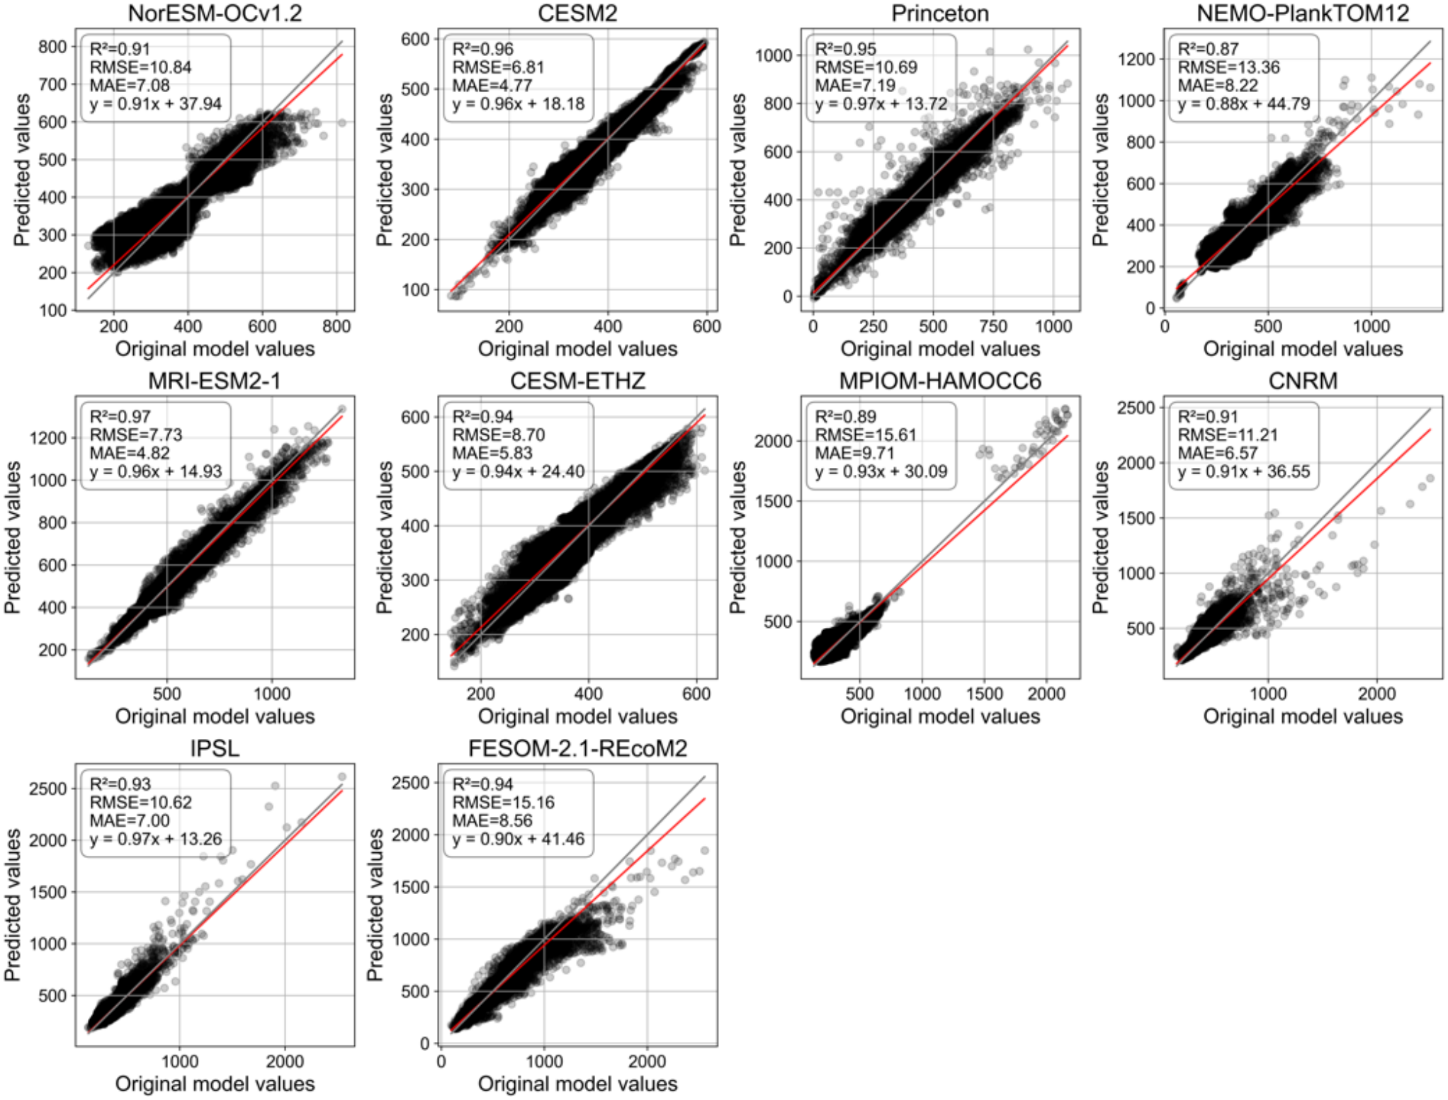
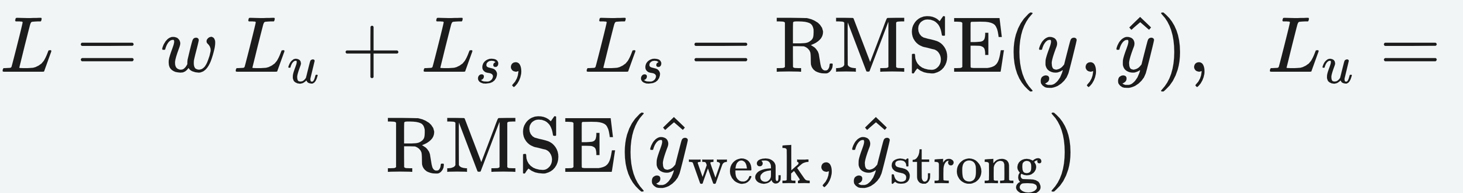
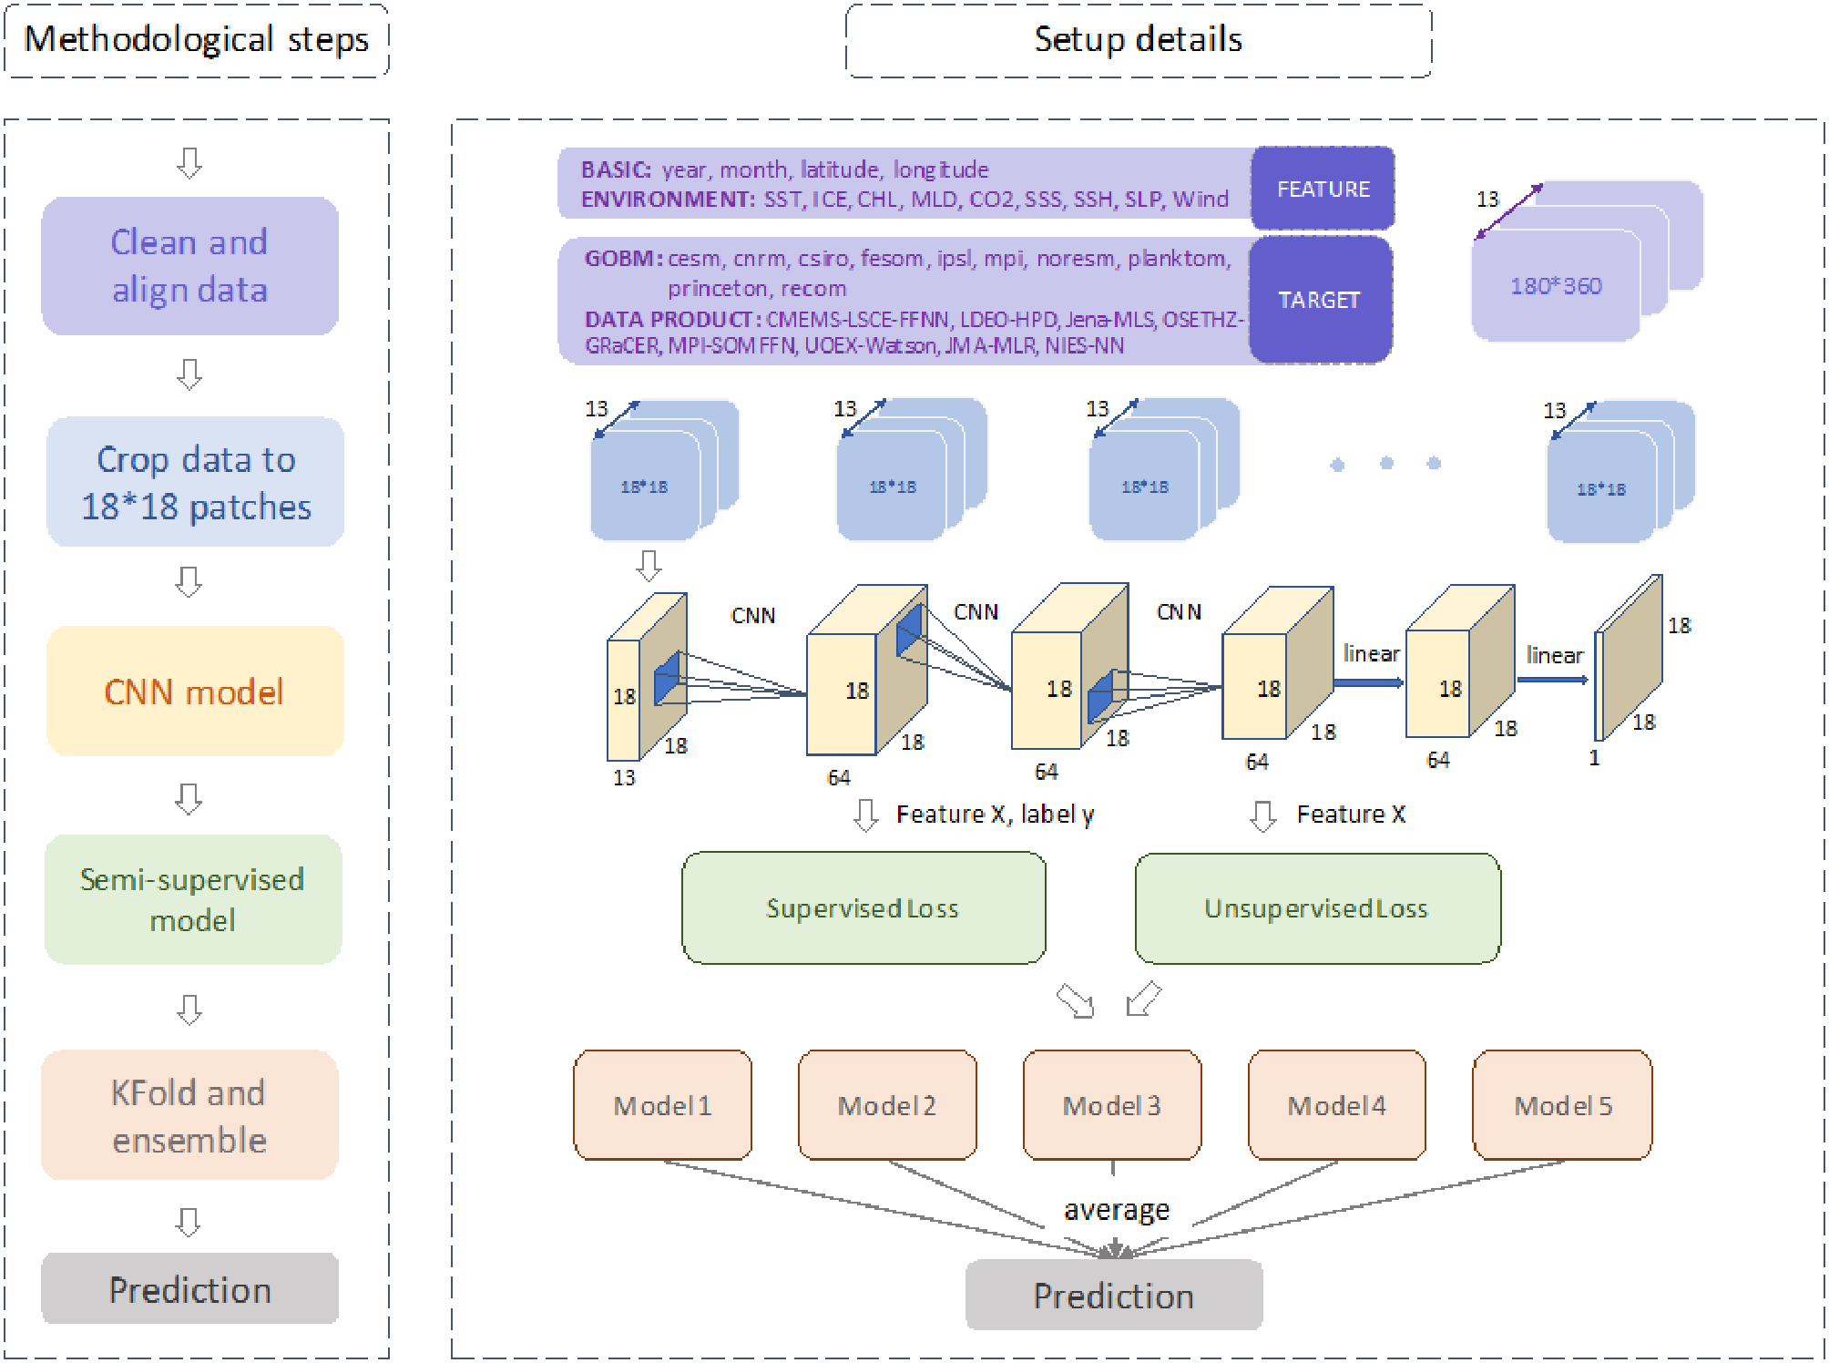
Near-Real-Time Monitoring of the Global Ocean Carbon Sink
Piyu Ke^{1,2,3}, Xiaofan Gui³, Wei Cao³, Dezhi Wang⁴, Ce Hou^{5,6}, Lixing Wang¹, Xuanren Song¹, Yun Li⁷, Biqing Zhu⁸, Jiang Bian³, Stephen Sitch², Philippe Ciais^{9,10}, Pierre Friedlingstein², Zhu Liu^{1,11}
¹ Tsinghua University ² University of Exeter ³ Microsoft Research ⁴ Lanzhou University ⁵ HKUST ⁶ Peking University ⁷ KU Leuven ⁸ IIASA ⁹ LSCE ¹⁰ The Cyprus Institute ¹¹ The University of Hong Kong
Problem
Method
Key Results
Official estimates of the global ocean carbon sink (the annual
Global Carbon Budget) lag actual conditions by roughly one
year, so recent shifts in ocean CO₂ uptake stay hidden until long
after they occur.
A CNN + linear model maps 13 predictors — year, month, lat, lon
and 9 environmental factors (SST, ICE, CHL, MLD, CO₂, SSS,
SSH, SLP, wind) — to each GOBM / data-product estimate.
Global grids are cut into 18×18 patches; semi-supervised
training adds a consistency loss (10% vs 30% masking) to the
supervised RMSE, then K-fold ensembling.
≈1-year lag → near-real-time monthly maps
Motivation
The Paris-Agreement global stocktake demands ocean carbon-
sink data at far lower latency than a one-year delay.
supervised RMSE + weighted unsupervised consistency loss
GOBM and data-product flux databases are detailed but always
historical — no near-present view.
Bring trusted-model rigor up to the present month.
Headline Numbers
18
R²>0.9
pred vs original
Prediction-vs-original correlation for each of the 10 GOBMs (held-out 2020–
2021); most R² > 0.9 (MRI-ESM2-1 R²=0.97, CESM2 R²=0.96).
source estimates → near-real-time
<3 µatm
global fCO₂ diff
10 GOBMs + 8 data products
1.74
xCO₂ RMSE
Dataset / Benchmark
Takeaway
CMO-NRT: monthly gridded fCO₂ & air–sea CO₂ flux, Jan 2022
– Jul 2023.
By pairing CNNs with semi-supervised learning to update trusted
models and data products, CMO-NRT turns the once year-delayed
global ocean carbon sink into a near-real-time, monthly, gridded
monitor — a timelier, spatially detailed constraint on ocean CO₂
uptake for the global carbon budget and climate-response
decisions.
Released openly on Figshare and refreshed at
carbonsink.microsoft.com.
Schematic overview of the CMO-NRT methodology and data sources:
clean & align data, crop to 18×18 patches, CNN + semi-supervised model,
K-fold ensemble → prediction.
SST
CHL
MLD
Wind
10 GOBMs
8 products

