Slide 1





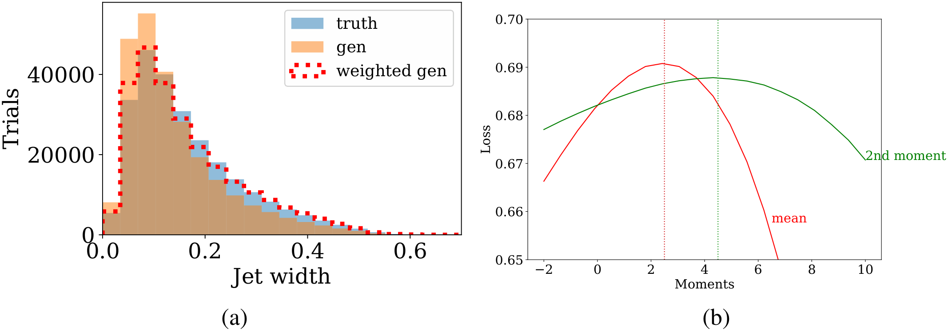
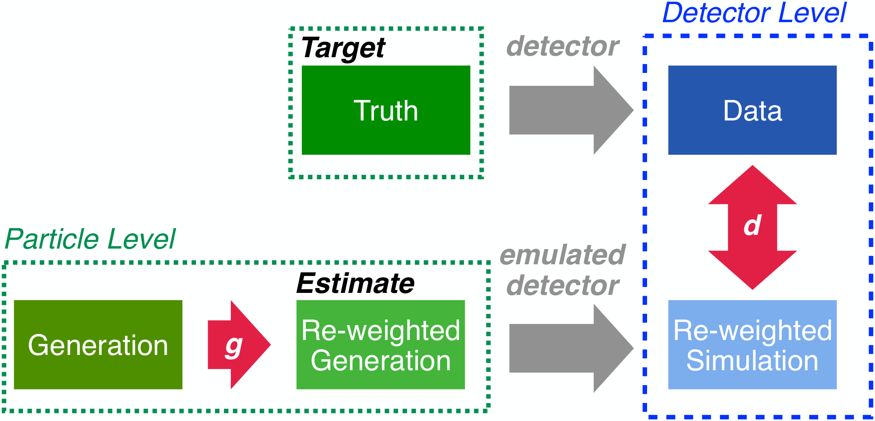


Deconvolving Detector Effects for Distribution Moments
Krish Desai¹, Benjamin Nachman², Jesse Thaler^{3,4}
¹ UC Berkeley ² Lawrence Berkeley National Lab ³ MIT ⁴ NSF AI Institute (IAIFI)
PROBLEM
METHOD
DATASET / BENCHMARK
HEADLINE NUMBERS
Binning to extract moments injects discretization artifacts that cap precision.
Each synthetic event is a pair (X_{T}, X_{D}): a pre-detector generation and its post-detector simulation.
Gaussian toy: truth N(0,1), generation N(−0.5,1), detector noise N(0,5); 10⁶ samples split 3:1.
2
moments unfolded at once
≤ 0.02%
Generator g reweights the generation so the reweighted simulation is statistically indistinguishable from data, as judged by a discriminator d.
LHC jet substructure: the jet width w from the OmniFold Pythia / Herwig + Delphes samples; one sim acts as "data", the other as synthetic.
10
epochs to converge
Deconvolving ("unfolding") detector distortions is critical for comparing measurements with theory. Yet most unfolding methods bin the data into histograms, while many theory predictions are stated directly at the level of statistical moments.
MAE, predicted vs. true moments
< 5 min
sub-percent, fully unbinned
on 1 RTX6000 GPU
Gaussian toy
LHC jets
Pythia
Herwig
Delphes
Inspired by Boltzmann, g is the exponential of a degree-n polynomial with only n parameters {λ_{i}} identified with the moments. The discriminator d has three 50-node ReLU layers with a sigmoid output; g and d train adversarially just once, so detector emulation runs a single time.
jet width w
TAKEAWAY
KEY RESULTS
Moment Unfolding is a novel unbinned, non-iterative, GAN-inspired reweighting method that unfolds a chosen set of distribution moments to sub-percent accuracy, sidestepping the discretization artifacts of binned unfolding. Unlike iterative OmniFold, a single generator–discriminator pair trains only once.
MOTIVATION
≤ 0.02%
mean absolute error, predicted vs. true moments (jet width)
Moments are predictable. An observable's energy-scale dependence is often computable from theory even when its full density is not.
the trainable coefficients λ_{i} ARE the unfolded moments; g maximizes the weighted BCE loss while d minimizes it
QCD example. Hadronic-jet densities are not computable in perturbative QCD, yet the energy dependence of their moments is.
Dataset-agnostic: the idea could carry deconvolution beyond particle physics, to medical devices, seismology, and spectral astronomy.
Jet width: (a) truth, generation, reweighted generation; (b) loss scans for the mean and 2nd moment — peaks (predicted) coincide with the true moments (dotted lines).
Generic unbinned unfolding overshoots. Existing methods unfold whole spectra, sacrificing precision on the few moments actually wanted.
SCAN TO READ
SO WHAT → The first and second moments are unfolded simultaneously; each loss-scan peak lands on the known true value (dotted lines). The Gaussian toy validates the same procedure: the loss peaks at the true mean and d converges within 10 epochs.
Target the moments directly, not the entire distribution.
Training setup: generator g reweights the particle-level generation; discriminator d pushes the reweighted simulation toward data. Detector emulation runs only once.
Paper
Code

