Slide 1

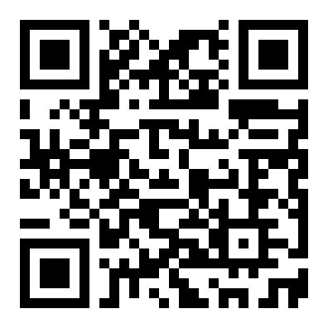
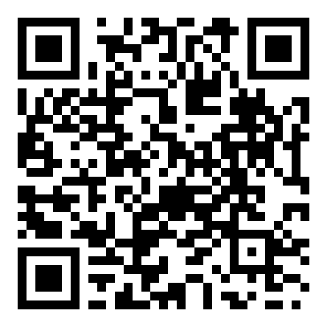
CVPR 2023
Object Pose Estimation with Statistical Guarantees:
Conformal Keypoint Detection and Geometric
Uncertainty Propagation
Heng Yang¹, Marco Pavone¹
¹ NVIDIA Research
Problem
Method
Headline Numbers
Two-stage object pose estimators (detect
semantic keypoints, then solve PnP) score
well on benchmarks but return a single 6D
pose with no provable guarantee on its
quality or uncertainty.
Conformal keypoint detection. Calibrate heatmap nonconformity scores into per-keypoint prediction sets —
circular (peak) or elliptical (covariance) — with 1−ε coverage.
90%
70.6%
avg-pose
success
Geometric propagation → PURSE → bounds. Keypoint sets constrain the nonconvex Pose UnceRtainty SEt
(PURSE); RANSAG averages P3P/PnP samples into an average pose, and an SDP relaxation certifies worst-
case rotation & translation error.
Coverage attained ·
LM-O · ε=0.1
61.1%
PVNet
baseline
n = 200 calibration images
100%
bounds
correct
Safety-critical uses — autonomous
driving, robotic manipulation, space
robotics — need formal worst-case error
bounds that prior pipelines never
provide.
the conformal coverage guarantee
Takeaway
Marrying conformal prediction with
geometric uncertainty propagation makes
the two-stage pose pipeline the first to
output an estimate carrying a provable,
computable worst-case error bound — with
no loss in accuracy. Keypoint coverage
guarantees propagate through the
geometry to the pose, which an SDP
relaxation turns into concrete bounds.
Motivation
Provably-correct pose estimation faces
three challenges that block any worst-case
guarantee:
Conformalized keypoint sets → PURSE → RANSAG average pose → SDP worst-case error bounds.
1
Outlier keypoints. Neural heatmap
detectors can be arbitrarily wrong,
corrupting the geometry.
Dataset / Benchmark
Key Results
Detector-agnostic: it wraps any
heatmap keypoint network, pointing
toward statistically guaranteed
perception for other safety-critical
geometric-vision problems.
LineMOD-Occlusion (LM-O): 1214 test images, 8
heavily-occluded objects on a table.
Valid coverage, correct bounds, and an accurate
average pose — all three hold together on LM-O.
2
Nonconvex back-end. Outlier
rejection is nonconvex; RANSAC-style
heuristics give no global-optimality
guarantee and can fail silently.
200 BOP-selected images form the calibration set;
all 1214 images are used for testing.
vs.
PVNET (BEST BASELINE)
OURS · GT-ELLIPSE
Four setups cross detection source with set shape:
61.1% average-pose
success (2D-
projection, <5px).
70.6% success —
every pose carries a
certified error bound.
gt-ball
gt-ellipse
frcnn-ball
frcnn-ellipse
Scan
to
Read
3
No certified uncertainty. No prior
method bounds the worst-case error
between the estimate and the groundtruth.
Uniform pose sampling (not a single video) keeps
the exchangeability conformal prediction requires
plausible.
When PURSE covers the true pose, the certified
bound is never violated — 100% of covered cases.
Paper
Code

