Slide 1

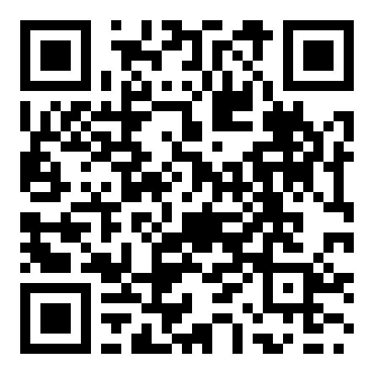
CVPR 2023 · PAPER WALKTHROUGH
Object Pose Estimation with
Statistical Guarantees
Heng Yang · Marco Pavone
NVIDIA Research · Conformal Keypoint Detection and Geometric Uncertainty Propagation
Scan for code
The gap: standard two-stage pipelines return a single 6D pose with no guarantee on how wrong it is.
This work is the first pose estimator that attaches provable, computable worst-case error bounds to its output.
1
Conformal
2
Geometric
3
Average Pose
Keypoint Detection
Uncertainty Prop.
plus SDP Bounds
Turns heatmap detections into
→
Propagates keypoint sets
→
RANSAG averages sampled
circular or elliptical prediction
through the geometry into a
poses; semidefinite relaxation
sets that cover true keypoints
Pose Uncertainty Set (PURSE)
certifies worst-case error.
with probability 1 minus epsilon
covering the true pose
Validated on LineMOD-Occ
arXiv:2303.12246 · github.com/NVlabs/ConformalKeypoint

Slide 2
THE PROBLEM
A good pose score, but no statement of trust
Where 6D object pose matters
Strong on benchmarks, silent on trust
Recover an object's 3D rotation and translation from one image.
These methods score well on standard datasets,
Robotic
yet they hand back a single pose with no
Augmented reality
Autonomous driving
manipulation
Space robotics
statement about how trustworthy it is.
The dominant recipe: a two-stage pipeline
A serious gap for safety-critical systems
In driving, manipulation, and space, wrong-and-confident fails hard.
1
Detect semantic keypoints
A neural network predicts a heatmap per keypoint
✗
No guarantee on the quality of the keypoints
on the input image.
↓
✗
No guarantee the optimizer found the right pose
2
Solve the pose (Perspective-n-Points)
Minimize reprojection error to recover the
✗
No formal bound on the worst-case error
rotation R and translation t.

Slide 3
WHY IS THIS HARD
Three challenges block a provable pose
C1
C2
C3
Keypoints can be
Outlier rejection is
No provably correct
arbitrarily wrong
nonconvex
uncertainty
Neural detectors produce
The second stage must reject
Most fundamentally, no prior
outliers: some predicted
outliers. Fast heuristics like
method delivers a formal
keypoints land far from the
RANSAC are widely used but
worst-case error bound
true location, with no
cannot guarantee global
between the estimate and the
warning that they are off.
optimality; they fail silently.
groundtruth pose.
THE MISSING PIECE
Certifying that the optimizer is globally optimal still gives no probabilistic guarantee on the pose itself.
This paper delivers exactly that guarantee, end to end.

Slide 4
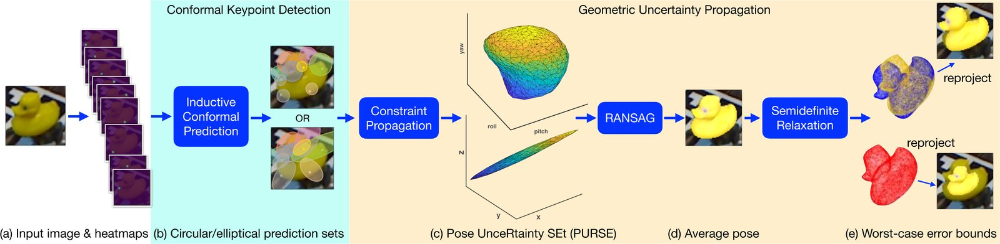
THE METHOD
Two additions turn detections into certified pose bounds
Pipeline: heatmaps → conformal prediction sets → constraint propagation (PURSE) → RANSAG average pose → semidefinite worst-case bounds
1
Calibrate scores
2
Two set shapes
3
Propagate to PURSE
4
Average and certify
A calibration set of labeled
Peak score gives a circular
The threshold guarantees
RANSAG samples 3 keypoints,
images gives nonconformity
ball; covariance score gives
coverage per keypoint. Sets
solves minimal P3P, keeps in-
scores for the heatmap
an ellipse.
become quadratic constraints
set poses, averages them.
detector.
on the pose, defining the
An SDP maximizes distance to
peak: p·∥y − q∥
Pose Uncertainty Set (PURSE).
the farthest in-PURSE pose.
P[y ∈ set] ≥ 1 − ε
cov: Mahalanobis dist.
nonconvex set over SE(3)
certified R, t error bounds

Slide 5
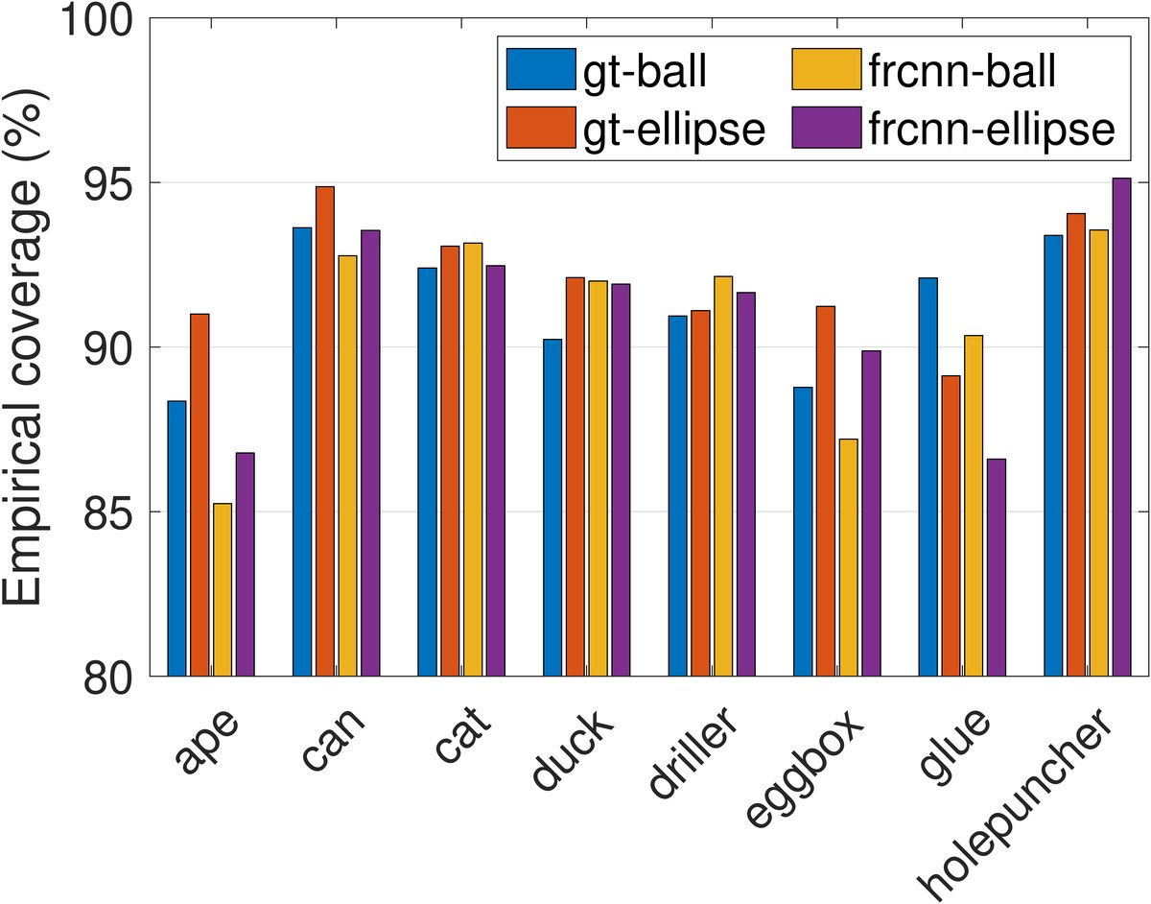
KEY RESULTS · LineMOD-Occlusion
The theory holds on all three fronts
Across 1214 images and 8 objects: valid coverage, correct bounds, and an accurate average pose.
1 · Coverage is valid
2 · Worst-case bounds are correct
Target 90% (ε = 0.1): empirical coverage per object sits right around 90%.
In bound-vs-error scatter plots, every case where
PURSE covers the true pose stays below y = x.
100%
The bound is never violated
bounds valid when PURSE
when the 1 − ε guarantee holds.
3 · The average pose is accurate
2D-projection success (mean reprojection error under 5 px):
70.6%
61.1%
Average pose (gt-ellipse)
PVNet (strongest baseline)
ε = 0.1
prior state of the art
Coverage concentrates near the target and tightens as the calibration set grows.

Slide 6
TAKEAWAY
A pose estimator that tells you how wrong it might be
Turn a standard two-stage pose estimator into one that reports a real
statistical guarantee on its worst-case error,
and pay little to nothing in accuracy.
Conformal prediction
Geometry propagation
Semidefinite relaxation
Coverage guarantees on the
Carries those guarantees to
Converts the set into concrete,
detected keypoints, at a user-
the 6D pose as the Pose
computable worst-case
chosen probability 1 − ε.
Uncertainty Set (PURSE).
rotation and translation bounds.
DETECTOR-AGNOSTIC
Because it wraps any heatmap-based keypoint detector, the framework is broadly applicable
and points toward provably correct perception wherever safety matters.

