Slide 1





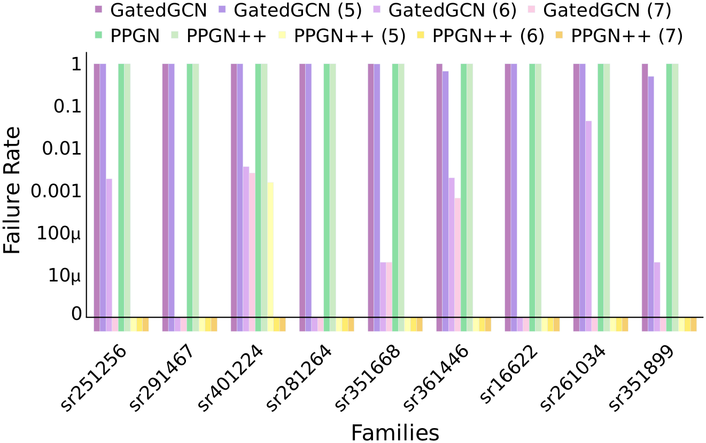
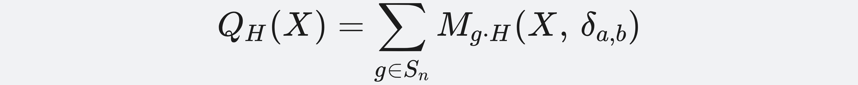
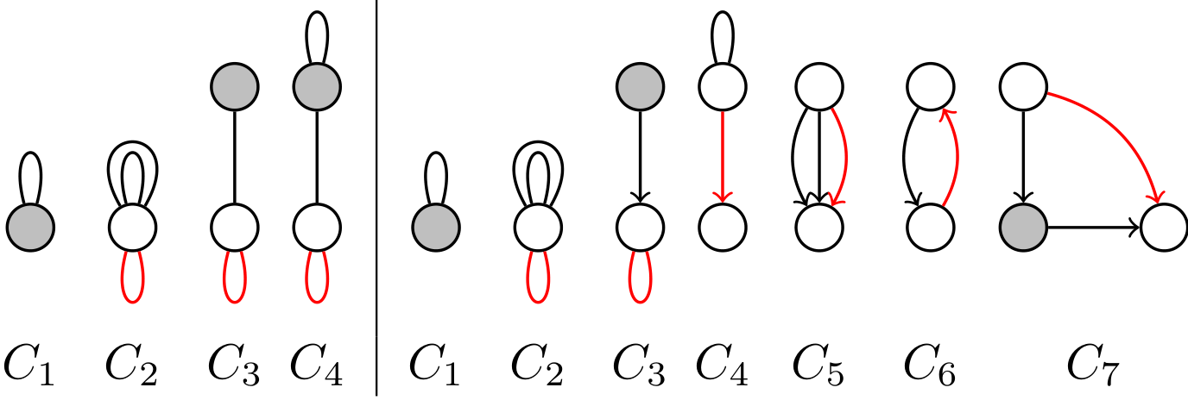
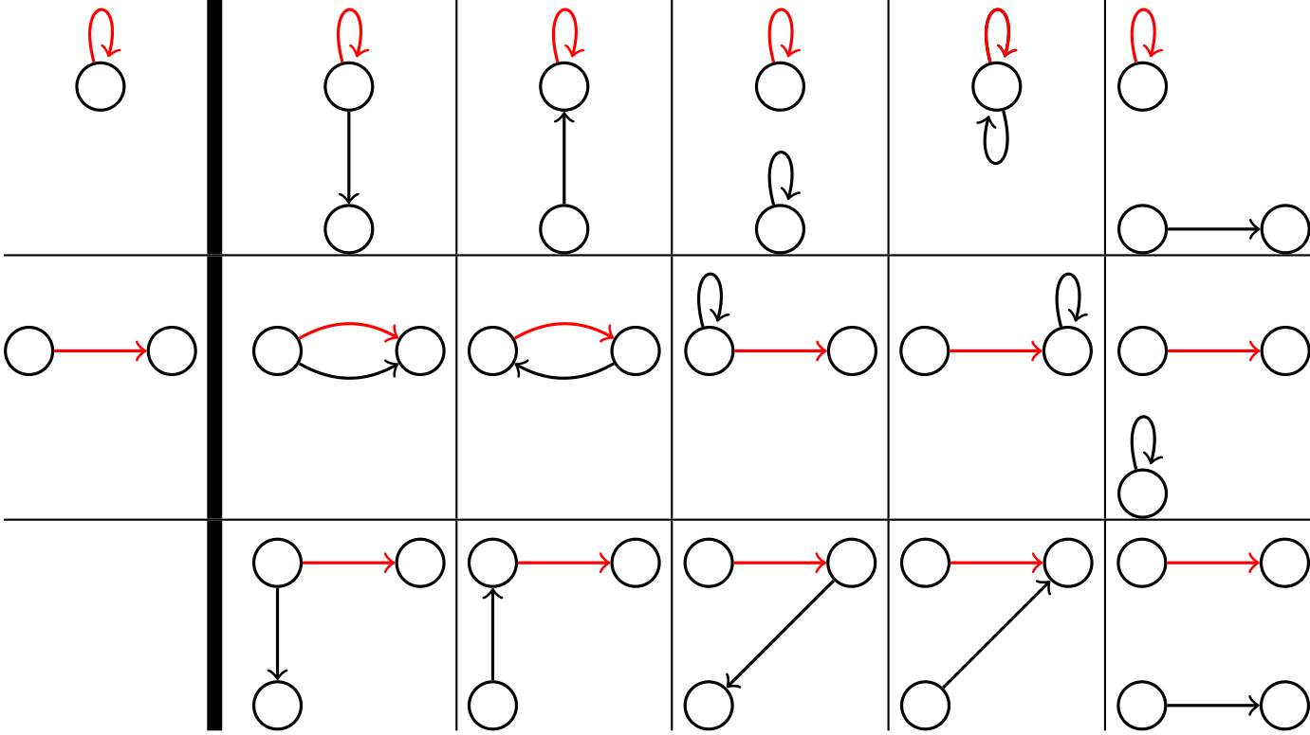
Equivariant Polynomials for Graph Neural Networks
Omri Puny¹, Derek Lim², Bobak T. Kiani², Haggai Maron³, Yaron Lipman^{1,4}
¹ Weizmann Institute of Science ² MIT CSAIL ³ NVIDIA Research ⁴ Meta AI Research
Problem
Method
Key Results
Graph neural networks have inherently limited expressive power.
The Weisfeiler-Lehman (WL) hierarchy used to measure it has a
complex, hard-to-act-on definition and is too coarse to separate
today's GNNs.
Every equivariant graph polynomial of degree ≤ d has a basis of
directed multi-graphs H; each element P_{H} is an einsum (tensor
contraction) over the input.
WL certifies pass/fail on an isomorphism test but gives no
recipe for building a stronger network.
Model a GNN as a contraction bank F; a linear-time algorithm
decides which P_{H} it computes — node banks recover 1-WL,
edge banks recover 2-FWL (a.k.a. 3-WL).
Motivation
Grade a graph network by the concrete quantities it can
compute: equivariant graph polynomials of the adjacency
matrix (subgraph counts and many structural features are
exactly these).
Reynolds operator: averaging monomials over all node permutations equals a sum over the orbit of H — the equivariant basis element P_{H}.
SR-graph distinguishing failure rate (log scale, lower is better).
Prior work characterized only low-order maps or leaned on WL,
leaving no complete, computation-friendly description of what
a GNN should output.
Headline Numbers
0.071
0.020
ZINC-full MAE
0.109
Alchemy MAE
ZINC-12K test MAE · PPGN++ (deg 6)
0.106
GatedGCN + poly6
best in class — vs CIN 0.079, GIN 0.163
> 3-WL
provable power
Prototypical node-based (left) and edge-based (right) contraction banks —
primitives Algorithm 1 composes to compute P_{H}.
All models within a 500K-parameter budget; power provably beyond 3-WL.
Takeaway
Dataset / Benchmark
Grade and build GNNs by the equivariant polynomials they can
compute — each a multi-graph evaluated by tensor contraction —
a finer ruler than WL that, via precomputed features, pushes
ordinary GNNs past 3-WL to state-of-the-art molecular accuracy.
The basis plus a linear-time computability test turn "how expressive
is this GNN?" into a concrete, checkable question with an
actionable answer: the exact operations a model is missing.
Molecular regression on ZINC-12K, ZINC-full (~220K graphs)
and Alchemy, all under a 500K-parameter budget.
Strongly Regular (SR) graph families stress-test raw power:
pairs 3-WL provably cannot separate.
Basis of equivariant constant (left of bold line) and linear graph polynomials
— each cell a multi-graph H; the complete characterization we derive.
ZINC-12K
ZINC-full
Alchemy
SR graphs

