Slide 1





ICML 2023 · PAPER WALKTHROUGH
Equivariant Polynomials
THE LIMITATION
GNN power is bounded — and WL is a
for Graph Neural Networks
coarse, hard-to-interpret ruler.
WL LADDER
Omri Puny · Derek Lim · Bobak T. Kiani · Haggai Maron · Yaron Lipman
rungs far apart
Weizmann Institute · MIT CSAIL · NVIDIA Research · Meta AI Research
THE NEW YARDSTICK
a graph, with one marked edge
Grade a graph network by which equivariant polynomials
of the graph it can actually compute.
Many different GNNs collapse to the same WL level.
01
02
03
Complete basis
Power analysis
PPGN++
of equivariant graph
linear-time test of
new state of the art on
polynomials
what a GNN computes
molecular benchmarks
AUTHORS' INSTITUTES
arXiv:2302.11556
Scan for code

Slide 2
01 · THE PROBLEM
Expressive power is bounded — and WL is a blunt ruler
The field measures GNN power with the Weisfeiler-Lehman hierarchy, but that ruler is coarse and opaque.
WHAT IS LIMITED
HOW IT IS MEASURED
TWO FLAWS OF WL
Bounded power
The WL hierarchy
Combinatorial
Only some functions of a graph
A family of graph-isomorphism
Gives no recipe for making a
can be represented at all.
tests, from 1-WL upward.
network stronger.
1-WL
Rungs far apart
computable
2-WL / 3-WL
functions
Architecturally different GNNs
k-WL …
collapse to the same WL level.
many others lie outside
a discrete ladder of power levels
→ hard to separate modern models
THE ASK
We need a finer, more actionable ruler for expressive power.

Slide 3
02 · THE IDEA
Grade a network by the quantities it can compute
Equivariant graph polynomials are natural, meaningful targets — and they give a to-do list, not just a score.
THE RIGHT MEASURE
EQUIVARIANT GRAPH POLYNOMIALS
Which concrete quantities
Polynomials of the adjacency matrix A
can the network compute?
that respect node relabeling:
Many useful structural features are
p(P A Pᵀ) = P · p(A) · Pᵀ
exactly such polynomials:
triangle counts
cycle counts
subgraph features
For any permutation P of the nodes, relabeling the
input just relabels the output — the value is intrinsic.
Computable quantities are interpretable and directly useful.
Prior work only described very low-degree cases.
WHY IT PAYS OFF
Know the full space of these polynomials — and which a network can evaluate —
and you get both a fine-grained ruler and a to-do list of missing operations.

Slide 4
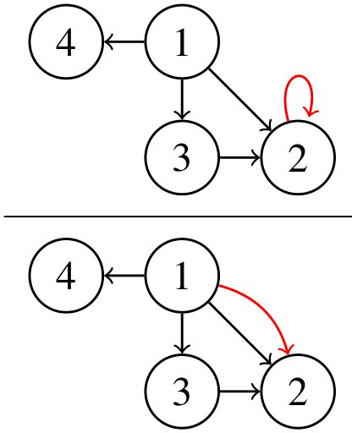
03 · METHOD
A basis of multi-graphs, read out by tensor contraction
THE CORE OBJECT
MAKING IT EQUIVARIANT
Basis element = multi-graph = einsum
Reynolds operator
Average each monomial over all node permutations Sₙ.
The paper shows this equals a sum over the orbit of H.
ANALYZING A NETWORK
Bank of primitive contractions
Treat the network as a bank of contractions; a linear-time
algorithm decides exactly which polynomials it can assemble.
WL CORRESPONDENCE → PPGN++
Paper Fig. 1 — node-valued (top),
Node-based banks = 1-WL
Edge-based banks = 2-FWL (3-WL)
edge-valued (bottom) basis elements
A directed multi-graph H with one marked
PPGN++ feeds in precomputed polynomial features
red edge; its value is an einsum over A.
→ strictly above 3-WL

Slide 5
04 · RESULTS
State of the art on molecular benchmarks
The result is state of the art across the board — all under a 500K parameter budget.
ZINC-12K · TEST MAE (LOWER IS BETTER)
MORE DATASETS · BOTH BEST IN CLASS
0.020
0.109
0.163
ZINC-full MAE
Alchemy MAE
0.079
0.071
FEATURES ARE MODEL-AGNOSTIC
Bolt degree-6 features onto a plain GatedGCN:
before
→
after
0.265
0.106
GIN
CIN
PPGN++
degree-6 features
PPGN++ beats strong baselines CIN and GIN — the best reported error.
Precomputed — so extra power comes without heavy runtime cost.

Slide 6
05 · TAKEAWAY
THE LASTING MESSAGE
Express a network's power as: which equivariant graph
polynomials can it compute?
A CONCRETE, CONSTRUCTIVE RULER
ACTING ON THE LIST
Every polynomial is a small
Precomputed polynomial features
multi-graph, read by a contraction.
push GNNs past the 3-WL barrier.
This is a finer ruler than Weisfeiler-
Ordinary graph networks reach
Lehman — and a direct list of the
best-in-class accuracy on molecular
operations a network is missing.
property prediction.
Equivariant Polynomials for Graph Neural Networks
arXiv:2302.11556
Puny, Lim, Kiani, Maron, Lipman · ICML 2023
github.com/omri1348/Equivariant-Polynomials

