Slide 1


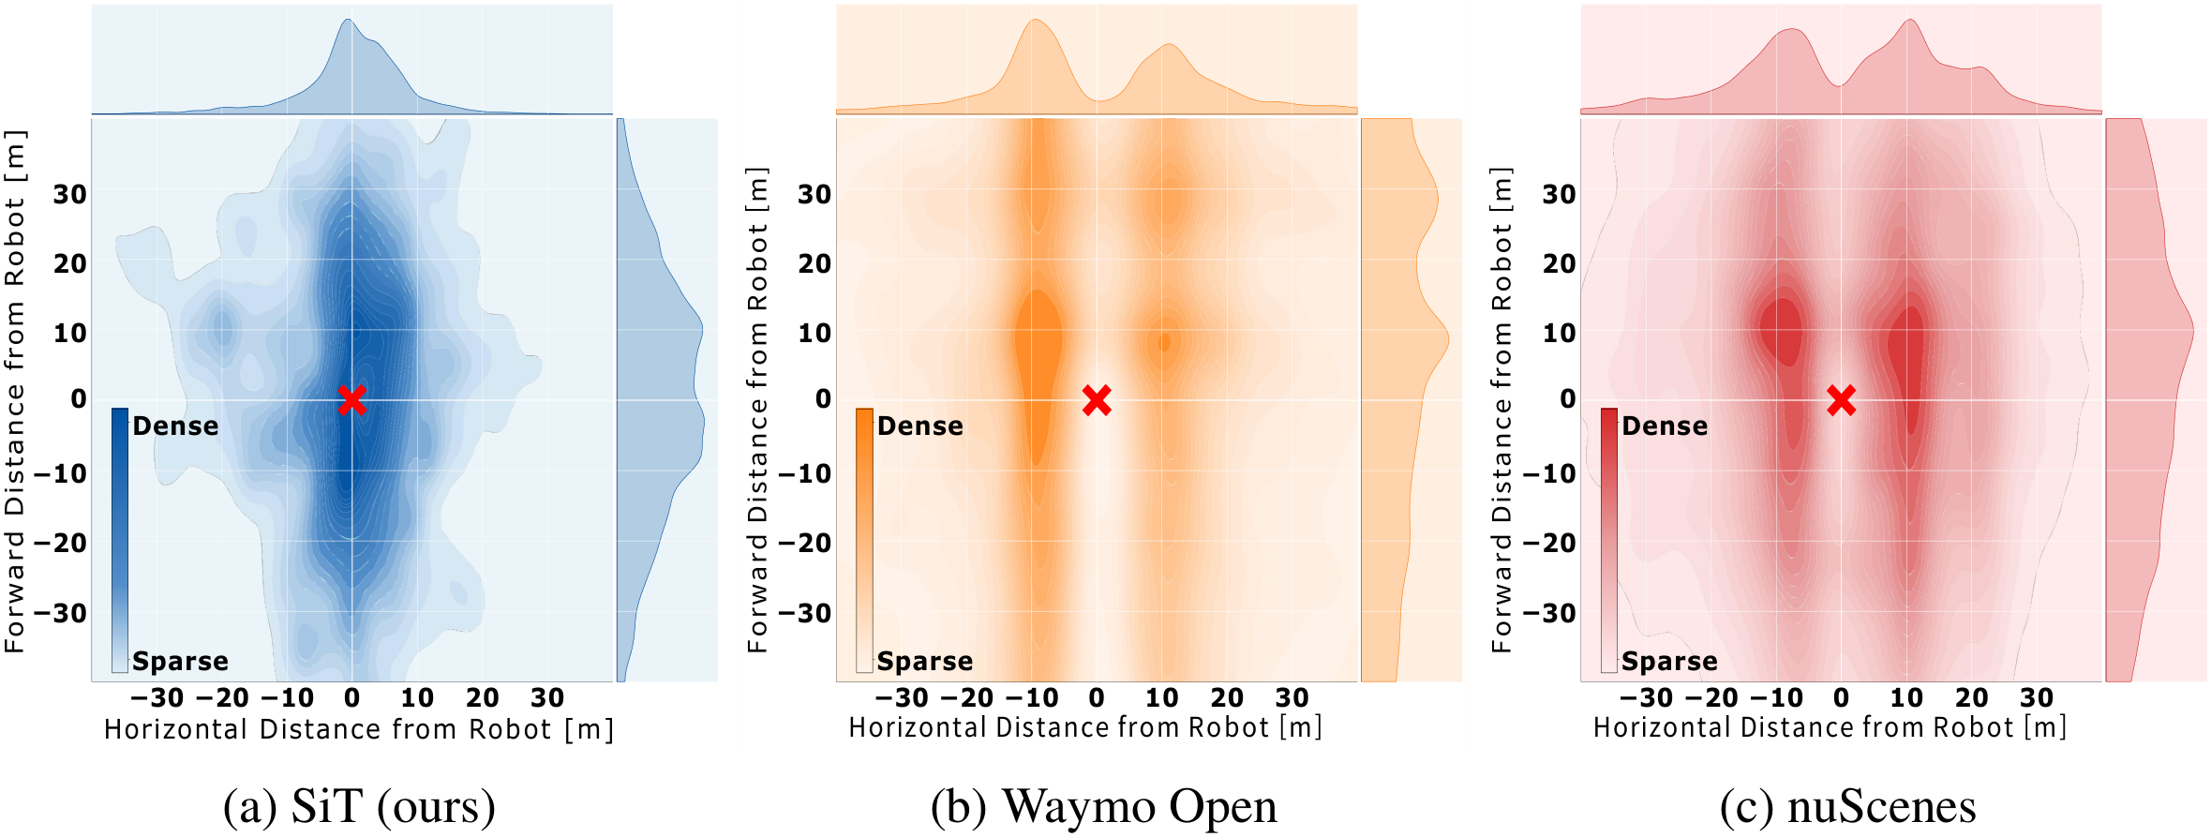
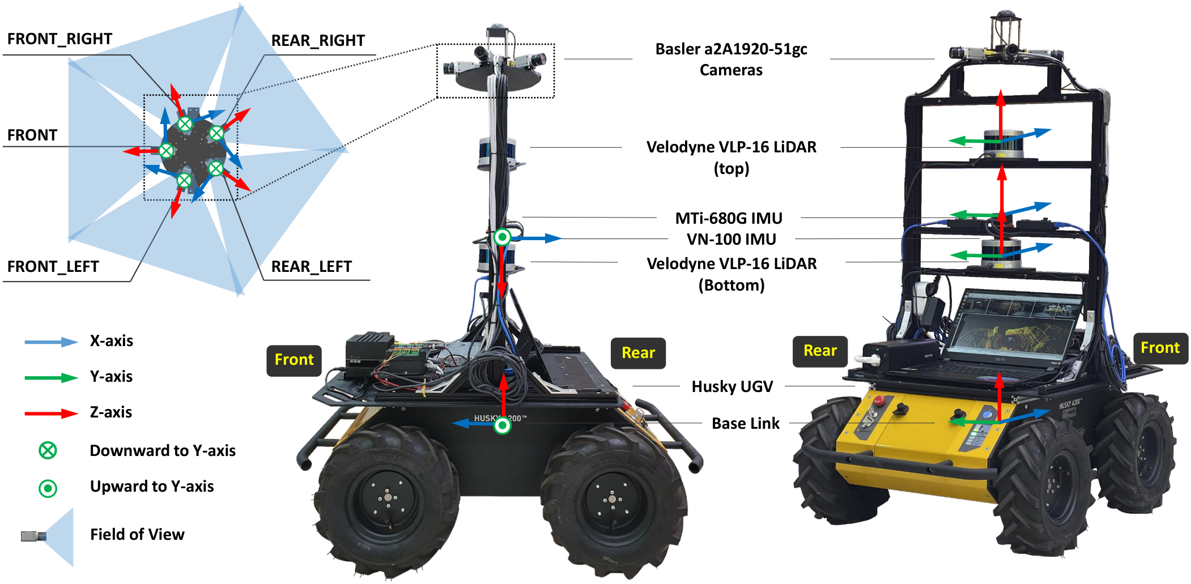
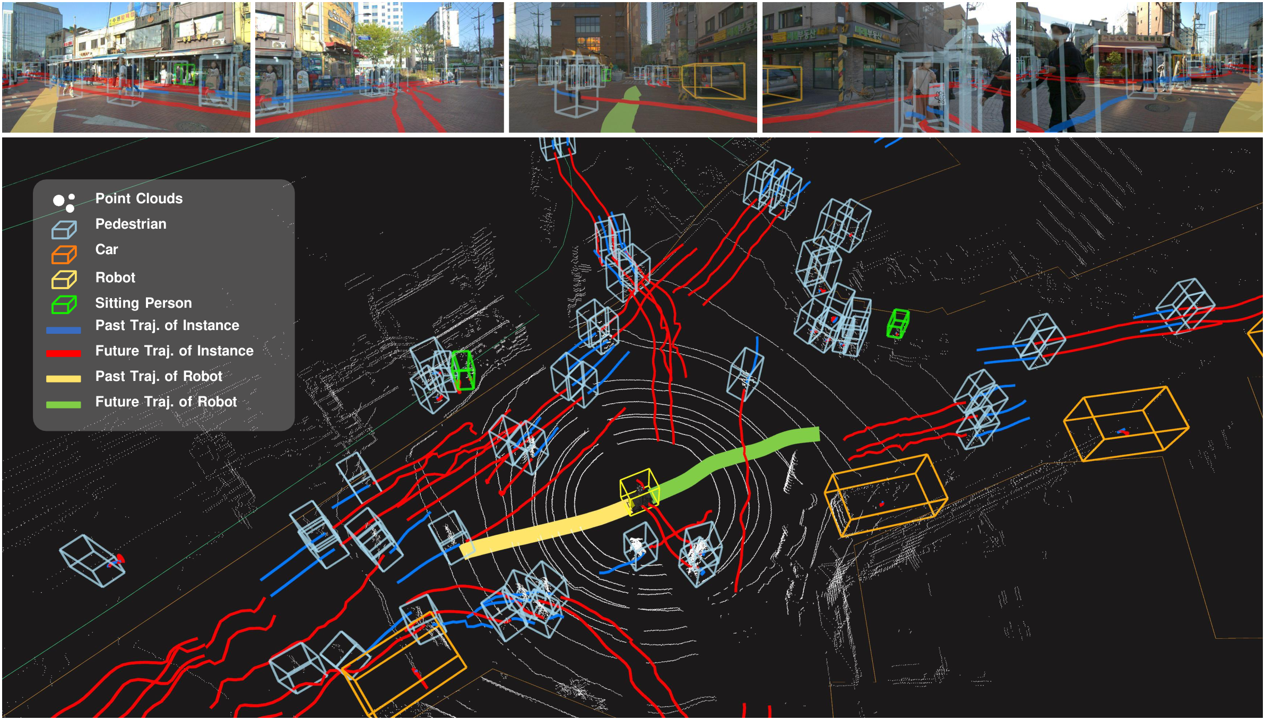
SiT Dataset: Socially Interactive Pedestrian Trajectory Dataset for Social Navigation Robots
Jongwook Bae, Jungho Kim, Junyong Yun, Changwon Kang, Jeongseon Choi, Chanhyeok Kim, Junho Lee, Jungwook Choi, Jun Won Choi
Hanyang University
Problem
Method
Key Results
Social navigation robots must perceive and predict nearby
pedestrian trajectories to move safely through shared spaces. Yet
existing datasets never capture the close human–robot interaction
a navigating robot actually experiences.
Remotely operated Clearpath Husky UGV with 2× Velodyne
VLP-16 LiDARs, five Basler cameras for full 360° coverage, two
IMUs, and RTK.
A pulse-per-second (PPS) trigger aligns every LiDAR and
camera for precise time synchronization.
Rooftop-camera and driving datasets keep pedestrians and the
sensor on separate paths.
1
Localize — RTK outdoors, LiDAR-inertial SLAM indoors.
Motivation
2
Annotate & map — 3D cuboids 5 Hz → 10 Hz, 2D from
shared IDs; 12-layer semantic maps; faces & plates blurred.
SiT clusters pedestrians close & all-around the ego-robot vs. Waymo and
nuScenes.
A robot shares pedestrians' path, provoking close-range
interactive walking behaviors.
Data must come from a robot moving in real crowds with time-
synchronized sensors.
Headline Numbers
320K
60K
images
12K
point clouds
3D annotations
0.531
best mAP
0.517
best ADE₂₀
Takeaway
Husky UGV: 5 cameras (360°), 2 LiDARs, 2 IMUs, RTK.
FIRST
Dataset / Benchmark
The first robot-in-crowd pedestrian trajectory dataset — synced
multi-modal sensors, semantic maps, and a full perception-to-
prediction benchmark.
60 scenes ≈ 60K images + 12K point clouds; ~470K 2D + ~320K
3D annotations. Each 20 s clip at 10 Hz gives a 9 s trajectory.
The dataset, development kit, and trained baselines are all publicly
released — giving social-navigation research the close human–
robot interaction data that driving and fixed-camera datasets lack.
3D detection
3D tracking
Trajectory prediction
360° pedestrian trajectories, point clouds & ego-motion in real crowds.
End-to-end motion

