Slide 1


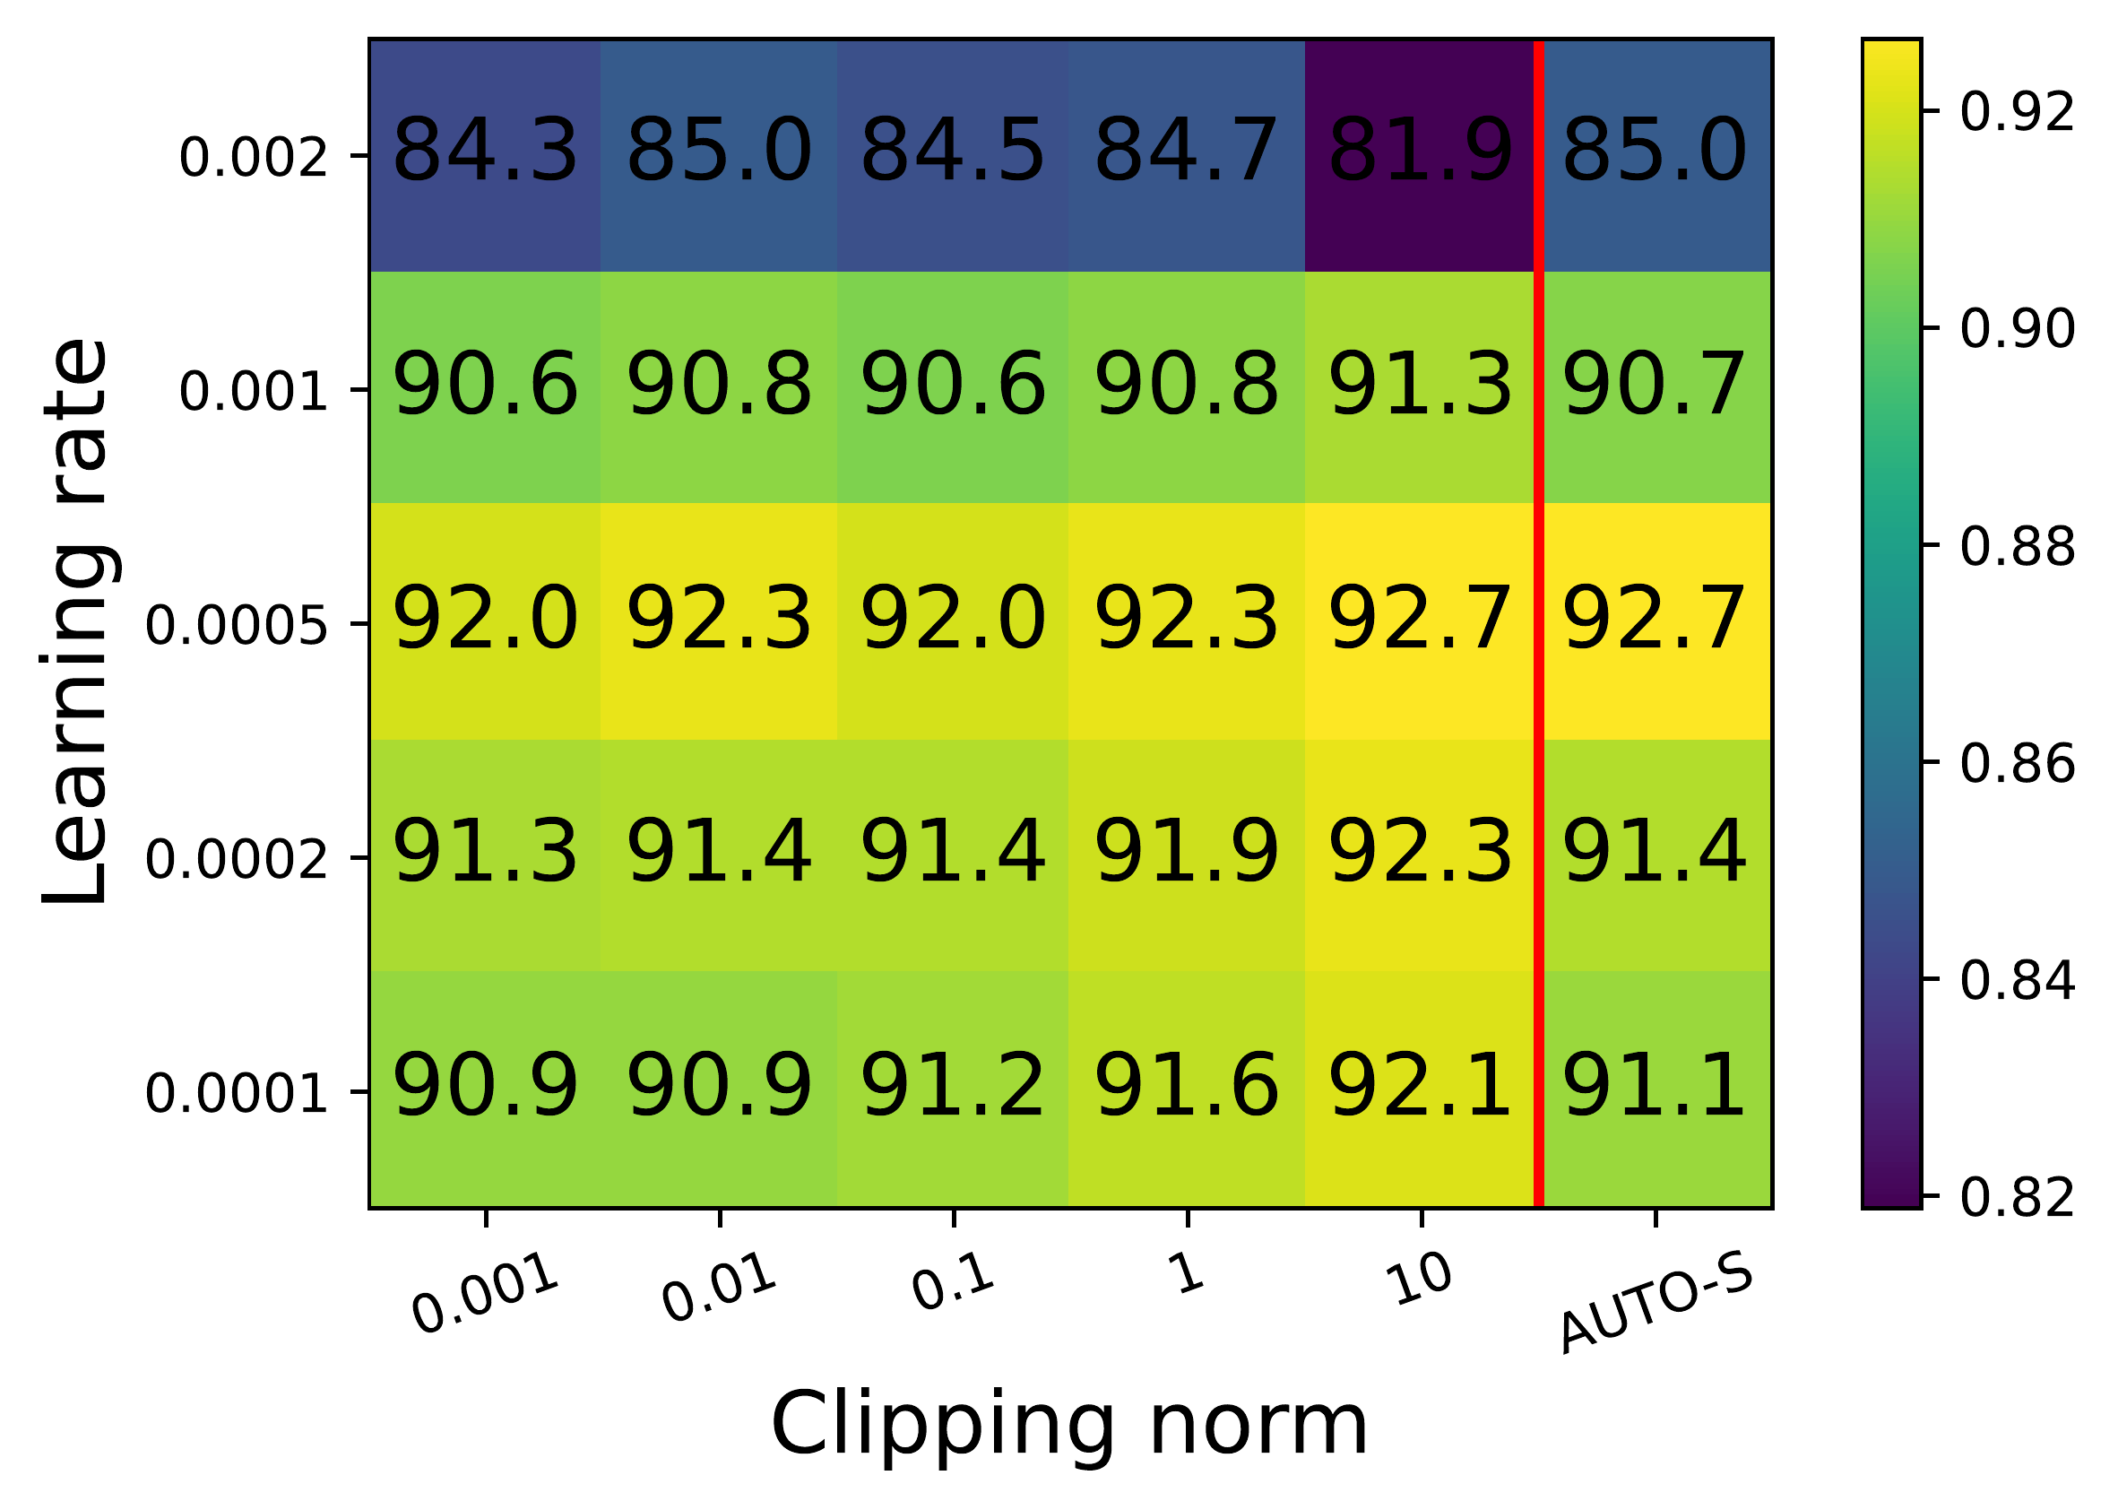
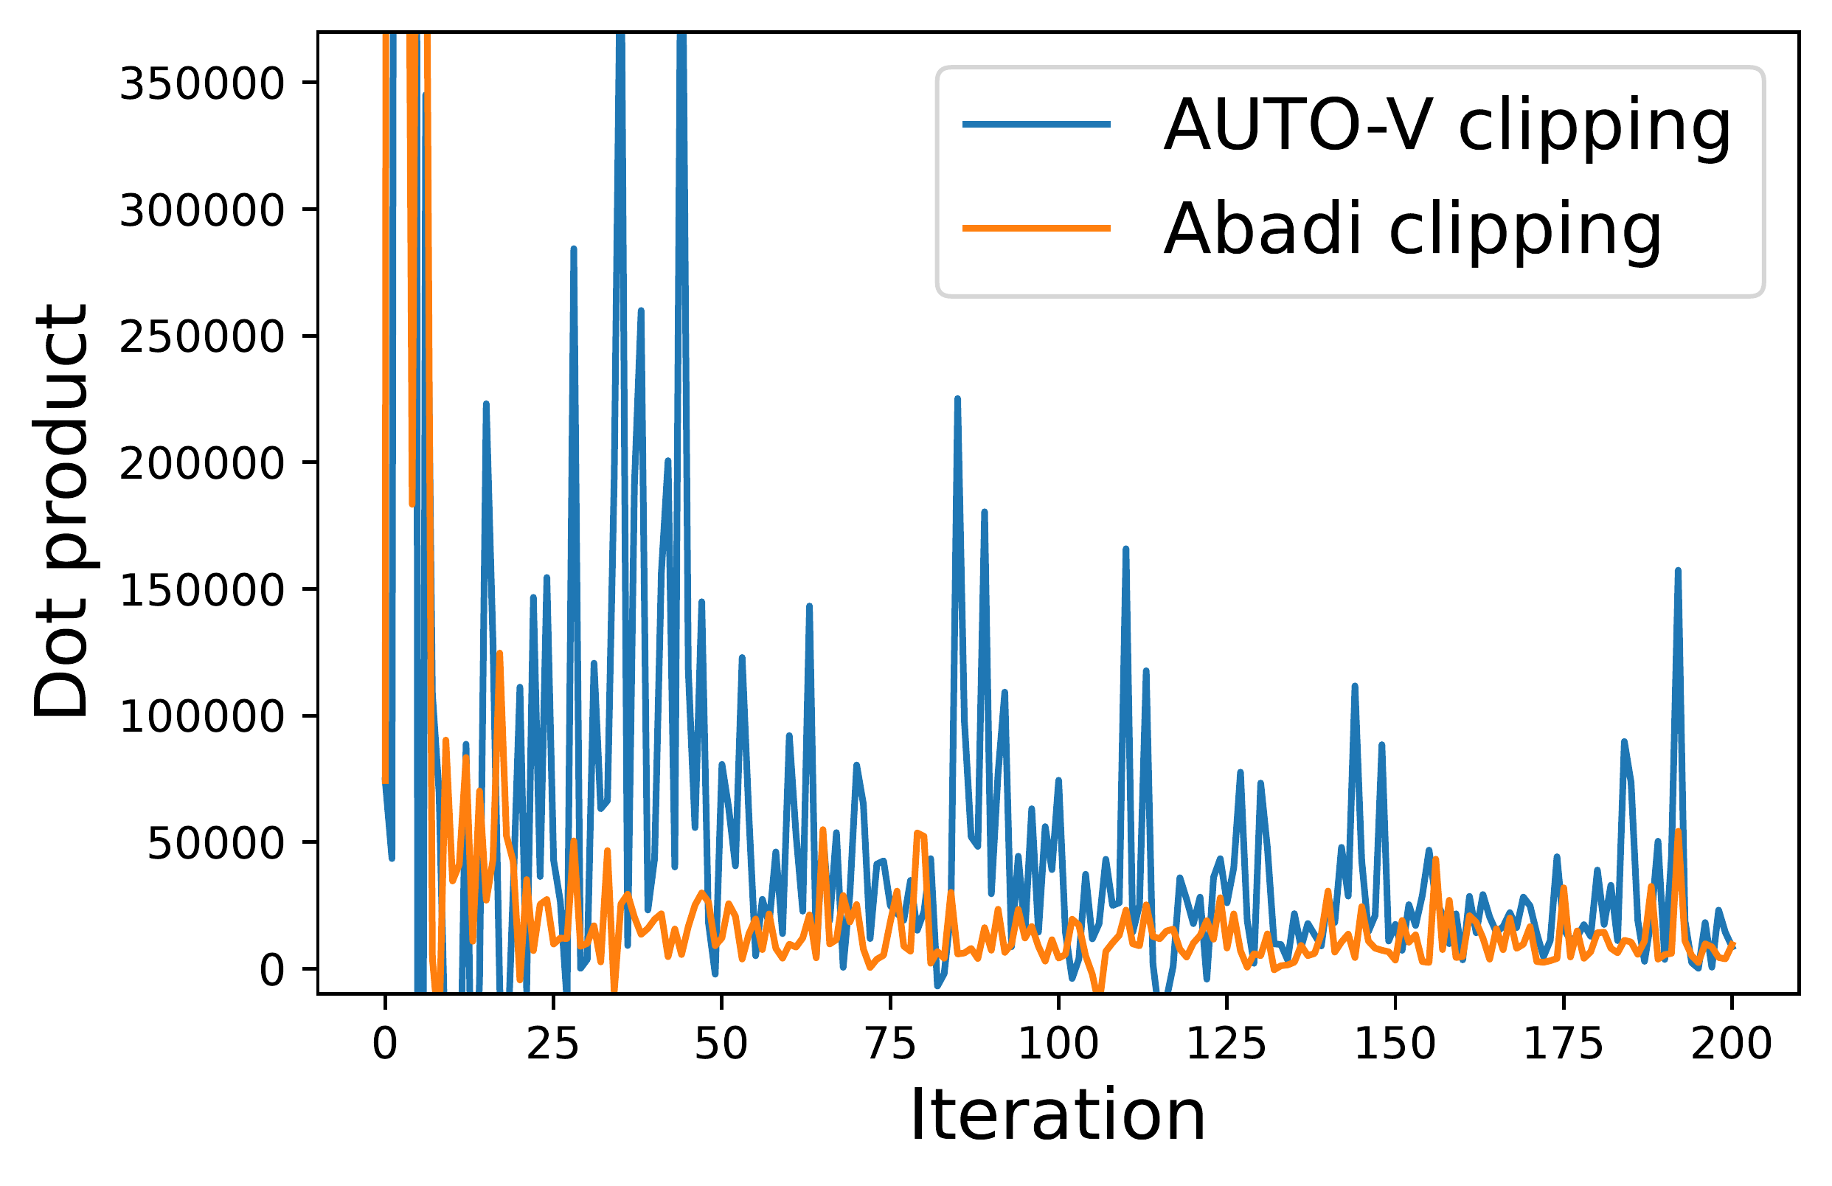


Automatic Clipping: Differentially Private Deep Learning Made Easier and Stronger
Zhiqi Bu¹, Yu-Xiang Wang^{1,2}, Sheng Zha¹, George Karypis¹
¹ AWS AI ² UC Santa Barbara
Problem
Method
Key Results
Headline Numbers
Differentially private (DP) deep learning
depends on per-example gradient
clipping, but the clipping threshold R is a
fragile, task-specific hyperparameter
whose value strongly determines final
accuracy.
AUTO-V: replace Abadi’s factor min(R/‖g‖, 1) with
pure normalization R/‖g‖.
TASK (Ε)
PRIOR SOTA
AUTO-S (OURS)
64.18
92.32%
SST-2 ·
ε=3
GPT2 · E2E BLEU (3)
63.85
64.18
83.22%
AUTO-S: divide by ‖g‖ + γ (small stability constant)
to keep magnitude and escape the “lazy region.”
RoBERTa-b · SST-2 (3)
91.86
92.32
BLEU · GPT2 on E2E
· ε=3
MNLI ·
ε=3
RoBERTa-b · MNLI (3)
82.45
83.22
new SOTA, no threshold
tuning
~5×
less tuning cost
Any constant R rescales into the learning rate, so R
is fixed to 1 — a threshold-free optimizer.
RoBERTa-L · SST-2 (8)
93.81
94.61
SO WHAT → Only the learning rate is searched — never R.
On ImageNet, ResNet18 accuracy
collapses from 45% to 31% when R is
merely doubled.
Convergence: automatic DP-SGD reaches min_{t}
𝔼‖g_{t}‖ = O(T^{−1/4}), matching standard SGD.
Matches or beats tuned SOTA across language
tasks — with no R search.
Takeaway
Motivation
Per-sample clipping needs no tuned
threshold: normalize each gradient,
add a tiny stability constant, and get
a threshold-free optimizer as private,
fast, and accurate as the best hand-
tuned DP methods.
γ = 0.01 default; as ‖g‖→0 the clipped gradient → g/γ, enabling convergence to zero gradient norm
Tuning the pair (R, learning rate) for
large models costs days to months of
compute.
Because it inspects private data, the
search also spends extra privacy
budget, making DP training far harder
than standard training.
A one-line change in existing DP libraries
(Opacus, ObJAX), backed by a
convergence guarantee matching standard
SGD.
Best thresholds are so small that nearly
every gradient is clipped every step, so
R’s exact value stops carrying
magnitude information.
Scan to Read
RoBERTa-base accuracy over R and learning rate (DP-
Adam, ε=3): the AUTO-S column (red) matches the best
tuned R while searching η only, cutting tuning cost ~5×.
Paper
Code
Per-step dot-product similarity of the private vs. true gradient:
AUTO-V magnifies alignment far above Abadi’s clipping.
This hints the precise value of R may not
matter at all, if clipping is reformulated to
drop it entirely.
AUTO-V is scale-invariant, so tiny gradients never
vanish; the γ in AUTO-S restores magnitude, letting the
clipped gradient approach g/γ as ‖g‖→0.
SO WHAT → The red AUTO-S column reproduces the best hand-tuned accuracy without ever searching R, so only the learning rate needs tuning.
Paper: arxiv.org/abs/2206.07136 · Code: github.com/awslabs/fast-differential-privacy

