Slide 1




ICLR 2024 · GRAPH UNCERTAINTY
G-ΔUQ
AT A GLANCE
Accurate, scalable epistemic uncertainty
G-ΔUQ — a single-model method
for graph neural networks under shift
One trained model estimates epistemic
uncertainty for GNNs — no ensemble of
GNN confidence turns unreliable exactly when the test graph drifts from training.
networks required.
Puja Trivedi · Mark Heimann · Rushil Anirudh · Danai Koutra · Jayaraman J. Thiagarajan
Stochastic centering, adapted to graphs
University of Michigan · Lawrence Livermore National Laboratory
Better calibration under shift
Well-calibrated confidence across size,
concept and covariate distribution shifts.
Lifts downstream OOD detection and
generalization-gap prediction, and its
pretrained variant is cheap to add.
Code
Paper
github.com/pujacomputes/gduq
arxiv.org/abs/2309.10976
G-ΔUQ · ICLR 2024
01 / 10
Notes:
Graph neural networks are increasingly deployed in safety-critical settings, but their confidence estimates often become unreliable when the test data shifts away from training. This paper, from the University of Michigan and Lawrence Livermore National Laboratory, introduces G-Delta-UQ, a single-model method for estimating epistemic uncertainty in graph neural networks. By adapting stochastic centering and partial stochasticity to structured graph data, G-Delta-UQ produces better-calibrated confidence indicators across size, concept, and covariate distribution shifts, and improves downstream tasks like out-of-distribution detection and generalization gap prediction.

Slide 2
02 · PROBLEM
Trustworthy GNN confidence — exactly when data shifts
High-stakes deployment, shifted test data
GNNs increasingly power high-stakes applications, yet the test-time graphs they meet rarely match training conditions.
Safety rides on confidence
Known in vision, open for graphs
The question
Under shift, key safety metrics all
Computer vision has long shown
Can GNN confidence indicators be
read the model's confidence:
that confidence quality degrades
made reliable under realistic shift?
Calibration error (ECE)
under distribution shift.
Four shift types studied
Out-of-distribution rejection
For graph neural networks, this
Structural distortion
Generalization-gap prediction
behavior has stayed largely
under-explored — until now.
Graph size
Concept
If confidence is wrong, every one
Covariate
of these downstream checks fails.
G-ΔUQ · ICLR 2024
02 / 10
Notes:
Graph neural networks are being deployed in high-stakes applications where the test-time data rarely matches training conditions. In these shifted settings, downstream safety metrics such as calibration error, out-of-distribution rejection, and generalization gap prediction all rely on the model's confidence indicators. While the computer vision community has long known that confidence quality deteriorates under distribution shift, this behavior has remained under-explored for graph neural networks. This paper asks whether GNN confidence indicators can be made reliable under realistic structural, size, concept, and covariate shifts.

Slide 3
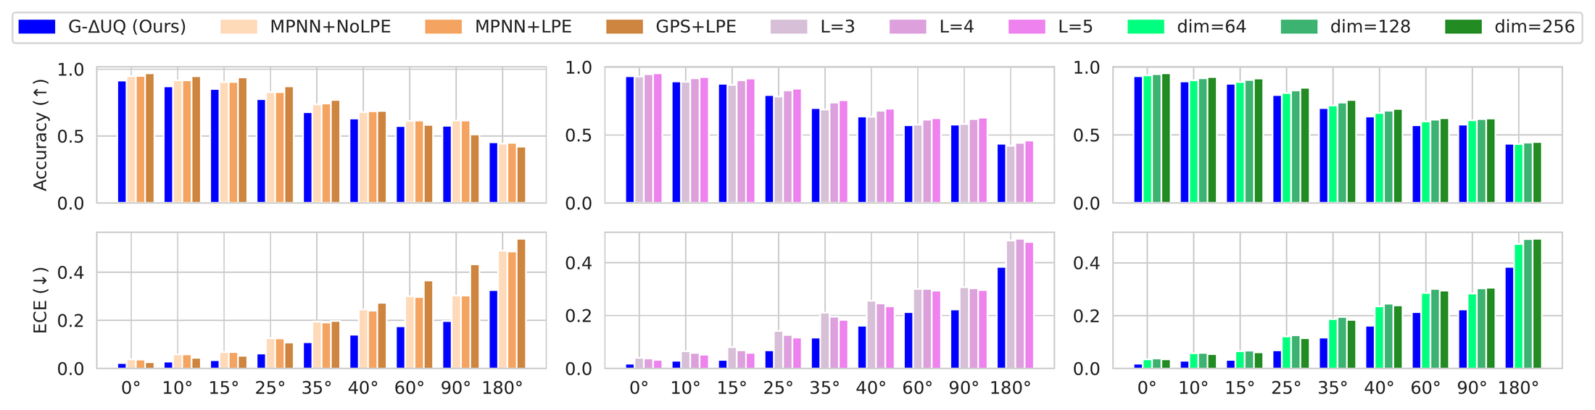
03 · MOTIVATION
More expressive models do not calibrate better
THE COMMON ASSUMPTION
CONTROLLED CASE STUDY: STRUCTURAL DISTORTION (Figure 1)
"Bigger, fancier models
will be better calibrated."
The intuition: graph transformers,
positional encodings, and more
depth or width should tighten
confidence — for free.
As rotation grows, accuracy drops as expected — but expected calibration error grows sharply too. Transformers (GPS),
The paper tests this directly.
deeper and wider models do not fix it; only G-ΔUQ cuts ECE while keeping accuracy close to the vanilla model.
SO WHAT NOW?
THE PROPOSED DIRECTION
Expressivity is not
Model epistemic uncertainty directly
the answer.
Instead of chasing more expressive architectures, use epistemic uncertainty
This finding motivates a different
quantification to directly modulate the confidence indicators the model reports —
path to trustworthy confidence.
so calibration improves without redesigning the backbone.
G-ΔUQ · ICLR 2024
03 / 10
Notes:
There is a common expectation that adopting more advanced or expressive architectures will inherently improve calibration. Through a controlled case study on a structural distortion benchmark, the authors demonstrate this expectation is false: graph transformers and positional encodings do not meaningfully improve calibration over vanilla message-passing networks, and increasing model size can even make calibration worse. This finding motivates a different path. Rather than chasing expressivity, the paper advocates for epistemic uncertainty quantification to directly modulate confidence indicators.

Slide 4
04 · CONTRIBUTION
Three contributions
One diagnosis, one method, one broad evaluation
The paper contributes a case study, a new single-model uncertainty method, and an extensive empirical study.
01
02
03
A rigorous
G-ΔUQ, a new
An extensive
case study
single-model method
empirical study
Shows that improving GNN
Extends the stochastic centering
Spanning three shift types:
expressivity does not mitigate
framework to structured graph
covariate · concept · size
poor calibration under
data.
distribution shift.
Across three safety-critical tasks:
Crucially, supports partial
calibration
Transformers, positional
stochasticity — only part of the
encodings and larger models
network is made stochastic, so it
generalization-gap prediction
all leave calibration poor.
stays cheap and scalable.
out-of-distribution detection
G-ΔUQ · ICLR 2024
04 / 10
Notes:
The paper makes three contributions. First, a rigorous case study establishing that improving graph neural network expressivity does not mitigate poor calibration under distribution shift. Second, G-Delta-UQ, a novel single-model uncertainty method that extends the stochastic centering framework to structured graph data and, crucially, supports partial stochasticity so that only part of the network is made stochastic. Third, an extensive empirical evaluation spanning covariate, concept, and graph size shifts, across the safety-critical tasks of calibration, generalization gap prediction, and out-of-distribution detection.

Slide 5
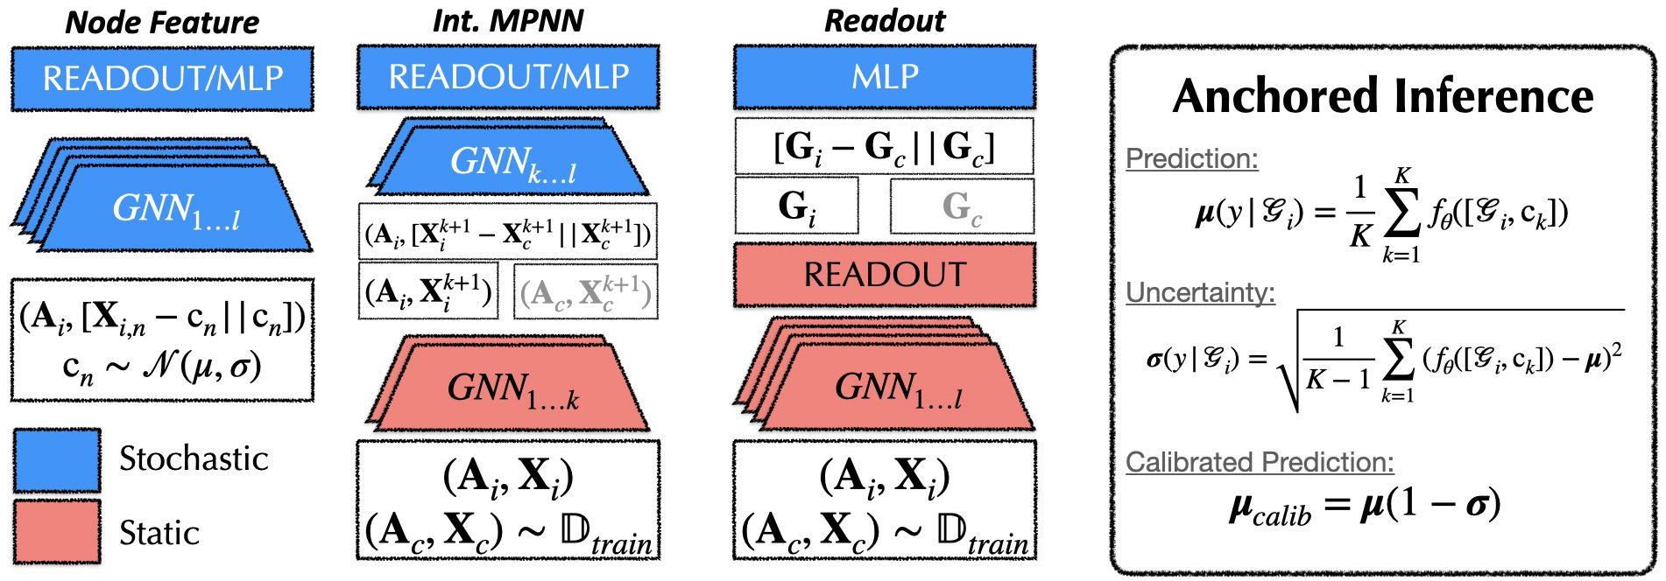
05 · METHOD
Stochastic anchoring, adapted to graphs
1 · Anchor the input
2 · Vary anchors → uncertainty
Pick a random anchor, subtract it and concatenate
Changing the anchor across iterations emulates
channel-wise to form a relative "anchored input":
sampling from a distribution of hypotheses.
anchored(x) = [ x − c , c ] with random anchor c
The variance of predictions over many anchors
is the epistemic uncertainty estimate.
THREE ANCHORING VARIANTS (Figure 2) — anchor in feature / hidden space, never adjacency
PRACTICAL VARIANT
Pretrained + READOUT
Freeze a pretrained backbone and
train only an anchored classifier
head — cheap, partial stochasticity.
At inference, average predictions
over K anchors to get both:
a calibrated prediction
Anchoring adjacency would add fake edges, so anchor at the node features, an intermediate
an uncertainty estimate
message-passing layer, or after readout — inducing different levels of stochasticity.
G-ΔUQ · ICLR 2024
05 / 10
Notes:
G-Delta-UQ builds on the principle of stochastic anchoring. Each input sample is transformed into a relative representation by subtracting a randomly chosen anchor and concatenating it channel-wise, producing an anchored input. By varying the anchor across iterations, the model emulates sampling from a distribution of hypotheses, and the variance of predictions over multiple anchors captures epistemic uncertainty. Because directly anchoring on graph adjacency would introduce artificial edges, the authors anchor in node-feature or hidden-representation space. They introduce three variants, applying anchoring at the node features, at an intermediate message-passing layer, or after the readout. A particularly practical variant freezes a pretrained backbone and only trains an anchored classifier head, delivering inexpensive, partial stochasticity. At inference, predictions are averaged over K anchors to produce both a calibrated prediction and an uncertainty estimate.

Slide 6
06 · DATASET / BENCHMARK
A deliberately broad evaluation
SHIFT 1 · STRUCTURAL
SHIFT 2 · GRAPH SIZE
SHIFT 3 · CONCEPT & COVARIATE
Rotated Super-pixel
Standard graph
The GOOD
MNIST
classification sets
benchmark suite
A controlled benchmark the
Train on small graphs, test on
A dedicated suite for graph
authors build: super-pixel k-NN
larger ones. Datasets:
out-of-distribution shifts, with
graphs from rotated MNIST digits.
D&D · NCI1 · NCI109 · PROTEINS
both concept and covariate splits.
Increasing the rotation angle
Evaluated across three GNN
Datasets used:
induces a controlled, escalating
backbones:
Colored MNIST
structural distortion shift.
GCN · GIN · PNA
Motif · SST2
COMPARED AGAINST STRONG BASELINES — MEASURED ON THREE SAFETY METRICS
Baselines
Metrics
Coverage
Deep Ensembles · Temp. Scaling · MC Dropout
Calibration ECE · OOD AUROC · Gen-gap MAE
3 shift types × 3 downstream safety tasks
G-ΔUQ · ICLR 2024
06 / 10
Notes:
The evaluation is deliberately broad. For structural shift, the authors build a Rotated Super-pixel MNIST benchmark where increasing rotation induces controlled distortion. For size shift, they use standard graph classification datasets including D and D, NCI1, NCI109, and PROTEINS with GCN, GIN, and PNA backbones. For concept and covariate shifts, they use the GOOD benchmark suite covering colored MNIST, motif, and SST2 datasets. Across all of these they compare against strong uncertainty baselines including deep ensembles, temperature scaling, and Monte Carlo dropout, measuring calibration error, out-of-distribution detection AUROC, and generalization gap mean absolute error.

Slide 7
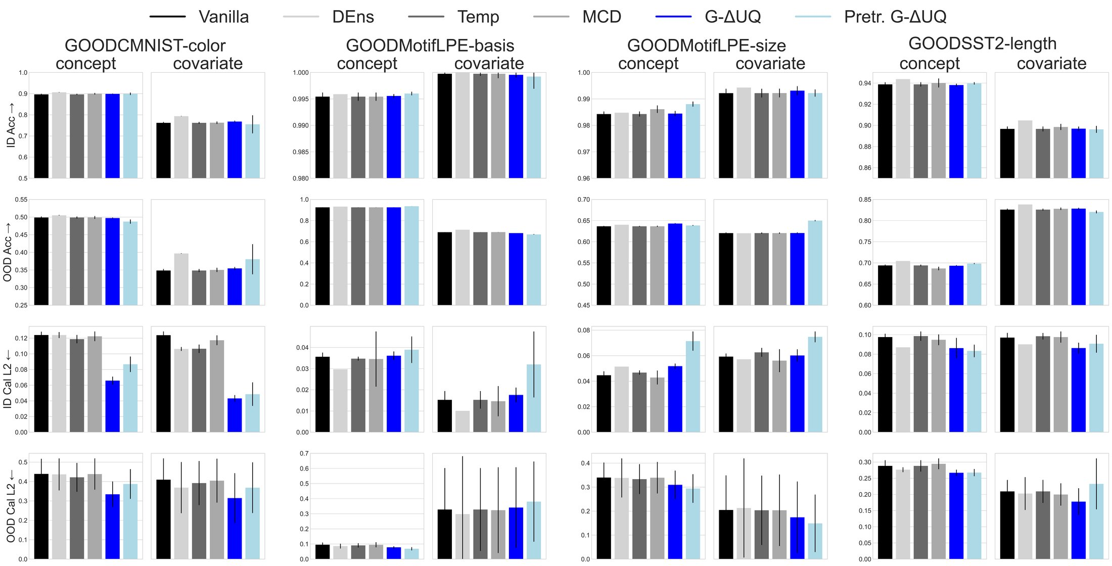
07 · KEY RESULT
Better-calibrated confidence, across every shift
Structural distortion
CONCEPT & COVARIATE SHIFTS (Figure 5)
Substantial ECE reductions even at severe rotations,
while accuracy stays close to the vanilla model.
Reliability improves across the board.
Size shift
Last-layer (READOUT) anchoring lowers calibration error
while maintaining or improving accuracy —
largest gains on the most severe shift.
FEEDS DOWNSTREAM SAFETY TASKS
Among the best single-model estimators for generalization-gap
prediction, and highly competitive for OOD detection.
Competitive in-distribution and out-of-distribution accuracy
Pretrained G-ΔUQ is frequently strongest under covariate shift.
while improving calibration — especially versus other
single-model UQ methods.
G-ΔUQ · ICLR 2024
07 / 10
Notes:
Across the board, G-Delta-UQ improves the reliability of confidence indicators. On the structural distortion benchmark it achieves substantial reductions in expected calibration error even at severe rotations, while keeping accuracy close to the vanilla model. Under size shift, last-layer anchoring lowers calibration error while maintaining or improving accuracy, with the largest gains on the most severe shift. Under concept and covariate shifts it delivers competitive in-distribution and out-of-distribution accuracy alongside better calibration than other single-model methods. And when its confidence estimates feed downstream tasks, it is among the best single-model estimators for generalization gap prediction and is highly competitive for out-of-distribution detection, with the pretrained variant frequently the strongest under covariate shift.

Slide 8
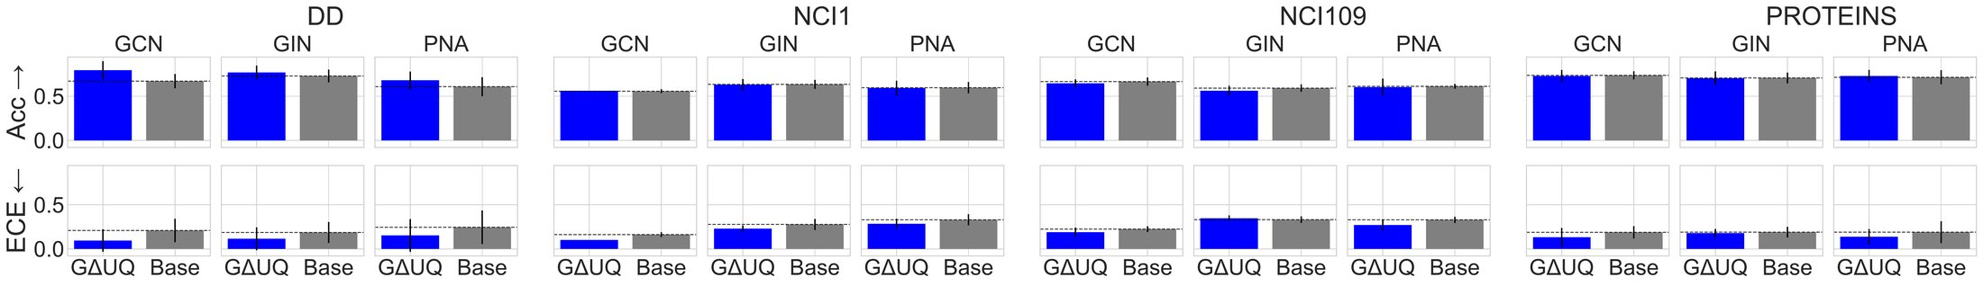
08 · ABLATION
Where should anchoring be applied?
Node features, an intermediate layer, or after readout?
The paper carefully ablates the placement of stochastic anchoring within the network.
PREDICTIVE UNCERTAINTY UNDER SIZE SHIFT — D&D HAS THE MOST SEVERE SHIFT (Figure 4)
On D&D, anchoring after the READOUT layer dramatically improves both accuracy and calibration as depth grows,
whereas earlier-layer anchoring converges less well.
PRACTICAL RECOMMENDATION
PARTIAL STOCHASTICITY, VALIDATED
Anchor at the last layer
The pretrained variant — training only an anchored classifier head — is both
For size-shift settings, READOUT (last-layer)
effective and scalable. A neural tangent kernel analysis confirms that intermediate
anchoring is the reliable default.
constant shifts truly alter the model's function, not a trivial reparameterization.
G-ΔUQ · ICLR 2024
08 / 10
Notes:
The paper carefully ablates where stochastic anchoring should be applied. On the D and D dataset, which has the most severe size shift, applying anchoring after the readout layer dramatically improves both accuracy and calibration as network depth grows, while earlier-layer anchoring converges less well. This leads to a practical recommendation to anchor at the last layer for size-shift settings. The authors also validate that partial stochasticity, in the form of the pretrained variant that only trains an anchored classifier head, is both effective and scalable, and a neural tangent kernel analysis confirms that intermediate constant shifts truly alter the model's function rather than acting as a trivial reparameterization.

Slide 9
09 · BY THE NUMBERS
One model, broad coverage, strong results
THE METHOD
THE EVALUATION
1
single trained model
3
3
4
no ensemble of networks required
shift types
downstream tasks
baselines (incl. DeepEns)
3 anchoring variants
+ 1 pretrained partial-stochasticity option
THE BOTTOM LINE
Single-model cost, ensemble-level reliability
Despite requiring only one model, G-ΔUQ consistently matches or outperforms these baselines on all three metrics:
Calibration (ECE)
OOD detection (AUROC)
Gen-gap prediction (MAE)
Lower error under every shift
Highly competitive vs. baselines
Among best single-model estimators
G-ΔUQ · ICLR 2024
09 / 10
Notes:
In numbers, G-Delta-UQ is a single-model method offering three anchoring variants plus a pretrained partial-stochasticity option. It is evaluated across three distinct types of distribution shift and three safety-critical downstream tasks, and compared against four established uncertainty baselines including deep ensembles. Despite requiring only a single model, it consistently matches or outperforms these baselines on calibration, out-of-distribution detection, and generalization gap prediction.

Slide 10
10 · TAKEAWAY
The core message is simple
DON'T
DO
Don't rely on scale
Anchor stochastically
Larger or more expressive GNNs do not
Adapt the principle of stochastic anchoring
automatically give trustworthy confidence
to graphs: anchor in feature or hidden space,
estimates under distribution shift.
vary anchors, and read uncertainty from the
Expressivity is not calibration.
variance of predictions.
G-ΔUQ
A flexible, scalable, single-model uncertainty framework
Reliable, well-calibrated uncertainty across structural, size, concept, and covariate shifts —
and its pretrained variant is inexpensive to add to the models you already have.
Structural · Size shifts
Concept · Covariate shifts
Pretrained = cheap to adopt
Code
/pujacomputes/gduq
G-ΔUQ · ICLR 2024
10 / 10
Notes:
The core message is simple. Do not expect larger or more expressive graph neural networks to automatically give trustworthy confidence estimates under distribution shift. Instead, adapt the principle of stochastic anchoring to graphs. G-Delta-UQ is a flexible, scalable, single-model framework that produces reliable, well-calibrated uncertainty across structural, size, concept, and covariate shifts, and its pretrained variant makes it inexpensive to add to models you already have.

